Slide 1
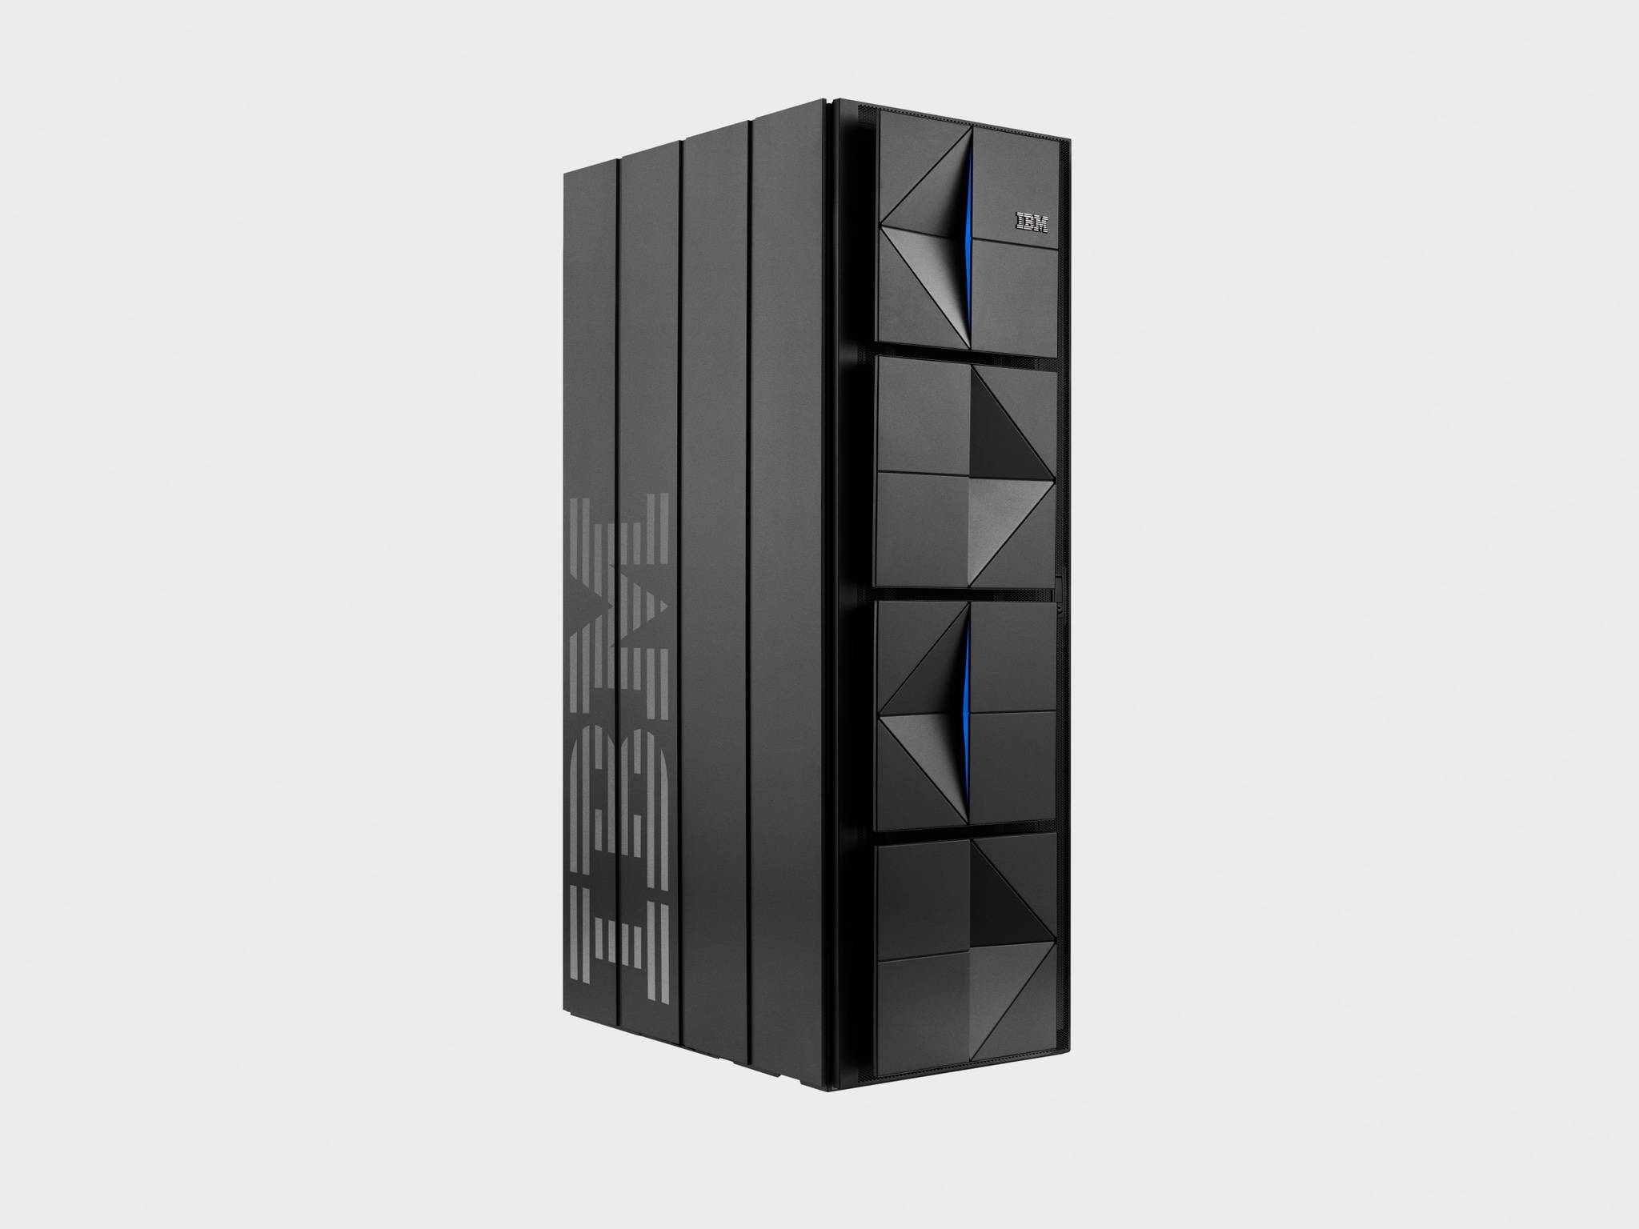
PRESSURE PREDICTION FOR VENTILATING SYSTEMS
By:
Robin Roy
Niveditha Choudary Puligundla
Saieesh S Rao
Nandita Pydikondala
Ritvik Wuyyuru

Slide 2
DESCRIPTION:
With this project we aim to overcome the drawbacks of conventional mechanical ventilators, by simulating a ventilator connected to a sedated patient's lung.
By adapting to a patient, this machine learning model could predict the right airway pressure of his lungs at a certain point in time.
Overcoming the cost barrier of developing new methods for controlling mechanical ventilators.

Slide 3
The dataset:
id - globally-unique time step identifier across an entire file
breath_id - globally-unique time step for breaths
R - lung attribute indicating how restricted the airway is (in cmH2O/L/S). Physically, this is the change in pressure per change in flow (air volume per time).
C - lung attribute indicating how compliant the lung is (in mL/cmH2O). Physically, this is the change in volume per change in pressure.
time_step - the actual time stamp.
u_in - the control input for the inspiratory solenoid valve. Ranges from 0 to 100.
u_out - the control input for the exploratory solenoid valve. Either 0 or 1.
pressure - the airway pressure measured in the respiratory circuit, measured in cmH2O.

Slide 4
Models used:
Linear Regression: mean absolute error = 4.053
Decision Tree Regression: MAE = 0.587
Random Forest Regression: MAE = 0.426
Extra Trees Regression: MAE = 0.378

Slide 5
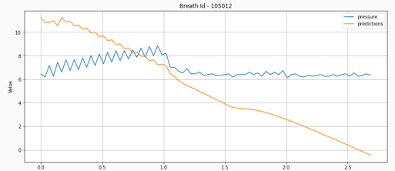
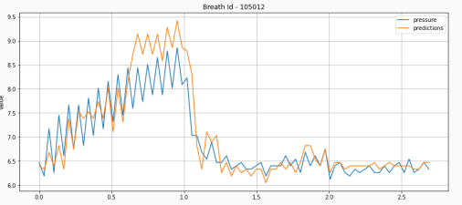
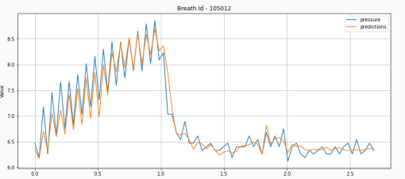
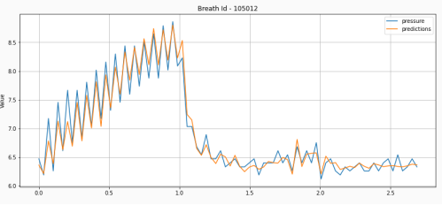
GRAPHS:
LINEAR
DECISION TREE
RANDOM FOREST
EXTRA TREES

Slide 6
So, we conclude:
Extra trees regressor is the better model compared to the four because least mean absolute error with all the test samples!!!

Slide 7
THANK YOU

