Slide 1

Predicting Car Prices: A Data-Driven Approach
By Saiem Amin

Slide 2
PROBLEM STATEMENT
Objective: Predict used car prices and provide interval estimates for new cars.
Dataset summary: 94 used cars with 10 ATTRIBUTES
Business value: Supports pricing decisions and uncertainty estimation.

Slide 3

Model Selection
Overview of the process:
Started with all predictors (KmDriven, FuelType, Transmission, Mileage, Engine, Power, Age, Seats).
Used statistical tests (5% significance, forward selection, and AIC) to identify weak predictors.
Removed predictors: Engine, Seats, and Age.
Final model:
Predictors: Power, Transmission, FuelType, KmDriven, and Mileage.
Remedies:
Validated assumptions using diagnostic plots.

Slide 4
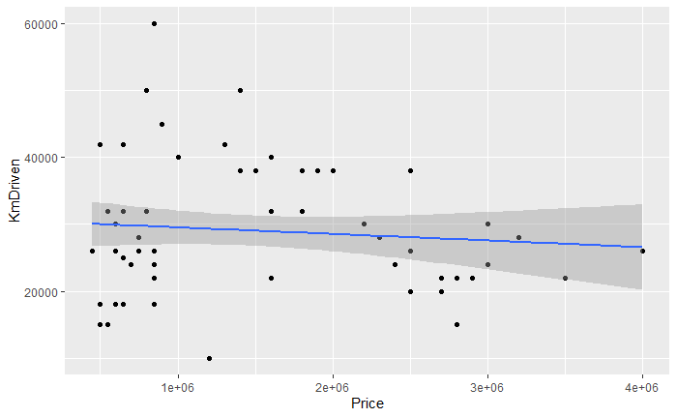
Relationship Between Price and KmDriven
Observation:
"The plot shows a weak negative relationship between kilometers driven and price."
Analysis:
"The trendline indicates that buyers may not place significant emphasis on how much the car has been driven when determining its price.”

Slide 5
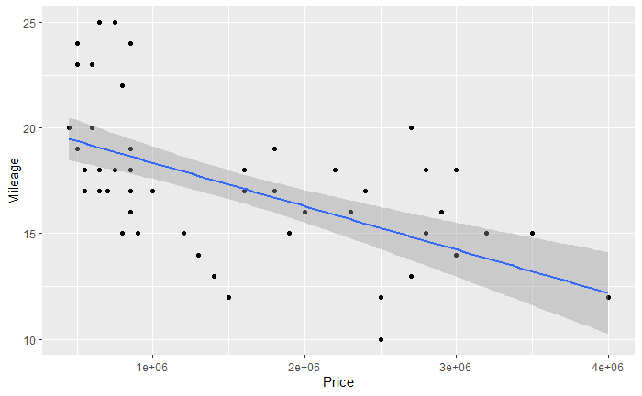
Relationship Between Price and KmDriven
Observation:
"The plot shows a negative relationship between mileage (fuel efficiency) and price."
Analysis:
"As mileage increases, the price tends to decrease. This suggests that cars with higher fuel efficiency may be priced lower, potentially due to other trade-offs like lower power or luxury features."

Slide 6
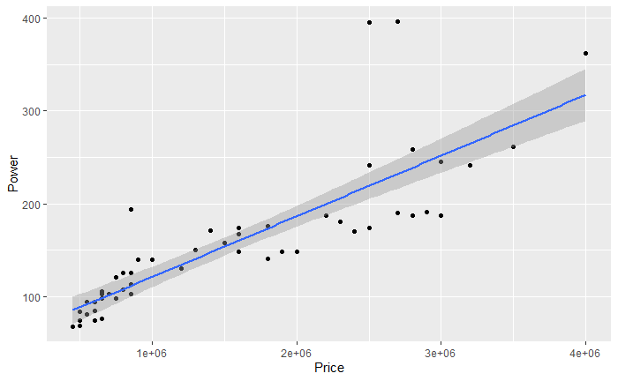
Relationship Between Price and Power
Observation:
"The plot shows a strong positive relationship between power and price."
Analysis:
"As power increases, the price also increases. This trend suggests that more powerful cars are valued higher, likely due to their performance and appeal to buyers seeking high-end features."
Insight:
"Power appears to be a key determinant of price, making it one of the strongest predictors in the model."

Slide 7
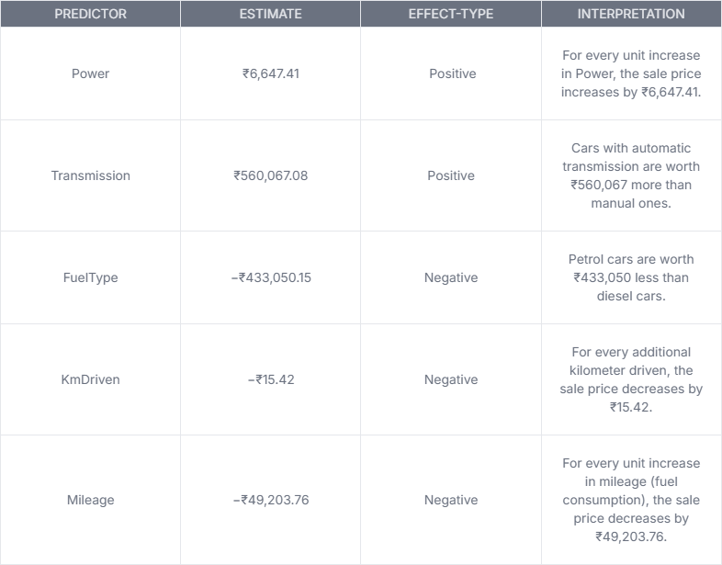
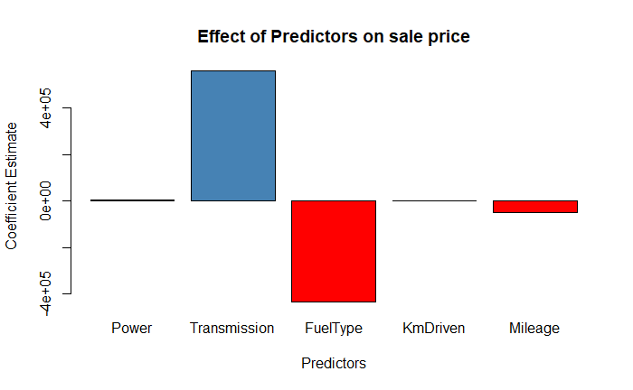
Model Interpretation
Effect Type: Indicates whether the predictor has a positive or negative effect on the price.
Interpretation: Explains the impact of a one-unit increase in each predictor on the sale price.

Slide 8
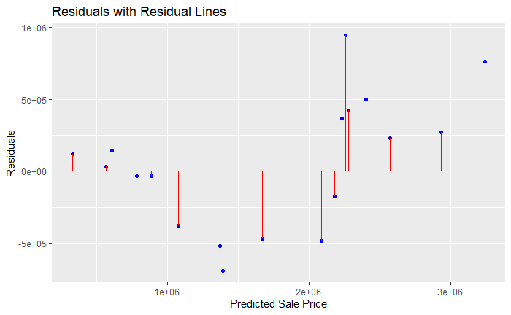

Predictive Ability of the Model
Residual Plot Analysis:
This plot shows the residuals (difference between actual and predicted prices) against the predicted sale prices.
The residuals show some increasing spread as the predicted prices grow up.
Evaluation Metrics:
MAE (Mean Absolute Error): ₹368,185.1 - The average absolute difference between actual and predicted prices.
RMSE (Root Mean Square Error): ₹444,295.7 - Highlights the model's prediction error, giving higher weight to larger errors.
MAPE (Mean Absolute Percentage Error): 25.21% - Indicates that, on average, the model's predictions deviate by 25.21% from actual prices

Slide 9
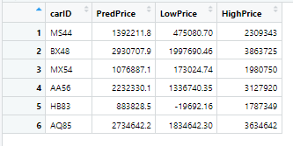
Conclusion and Summary
Key Predictors: Power, Transmission, FuelType, KmDriven, and Mileage.
Model Insights: Accurate predictions with interval estimates reflecting uncertainty..
Next Steps:Evaluate buyer behavior or add more predictors (e.g., brand, condition) to further refine predictions.

