Slide 1
SQL injection & Prevention

Slide 2
AGENDA
Introduction to SQL Injection
Understanding SQL Injection Attacks
Identifying SQL injection Vulnerabilities
Prevention Technique for SQL Injection

Slide 3
Problems With SQL Injection
Unauthorized data access
Data manipulation
Remote code Execution
Denial of Service
Malware Injection

Slide 4
Preventing SQL Injection
Input validation and Sanitization
Least privilege principle
Principle of Least exposures
Regular Updates and patches
Web application Firewalls

Slide 5
Project Overview
If the login application does not perform correct input validation of the form fields, the attacker can inject strings into the query that alter its semantics.
EX: consider a hacker entering “OR 1=1” -- one of SQL injection string as in the table(1), the “--” command indicates a comment in Transact-SQL. Hence, everything after the first “--” is ignored by the SQL database engine with the help of the first quote in the input string, the user’s name string is closed, while the “OR 1=1” adds a clause to the query which evaluates to true for every row in the table. When executing this query, the database returns all user rows, which applications often interpret as a valid login. So, in the proposed system all client-supplied data needs to be cleansed of any characters or strings that could possibly be used maliciously.

Slide 6
Project Requirements:
HTML
CSS
BOOTSTRAP
PHP
SQL
Windows 10 or higher
XAMPP Apache tomcat server
MySQL database

Slide 7
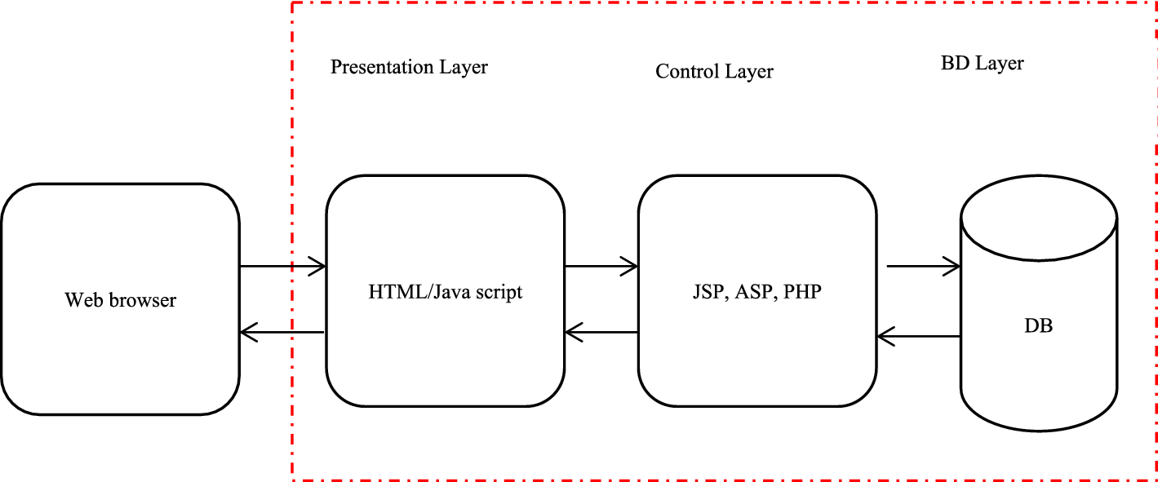
Project Architecture

Slide 8
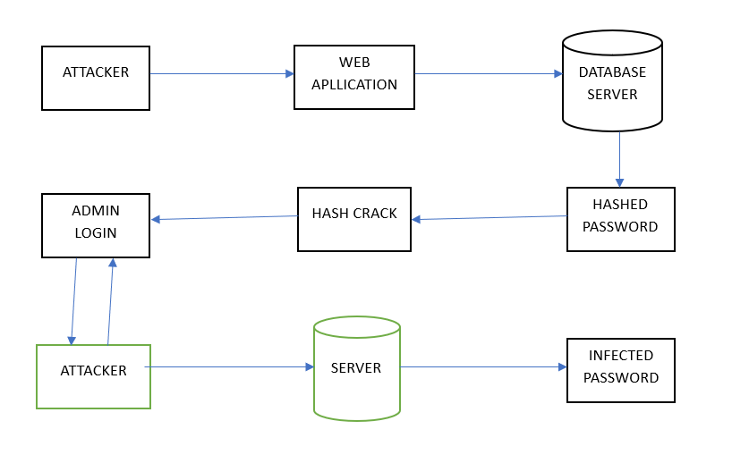

Slide 9

RESULTS AFTER SQL INJECTION ATTACK

Slide 10

RESULTS AFTER SQL INJECTION ATTACK
WELCOME PAGE:

Slide 11
RESULTS AFTER SQL INJECTION PREVENTION
LOGIN PAGE:

Slide 12

RESULTS AFTER SQL INJECTION PREVENTION
LOGIN PAGE:

Slide 13
Who Are The End Users
Developers
Database Administrators
System Administrators
Security Professionals
End Users

Slide 14
Conclusion
SQL injection attackers are smarter and more comprehensive in finding vulnerable websites.
Hackers can use various tools to speed up the process of exploiting vulnerabilities.
Preventing SQL injection requires a proactive and multi-faceted approach.
By adopting these preventive measures, organizations can significantly reduce the risk of SQL injection attacks and safeguard their databases and applications against unauthorized access, data manipulation, and other potential security breaches.

