Slide 1
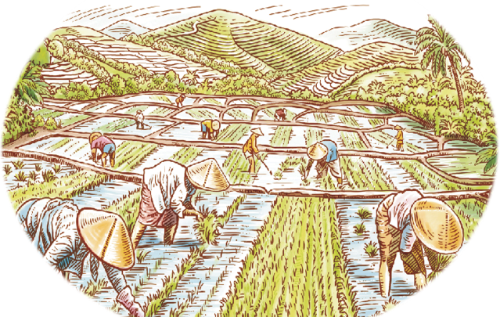
STAR ORGANIC
“Time and health are two precious assets that we don't recognize and appreciate until they have been depleted “

Slide 2
01
INTRODUCTION
About members of E-project.
02
ABOUT E-PROJRCT
OBJECTIVES
Explanation of e project.
03
REQUIREMENTS BY CLIENT
Requirements given by client.
04
OUR WORK DIVISION
Work division between us.

Slide 3
01
INTRODUCTION
PREFACE
About members of E-project.

Slide 4
INTRODUCTION
01
Saif-Ur-Rehman
Student1391520
“Sir Muhammad Hamza”
Supervisor/Facility
02
Shaheer-Azeem
Student1397443
“Miss Sana Yousuf”
03
Co-ordinator
Muhammad-Bin-Zubair
Student1395493

Slide 5
02
About E-PROJECT
PREFACE
Explanation of e project

Slide 6
About E-Project
Problem Statement
Star Organic farm is commenced in the year 1988. Company is involved in trading
and manufacturing a wide range of Organic Products and spices to the consumers all
around the global market. Company has wide variety of collection of products lies of
Nutritious cereals, Pulses, Spices and Condiments, Cooking Oils, Fruit Pulps,
Agro Products, Oils, Wheat and Wheat Flour, Rice and Rice products and so
on.

Slide 7
03
REQUIREMENTS BY CLIENT
PREFACE
Requirements Given By Client

Slide 8
Requirement's of E-Project
The Home Page should be created making use of Sections with The Home Page should be created making use of Sections with a suitable logo of STAR Brand a suitable logo
01
06
Navigation must be made smoother. Images must be defined with alt attribute defined.
Star
Organic
Links such as Home, Products, Contact Us, Query, Show case gallery must be included.
02
05
Contact us page must be included. And Uniformity in the designing must be maintained in the application.
The Products must be properly categorized and details of each product must be presented with suitable size image.
03
04
For each information section of the products the enquiry and order link must be provided..

Slide 9
04
OUR WORK DIVISION
PREFACE
Work division between us

Slide 10
WORK DIVISION
Saif
Shaheer
Zubair
JS, CSS , HTML , DESIGN OF ALL PAGES
CONTACT US PAGE DESIGN
DOCUMENTATION.

Slide 11
STAR ORGANIC
THANKS!
Any Questions?

