Slide 1

DEPI TRAINING DISCUSSION
Interactive Learning
Platform
Backend and lesson experience
Saif eldin Ahmed Helmy
420230168
DEPI React Frontend Web Developer
Individual training discussion
1 November 2026
Notes:
Good morning. I am Saif eldin Ahmed Helmy, student code 420230168. I completed the DEPI React Frontend Web Developer training. I will introduce what I studied, explain our team project, then focus on my work on the backend and the main lesson experience. The application is a training prototype. Transition: I will first give a short overview of the training.
Presentation context: individual college discussion, 1 November 2026, 09:00. Source baseline: current repository inspected on 28 October 2026, supplied team project PDF and curriculum image. Personal responsibility comes from the user; current checkout may contain later revisions.

Slide 2
My training and project role
Training
React Frontend Web Developer, DEPI
Course outline
120 contact hours and 39 assignment hours
My contribution
Backend, course lesson page, video playback, topics and subtopics
Saif eldin Ahmed Helmy
02
Notes:
The supplied timetable totals 159 hours, including assignments. Its contact hours consist of 84 online and 36 physical hours. My responsibility was the backend and the main course page with video playback and the hierarchy of topics and subtopics. The team also built other screens. I will explain those as shared project context without claiming I implemented them. Source: supplied curriculum image and personal role confirmed by Saif in this conversation.
Presentation context: individual college discussion, 1 November 2026, 09:00. Source baseline: current repository inspected on 28 October 2026, supplied team project PDF and curriculum image. Personal responsibility comes from the user; current checkout may contain later revisions.

Slide 3
Frontend subjects in the training
HTML5 and CSS
12 hours and 9 hours: page structure, styling and layout
JavaScript and TypeScript
15 hours and 6 hours: behaviour, asynchronous code and types
React and Bootstrap
33 hours and 12 hours: components, state and responsive interfaces
UX/UI principles
3 hours: clear navigation, feedback and usable screens
Saif eldin Ahmed Helmy
03
Notes:
HTML describes content structure. CSS controls presentation. JavaScript adds interaction and asynchronous requests. TypeScript adds static checking before execution. React organizes the UI into reusable components whose rendered output depends on props and state. Bootstrap supplies a responsive grid and reusable styles. The hours come directly from the curriculum, while these concept summaries are revision explanations. Transition: the curriculum also covered the workflow around application development. Sources: curriculum image; https://react.dev/learn/state-a-components-memory ; https://www.typescriptlang.org/docs/handbook/typescript-from-scratch ; https://getbootstrap.com/docs/5.3/layout/grid/
Presentation context: individual college discussion, 1 November 2026, 09:00. Source baseline: current repository inspected on 28 October 2026, supplied team project PDF and curriculum image. Personal responsibility comes from the user; current checkout may contain later revisions.

Slide 4
The supporting development skills
Prompt engineering
6 hours: clear goals, context, constraints and verification
Node.js and Express
9 hours: routes, middleware and JSON APIs
Code quality, Docker, testing and Git
3 hours each: maintainability, environments, checks and collaboration
Capstone project
3 scheduled contact hours, supported by assignment work
Saif eldin Ahmed Helmy
04
Notes:
Prompt engineering means specifying the task and checking the result, including generated code. Node runs JavaScript outside the browser and Express organizes HTTP request handling. Docker packages application processes and dependencies into containers. Git records changes and supports branches and merges, while GitHub hosts collaboration. Documentation makes setup and behaviour understandable. The curriculum includes Docker, but this checkout has no Dockerfile or Compose file, so I should not claim we deployed this application with Docker. The timetable assigns three contact hours to the capstone; that does not establish the team's total project effort. Sources: curriculum image; https://expressjs.com/en/guide/using-middleware/ ; https://docs.docker.com/get-started/docker-concepts/the-basics/what-is-a-container/
Presentation context: individual college discussion, 1 November 2026, 09:00. Source baseline: current repository inspected on 28 October 2026, supplied team project PDF and curriculum image. Personal responsibility comes from the user; current checkout may contain later revisions.

Slide 5
The project problem and approach
Learning needs practice
Our team combined video lessons, quizzes and code practice in one application.
Progress and achievements make completed work visible.
Saif eldin Ahmed Helmy
05
Notes:
The problem we targeted was passive video watching and the friction of moving between a lesson platform and a separate editor. The project aims to keep learning and practice in one place. Quizzes provide a knowledge check, and progress indicators show what a learner has completed. These are design intentions, not measured learning outcomes. We did not collect evidence that the prototype improves grades. Source: supplied team PDF pages 1–5 and current repository. Transition: here is the application structure that supports that journey.
Presentation context: individual college discussion, 1 November 2026, 09:00. Source baseline: current repository inspected on 28 October 2026, supplied team project PDF and curriculum image. Personal responsibility comes from the user; current checkout may contain later revisions.

Slide 6
Application architecture
Browser
React 18, TypeScript, Vite and Bootstrap render the interface
API
Axios sends credentialed requests to Express routes and controllers
Database
Mongoose models persist users, courses, lessons, quizzes and progress
Identity
Express sessions use a cookie and a MongoDB session store
Saif eldin Ahmed Helmy
06
Notes:
Explain one round trip: the lesson page calls a service function, Axios sends a request to the Express API, middleware checks the session, the controller reads MongoDB through Mongoose, and JSON comes back to update React state. React is the UI library, Vite is the development and build tool, and MongoDB stores data. The project uses session cookies rather than JWT authentication. Source: client/src/services/api.ts; server/src/server.ts; server/src/config/session.ts; server/src/models. Transition: next is the lesson page, which was my main part.
Presentation context: individual college discussion, 1 November 2026, 09:00. Source baseline: current repository inspected on 28 October 2026, supplied team project PDF and curriculum image. Personal responsibility comes from the user; current checkout may contain later revisions.

Slide 7
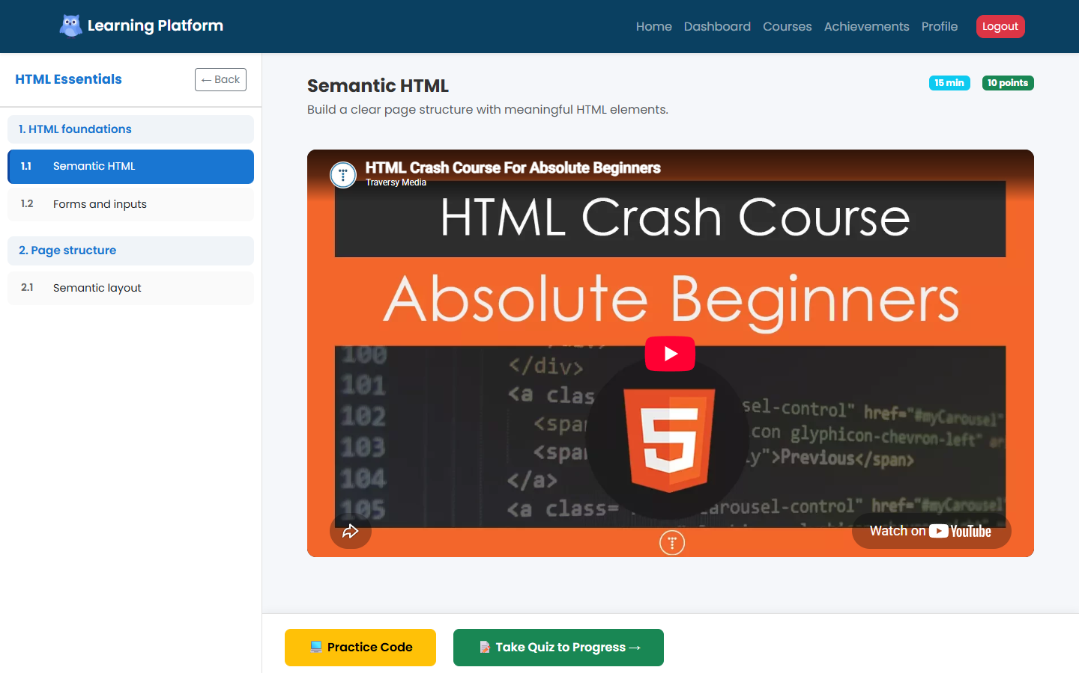
My lesson page
Actual lesson player with sample course data and an embedded YouTube lesson
Saif eldin Ahmed Helmy
07
Notes:
Point to the left sidebar: topics are modules, and subtopics are lessons. The selected lesson determines the title, video and available practice. The main state includes currentModuleIndex, currentLessonIndex, completedLessons and showCodeEditor. The course ID comes from the URL. Changing selected indices updates the visible lesson through React rendering. The screenshot uses sample API data. Source: client/src/pages/LessonPlayer.tsx. Transition: below the video, the learner can practice in the same page.
Presentation context: individual college discussion, 1 November 2026, 09:00. Source baseline: current repository inspected on 28 October 2026, supplied team project PDF and curriculum image. Personal responsibility comes from the user; current checkout may contain later revisions.

Slide 8
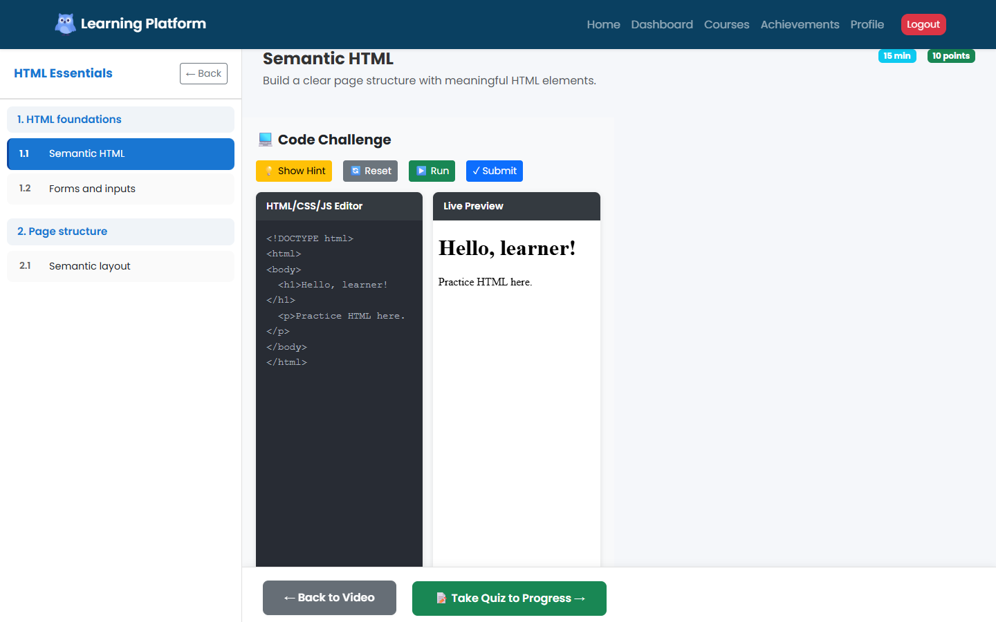
Practice inside the lesson
Actual code practice screen with sample exercise data
Saif eldin Ahmed Helmy
08
Notes:
The current CodeEditor uses a controlled textarea and a sandboxed iframe with srcDoc for the preview. Hints and reset help the learner experiment. Its validation checks whether parsed HTML contains expected output text. This is a simple training check, not a full JavaScript test runner. The old PDF calls this Monaco, but Monaco is not in the current dependencies or editor implementation. This feature is team context. Transition: that is the project; next is what the training gave me. Source: client/src/components/CodeEditor.tsx.
Presentation context: individual college discussion, 1 November 2026, 09:00. Source baseline: current repository inspected on 28 October 2026, supplied team project PDF and curriculum image. Personal responsibility comes from the user; current checkout may contain later revisions.

Slide 9
How the training helped me
Real pages
I can turn a design into a responsive React page using components and Bootstrap
Live data
I fetch data from an API, show loading and errors, and update the screen
Debugging
I use the browser DevTools, console and build errors to fix issues step by step
Teamwork
We split the work, used Git and joined our parts into one application
Saif eldin Ahmed Helmy
09
Notes:
The college asks what we gained from the training, so this slide answers it directly. Real pages: before the training I knew basic HTML and CSS; now I can take a design, split it into React components and make it responsive with the Bootstrap grid. Live data: our pages do not use fixed text; they request courses and lessons from the server with Axios, show a spinner while loading and a message if something fails. Debugging: when something breaks I open DevTools, read the console and network tab, and fix one thing at a time. Teamwork: we divided the project into screens, each person owned a part, and we merged everything with Git. Next, I want to keep building React projects and get stronger in TypeScript.

Slide 10
Live demo
One click
run.bat prepares Node.js, the database and sample courses automatically
Sign in
A learner account that already has courses in progress
Learn
Open a course, watch a lesson and try the code editor
Progress
Take the quiz, then see progress and achievements on the profile
Saif eldin Ahmed Helmy
10
Notes:
Offer to show the project running: 'If you like, I can show it working.' Double-click run.bat in the project folder. The first run on a new computer needs internet and a few minutes; after that it starts quickly. It opens the website and a Notepad file with the sign-in details. Sign in as Saif, open Courses, choose a course, open a lesson. Show the video, the list of topics on the side, and the code editor with its live preview. Then open the quiz, answer a few questions, and finish on the Profile and Achievements pages. Keep it to about two minutes. Close the black run.bat window to stop the app.

