Slide 1

DEPI · REACT FRONTEND WEB DEVELOPER
Interactive Learning Platform
My training journey, and the learner screens I designed for our capstone
Maaly Samir elsaied
Student code 420230295
Notes:
• Good morning, I’m Maaly, student 420230295
• DEPI React Frontend Web Developer track
• Plan: the training, the soft skills, our project, then my screens
• I’ll finish with a short live demo

Slide 2








THE TRAINING
My DEPI journey in numbers
159
14
33
1
hours of training
modules
hours of React, the biggest module
team capstone project
Foundations
Programming
Frameworks
Backend & tools
Capstone
HTML5 · CSS · UX/UI
JavaScript · TypeScript
Bootstrap · React
Node · Git · Docker · Tests
Our learning platform
02
Notes:
• 159 hours: 120 with instructors + 39 of assignments
• Foundations first: HTML, CSS and UX/UI
• Then JavaScript, TypeScript, Bootstrap and React
• Ended with a team project that used everything

Slide 3
THE TRAINING
Where the 120 contact hours went
React
33h
JavaScript
15h
HTML5
12h
React was over a quarter of the course
Bootstrap
12h
Git · Docker · tests · style
12h
CSS
9h
› Components and props
› State and effects
› Lists and conditional rendering
› Pages with React Router
Node.js + Express
9h
TypeScript
6h
Prompt engineering
6h
UX/UI · Capstone
6h
03
Notes:
• React was the biggest part
• UX/UI was short but I used it the most in my screens
• Bootstrap (12 hours) is how my pages stay responsive
• Best practices: Git, Docker, testing, code style

Slide 4




BEYOND CODE
Skills that turn code into a career
Freelancing
English
Finding clients
Writing proposals
Pricing my time
Technical vocabulary
Presenting ideas
Interview answers
Writing a CV
Personal branding
One clear page
Projects and results first
Tailored per job
LinkedIn profile
GitHub portfolio
Sharing what I build
04
Notes:
• Not only technical: we had sessions on career skills
• Freelancing: finding clients, proposals, pricing
• English: presenting ideas and interview answers
• CV and personal branding: one-page CV, LinkedIn and a GitHub portfolio
• Add one personal example from your sessions

Slide 5
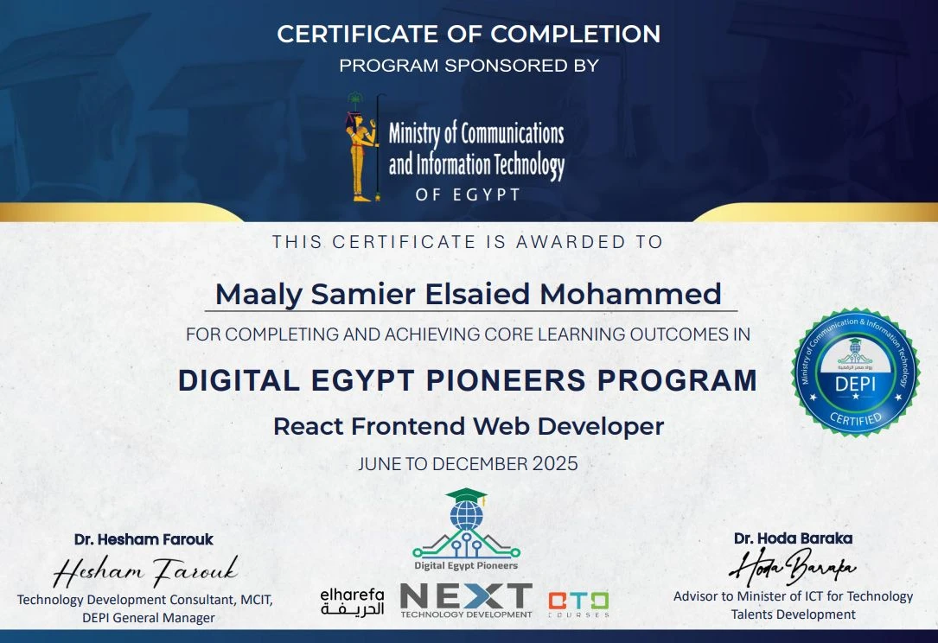
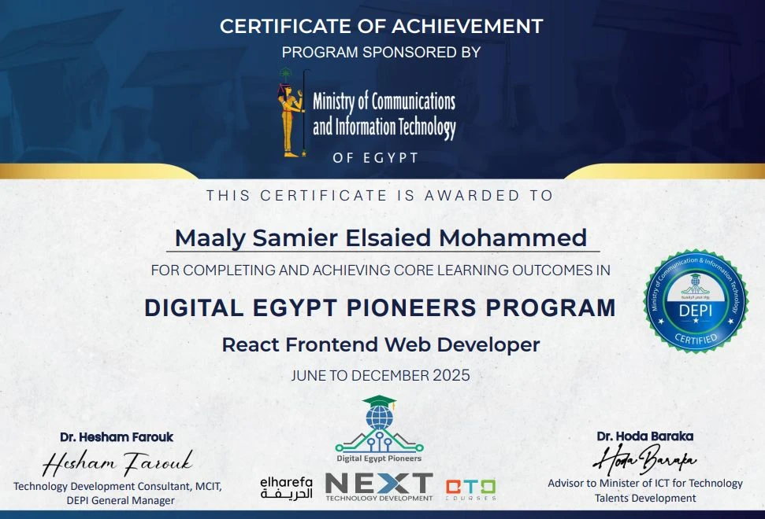

BEYOND CODE · RESULTS
Freelancing
3
freelancing gigs done
Certificate of Completion
Finished the React Frontend track
Certificate of Achievement
Certificate of Completion
Certificate of Achievement
Only for students who completed freelancing gigs
For finishing the React Frontend Web Developer track
Given only for completing real freelancing gigs
Real client work
Proposals, communication and delivering on time
05
Notes:
• I didn’t only study, I applied it: freelancing during the course
• 3 freelancing gigs completed
• Completion: for finishing the track
• Achievement: only for students who completed gigs
• Link back: proposals, pricing and English came from the soft-skills sessions

Slide 6



THE CAPSTONE PROJECT
Watching isn’t learning.
Our team built one place to watch a lesson, practise the code and prove you understood it.
Passive watching
No proof of learning
Scattered tools
Hours of video, little practice
Nothing checks understanding
Video in one tab, editor in another
Notes:
• Our team’s problem: people watch tutorials but can’t apply them
• Nothing checks understanding, tools are scattered
• We built one place to learn, practise and prove it

Slide 7
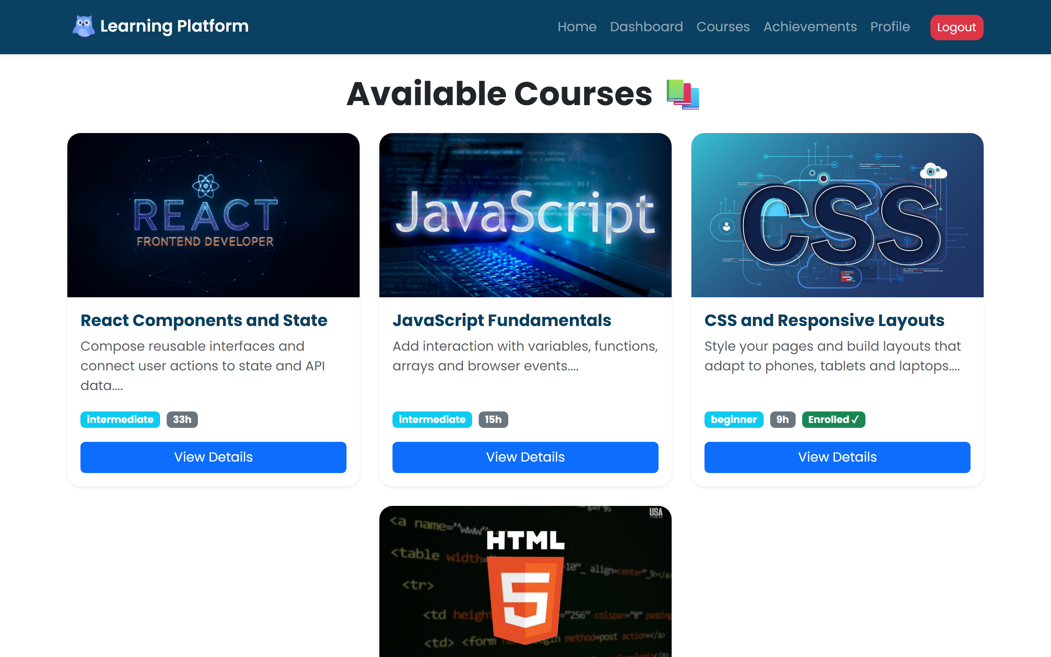
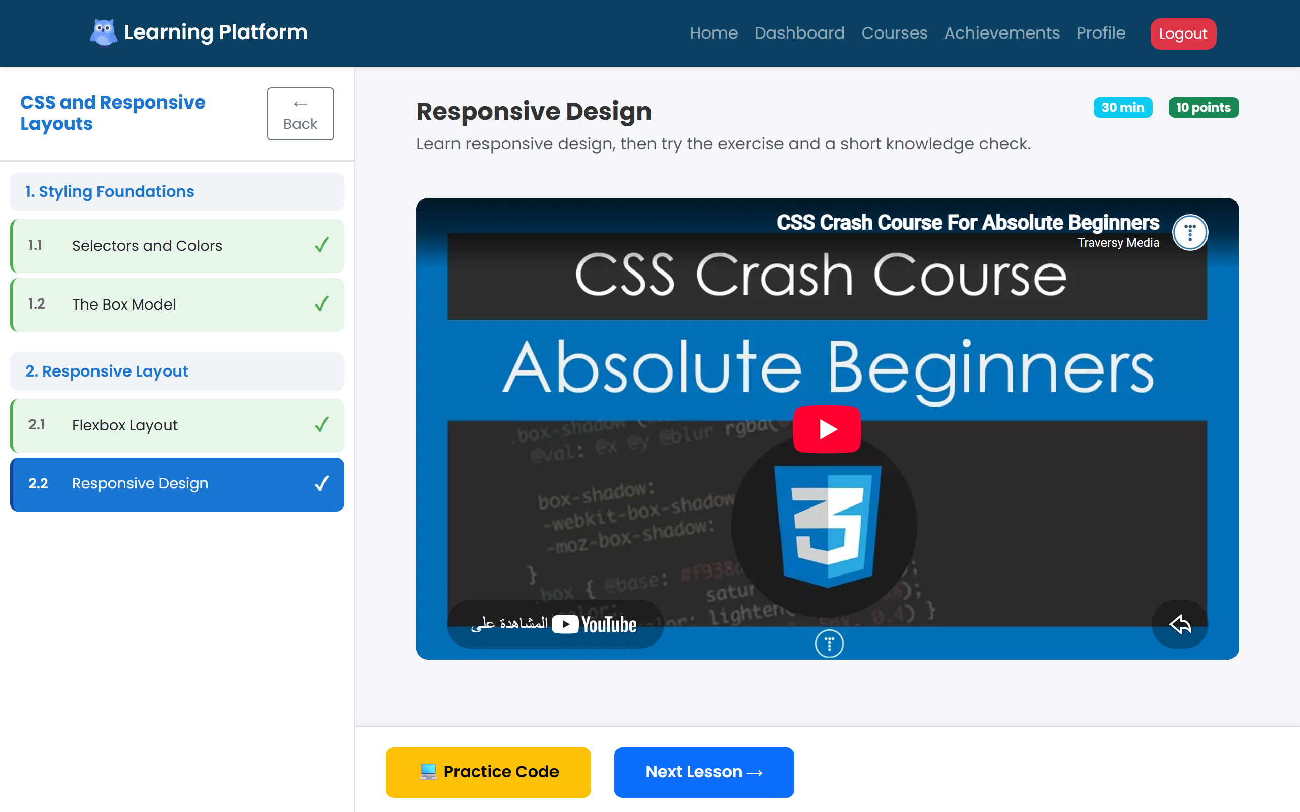
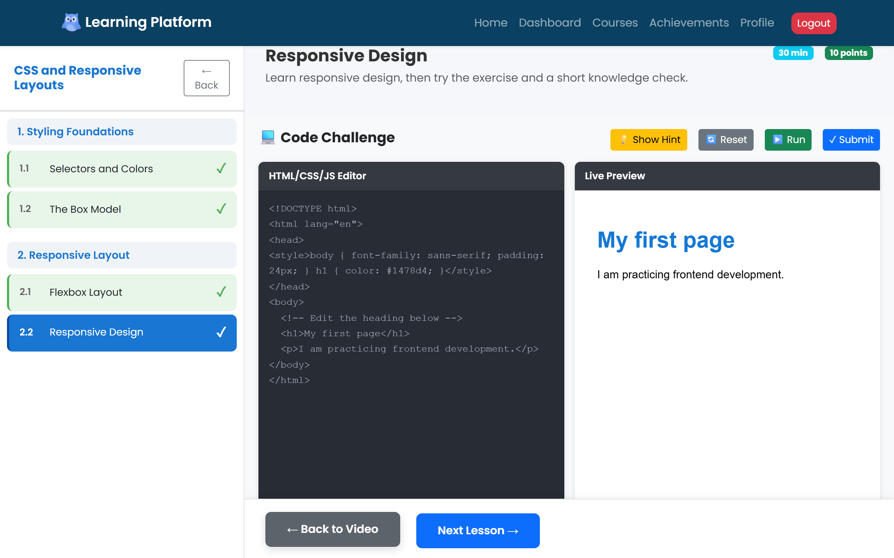
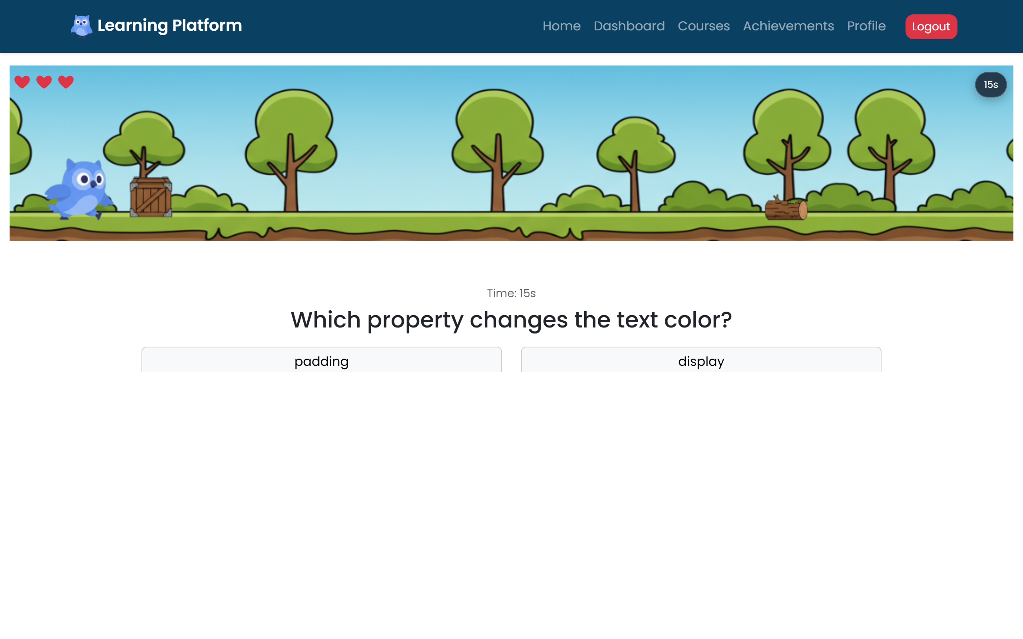
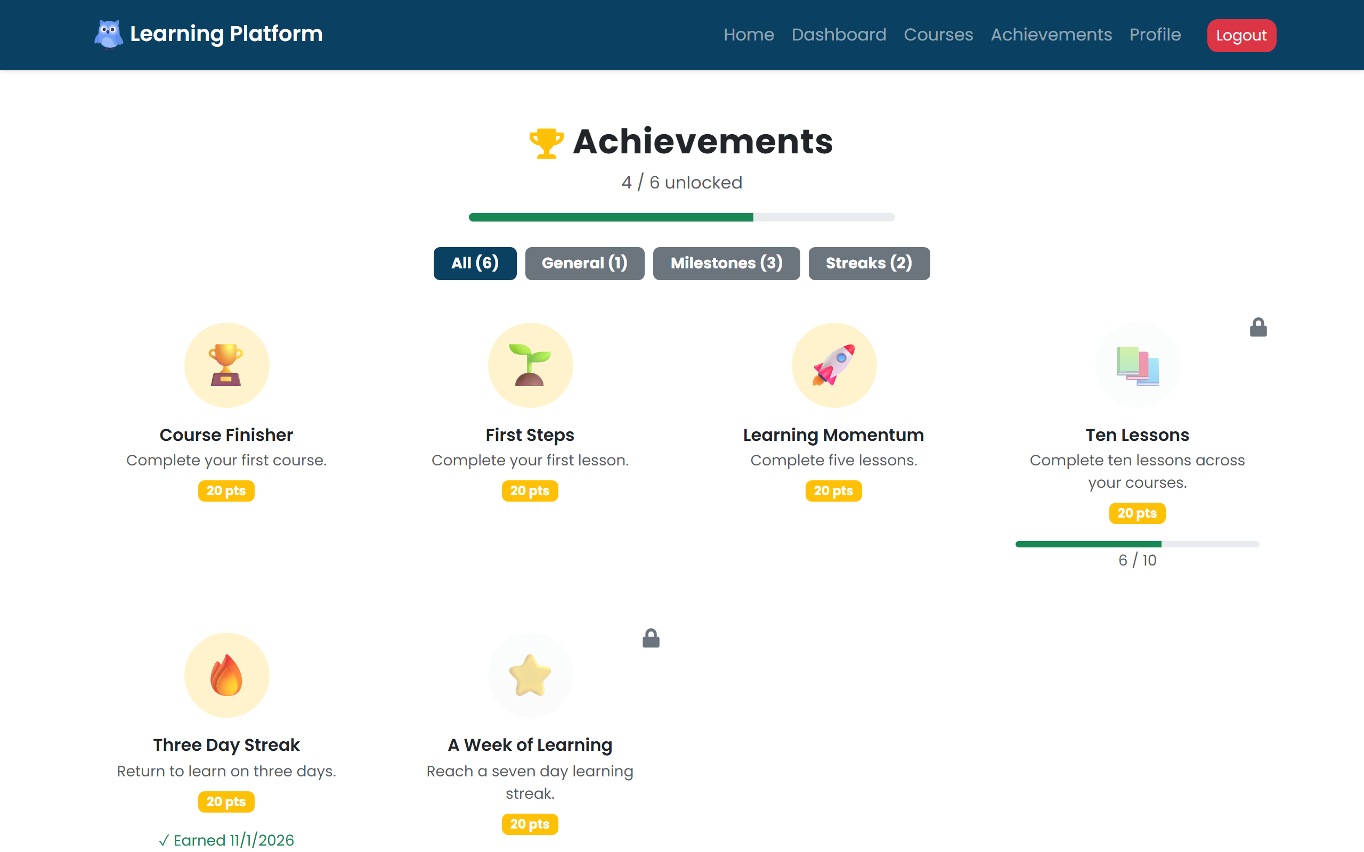

THE CAPSTONE PROJECT
Learn → practise → prove it
1
2
3
4
5
Pick a course
Watch the lesson
Practise the code
Pass the quiz game
Earn badges
Catalog with levels
Topics and video
Editor + live preview
Lives and a timer
Streaks, tree, points
The rule that makes it active: you only move to the next lesson after passing the quiz.
07
Notes:
• Walk the five steps
• Pass the quiz to unlock the next lesson
• My screens are the start (landing) and the motivation at the end (profile, achievements)

Slide 8
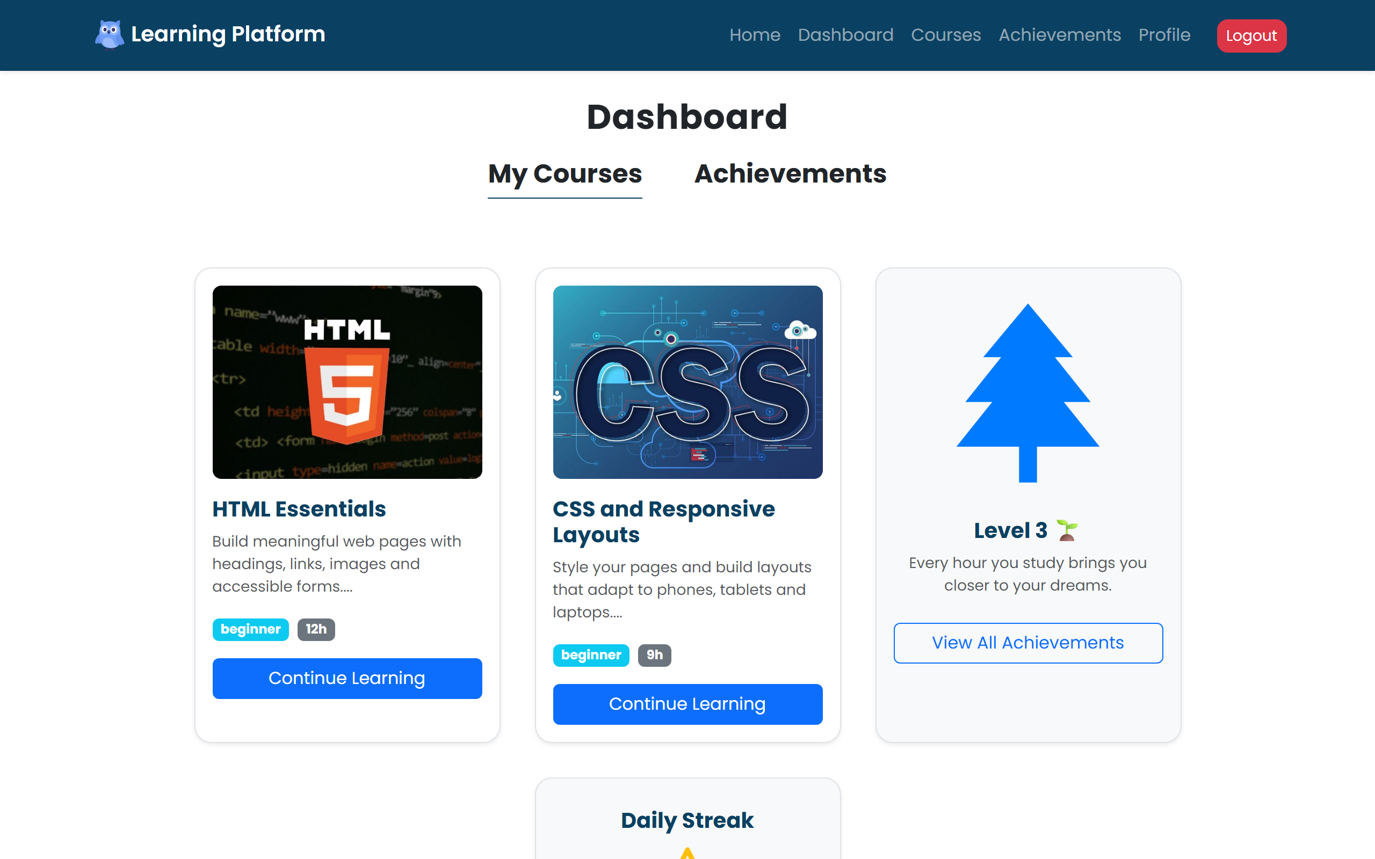




MY PART · DESIGN
UX principles I applied
One clear next step
Progress you can see
One main button on each screen
Tree, streak and badges
Same look
Fits any screen
Shared cards, colours, spacing
Bootstrap grid, phone to laptop
The dashboard: courses as cards, progress on the side
08
Notes:
• What I applied from the UX/UI module
• Clear next step: one main button per screen
• Progress you can see: tree, streak, badges
• Same cards, colours and spacing on every page
• Works on phone and laptop with the Bootstrap grid

Slide 9
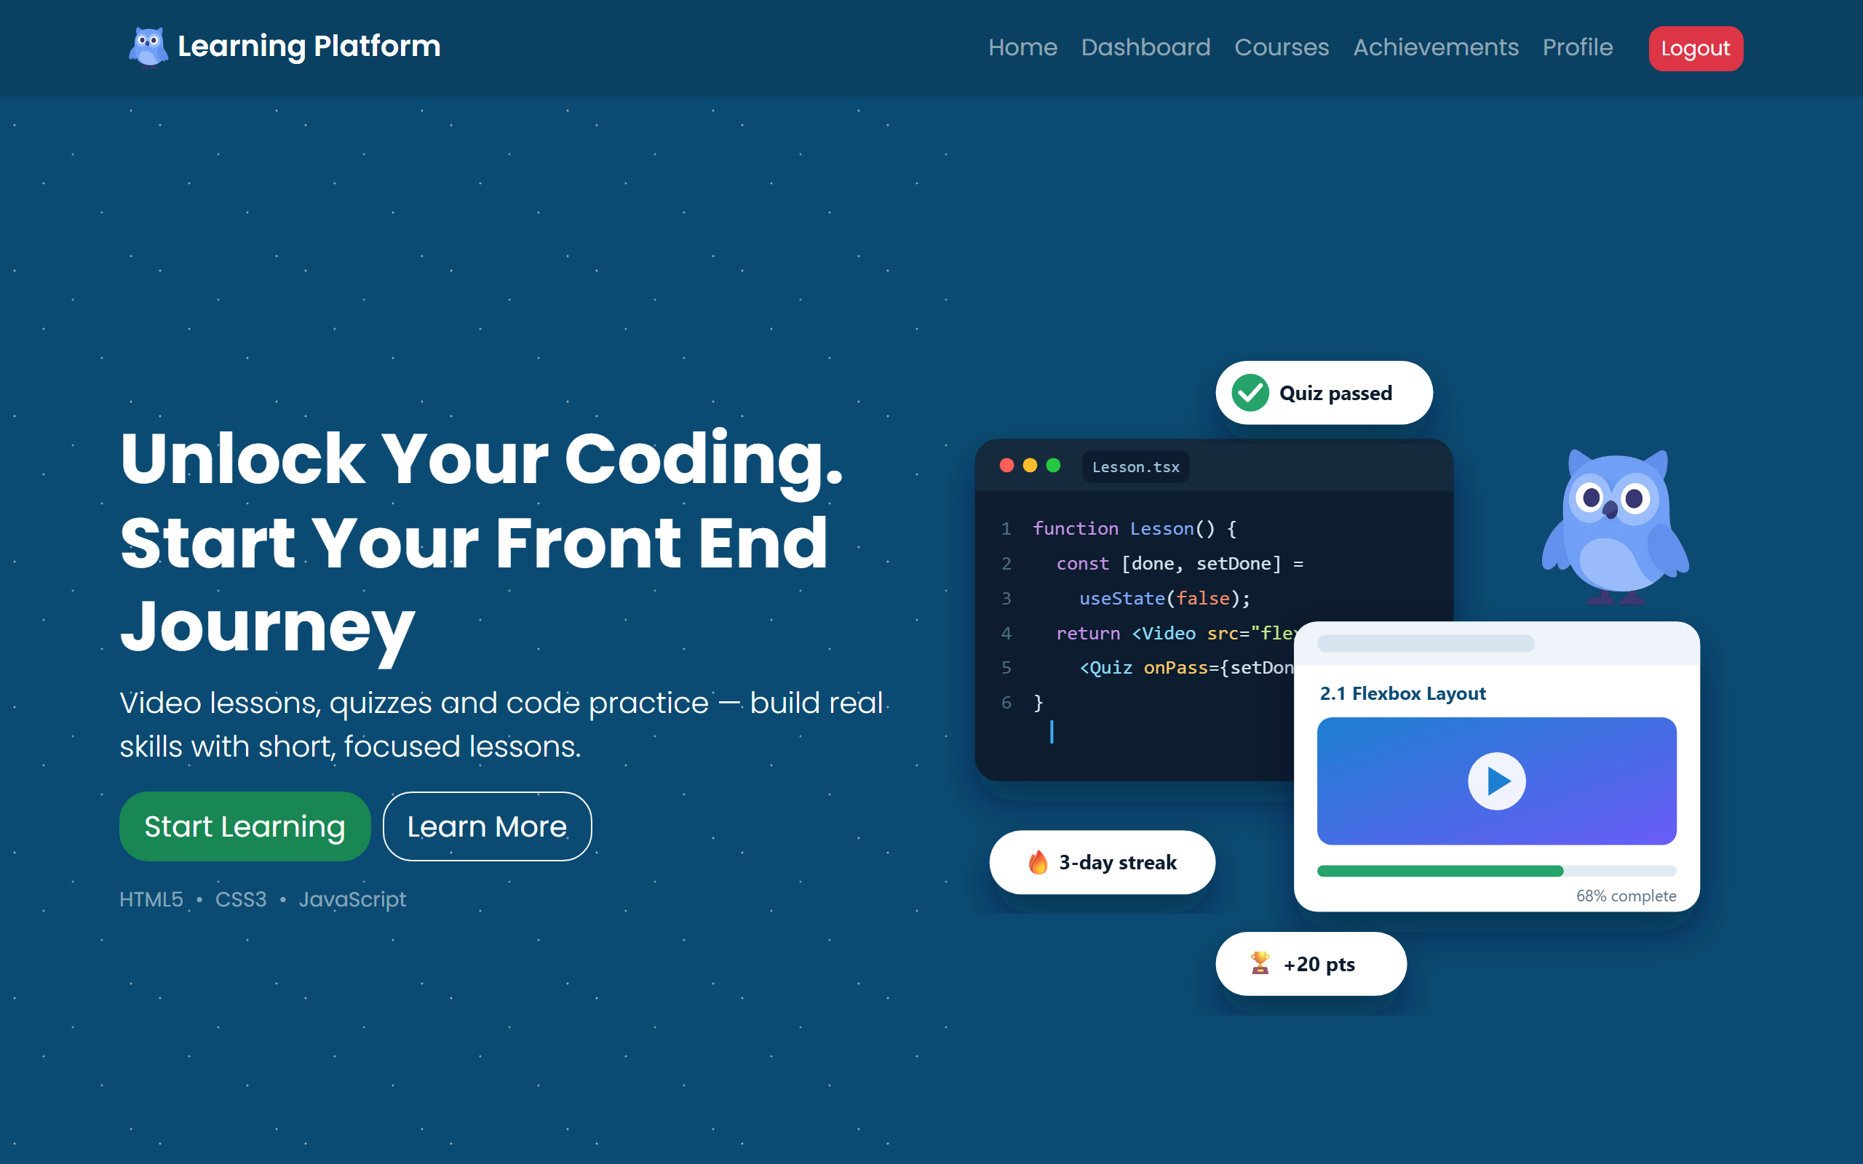
MY PART · LANDING PAGE
The first impression
1
A clear promise
The headline says what you’ll learn
3
1
2
One main action
Start Learning leads to the courses
3
Show, don’t tell
2
Code, a lesson and badges in one picture
09
Notes:
• My first screen: the landing page
• 1 Headline says what the platform is in one line
• 2 Start Learning is the main action
• 3 The illustration shows code, a lesson and progress together

Slide 10
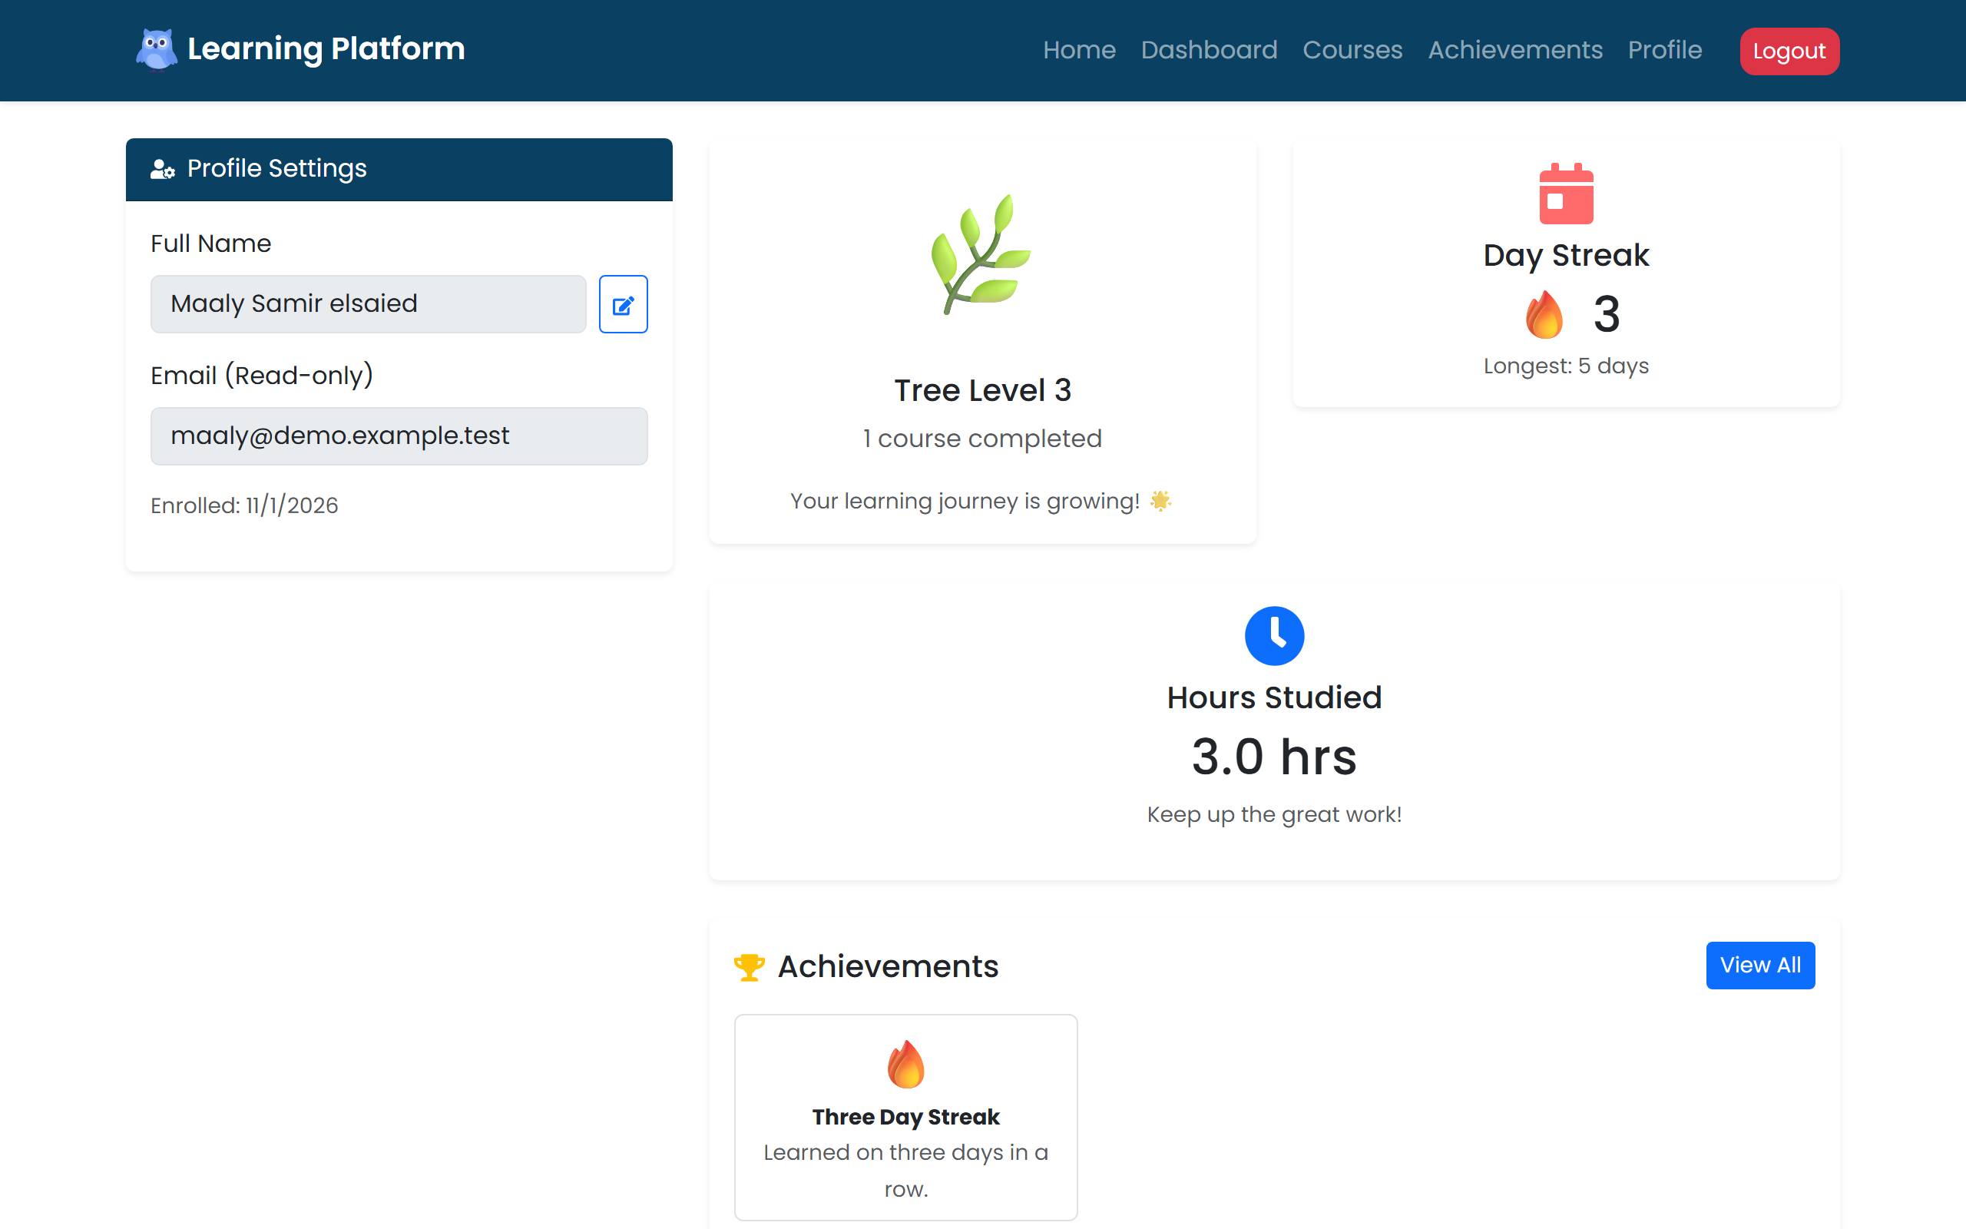
MY PART · MOTIVATION
Profile and achievements
Profile
Achievements
Editable name, streak, study hours and tree level
Filters, unlocked badges and progress to the next goal
10
Notes:
• Profile: name (editable), streak, study hours, tree level
• Achievements: filter by category, locked goals show progress
• Both load the learner’s real data from the server

Slide 11
LIVE DEMO
Let’s see the site working live!
WHAT YOU’LL SEE
1
The first impression
The landing page and its main button
2
A learner’s profile
Streak, study hours and the growing tree
3
Achievements
Filter badges and see what’s next
Thank you — questions?
Notes:
• Say: “Let me show you the site working live”
• Before the talk: double-click run.bat and leave it open (first run needs internet)
• Landing page → sign in as Maaly (details are in the Notepad file it opens)
• Profile (edit the name) → Achievements (filters, a locked goal)
• Keep it about 2 minutes, then thank them and take questions

Slide 12
APPENDIX · CERTIFICATES
Certificate of Completion
12

Slide 13
APPENDIX · CERTIFICATES
Certificate of Achievement
13

