Slide 1
Sales Insights
Saifullah’s Analysis​

Slide 2
Introduction
In this Power BI analysis, I imported and cleaned data using Power Query, ensuring its suitability for analysis. I then constructed a data model, establishing connections between tables and generating calculated tables. By leveraging DAX expressions, I extracted insights such as the maximum order value, identifying the corresponding customer. Additionally, I determined the most in-demand product categories, highest revenue-generating categories, and detailed order information by country and city. Furthermore, I analyzed the involvement of shipping companies in fulfilling orders. This comprehensive analysis offers insights into order patterns, customer behavior, and revenue generation across various dimensions, aiding strategic decision-making.

Slide 3
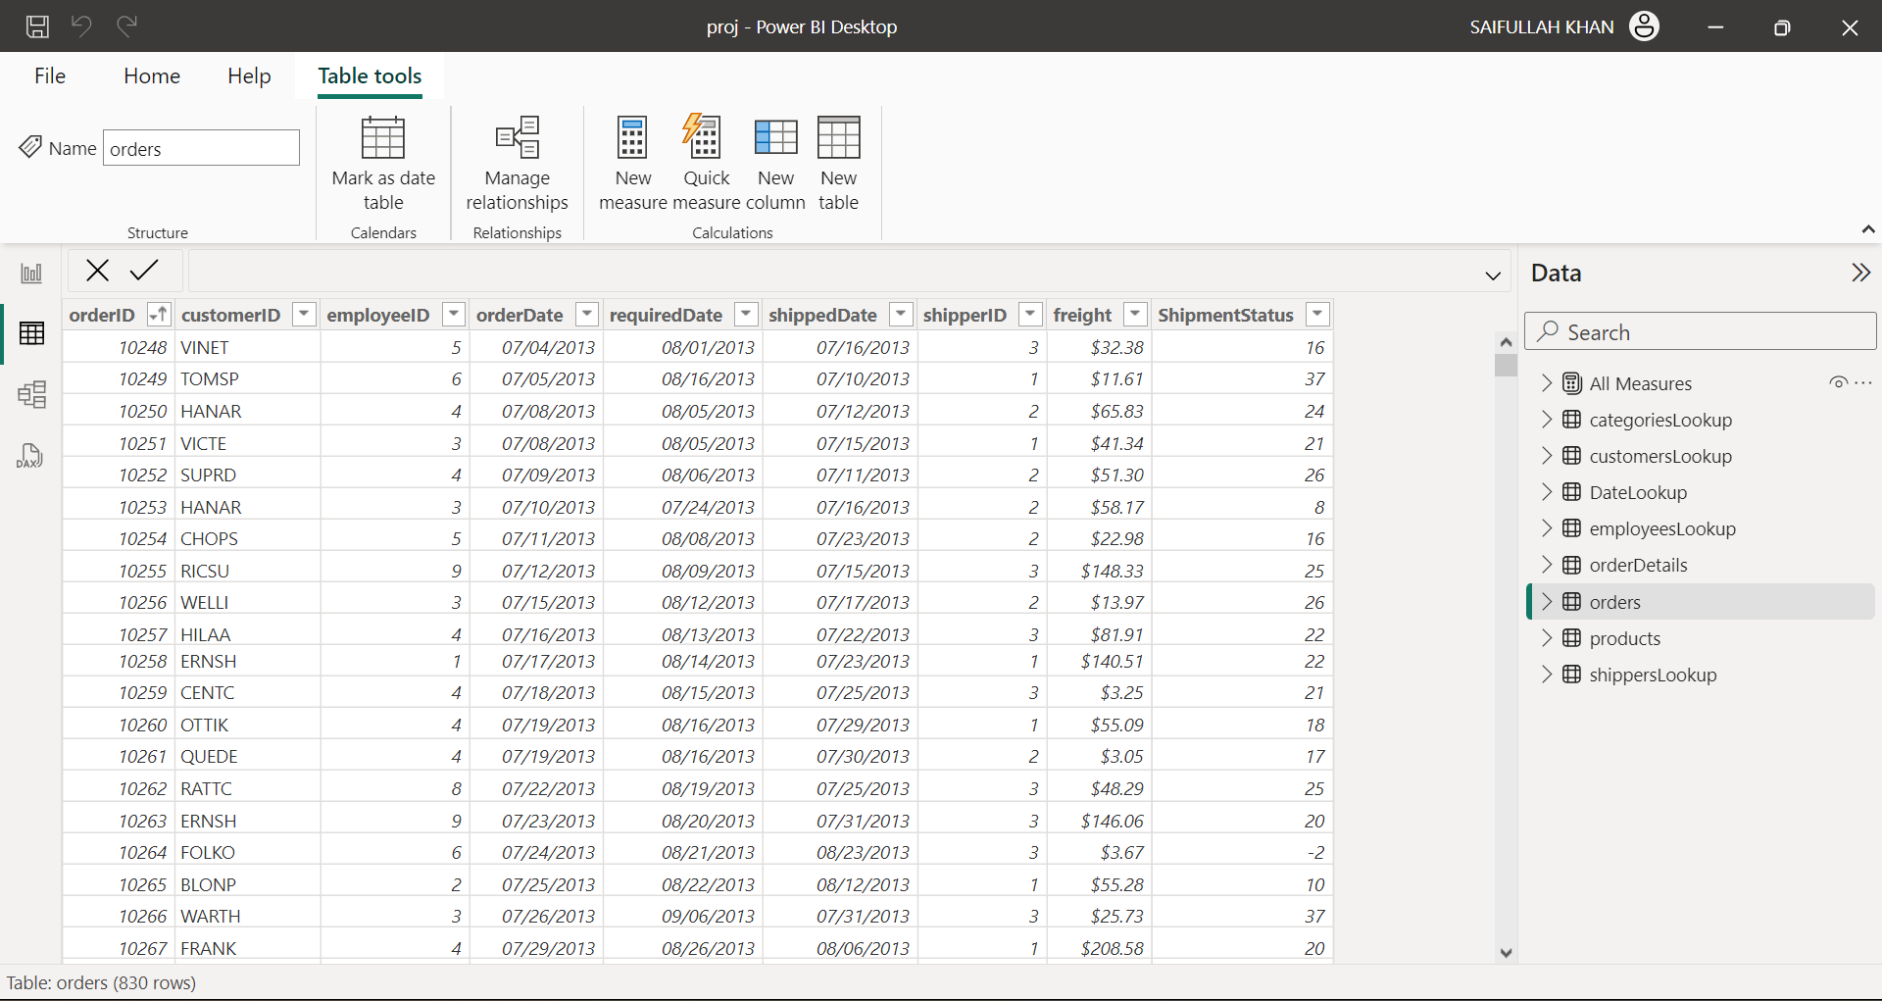
Tables

Slide 4
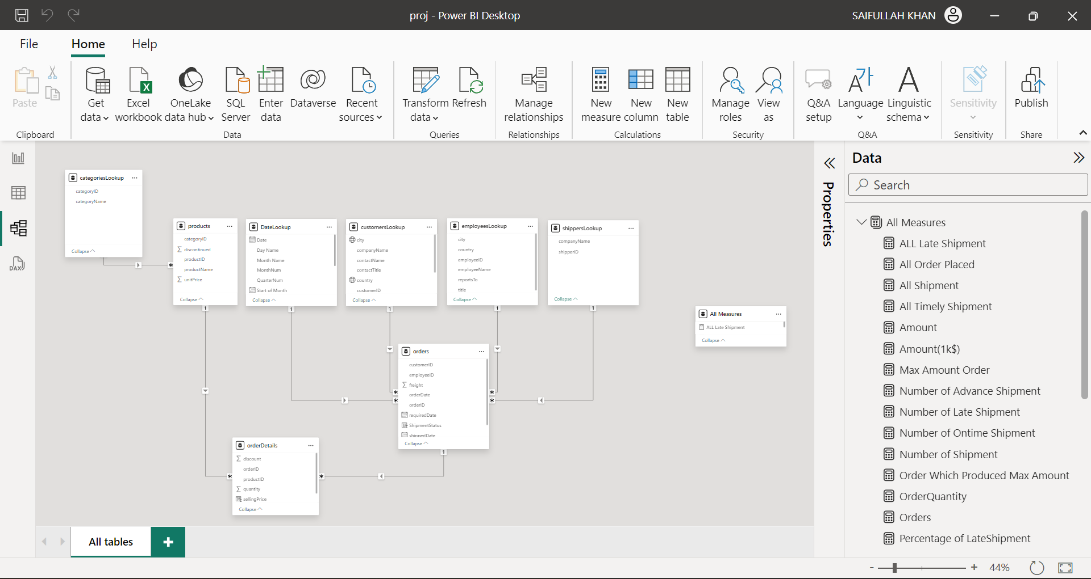
Table Relations

Slide 5
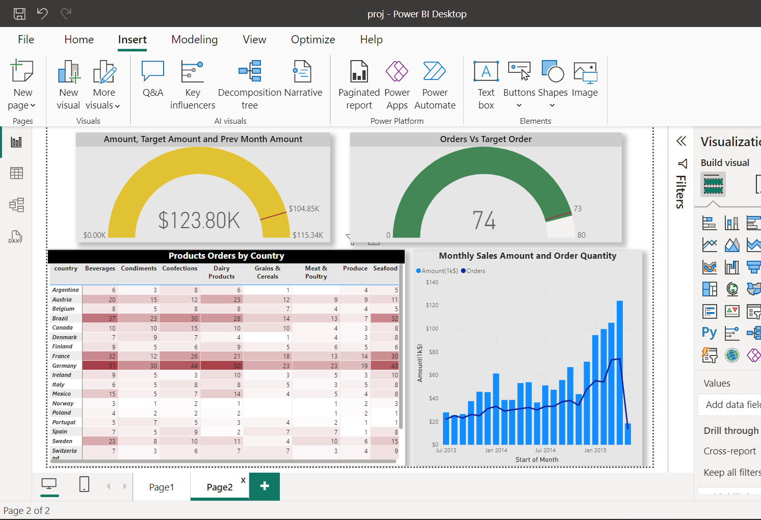
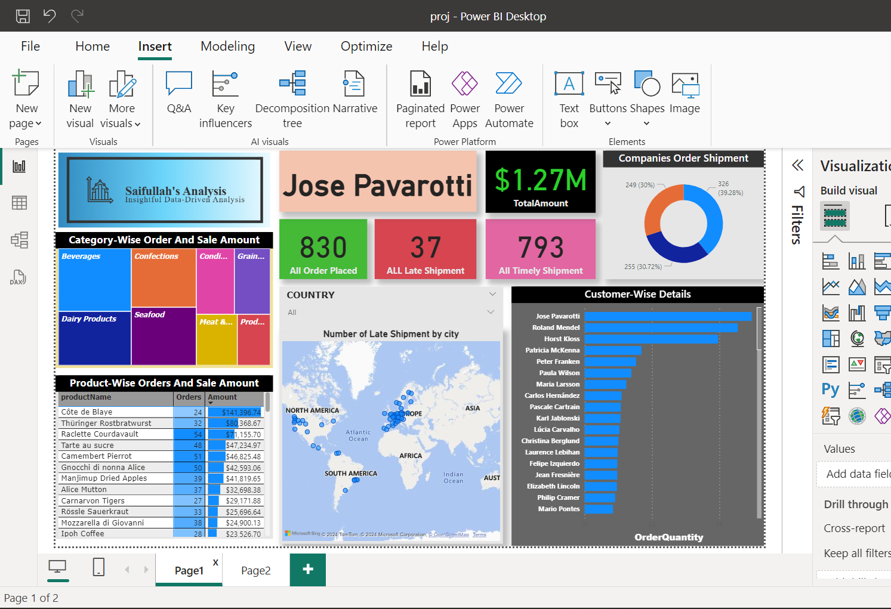
Visualization

Slide 6

Data Visualization (Click to add filter context)

Slide 7
Data Visualization

Slide 8
Key Insights
Beverages has the highest category-wise sale.
Cote de Blaye is the most demanded product.
Jose Pavarotti has placed maximum number of Orders.
United Packages has shipped the most orders(39%)
Late shipment geographical plot.

Slide 9
Thank you
Saifullah Khan
saifullah1902743@st.jmi.ac.in
https://github.com/saif604

