Slide 1
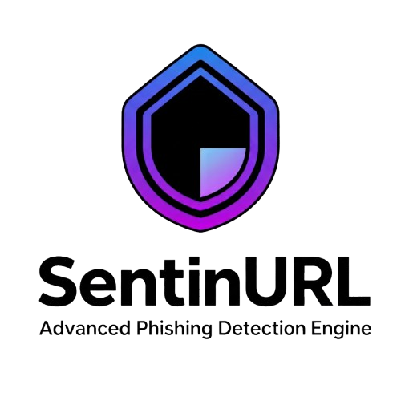


SentinURL: Advanced Multi-Layered Phishing Detection Engine
Student Name: Saif Al-Sabaneh
Supervisor’s Name : Dr.Hussam Barham
Course: 307498 – Graduation Project
Second Semester, 2025/2026
Notes:
Today, we are proud to present our graduation project, SentinURL: an advanced, multi-layered phishing detection system designed to combat the next generation of cyber threats."

Slide 2
The Problem We Are Trying to Solve
Phishing attacks are growing in volume and sophistication (polymorphic URLs, zero-day threats).
Traditional blacklist-based solutions are too slow; they only catch threats after they are reported.
Existing ML models often suffer from high "False Positive" rates, blocking legitimate websites and disrupting user workflow.
Notes:
The cybersecurity landscape is losing the war against phishing. Attackers are generating millions of new, unique malicious URLs daily. Traditional methods rely on databases of known bad links, which means someone has to be a victim first. Furthermore, while AI solutions exist, they frequently mistake complex but safe sites—like cloud portals—for phishing, causing severe workflow disruptions due to false positives.

Slide 3
Target Audience & Value Proposition
Target Audience: Enterprise security teams, everyday web users, and threat intelligence firms.
Value Proposition: Proactive zero-day threat detection, ultra-low false-positive rate, and seamless real-time browser integration.
Notes:
We built SentinURL for two primary groups: the everyday user who needs silent, continuous protection in their browser, and enterprise security teams who need a robust API to analyze URLs in bulk. Our core value proposition is our ability to detect 'zero-day' or brand new phishing links with an ultra-low false positive rate, ensuring safety without sacrificing usability.

Slide 4
The Solution: SentinURL
What is it? A hybrid intelligence platform combining Machine Learning and external Threat Intelligence.
Core Capabilities: Real-time analysis, continuous self-learning dataset, cross-platform accessibility (API, Web, Extension).
Notes:
Our solution is SentinURL. It is not just a machine learning model; it is a complete, full-stack cybersecurity product. By combining a dual-stage neural architecture with live external threat intelligence, SentinURL evaluates URLs in milliseconds. It provides real-time protection directly in the browser, alongside a detailed analytical dashboard for security researchers.

Slide 5
Data Acquisition & Feature Engineering
Extraction of 110+ distinct features (lexical, structural, and network-based).
Automated daily stress tests to ingest and label high-confidence new threats (>90% confidence).
Rigorous deduplication pipeline to maintain data integrity.
Notes:
A model is only as good as its data. We didn't just download a static dataset. We built a continuous data pipeline that extracts over 110 distinct features from any given URL—analyzing everything from domain entropy to lexical structures. Furthermore, we implemented an automated stress-testing script that daily finds new, high-confidence phishing URLs and feeds them back into our master dataset, allowing SentinURL to continuously learn and expand.

Slide 6
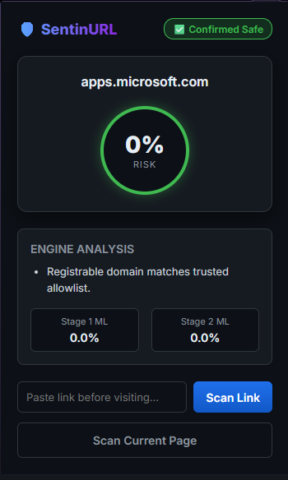
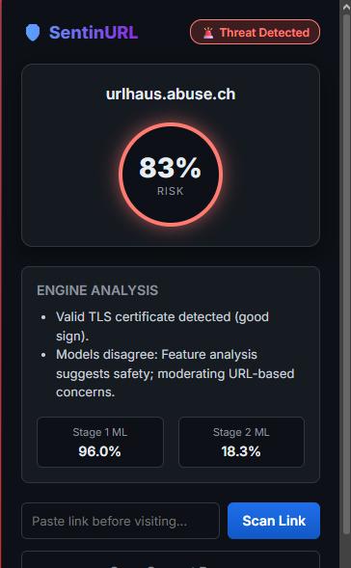
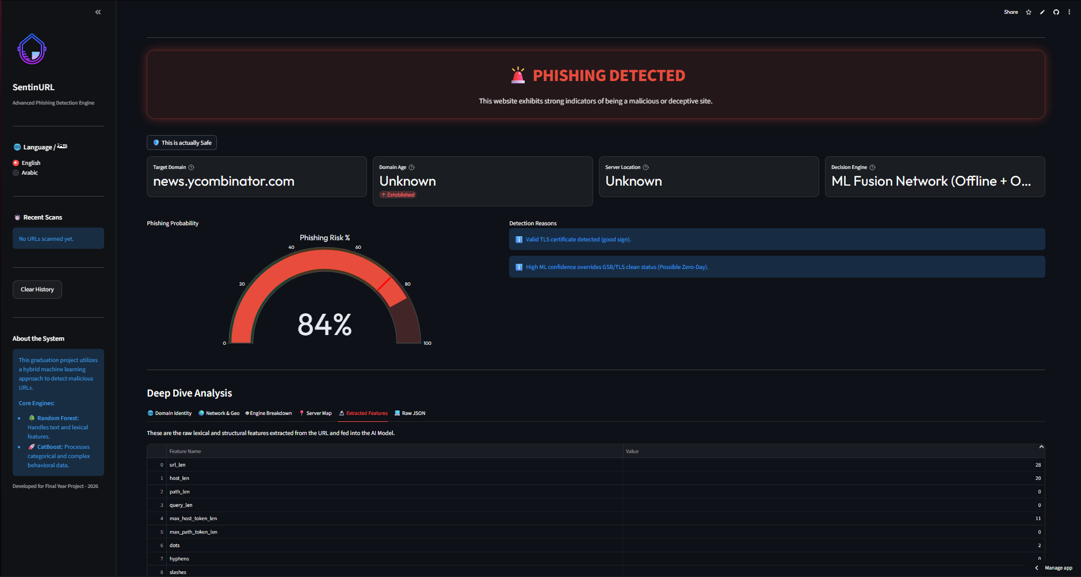
System Architecture Overview
Main Streamlit Dashboard
Safe
Phishing
Notes:
"Here is how the pieces fit together. When a user navigates to a site, our Chrome Extension intercepts the URL and sends it to our cloud-hosted API on Render. The API passes this to our ML Engine, which consults external Threat APIs, processes the ML stages, and returns a verdict in milliseconds. Simultaneously, researchers can interface directly with the core engine via our Streamlit dashboard.

Slide 7
ML Pipeline - Stage 1 (Lexical Fast-Check)
Technology: TF-IDF (Term Frequency-Inverse Document Frequency) & Initial Classifiers.
Purpose: Rapid lexical analysis to catch obvious structural anomalies.
Speed: Processes massive volumes instantly to filter out noise.
Notes:
Our AI works in stages to balance speed and accuracy. Stage 1 utilizes TF-IDF to perform rapid lexical analysis. It acts as a fast-filter, instantly looking at the structural DNA of the URL string to catch obvious anomalies and known bad patterns. This ensures we don't waste heavy computational power on obvious threats.

Slide 8
ML Pipeline - Stage 2 (Deep Feature Analysis)
Technology: HGB (HistGradientBoosting) algorithms.
Purpose: Deep, non-linear analysis of all 110+ extracted features.
Advantage: Highly robust against polymorphic and intentionally obfuscated URLs.
Notes:
URLs that pass or require deeper scrutiny move to Stage 2, which is powered by HistGradientBoosting. This model doesn't just look at text; it analyzes the complex relationships across all 110 extracted features. It is specifically designed to catch highly sophisticated, heavily obfuscated phishing sites that mimic legitimate services.

Slide 9
Dynamic Fusion & Verification Layer
Absolute-override logic to resolve conflicting model predictions.
Reputation-aware system specifically designed to whitelist high-entropy legitimate sites (e.g., cloud platforms, gaming servers).
Notes:
This slide represents our proudest engineering achievement. We noticed our models occasionally flagged legitimate cloud and gaming sites due to their strange, high-entropy URLs. To fix this, we engineered a Dynamic Fusion Layer. If Stage 1 and Stage 2 disagree, or if the URL exhibits specific high-entropy traits of a known safe platform, this reputation-aware engine acts as an absolute-override, effectively eliminating our most stubborn false positives.

Slide 10
External API Integration
Cross-referencing URLs with live, global threat databases.
Enriches the ML prediction with real-world, real-time context.
Ensures protection against established zero-minute campaigns.
Notes:
Machine learning is powerful, but we don't rely on it alone. SentinURL actively queries external Threat Intelligence APIs. By cross-referencing our AI's prediction with global databases in real-time, we provide a definitive verdict that relies on both predictive algorithms and known real-world threat reports.

Slide 11
Cloud Deployment (Render)
API is containerized and deployed on Render cloud infrastructure.
1
Ensures 24/7 availability for the Chrome Extension and Dashboard.
2
Highly scalable architecture capable of handling concurrent requests.
3
Notes:
To make SentinURL a real product, it couldn't just live on our laptops. We deployed the core API to the Render cloud platform. This guarantees 24/7 uptime, meaning anyone with our Chrome extension or accessing our Streamlit dashboard can utilize the engine at any time, from anywhere, with zero downtime.

Slide 12
Streamlit Dashboard
Interactive UI for security researchers and power users.
Detailed feature breakdown and confidence scores for every URL.
Global scan history and logging for auditing purposes.
Notes:
For researchers and power users, we built a fully interactive web application using Streamlit. Users can manually input URLs and receive an incredibly detailed breakdown of exactly why SentinURL flagged it, viewing the specific features that triggered the alarm. It also includes a global history log, ensuring all scans are recorded and auditable.

Slide 13
The Chrome Extension
Silent, real-time background protection.
Intercepts malicious navigation before the page loads.
Lightweight footprint with seamless user experience.
Notes:
For the everyday consumer, we built the SentinURL Chrome Extension. It runs silently in the background. The moment a user clicks a link, the extension queries our Render API. If the site is malicious, SentinURL intercepts the request and throws a warning screen before the page can even load, completely neutralizing the threat without requiring any technical knowledge from the user.

Slide 14
Data Visualization (Tableau)
Interactive dashboards tracking threat trends and model performance.
Visualizes which URL features are most predictive of phishing.
Notes:
To truly understand our data, we integrated Tableau. This allowed us to visualize macroscopic trends in phishing attacks and deeply analyze our model's behavior. Through these visualizations, we can easily demonstrate to stakeholders which features are most critical in identifying modern threats, proving the efficacy of our 110-feature extraction method.

Slide 15
Results & Performance
Overall Accuracy: 99.96%
Threat Detection Rate: 99.52%
Near-zero false positive rate due to the Fusion Verification Layer.
Notes:
The results speak for themselves. After rigorous testing across vast datasets, SentinURL achieved an overall accuracy of 99.55%, with a specific threat detection rate of 99.52%. More importantly, thanks to our dynamic fusion layer, we maintained these incredibly high detection rates while virtually eliminating the false positives that plague competing systems.

Slide 16
Challenges / Overcome
Challenge: Cloud Deployment routing issues
Challenge: False Positives on Gaming Sites
Solution: Restructured API paths for Render.
Solution: Engineered the absolute-override Fusion Engine.
Notes:
Building this wasn't without hurdles. Deploying a complex ML pipeline to the cloud presented massive path resolution and network socket errors, which we solved by completely restructuring our API logic for Render. Furthermore, our initial models struggled with gaming platforms. By analyzing the failure data, we engineered the Reputation-Aware Fusion Engine, turning our biggest weakness into our most unique feature.

Slide 17
Commercialization & Future Work
Ready for enterprise "Acqui-hire" or strategic partnership.
Future Work: Expanding the 110-feature set to include deep-page HTML analysis.
Scaling infrastructure for B2B API licensing.
Notes:
SentinURL is beyond an academic prototype; it is commercial-ready. Our strategy is to leverage this 99.5% accuracy to seek strategic acqui-hire partnerships with major Jordanian cybersecurity firms. Moving forward, we plan to expand our feature extraction to include deep-HTML scraping and scale our Render API to support paid, enterprise-level B2B licensing.

Slide 18
Conclusion
In conclusion, SentinURL proves that by combining robust feature engineering, multi-layered machine learning, and dynamic fusion logic, we can create a highly accurate, deployable solution to modern phishing. Thank you for your time and guidance throughout this project. We would now be happy to answer any questions.

