Slide 1
Density Based Traffic Control System

Slide 2
Disadvantages of Current Traffic Control System
Fixed time for each phase irrespective of the traffic.
Does not help in reducing traffic congestion.
Fails in dense traffic.
In some situations, may require man power to control the traffic thus adding to the expenses.

Slide 3
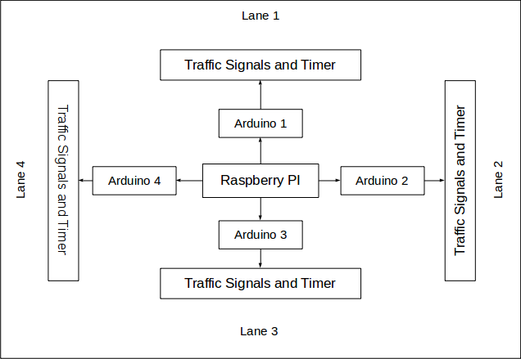
Block Diagram

Slide 4
Components Involved
Raspberry Pi
Arduino Uno
Jumper Wires
Three digit 7 segment displays
Resistors
Bread boards
Green and Red LEDs

Slide 5

Raspberry Pi
A Raspberry Pi is a credit card-sized computer which is a complete Linux computer and can provide all the expected abilities that implies, at a low-power consumption level.

Slide 6
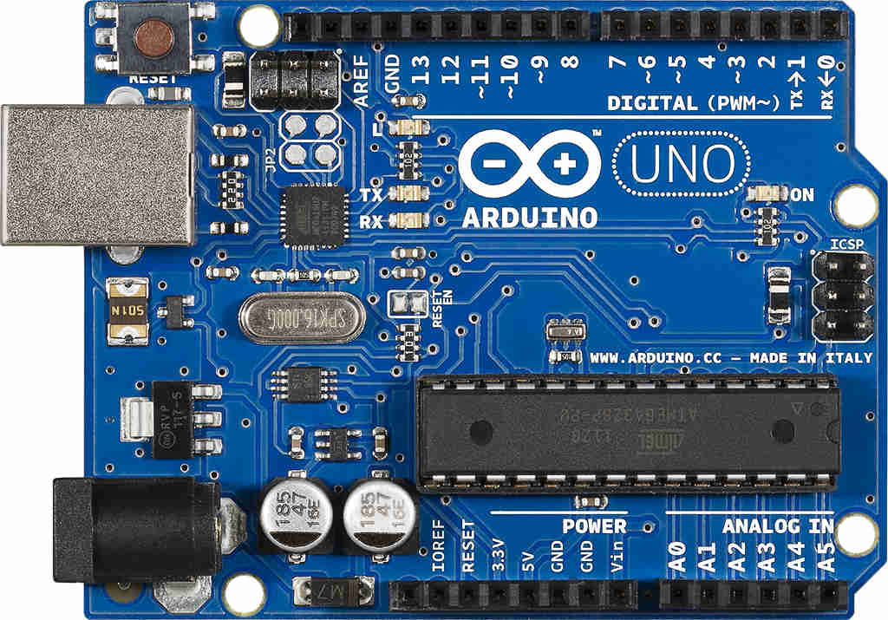
Arduino Uno
The Arduino Uno is a microcontroller board based on the ATmega328

Slide 7
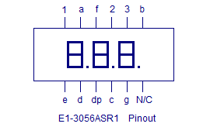
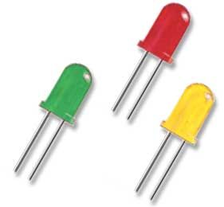
Three Digit Seven Segment Display
For the signalling system we are using three digit seven segment display and green and red LEDs
A 3 digit seven segment display consists of three seven segment displays.
It consists of a total of 12 pins, pins a to g to control a seven segment and pins 1, 2 and 3 to choose a seven segment.

Slide 8
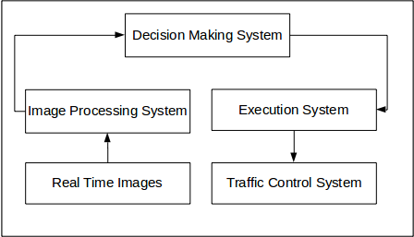
Working Diagram

Slide 9
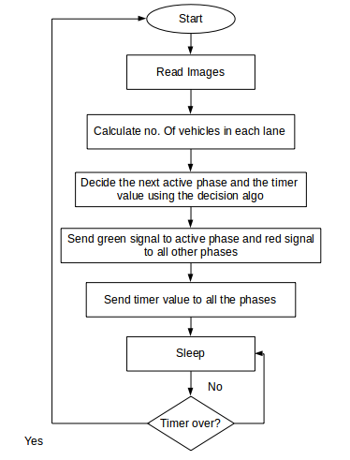

Slide 10

Image Processing
OpenCV (Open Source Computer Vision) is a library of programming functions mainly aimed at real-time computer vision.
Once the images are fed into the system, we use the openCV library to detect vehicles from each lane.

Slide 11
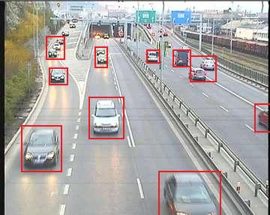
Vehicle Detection using Haar Cascade Approach
Haar Cascade Approach: It is a machine learning based approach where a cascade function is trained from a lot of positive and negative images. It is then used to detect objects in other images.

Slide 12
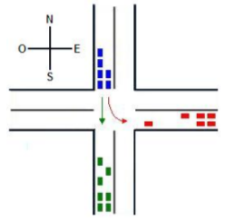
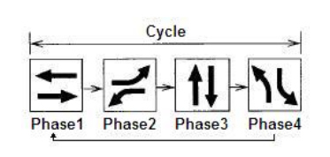
Decision Making Algorithm
Once the number of vehicles in each lane is stored in a multi-dimensional array, the decision making algorithm is used to determine which phase should be made active next.
Phase: A phase is a traffic signal which allows a flow of non-conflictive movements.
A four phase cycle

Slide 13
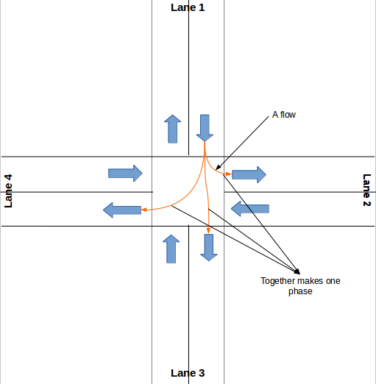

Slide 14
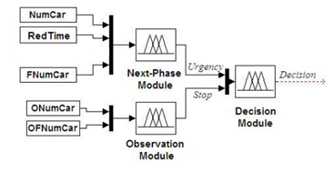
Schematic Diagram of the Decision Controller
Notes:
Diagram to be edited

Slide 15
Next Phase Module
Responsible for selecting among all the phases that are not active, the one whose level of urgency is higher.
This module evaluates the urgency of each of the flows associated with each phase and the average of these values will be the level of urgency of the phase analyzed.
To obtain the level of urgency of each flow, three variables are evaluated:
  NumCar: Number of vehicles waiting for the green signal.
  RedTime: Time for which the evaluated phase has been deactivated.
  FnumCar: The number of vehicles on the road in front of the intersection
Next Phase finds the inactive phase with the maximum urgency.

Slide 16
Observing Module
This module is responsible for assessing traffic conditions for the active phase and determines, how timely it would be to stop that phase.
The fuzzy rules of this module have two inputs and one output:
  ONumCar: Indicates the number of cars that still are on stanby.
  OFNumCar: Represents the number of vehicles at the next intersection.
  Stop: Output of the module and indicates, whether or not should be necessary to stop the phase.
The observing module decides if the current active phase should be continued or not.

Slide 17
Decision Module
Decides which will be the next active phase.
The inputs in this module comes from the next phase and the observing module.
The next phase returns the inactive phase with highest urgency
Observing module tells whether or not to stop the current phase

Slide 18
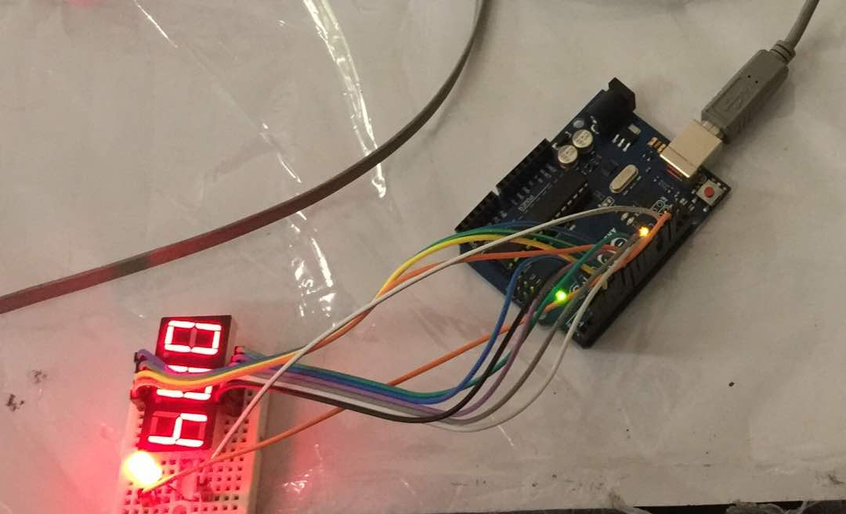
Execution System
Once the decision is made which phase will be active, appropriate signals are passed to each arduino.
Connected to each arduino is a timer showing the time remaining and LEDs showing the signal.

Slide 19
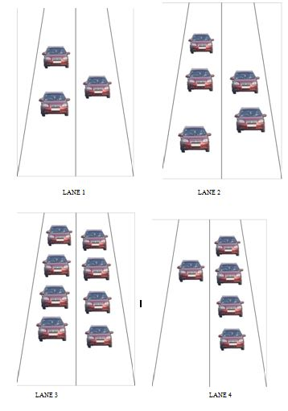

Slide 20
Advantages
Signals are given based on the density of traffic in each lane
No need of human supervision
Increases efficiency
Helps in avoiding congestion

Slide 21
Disadvantages
Cost is higher compared to fixed time systems
As signal is based on density, can lead to starvation of the lane with minimum traffic
As a phase can be inactive for more than one decision, the value of its timer may seem misguided.

Slide 22
THANK YOU

