Slide 1
Assignment problem
Prepare by: Subject's instructor:
Saif Alshamrani - 361003663 Dr. Hatem El-Boghdadi
Mohmmad Jamal -362049583 Mr. Majed Alhariry

Slide 2
01
02
03
04
PROBLEM STATEMENT
Brief discerption of the problem
OBJECTIVES
The goal of this project
HUNGARIAN ALGORITHM
Brief discerption of the algorithm
ORIGINAL VERSION OF SOLUTION
The solution after applying Hungarian method
OPTIMIZATION OF THE SOLUTION
05
Improvement of solution

Slide 3
PROBLEM STATEMENT
Imagine, you own a company and you have only four available jobs and you need only for people for these jobs.
You will as much as you can to assign the right person in the right job with minimum salary (cost).
One person can only assign to one job.

Slide 4
PROBLEM STATEMENT
Imagine, you own a company and you have only four available jobs and you need only for people for these jobs.
You will as much as you can to assign the right person in the right job with minimum salary (cost).
One person can only assign to one job.

Slide 5
PROBLEM STATEMENT
Imagine, you own a company and you have only four available jobs and you need only for people for these jobs.
You will as much as you can to assign the right person in the right job with minimum salary (cost).
One person can only assign to one job.

Slide 6
Objectives
Provide the right job for the right person.
Solving the problem by Hungarian method.
Optimize the solution

Slide 7
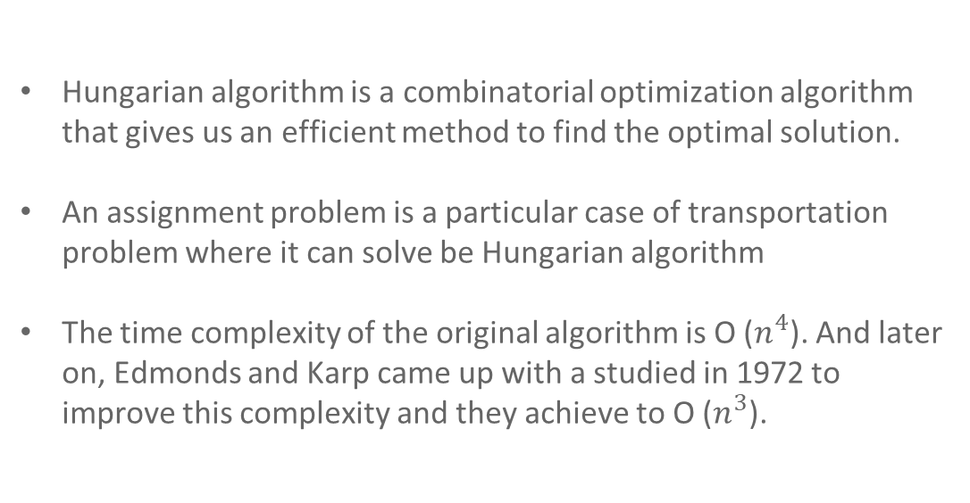
Hungarian Algorithm
Hungarian algorithm is a combinatorial optimization algorithm that gives us an efficient method to find the optimal solution.
An assignment problem is a particular case of transportation problem where it can solve be Hungarian algorithm
The time complexity of the original algorithm is O ($n^{4}$). And later on, Edmonds and Karp came up with a studied in 1972 to improve this complexity and they achieve to O ($n^{3}$).

Slide 8
Hungarian Algorithm
In order to implementing the Hungarian method, you must go through four steps:
Step One: subtract the smallest entry in a row to all entry row.
Step Two: subtract the smallest entry in a column to all entry column.
Step three: draw lines through the row and columns to cover all zeros.
Step four: find the smallest entry that is not covered by any line and subtract it to all other elements that is not covered as well. Then, add the same entry to the intersection of the row in the column, if any.
Step one and two is going to be once, while three and four will be repeated until it optimizes the problem

Slide 9
Hungarian Algorithm
Step 1 subtract the smallest entry in a row to all entry row
Step 2 subtract the smallest entry in a column to all entry column
Step 3 draw lines through the row and columns to cover all zeros
Step 4 find the smallest entry that is not covered by any line and subtract it to all other elements that is not covered as well. Then, add the same entry to the intersection of the row in the column, if any
Note:- Step one and two is going to be once, while three and four will be repeated until it optimizes the problem.

Slide 10
ORIGINAL VERSION OF SOLUTION
Step One: subtract the smallest entry in a row to all entry row.

Slide 11
ORIGINAL VERSION OF SOLUTION
Step Two: subtract the smallest entry in a column to all entry column.

Slide 12
ORIGINAL VERSION OF SOLUTION
Step three: draw lines through the row and columns to cover all zeros.

Slide 13
ORIGINAL VERSION OF SOLUTION
Step four: find the smallest entry that is not covered by any line and subtract it to all other elements that is not covered as well. Then, add the same entry to the intersection of the row in the column, if any.

Slide 14
ORIGINAL VERSION OF SOLUTION
Acutely, we can perform many solutions with the same cost.
To preform a new solution make sure that whenever you assigned person into a job the place (row and column) is reserved and can not be used anymore.

Slide 15
ORIGINAL VERSION OF SOLUTION
Cost = 10 + 3 + 2 + 17 = 32

Slide 16
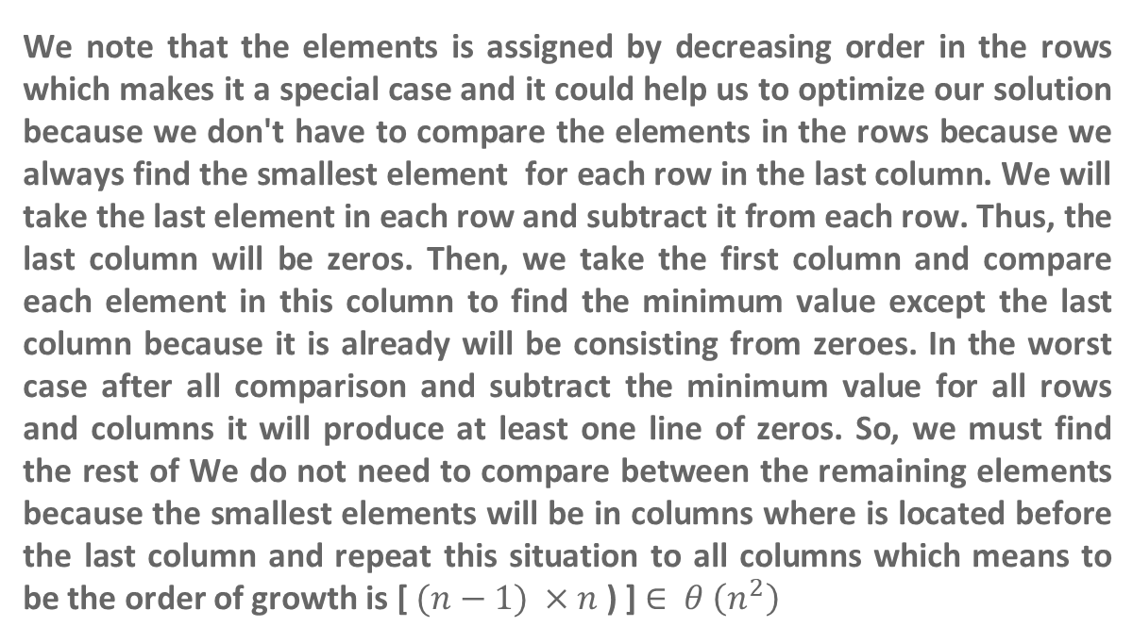
We note that the elements is assigned by decreasing order in the rows which makes it a special case and it could help us to optimize our solution because we don't have to compare the elements in the rows because we always find the smallest element for each row in the last column. We will take the last element in each row and subtract it from each row. Thus, the last column will be zeros. Then, we take the first column and compare each element in this column to find the minimum value except the last column because it is already will be consisting from zeroes. In the worst case after all comparison and subtract the minimum value for all rows and columns it will produce at least one line of zeros. So, we must find the rest of We do not need to compare between the remaining elements because the smallest elements will be in columns where is located before the last column and repeat this situation to all columns which means to be the order of growth is [ $(n−1) ×n$ ) ] $∈$ $θ \left(n^{2}\right)$
OPTIMIZATION OF THE SOLUTION

Slide 17
OPTIMIZATION OF THE SOLUTION
Step 1
We will take the last element in each row and subtract it from each row
Step 2
We take the first column and compare each element in this column to find the minimum value except the last column because it is already will be consisting of zeros.
Step 4
Repeat step three, which means After completing the last column and the penultimate column. We take the column that exists before these two columns and compare each element in this column to find the minimum value and subtract it from elements of this column and repeat this step until we reach the first column.
Step 3
We take column before the last column and compare each element in this column to find the minimum value and subtract it from elements of this column
Note:- We do not need to compare between the remaining elements because the smallest elements will be in columns where is located before the last column

Slide 18
Reference:
Mansi, Angela (2019) Personality at work: an empirical investigation into higher order factors underpinning the socioanalytic theory of personality. Doctoral thesis, Birkbeck, University of London.
https://www.hungarianalgorithm.com/
https://shodhganga.inflibnet.ac.in/bitstream/10603/3970/10/10_chapter%205.pdf

Slide 19
THANK YOU

