Slide 1

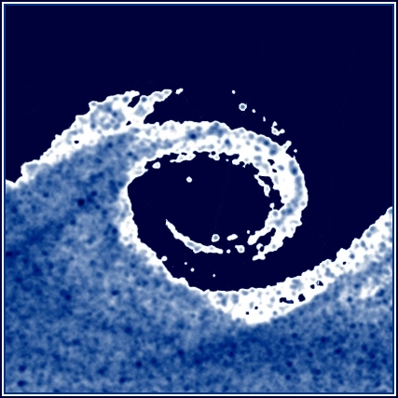
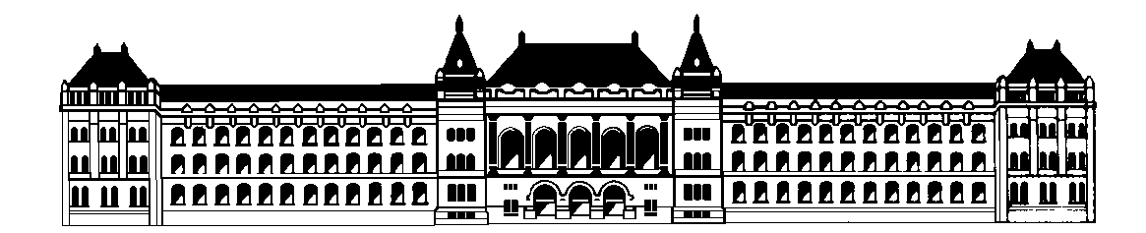
Fluid Mechanics Lab Report Presentations
DEPARTMENT OF FLUID MECHANICS
Budapest University of Technology and Economics
MEASUREMENT OF SHEET DIFFUSER PROPERTIES
Measurement Group Members:
Aqel Saif-Aldain Ahmad Deeb | QTY3S6
Heydarov Firuddin | IG6JX7
Horváth Kornél Ádám | OFI50V
Instructor : Márton KOREN
30.05.2023
Fluid Mechanics lab report presentation

Slide 2
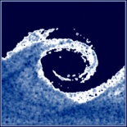
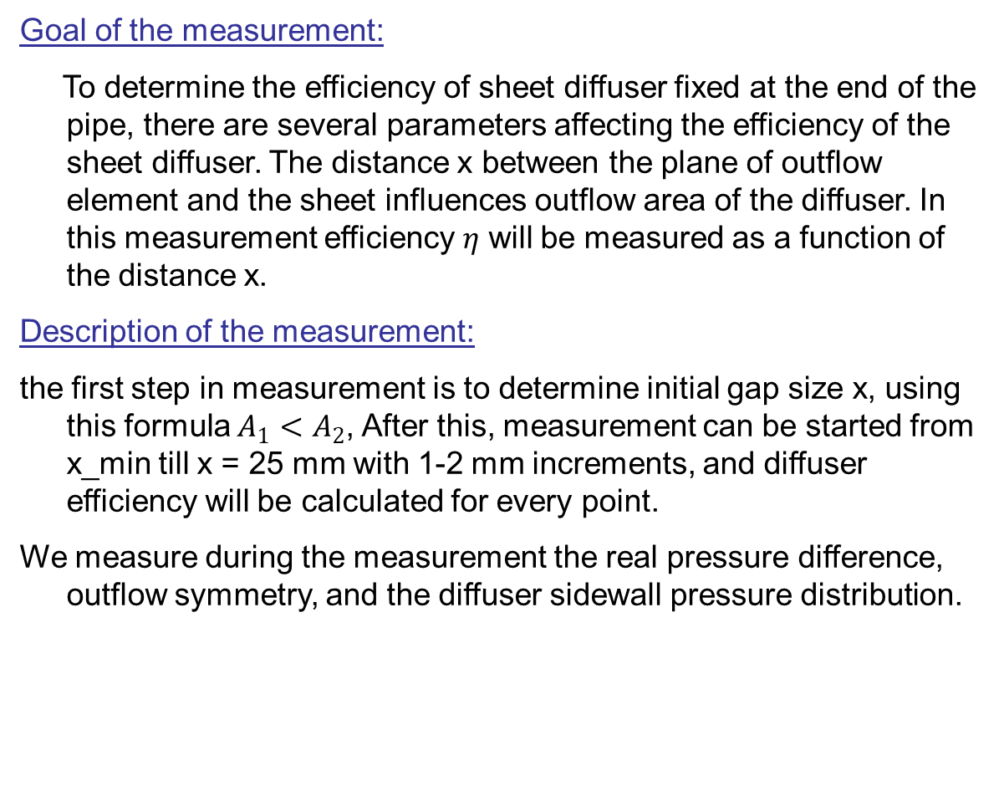
Short Description of the Measurement
Goal of the measurement:
To determine the efficiency of sheet diffuser fixed at the end of the pipe, there are several parameters affecting the efficiency of the sheet diffuser. The distance x between the plane of outflow element and the sheet influences outflow area of the diffuser. In this measurement efficiency 𝜂 will be measured as a function of the distance x.
Description of the measurement:
the first step in measurement is to determine initial gap size x, using this formula $A_{1}<A_{2}$, After this, measurement can be started from x_min till x = 25 mm with 1-2 mm increments, and diffuser efficiency will be calculated for every point.
We measure during the measurement the real pressure difference, outflow symmetry, and the diffuser sidewall pressure distribution.
Fluid Mechanics lab report presentation
2.

Slide 3
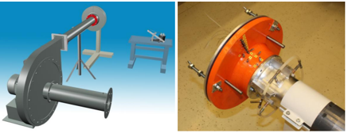
Description of the measurement set-up
The sheet diffuser is connected to a pipeline located at the delivery side of a radial fan. At the suction side of the fan there is an inlet orifice to measure the volume flow rate. The sheet diffuser gap size can be set using the three bolts. Diffuser efficiency can be improved using a cone that can be attached using an M5 bolt.
Fluid Mechanics lab report presentation
3.

Slide 4
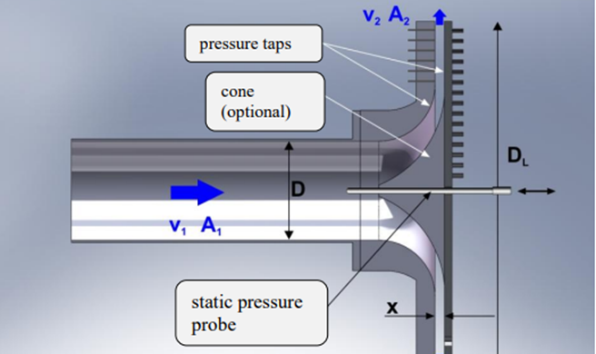
Description of the measurement set-up
Devices used in the measurement:
Fluid Mechanics lab report presentation
4.

Slide 5
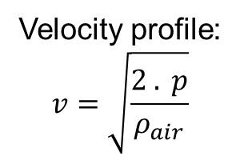

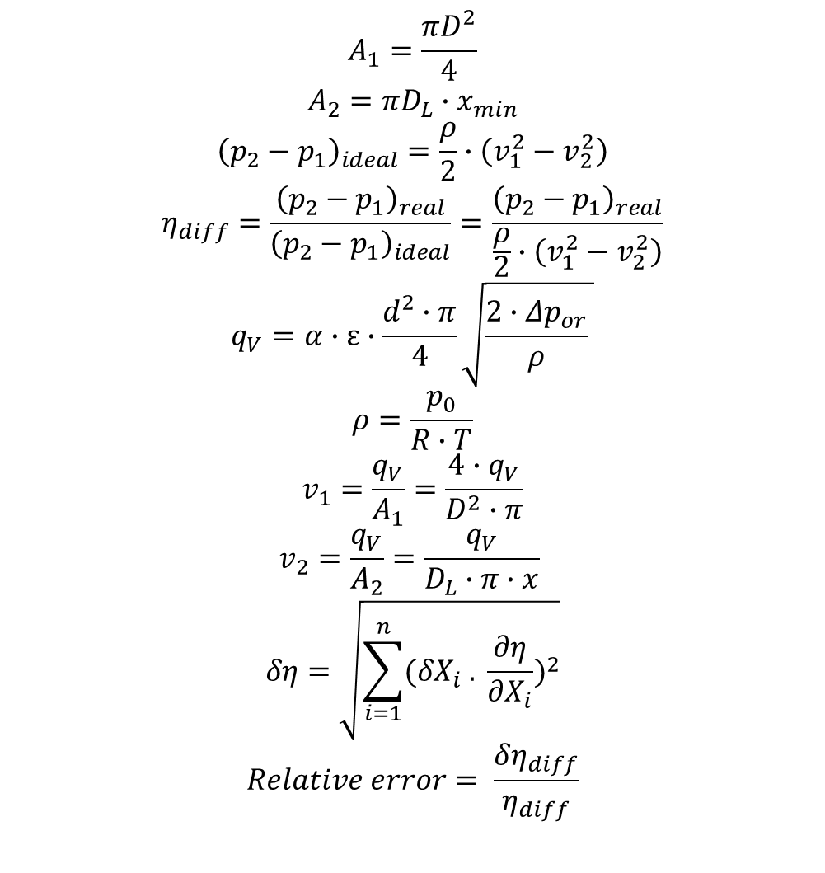
The applied formulas
$$A_{1}=\frac{πD^{2}}{4}$$
$$A_{2}=πD_{L}∙x_{min}$$
$${\left(p_{2}−p_{1}\right)}_{ideal}=\frac{ρ}{2}∙\left(v_{1}^{2}−v_{2}^{2}\right)$$
$$η_{diff}=\frac{{\left(p_{2}−p_{1}\right)}_{real}}{{\left(p_{2}−p_{1}\right)}_{ideal}}=\frac{{\left(p_{2}−p_{1}\right)}_{real}}{\frac{ρ}{2}∙\left(v_{1}^{2}−v_{2}^{2}\right)}$$
$$q_{V}=α∙ε∙\frac{d^{2}∙π}{4}\sqrt{\frac{2∙Δp_{or}}{ρ} }$$
$$ρ=\frac{p_{0}}{R∙T}$$
$$v_{1}=\frac{q_{V}}{A_{1}}=\frac{4∙q_{V}}{D^{2}∙π}$$
$$v_{2}=\frac{q_{V}}{A_{2}}=\frac{q_{V}}{D_{L}∙π∙x}$$
$$δη=\sqrt{\sum_{i=1}^{n}{{({δX}_{i} . \frac{∂η}{{∂X}_{i}})}^{2}}}$$
$$Relative error= \frac{δη_{diff}}{η_{diff}}$$
Calibration:
$$p=\frac{\left(ρ_{w}−ρ_{air}\right)gh_{w}}{1000}$$
Velocity profile:
$$v=\sqrt{\frac{2 . p}{ρ_{air}}}$$
Fluid Mechanics lab report presentation
5.

Slide 6
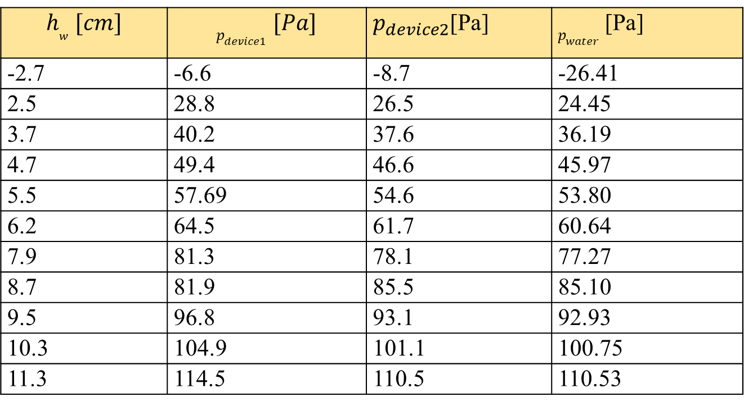
The investigated physical parameter
The environmental data:
d_{or} [m] | 0.1
D [m] | 0.105
T₀ [k] | 19.5
p₀ [Pa] | 100300
D_{L} [m] | 0.36
α [-] | 0.6
The digital manometer calibration data:
$$h_{w} [cm]$$ | $$p_{device1} [Pa]$$ | $p_{device2}$[Pa] | $p_{water}$ [Pa]
-2.7 | -6.6 | -8.7 | -26.41
2.5 | 28.8 | 26.5 | 24.45
3.7 | 40.2 | 37.6 | 36.19
4.7 | 49.4 | 46.6 | 45.97
5.5 | 57.69 | 54.6 | 53.80
6.2 | 64.5 | 61.7 | 60.64
7.9 | 81.3 | 78.1 | 77.27
8.7 | 81.9 | 85.5 | 85.10
9.5 | 96.8 | 93.1 | 92.93
10.3 | 104.9 | 101.1 | 100.75
11.3 | 114.5 | 110.5 | 110.53
Fluid Mechanics lab report presentation
6.

Slide 7
The investigated physical parameter
Fluid Mechanics lab report presentation
7.

Slide 8
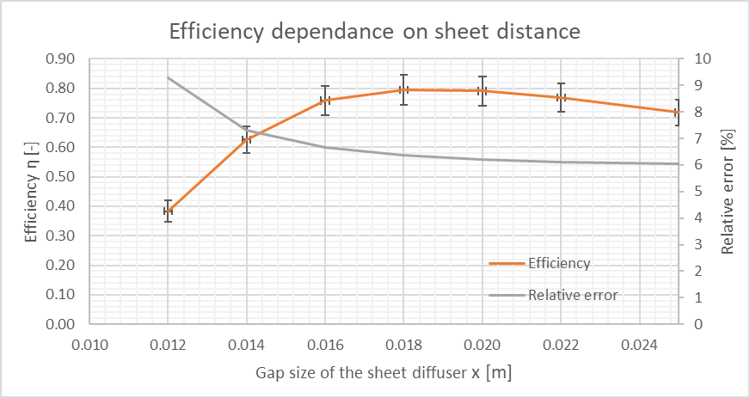
The investigated physical parameter
Parameters:
Gap size x [m]
Efficiency η [-]
Fluid Mechanics lab report presentation
8.

Slide 9
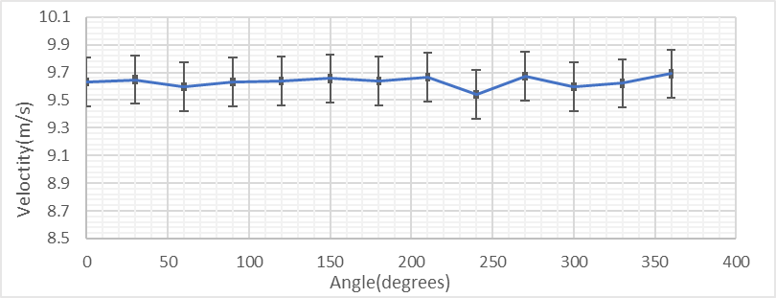
The investigated physical parameter
Parameters:
Angle [°]
Velocity [m/s]
Fluid Mechanics lab report presentation
9.

Slide 10
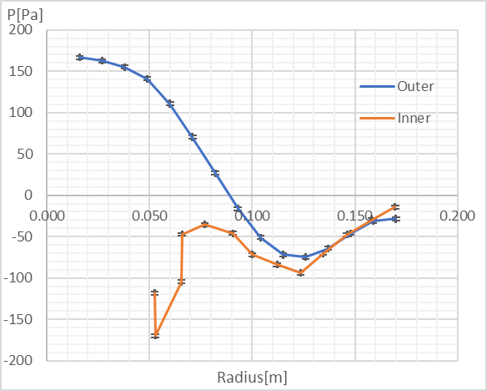
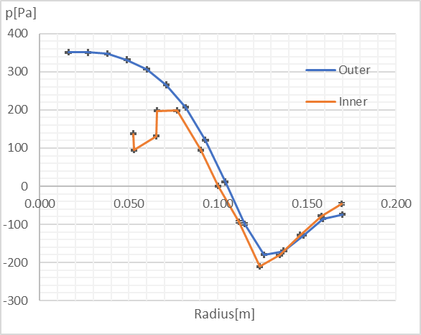
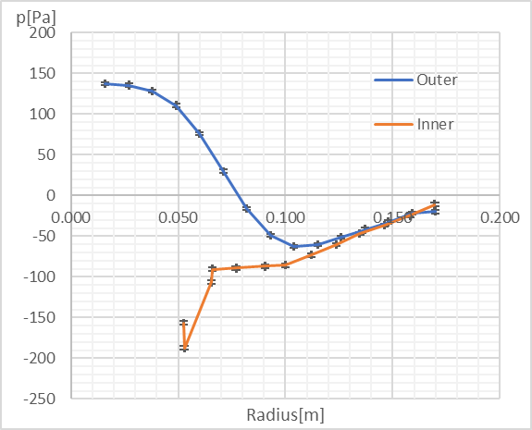
The investigated physical parameter
Parameters:
Pressure p [Pa]
Radius [m]
x = 14mm
x = 8 mm
x = 25mm
Fluid Mechanics lab report presentation
10.

Slide 11
Experiences
Summary and conclusion:
During this laboratory measurement by making calculations and graphs we were able to understand how the efficiency of a sheet diffuser behaves depending on the sheet distance.
The optimal sheet distance for the diffuser is at 18 mm, with an efficiency of 79.5% ± 0.051%.
The outflow velocity is very similar all around so the velocity is symmetrical.
The average relative error in the efficiency calculation is 0.15, and in the velocity calculation is 0.018.
Fluid Mechanics lab report presentation
11.

