Slide 1
Reversing the Trend: Understanding and Reducing Subscriber Churn at Fit.ly
Data-Driven Insights and Action Plan for Q4
Saif Essam
Data Analyst

Slide 2
The Business Challenge
• The Cost of Acquisition is Rising
• Leadership identified an upward trend in subscriber churn over the last two quarters.
• Retaining our existing users is now our top priority to relieve pressure on Marketing and Product.
• Goal: Identify the hidden drivers of churn and deploy practical, immediate actions to fix them.

Slide 3
Our Data Approach
• A Unified View of the Customer
• We broke down data silos by combining Account Information, Customer Support logs, and App Engagement metrics.
• Takeaway: This single, validated source of truth allows us to see exactly what a user did before deciding to cancel their subscription.

Slide 4
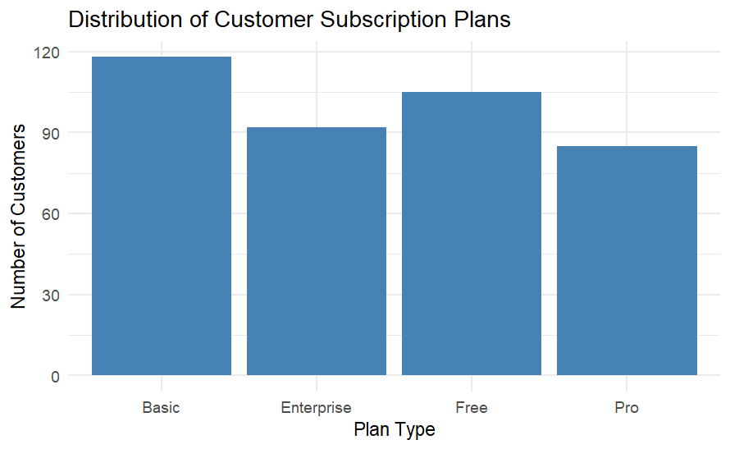
Who are our Customers?
• A Balanced Subscriber Base
• Our user base is healthy in terms of tier diversity, with a strong showing in our Basic and Enterprise plans.

Slide 5
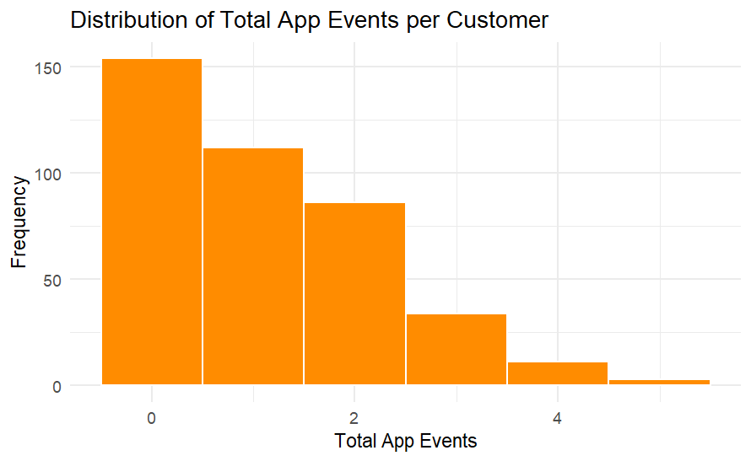
The Engagement Gap
• Users Are Not Experiencing Our Core Value
• The vast majority of our users interact with the app 1 time or less.
• If they aren't logging workouts or watching videos, they have no reason to stay.

Slide 6
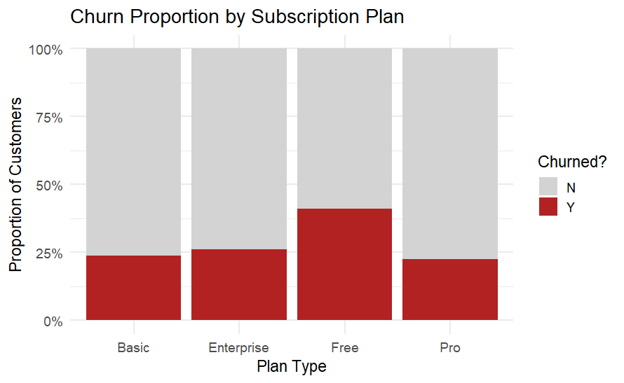
Where is Churn Happening?
• The 'Free' Tier is Leaking Users
• While paid tiers hover around a 20-25% churn rate, nearly 40% of our Free tier users are leaving the platform.

Slide 7
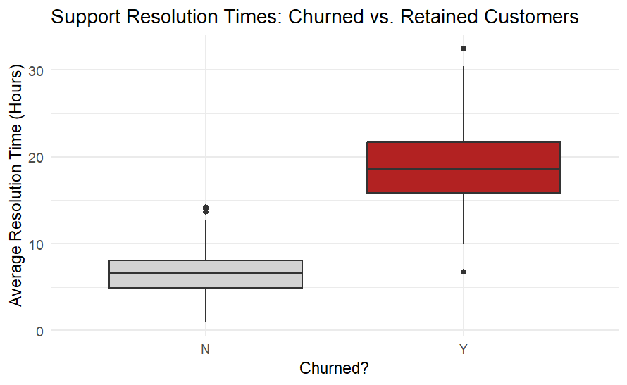
The Primary Driver of Churn
• Slow Support Kills Retention
• This is our most critical finding.
• Customers who stay have their issues resolved in roughly 6 hours.
• Customers who leave are waiting nearly 20 hours for a solution.

Slide 8
How We Measure Success
• Baselines & Targets for Next Quarter
• We will hold ourselves accountable using two KPIs:
- Current Churn Rate: 28.5% (Goal: Drive below 20%)
- Avg. Support Resolution Time: 10.2 Hours (Goal: Drive below 8 hours)
• Takeaway: If we fix the resolution time (the driver), the churn rate (the outcome) will naturally fall.

Slide 9
Action Plan & Recommendations
• Three Steps to Reduce Churn Today
1. Overhaul Support SLAs: Immediately reallocate resources to guarantee ticket resolution in under 8 hours.
2. Gamify Onboarding: Product/Marketing must launch a campaign to ensure every new user tracks at least 2 workouts in their first week.
3. Audit the Free Tier: Determine if the Free tier is broken or simply attracting the wrong demographic.

