Slide 1
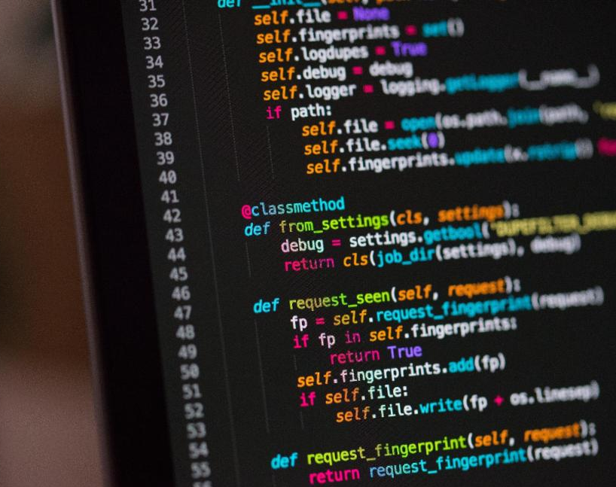
Welcome Back PYTHONISTAS

Slide 2

Dictionaries

Slide 3
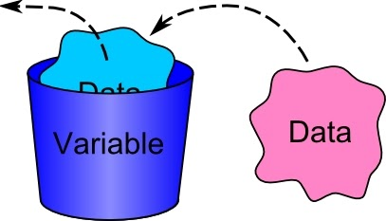
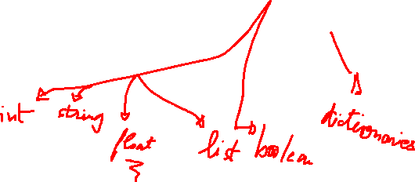
Data types

Slide 4
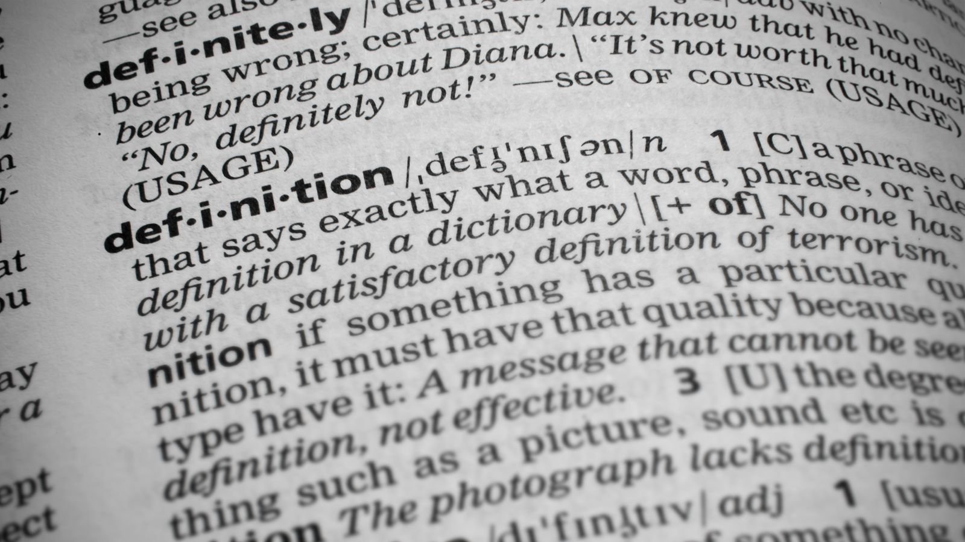
Storing information
Dictionaries work a bit like lists, but each item in a dictionary has two parts, called a key and a value. It’s usually quicker to look things up in a dictionary than it is to find something in a long list.
For example, You can store the names of countries and their capitals in a dictionary.

Slide 5
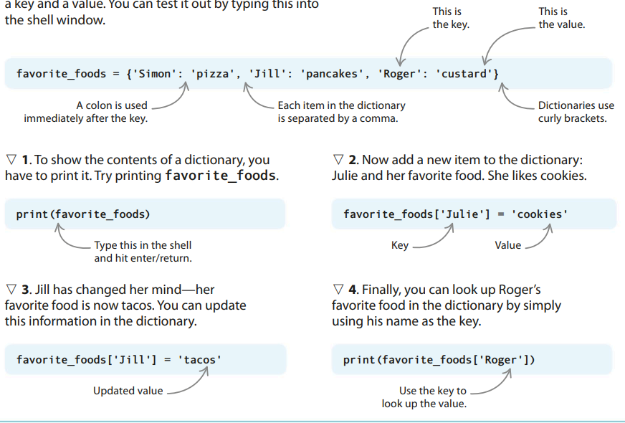
How Dictionaries work

Slide 6

Time to code

Slide 7
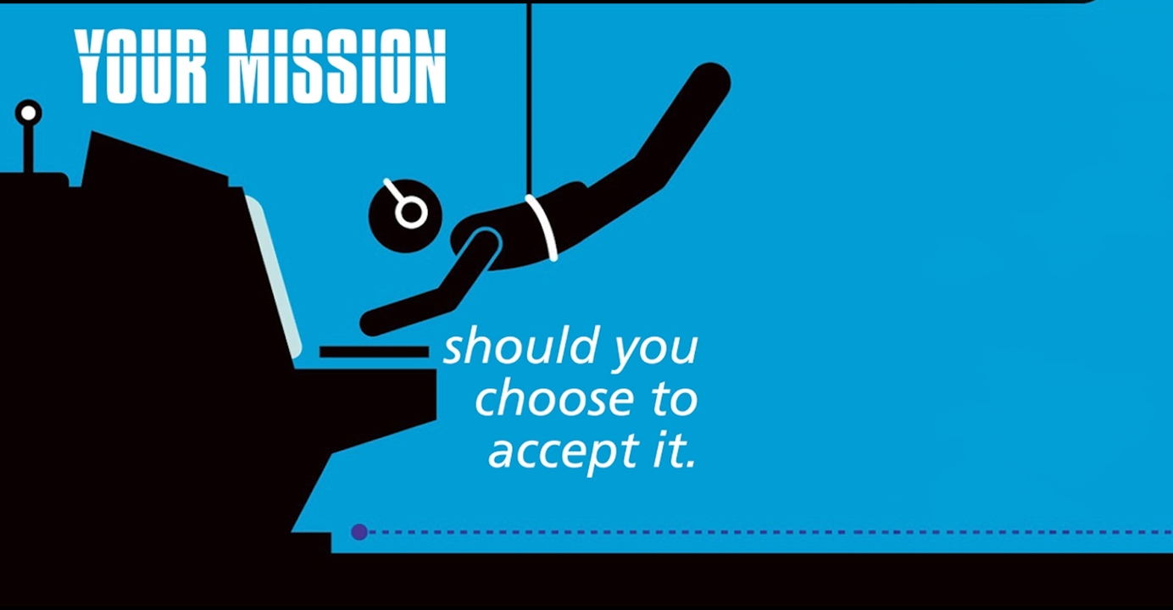
The Restaurant
The
Restaurant

Slide 8
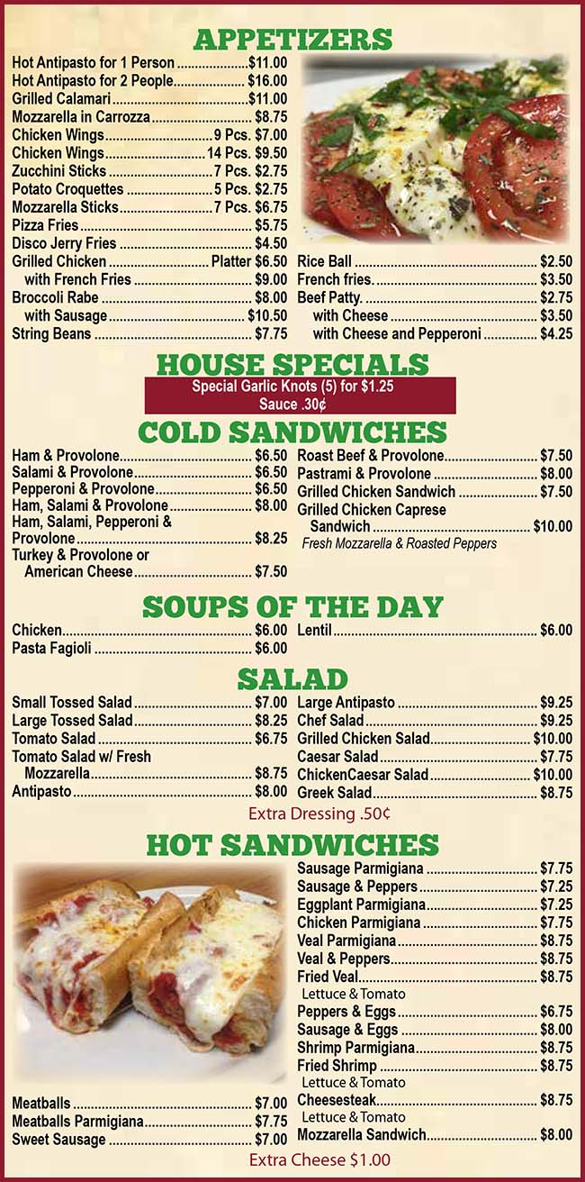
http://www.jerryspizza440.com/images/appetizers-menu.jpg
Transform this menu into a dictionary.
Ask the user for what he wants to eat (Appetizer, then sandwich)
Ask the user if he wants Extra Cheese
#Ask the user if he wants to order something else ( Appetizer or Sandwich)
Once the user finishes his/her order. Give him/her the receipt.

