Slide 1
PROJECT PRESENTATION-3
Crick Informer

Slide 2
Introduction
System Design:
Design constraints.
System model: Data Flow diagrams.
Data Model
User Interface

Slide 3
Design constraints
Performance Constraints: Handle high traffic and provide timely updates.
Compatibility Constraints: The system should be compatible with a wide range of devices and browsers to ensure accessibility for all users.
Scalability Constraints : Easily scale to accommodate increased user demand.
Reliability Constraints : Minimize downtime and ensure high availability.

Slide 4
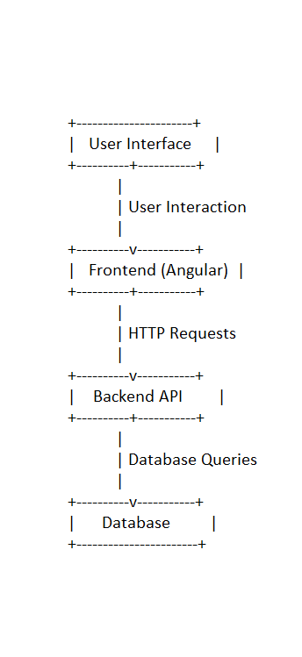
SYSTEM MODEL

Slide 5
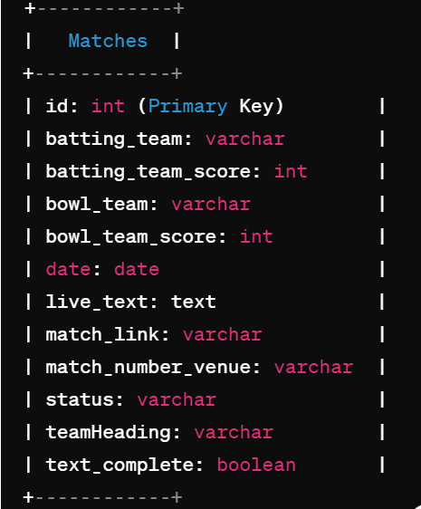
Data model

Slide 6
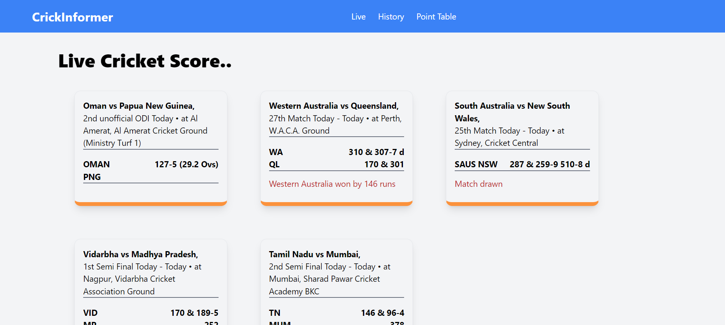
User interfaces

Slide 7
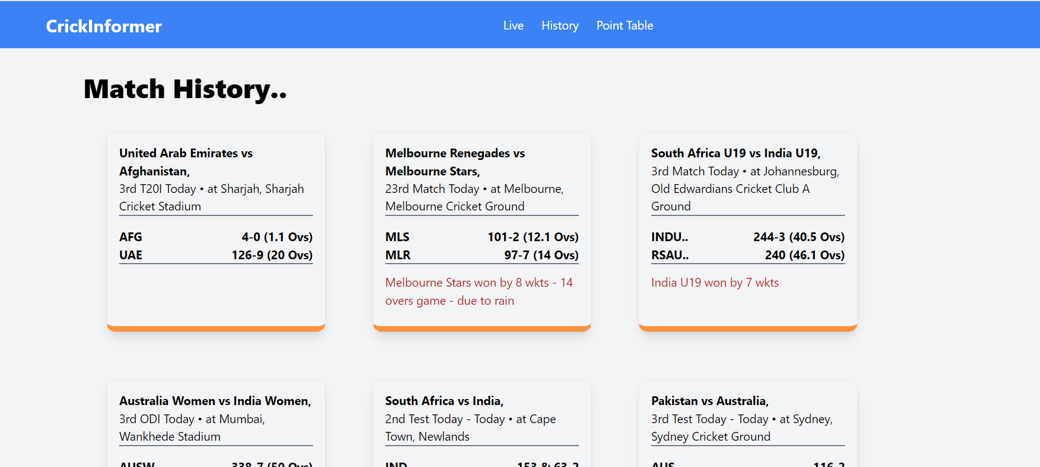

Slide 8
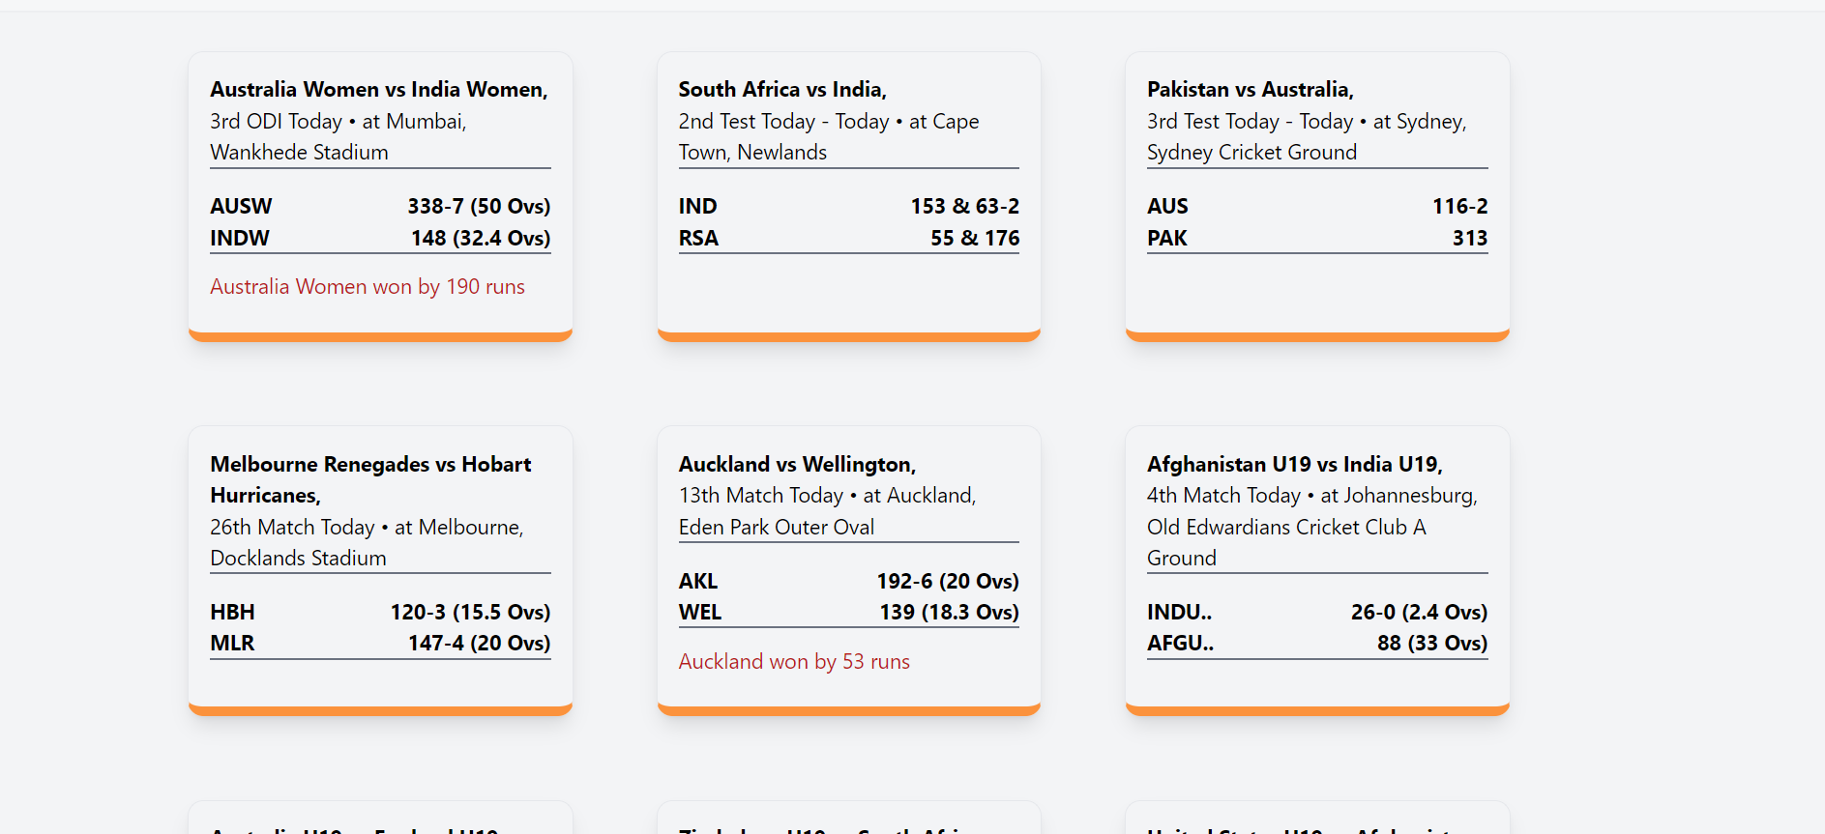

Slide 9
