Slide 1

Edge Computing an Introduction and Lab
EL3 - ECI09T884BH

Slide 2

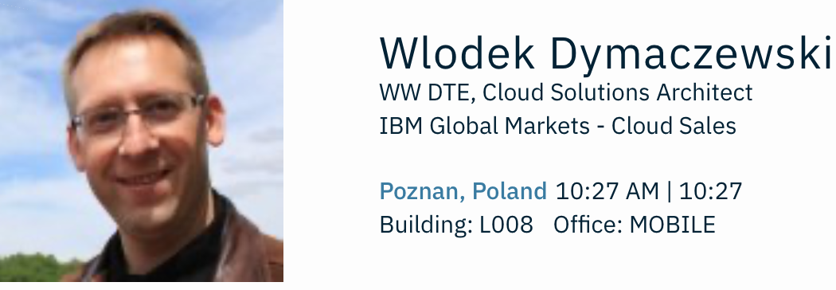
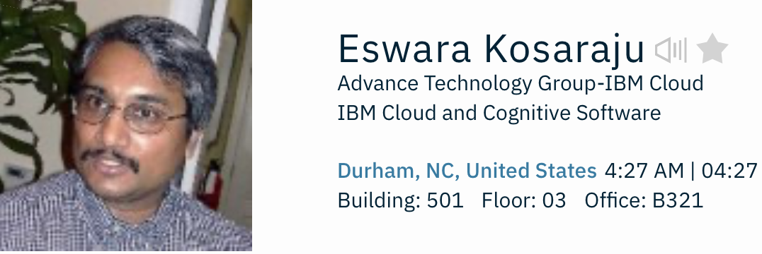

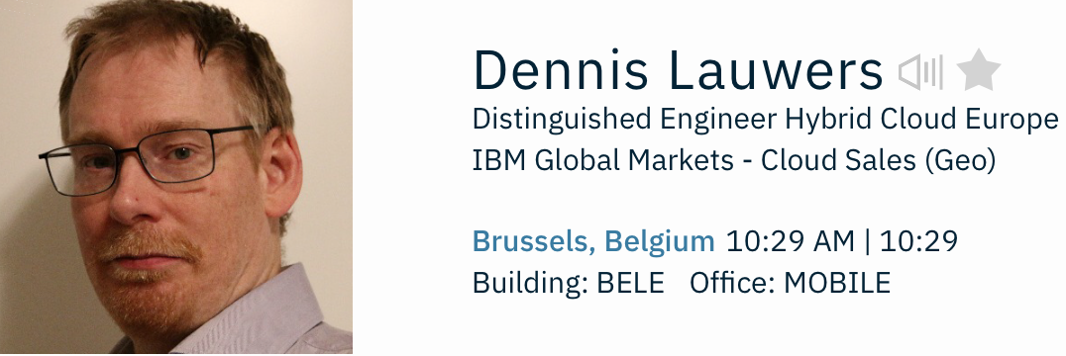
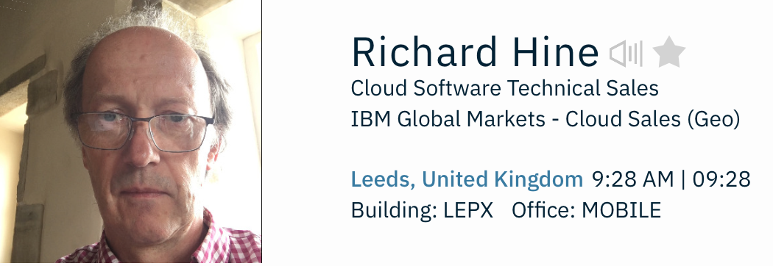
Meet the Team

Slide 3

Lab Guide
Start your SkyTap VMs NOW!
https://ibm.biz/BdqxNr
https://github.ibm.com/Richard-Hine/OnTheEdge

