Slide 1

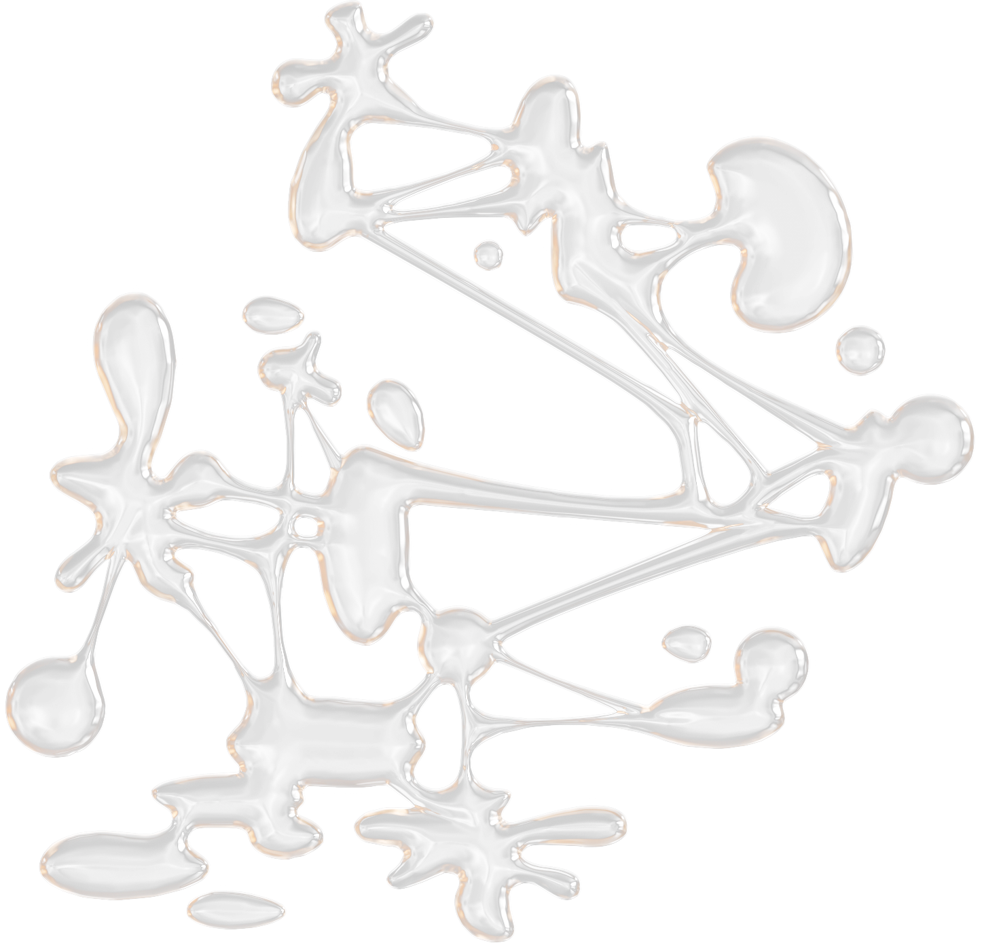



SWE 4304: SOFTWARE PROJECT LAB 1
TEAM 4
PROJECT PROPOSAL
FEATHER DB

Slide 2




MEMBERS
WASI OMAR SYED
230042143
MD SAIF-AL SARKER
230042106
M SAFWAN HASAN KHAN
230042117

Slide 3

MOTIVATION
HANDS-ON DB
WHO NEEDS SQLITE WHEN WE CAN PRETEND
TO BE IT?
NO MORE BLACK BOX
BECAUSE EVERYONE LOVES MAKING THEIR
OWN TINY DATABASE EMPIRE
MINI BUT MIGHTY
MAKING A DATABASE SO
SMALL IT FITS OUR BRAINS

Slide 4


CORE FEATURES
CUSTOMDATABASE ENGINE
LightweightSQL database built from scratch
SQL OPERATIONS
Supports CREATE, INSERT, SELECT, UPDATE, and DELETE commands
INTERACTIVE CONSOLE
Users interact with the database via a simple, text- based interface

Slide 5




APPLICATIONS
AaKkAa WHO WILL USE IT?
ANYONE DARING ENOUGH TO UNDERSTAND DATABASE INTERNALS, ONE CLI COMMAND AT A TIME.

Slide 6

input() 1
read() 1
TOOLS & TECHNOLOGY
write() 1
close() 1
PYTHON VS CODE GIT GITHUB
readline() 1

Slide 7

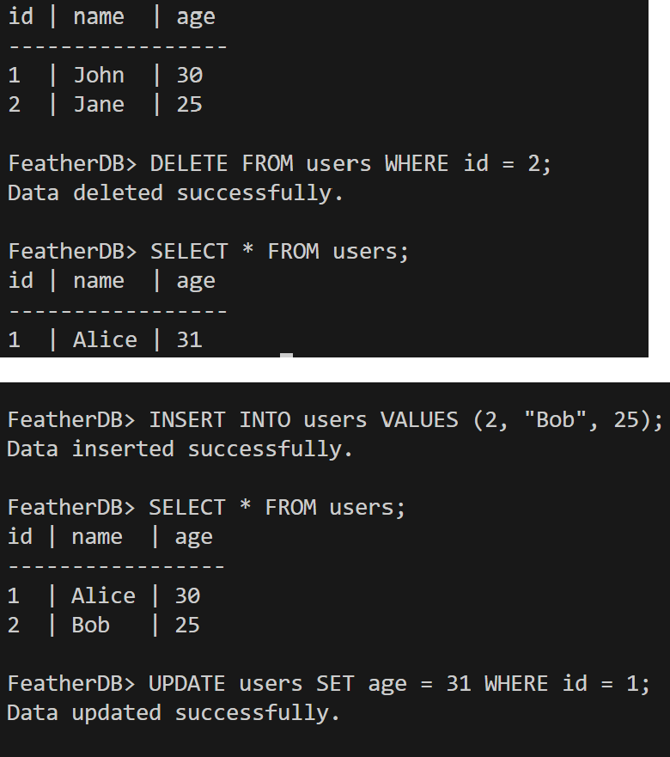
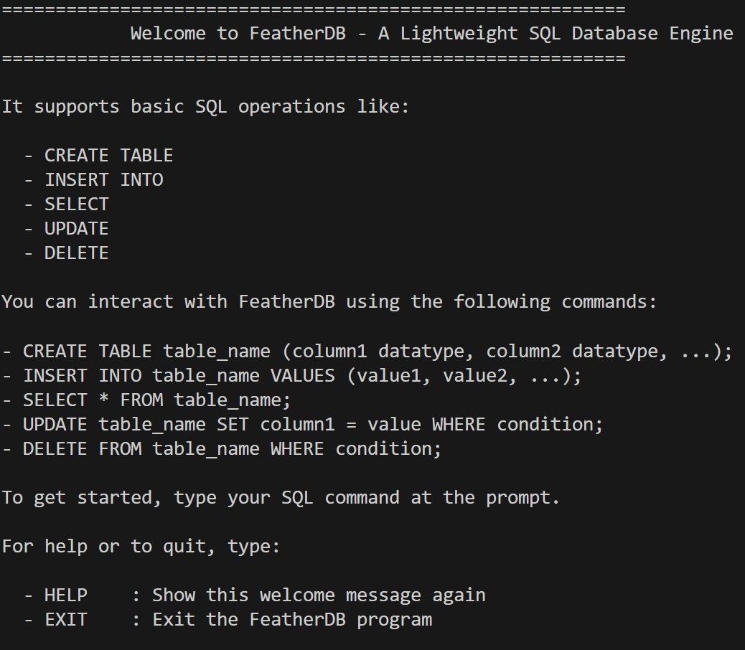
PROJECT DEMO

Slide 8
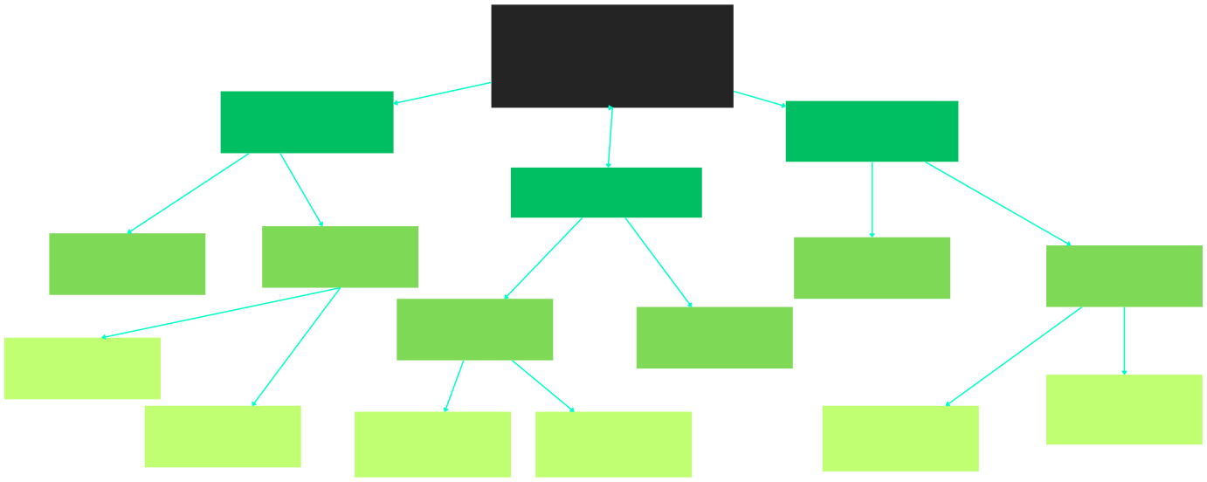
WORK DISTRIBUTION
Separate tasks, shared suffering
FEATHERDB
Wasi 143
Saif 106
Safwan 117
Query Execution
CLI Interface
SQL Parsing
Tokenize SQL
Storage Engine
File Engine
REPL
Handle Special Characters
Error Handling
Alter without Corruption
Store table, Schemas
Data types, Columns And Values

Slide 9

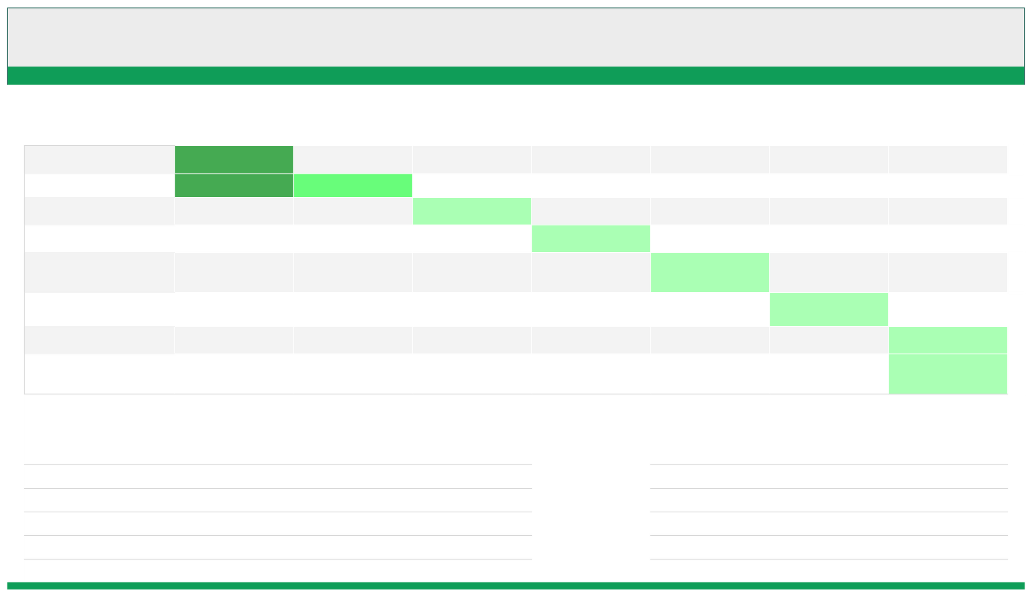

TIME LINE
Weeks
Tasks
Formation Proposal Project Setup Fundamentals Storage,Parsing
CLI Dev
Testing Documentation
1 - 2
3 - 4
5 - 6
7 - 8
9 - 10
11 - 12
13 - 14
curr*
Note
ToDo
Progress doesn't care if you're confident or
Don’t Procastrinate
clueless. Itonly cares if you're moving.
Plan? What plan?

Slide 10


THANK YOU!
ANY QUESTIONS?? PLEASE DONT
ANY QUESTIONS?
[please no]

