Slide 1

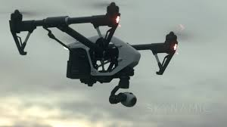
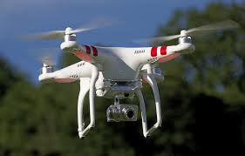
Drones in the Legal Environment
Gene Betler, CLVS CTTS
AMA, AUVSI, & Small UAV Coalition
member

Slide 2

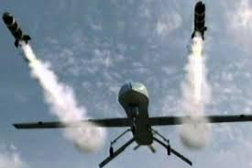
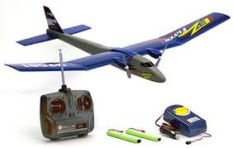
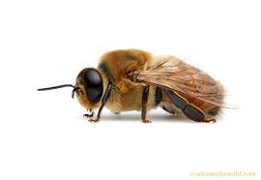
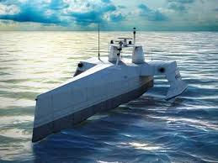
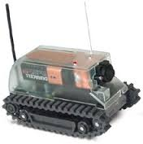
Drones
What are drones?

Slide 3
Drones
Controlled unmanned aircraft with a camera

Slide 4
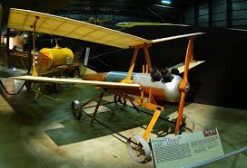
Drones
They are not new, so what’s all the fuss?
1917 Kettering-bug

Slide 5
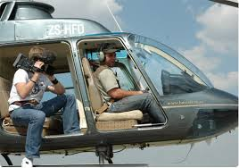
Aerial photography/videography is not new to the legal field, just expensive

Slide 6





Aerial photography in the legal environment until now has been limited to the BIG cases

Slide 7
Drones
But with the low cost of drones in comparison to manned aircraft
All of that can change!

Slide 8
Any case, no matter how small, that a aerial view of the subject would enhance the understanding of the jury will be an opportunity for you.
Can you think of any?

Slide 9
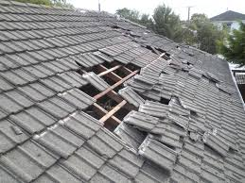

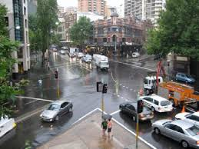

Even in the smallest of cases

Slide 10
HISTORY
1903 – Wright brothers flight
1926 – Air Commerce Act
1936 – AMA founded
1938 – CAA founded
1958 – CAA becomes the FAA
FAA Modernization and Reform Act of 2012

Slide 11
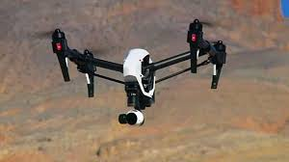
Can I legally fly drones?
Yes
No

Slide 12
FAA Modernization and Reform Act of 2012 Section 336
Model Aircraft Operations Limits
the aircraft is flown strictly for hobby or recreational use;
the aircraft is operated in accordance with a community-based set of safety guidelines and within the programming of a nationwide community-based organization;
the aircraft is limited to not more than 55 pounds unless otherwise certified through a design, construction, inspection, flight test, and operational safety program administered by a community-based organization;
the aircraft is operated in a manner that does not interfere with and gives way to any manned aircraft;
when flown within 5 miles of an airport, the operator of the aircraft provides the airport operator and the airport air traffic control tower…with prior notice of the operation; and
the aircraft is flown within visual line sight of the operator.

Slide 13
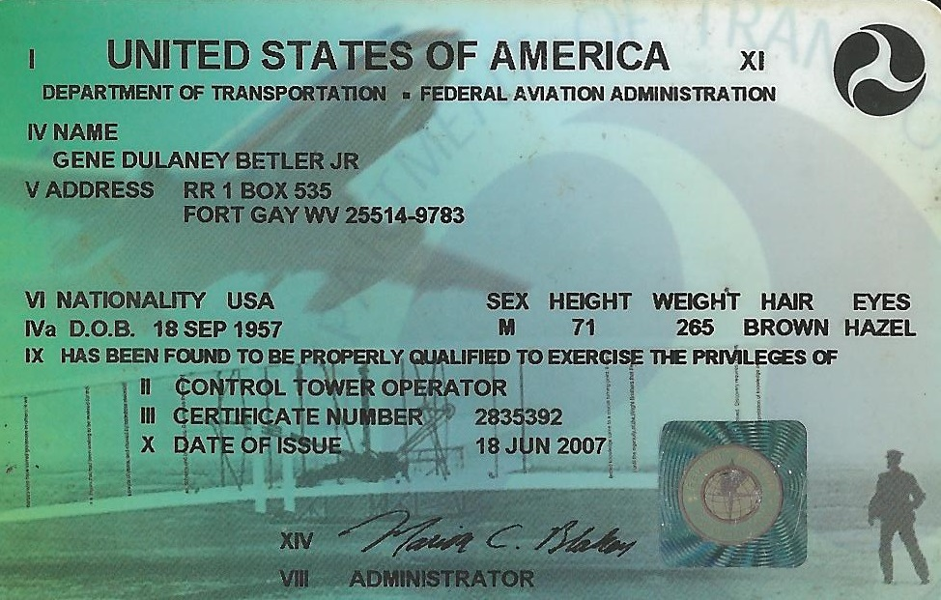
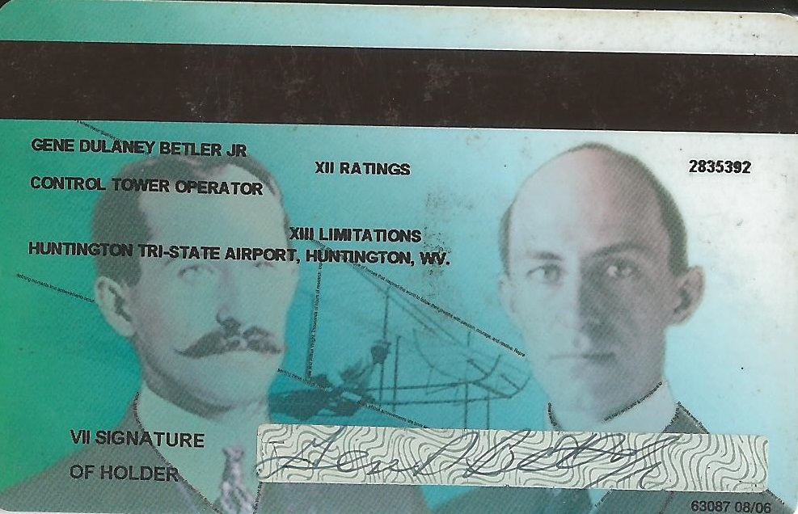
FAA Modernization and Reform Act of 2012 Section 333
Must apply for a Section 333 exemption
Approximately a 4 month process
Must be a FAA licensed pilot
Must have a current medical
(Very restrictive in their use)

Slide 14
Small UAS Notice of Proposed Rule Making – Part 107
The FAA proposal offers safety rules for small UAS (under 55 pounds) conducting non-recreational operations.
The proposed regulation was published on the Federal Register for public comment on February 23, 2015.
Send comments on or before April 24, 2015.

Slide 15
Major Provisions of Proposed FAR Part 107
Operational Limitations
Operator Certification and Responsibilities
Aircraft Requirements

Slide 16
Operational Limitations
Unmanned aircraft must weigh less than 55 lbs.
Small unmanned aircraft may not operate over any persons not directly involved in the operation.
Daylight-only operations (official sunrise to official sunset, local time).

Slide 17
Operational Limitations
Must yield right-of-way to other aircraft, manned or unmanned.
Visual line-of-sight (VLOS) only; unaided by any device other than corrective lenses.
First-person view (FPV) camera cannot satisfy “see-and-avoid” requirement but can be used as long as requirement is satisfied in other ways.
May use visual observer (VO) but not required.

Slide 18
Operational Limitations
Maximum airspeed of 100 mph (87 knots).
Maximum altitude of 500 feet above ground level.
Minimum weather visibility of 3 miles from control station.
Requires preflight inspection by the operator.

Slide 19
Operational Limitations
No person may act as an operator or VO for more than one unmanned aircraft operation at one time.
No careless or reckless operations.
A person may not operate a small unmanned aircraft if he or she knows or has reason to know of any physical or mental condition that would interfere with the safe operation of a small UAS.

Slide 20
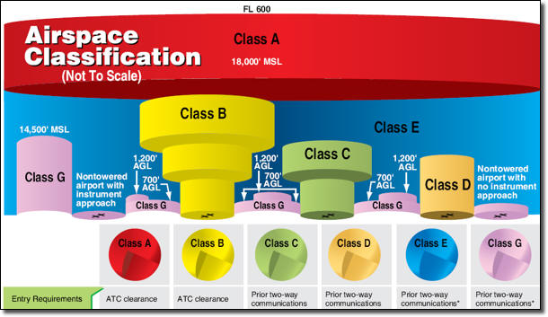
Operational Limitations
No operations are allowed in Class A airspace.
Operations in Class B, C, D and E airspace are allowed with the required ATC permission.
Operations in Class G airspace are allowed without ATC permission

Slide 21
Major Provisions of Proposed Part 107
Operational Limitations
Operator Certification and Responsibilities
Aircraft Requirements

Slide 22
Operator Certification and Responsibilities
Pilots of a small UAS would be considered “operators”.

Slide 23
Operators would be required to:
Be at least 17 years old.
Pass an initial aeronautical knowledge test.
Be vetted by the Transportation Security Administration.
Obtain an unmanned aircraft operator certificate with a small UAS rating (like existing pilot airman certificates, never expires).
Pass a recurrent aeronautical knowledge test every 24 months.

Slide 24
Operators would be required to:
Make available to the FAA, upon request, the small UAS for inspection or testing, and any associated documents/records required to be kept under the proposed rule.
Report an accident to the FAA within 10 days of any operation that results in injury or property damage.
Conduct a preflight inspection, to include specific aircraft and control station systems checks, to ensure the small UAS is safe for operation.

Slide 25
Major Provisions of Proposed Part 107
Operational Limitations
Operator Certification and Responsibilities
Aircraft Requirements

Slide 26
Aircraft Requirements
FAA airworthiness certification not required. However, operator must maintain a small UAS in condition for safe operation and prior to flight must inspect the UAS to ensure that it is in a condition for safe operation.
Aircraft Registration required (same requirements that apply to all other aircraft).

Slide 27
Aircraft Requirements
Aircraft markings required (same requirements that apply to all other aircraft).
If aircraft is too small to display markings in standard size, then the aircraft simply needs to display markings in the largest practicable manner.

Slide 28
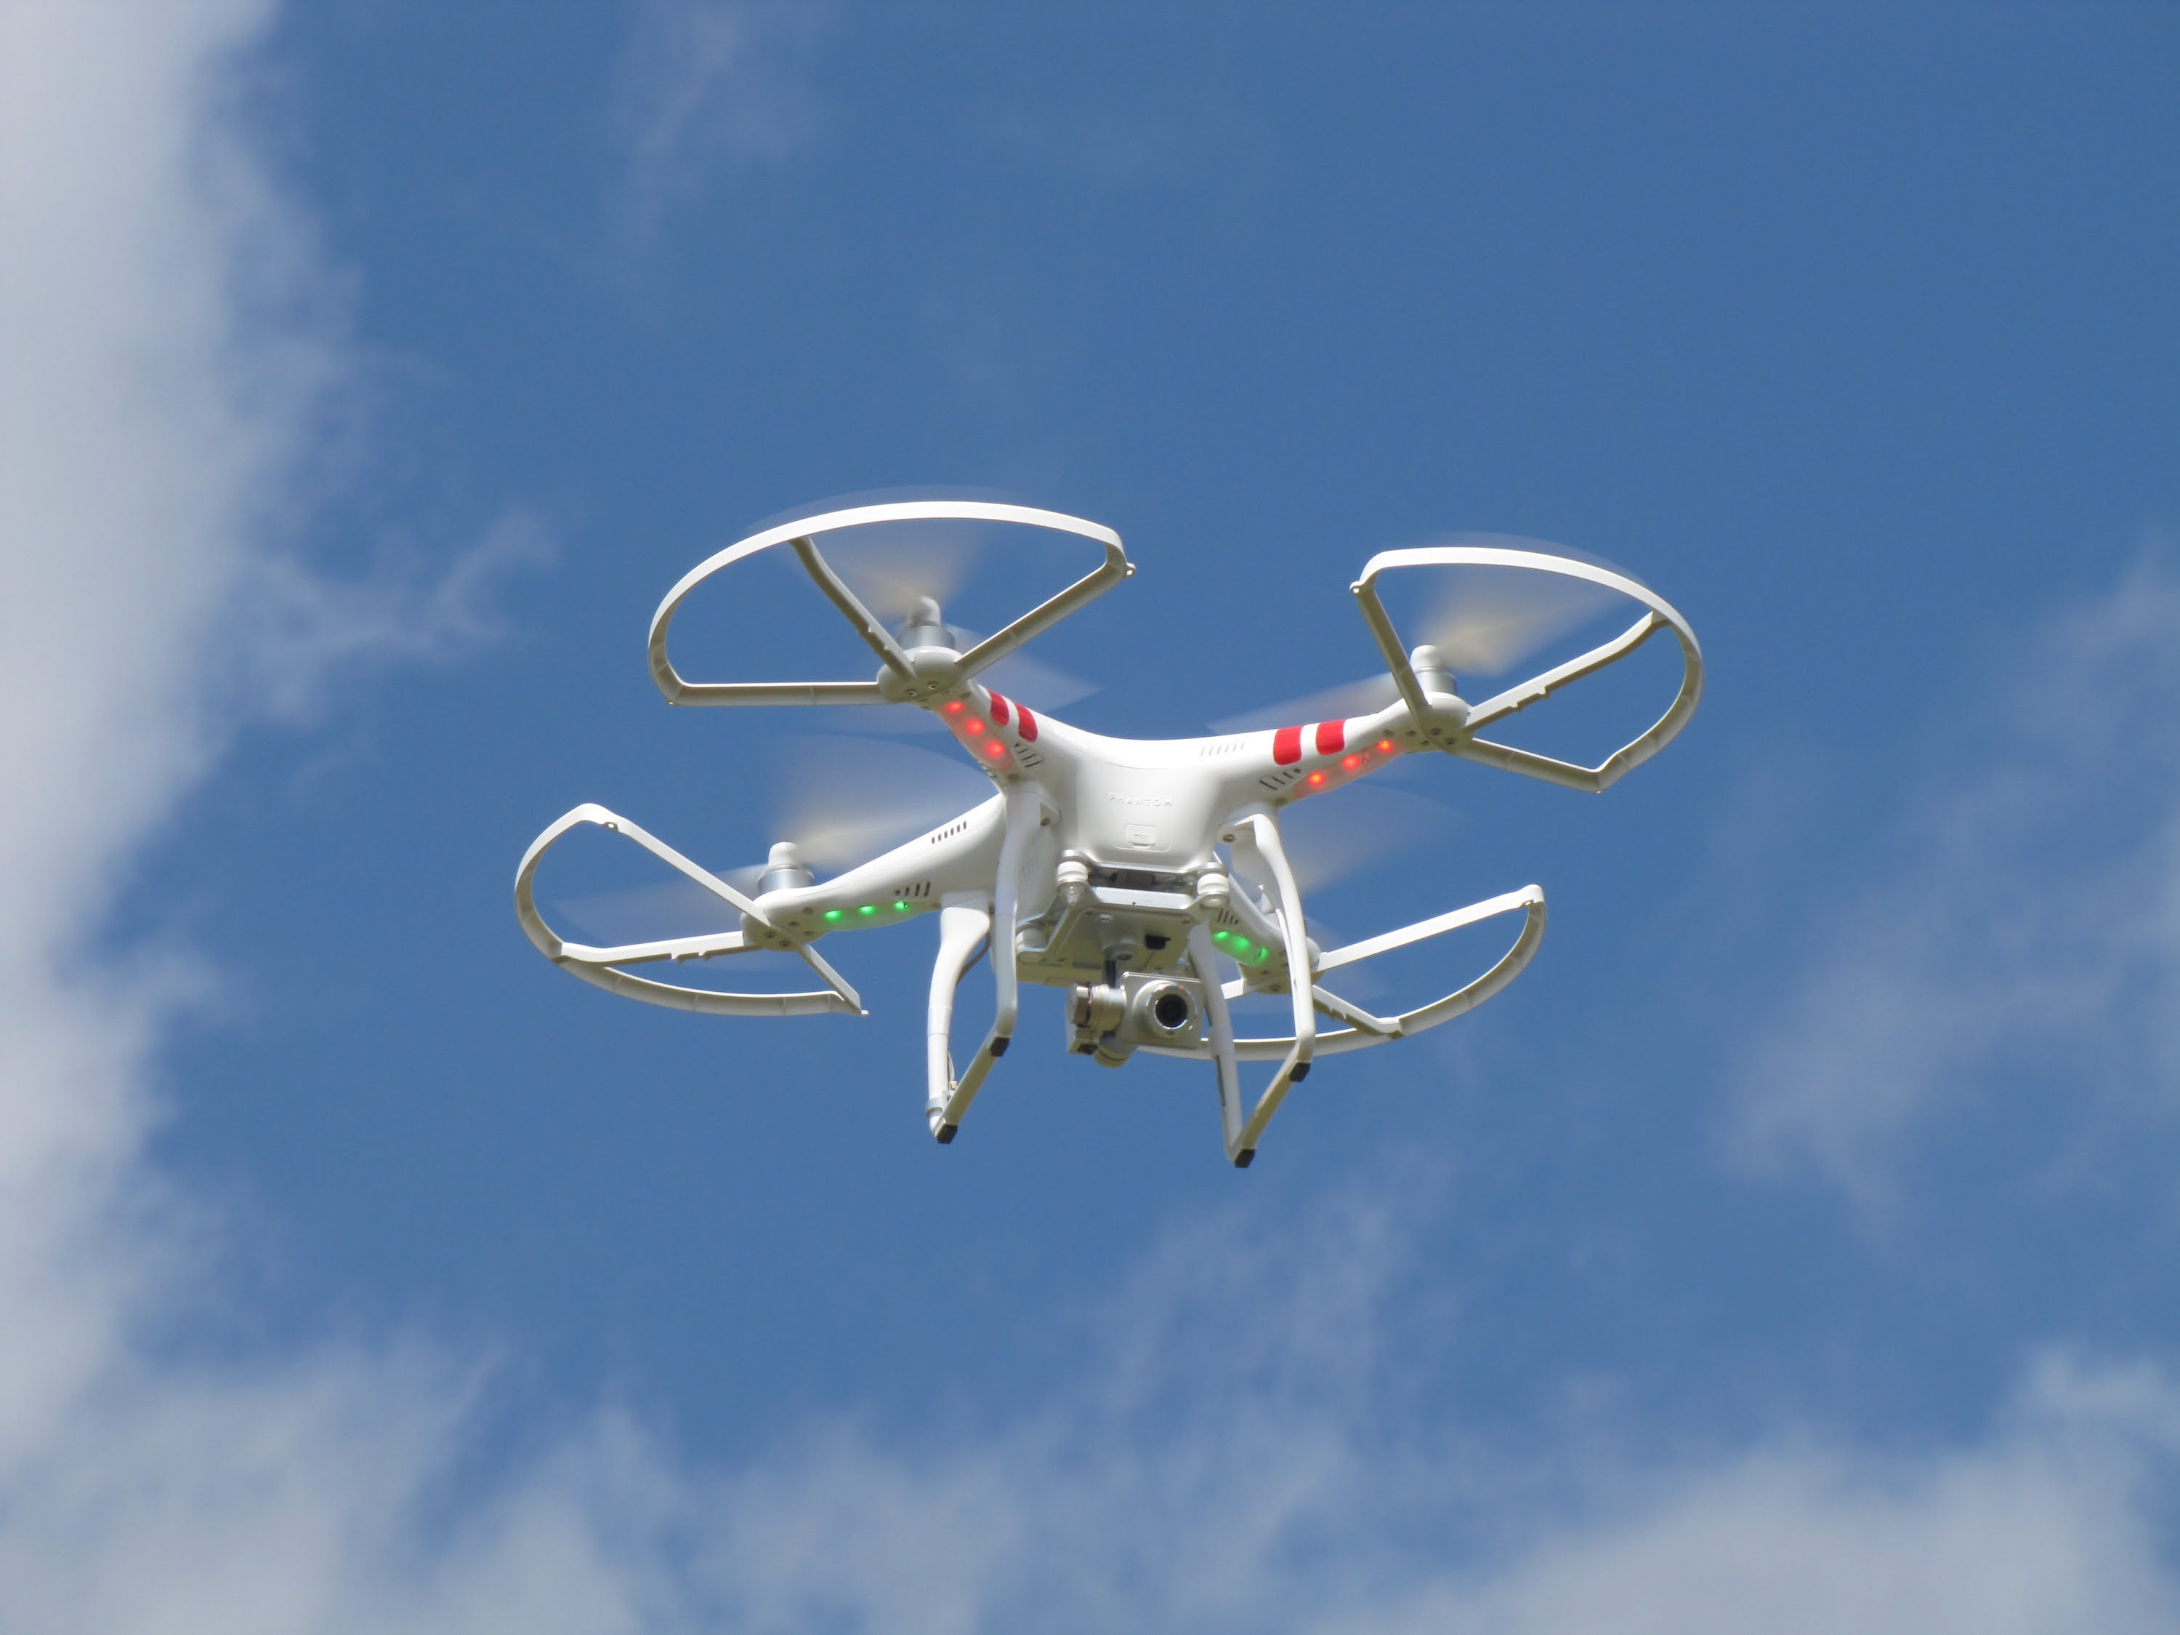
microUAS (Under 4.4 pounds)
Proposes a microUAS option that would allow operations in Class G airspace, over people not involved in the operation, provided the operator certifies he or she has the requisite aeronautical knowledge to perform the operation.

Slide 29
State Laws about drones
http://www.drone-laws.com/map/
Video

Slide 30
Reference
Knowbeforeyoufly.org
Academy of Model Aeronautics (AMA)
http://www.modelaircraft.org/
Association for Unmanned Vehicle Systems International
http://www.auvsi.org/
Small UAV Coalition
http://www.smalluavcoalition.org/
FAA NPRM Part 107
http://www.gpo.gov/fdsys/pkg/FR-2015-02-23/pdf/2015-03544.pdf

Slide 31
Drones in the Legal Environment
Gene Betler, CLVS

