Slide 1
Environmental Pollution: A Global Challenge
Presented By: Saif Abdullah Supto
3rd Year 2nd Semester
Department of Geography and Environment
Shahjalal University of Science and Technology, Sylhet.

Slide 2
OVERVIEW
Definition of Environmental Pollution.
Types of Environmental Pollution.
Air Pollution
Water Pollution
Effects of Environmental Pollution
Solutions of Environmental Pollution

Slide 3
What is Environmental Pollution?
Environmental Pollution refers to the introduction of harmful substances or contaminants into the natural environment, causing adverse effects on ecosystems, human health, and the planet's overall balance. These contaminants can originate from natural processes or human activities and disrupt the quality of air, water, soil, and other environmental components.

Slide 4
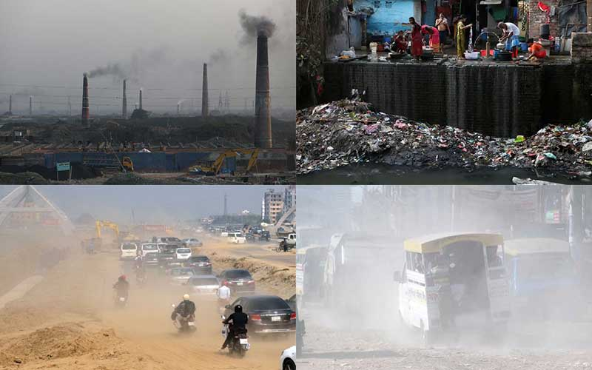
Types of Environmental Pollution.
Air Pollution
Water Pollution
Noise Pollution
Land Pollution

Slide 5
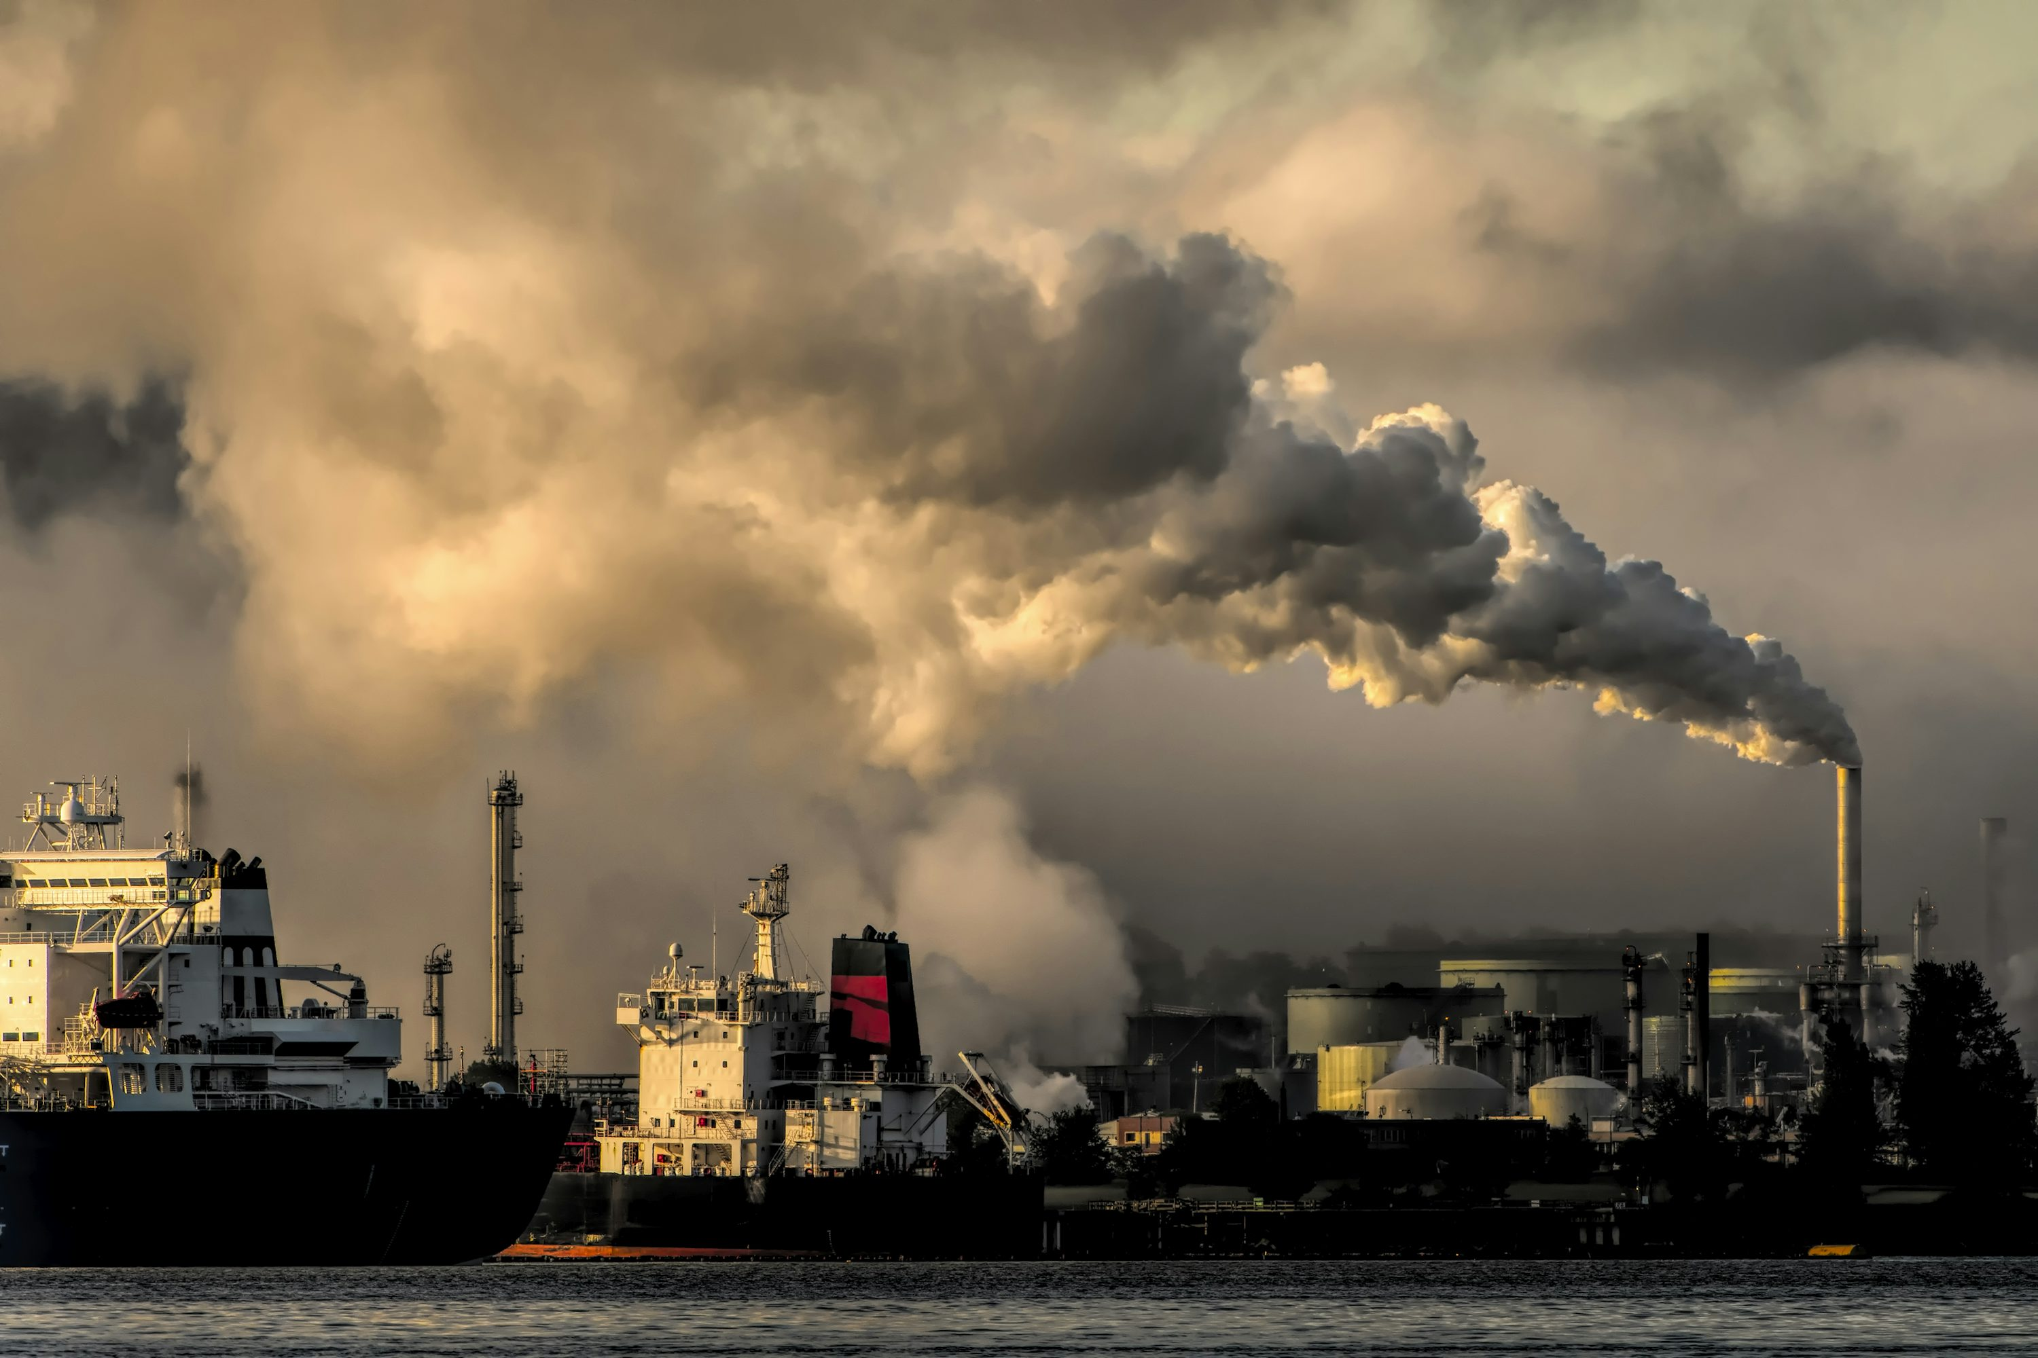
Air Pollution
Burning of Fossil Fuels: Emissions from vehicles, power plants, and factories release harmful gases like carbon monoxide, sulfur dioxide, and nitrogen oxides into the atmosphere. Industrial Activities: Factories emit particulate matter, volatile organic compounds (VOCs), and other pollutants during manufacturing processes. Deforestation and Agricultural Practices: Cutting down trees and using fertilizers release carbon dioxide, methane, and ammonia, contributing to air pollution.

Slide 6
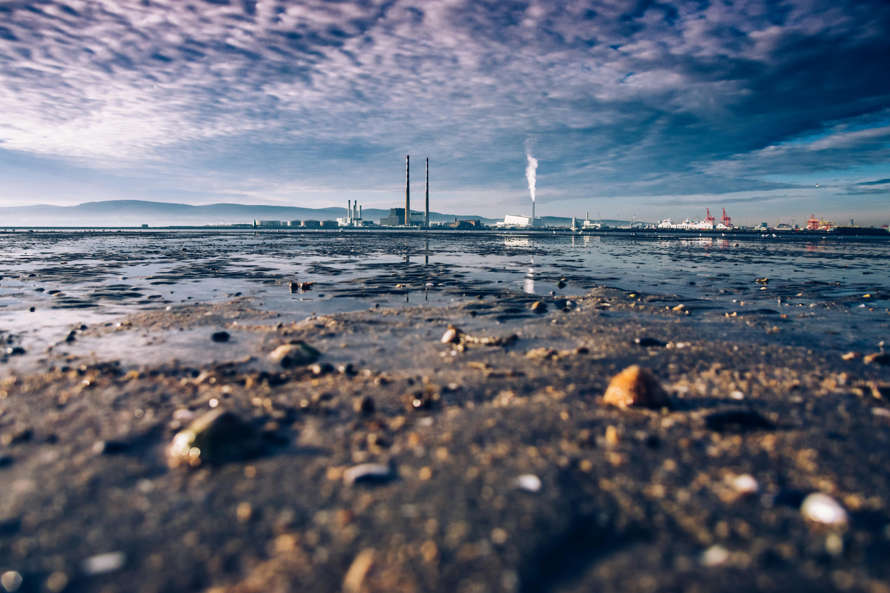
Water Pollution
Industrial Waste: Factories discharge chemicals, heavy metals, and toxins directly into rivers and oceans, contaminating water sources. Agricultural Runoff: Excess fertilizers, pesticides, and animal waste wash into water bodies during rain, leading to nutrient pollution and algal blooms. Improper Waste Disposal: Dumping of untreated sewage, plastics, and other waste into water bodies pollutes drinking water and harms aquatic ecosystems.

Slide 7
Effects of Environmental Pollution
Health Issues: Air and water pollution cause respiratory problems, cardiovascular diseases, and waterborne illnesses.
Global Warming: Greenhouse gas emissions trap heat, leading to rising global temperatures and climate change.
Biodiversity Loss: Pollution destroys habitats, endangers species, and disrupts ecosystems.
Soil Degradation: Chemical pollutants reduce soil fertility, affecting agriculture and food security.
Water Scarcity: Contamination of water bodies limits access to clean and safe drinking water.
Economic Impact: Increased healthcare costs and reduced productivity due to pollution-related health issues.

Slide 8
Solutions of Environmental Pollution
Switch to Renewable Energy: Promote solar, wind, and hydroelectric power to reduce reliance on fossil fuels.
Sustainable Waste Management: Encourage recycling, composting, and proper disposal of hazardous materials.
Green Transportation: Use public transit, carpooling, electric vehicles, and biking to lower emissions.
Reforestation: Plant trees and protect forests to absorb carbon dioxide and improve air quality.
Water Conservation: Treat wastewater and reduce pollutants entering water sources.
Strict Regulations: Implement and enforce policies to control industrial emissions and ban single-use plastics.

Slide 9


