Slide 1
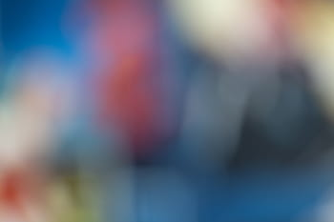
Image Processing
Cartooning Of An Image
Group No.- 6
Group Members:
Apurva Rathore (M190376CA) 5. Saif Ali Khan (M190379CA)
Nidhi Redekar (M190366CA) 6. Kundan Singh Bhadoriya(M190661CA)
Naziya Khanam (M190393CA) 7. Saurabh Shahi (M190378CA)
Shivangi Kesharwani (M190402CA) 8. Anjali Sharma (M190374CA)

Slide 2

Introduction
Cartoons are often used in a variety of contexts. In this project our team had worked on the idea of digital cartooning of an image. As we know cartoons are artistically made it requires elegant and fine human artistic skills.While portraying there are a lot of cartoons for any animated film, the artist must spend time properly defining the cartoon sketch in order to achieve a successful result in less time, one needs a cartooning tool. As cartooning a digital image appears to be a fascinating and enjoyable project to work on. We just need a bilateral filter and an edge detection mechanism to create cartoon images from a digital image. These bilateral filters will help us reduce the image's colour or shading palette, which is a crucial move for the cartoon look, and edge detection will be used to achieve the perfect result.

Slide 3
Objectives
This project's main goal is to transform photos or snapshots into cartoons. As a result, it would be beneficial in today's cartooning situation.
As we all know, anime movies and cartoons are popular in magazines for social entertainment and visual irony, as well as for political commentary and editorial opinion.
This is a quick rundown of cartoons, comic strips, and short films such as anime animation.
The majority of books with cartoons are magazine-format "comic books," or editions of newspaper cartoons.
We will teach our children about our world, today's condition, and what we are facing in every area with the aid of this project. They will be able to comprehend the current situation more readily as they are more familiar with cartoons and animes than with posts.
Political cartoons are drawings (usually of a cartoon character) that are used to convey editorial commentary on government, politicians, and current events. Such cartoons have a place in a culture that values press freedom, which is also important in politics.

Slide 4
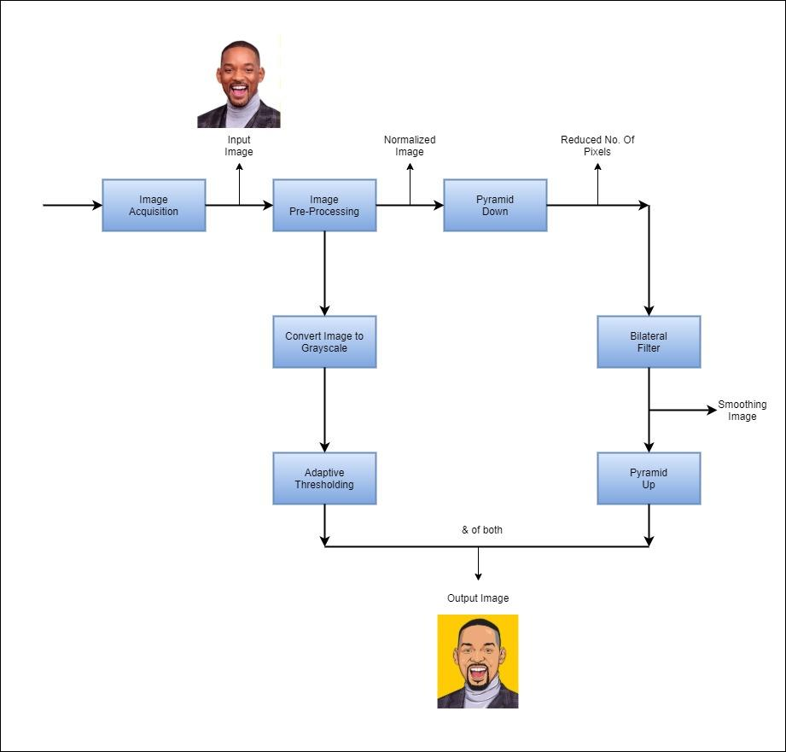
Block Diagram

Slide 5
Explanation:
To get the cartoonized image generally there are two main operations that we have to apply to get the output. One is to reduce the colour palette and the other is to identify the edges. Basically reducing the colour palette is done by the Bilateral filter, it refers to reducing the noise from the image and making the image smooth. To Identify edges we have to apply Adaptive thresholding. It's a process of converting an image into one particular pixel either white or black given a particular threshold. Combination of both the operations result in the image into cartoon effect.
Data collection:
In our project 'Cartooning of an image', we are converting a person's image to its cartoon aspect. We have taken the image dataset from https://www.kaggle.com/prasunroy/natural-images. This dataset originally includes 6899 images from which we have taken approx 400 images with size 16kb to 20kb and a dimension of 256 x 256 (width = 256 pixels and height = 256 pixels). The resolution of these images is 96 dpi and the bit depth is 24.

Slide 6
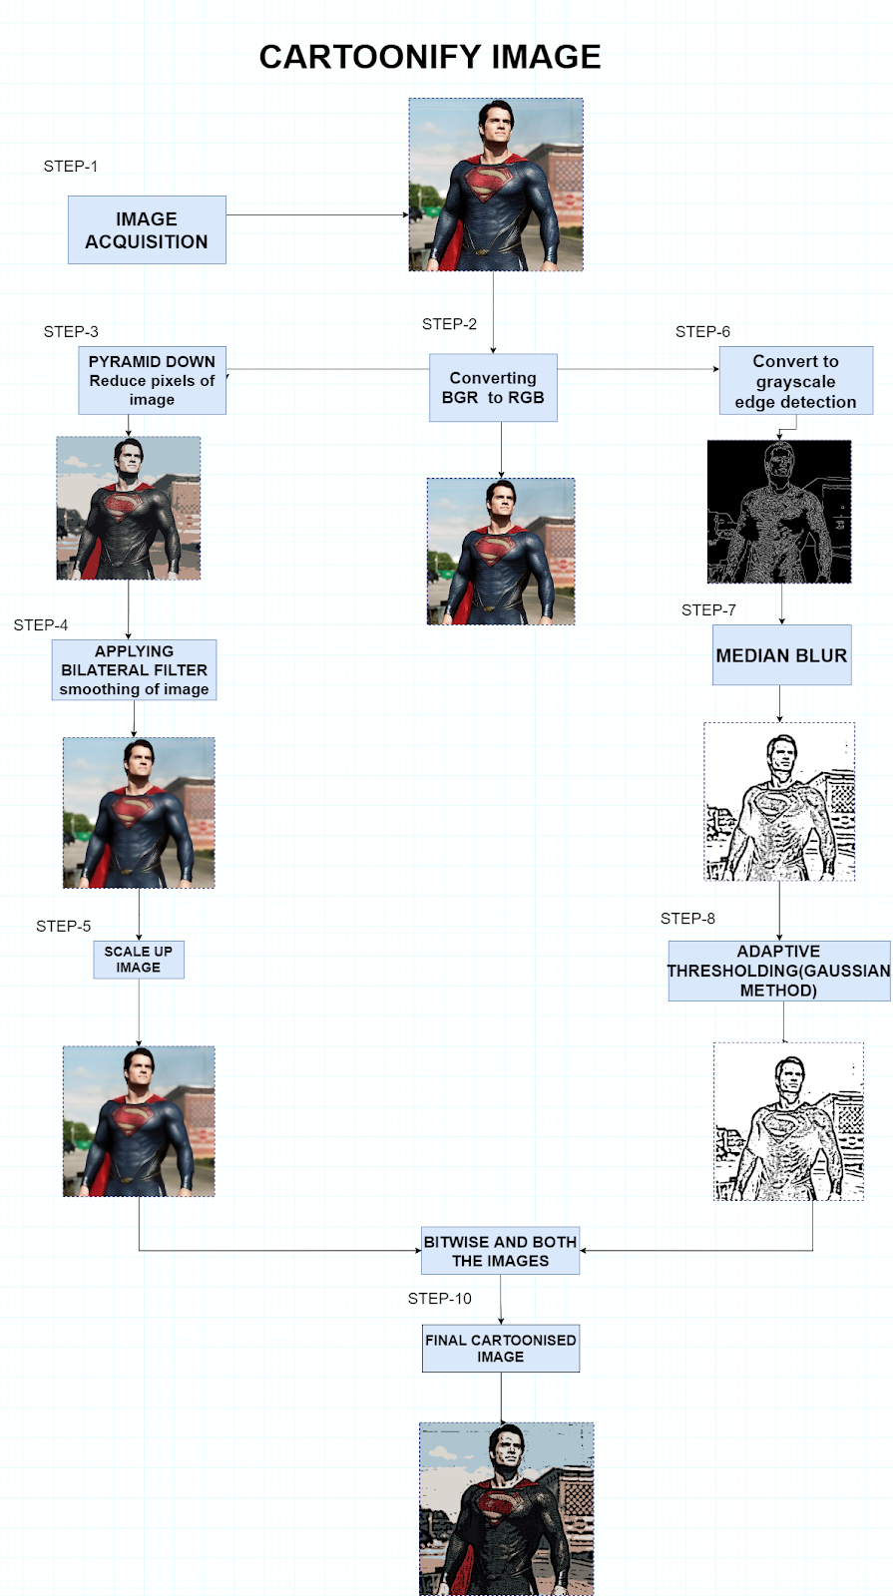
Methodology & Classification

Slide 7
Explanation:
Image Acquisition is the process of retrieving the image from the source. Images can be of any format which means in jpeg, jpg, or png format. OpenCV image reader function (imread()) reads the image as a NumPy array ndarray of row (height) x column (width) x color (3) and here the order of color is in BGR format, so image should be converted in the RGB format. After getting the image in a correct format,two operations are performed on this Image.
1. Image restoration is the operation on corrupt images such as noisy, camera mis-focus, blur images etc. and estimates the clean and original image.For Image Smoothing we have used the Bilateral filter which actually removes the high frequency content(noise,edges) and reduces the color palatte.
2. Detect the Edges Adaptive thresholding is used, and before applying this Median
blur is performed so that it will help in later processing.Adaptive thresholding takes a
grayscale or color image as input so RGB image has to be converted into Grayscale.For each pixel in the image threshold is calculated. OpenCV provides adaptiveThreshold(), it uses two methods, one is to find out the mean of neighboring pixels and other is to find out the total weight of neighboring pixels,where weight is the Gaussian window. At last we can combine the results of the first and second operation and we get the cartoon effect.

Slide 8
Working Procedure
By using OpenCV in Python we are going to process our images and first, we will import all the essential libraries. Then we can read the images and store them into an array by providing the path of the dataset in our system. We will also print the images to verify that the images are correctly stored in a variable.
Now, as the image dataset is imported into the program, we can perform various operations for cartoonizing those images by reducing the color palette and edge identification through Bilateral Filter and Adaptive Thresholding and get the necessary output.

Slide 9
Classification : IP Algorithms
Median Blur
Adaptive Thresholding

Slide 10
Median Blur
This is used to remove noise from the image, if in case the image contains any noise so it will restore that,so that in later processing a quality of image can be used.
In this, a median of each patch is found and replaces it with its mid Value. For example
234 | 67 | 245 | 234
123 | 45 | 23 | 245
34 | 0 | 234 | 24
255 | 235 | 145 | 253
In this image take a patch of 3*3 and find the median of it.
Values = 234, 67, 245, 123, 45 , 23, 34, 0, 234
Sort this value to find the median.
Values = 0, 23, 34, 45, 67, 123, 234, 234, 245
Median = 67
Do this for the entire image.

Slide 11
Adaptive Thresholding
It is a method in which a threshold is calculated and operation will be performed according to that. It is basically of 3 types:
1. Global Thresholding : In this a Threshold is fixed for entire image and
operation will be performed according to that, for example :
Threshold = 150, so all the values Greater than 150 assigned 255 or all the
values less than 150 assigned 0.
2. Mean Threshold : in this a threshold is calculated for each pixel, by taking
mean of its neighbouring pixels.for example :

Slide 12
This is an image, take a patch of 3*3 and find the mean of it and that is the threshold value and do this for each patch.
For 1st patch = ( 234 + 67 + 245 + 123 + 45 + 23 + 34 + 234 + 0)/9
Threshold value = 111.667
3. Gaussian threshold : The threshold value is a gaussian-weighted sum of the
neighbourhood values minus the constant C.
234 | 67 | 245 | 234
123 | 45 | 23 | 245
34 | 0 | 234 | 24
255 | 235 | 145 | 253

Slide 13
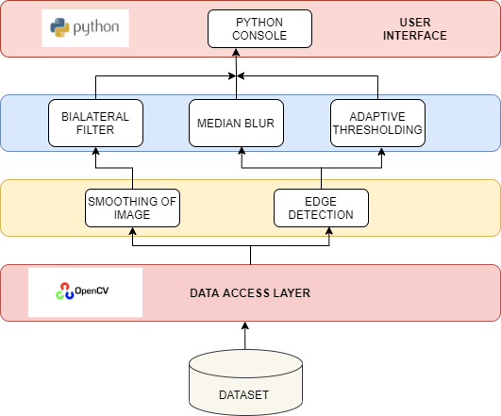
Design and Implementation

Slide 14
Implementation
In this project the implementation part is done with the help of the design that has shown everything clearly that we have used in the implementation part while coding. We have imported the entire dataset of the images and read the images using open cv2 which read the images in BGR format.
Basically Two steps is followed :
-> Edge detection
-> Image Restoration and Smoothing of the images
Before Edge Detection, We can perform Median Blur, it will basically reduce noise, As it is optional but noise can create false edges so its better to remove it. To detect edges, convert the RGB images to GrayScale, As in the grayscale each pixel is of the same intensity and in RGB each pixel in an image is a combination of three intensities, so processing of a single channel is faster than processing a three channel image.
To detect image, we are using adaptive thresholding, opencv provide a method
adaptiveThreshold(), that we are using.
As the detection will take place in an image with the help of the adaptive threshold simultaneously For Image Smoothing we have used the Bilateral filter which will actually remove the high frequency content and reduce the color palette.
Then after combining all the algorithms Adaptive Threshold, Median Blur and Bilateral Filter we will get an our required output in the python console i.e. Cartooning of an image that we have shown in the result part below.

Slide 15
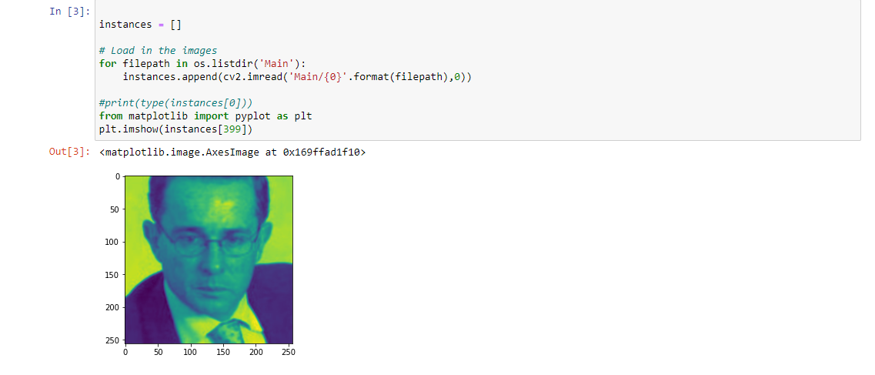
Imported the entire dataset and read the images with cv2.imread(), it will read all images in BGR format. That we can see in the below image, it is bluish in color.

Slide 16
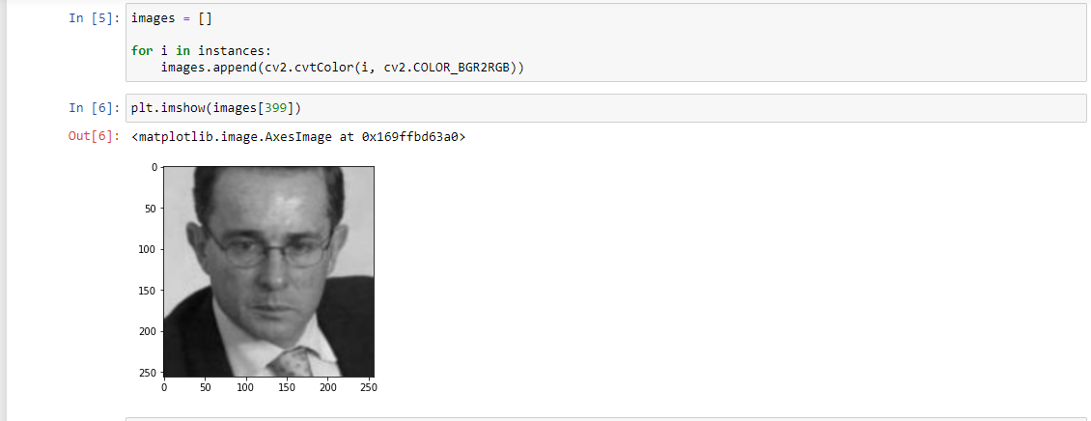
We have to convert all the images to RGB format for later processing to remove that bluish effect and in the image below we can see the difference between RGB image and BGR image.

Slide 17
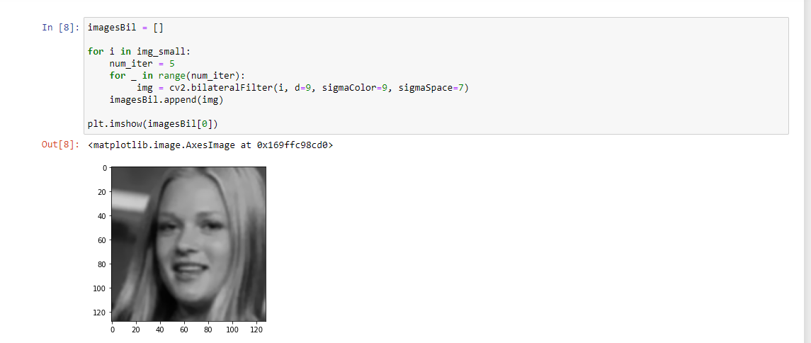
As we need to restore the images, if there is any noise, so by applying Bilateral Filter we can remove that noise and can make the image more smooth.
In the below image we can see the image is better than before.

Slide 18
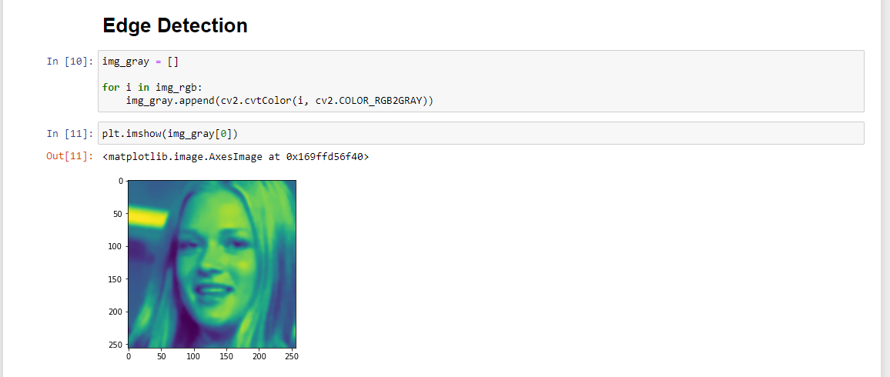
Here, we are converting a RGB image to GrayScale image, As processing of grayscale images is faster than RGB images. In the image below, we can see how the grayscale image is different from RGB.

Slide 19

Here, we can see the result of Median blur, it will reduce noise from the image,As it is optional but it is a good practice to use it because a noise in an image can give false results also.

Slide 20
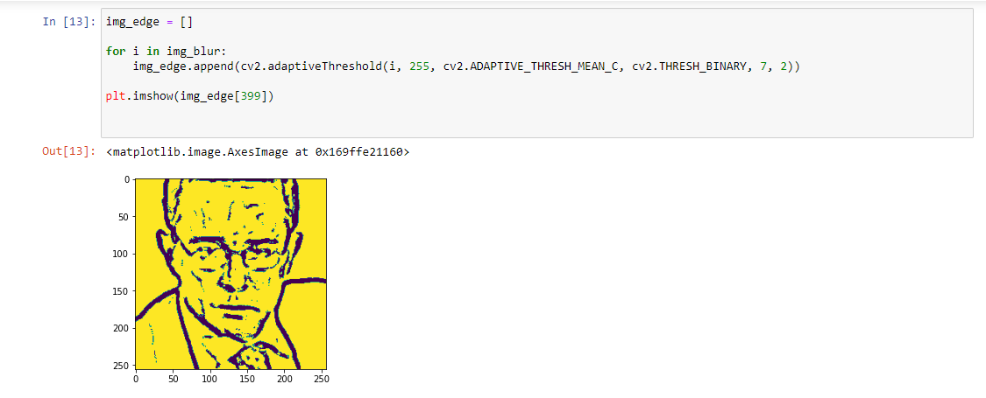
Here, we are applying Adaptive thresholding and we can see the results, it detected the edges.

Slide 21
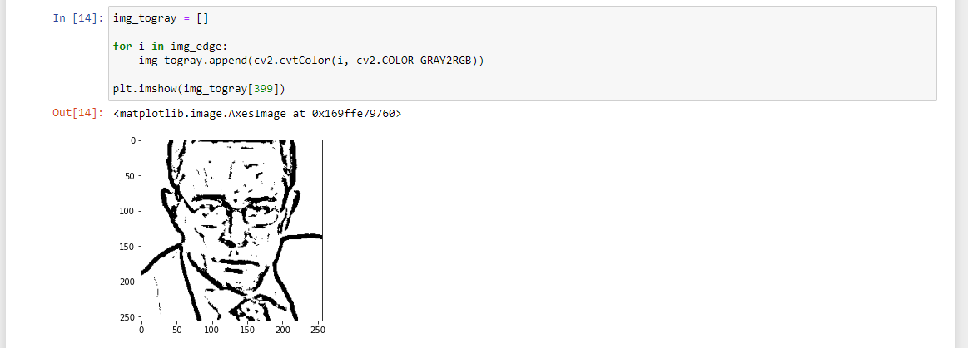
As our processing is completed we can now convert again the grayscale image to RGB.

Slide 22
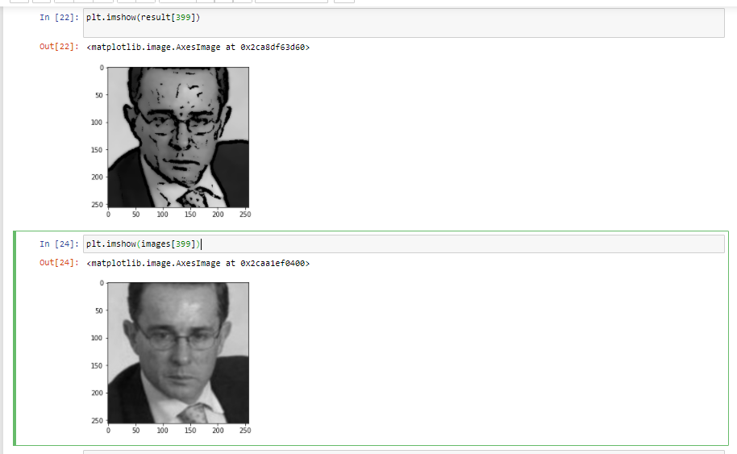
Results:
Here is the resulting effect that we have got. We can see the difference between original image and resulting image.That we have got after applying bitwise operator to both the images, Bilateral filter and edge detection.

Slide 23
THANK YOU!!!

