Slide 1

Weather Data Analysis & Forecasting
Technical Assessment | Data Scientist
April 26, 2026
By Saifeddine Rejeb

Slide 2

Mission
By making industry-leading tools and education available to individuals from all backgrounds, we level the playing field for future PM leaders. This is the PM Accelerator motto, as we grant aspiring and experienced PMs what they need most – Access. We introduce you to industry leaders, surround you with the right PM ecosystem, and discover the new world of AI product management skills

Slide 3
Introduction
Goal: Analyze the 'Global Weather Repository.csv' dataset to forecast future weather trends.
Dataset contains 137,803 records with 41 columns related to global weather conditions.
Focus: Tunis, Tunisia; Mediterranean climate, single-location model for temporal continuity

Slide 4
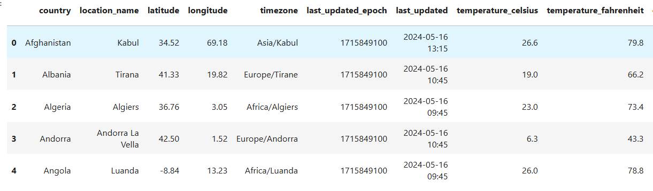
Data Exploration
• Dataset contains country, location, latitude, longitude, timezone, temperature, wind, air quality, and celestial data.
• Data inspection showed no missing values and no duplicates.
• Key variables include temperature, wind speed, air quality indices, and moon illumination.

Slide 5
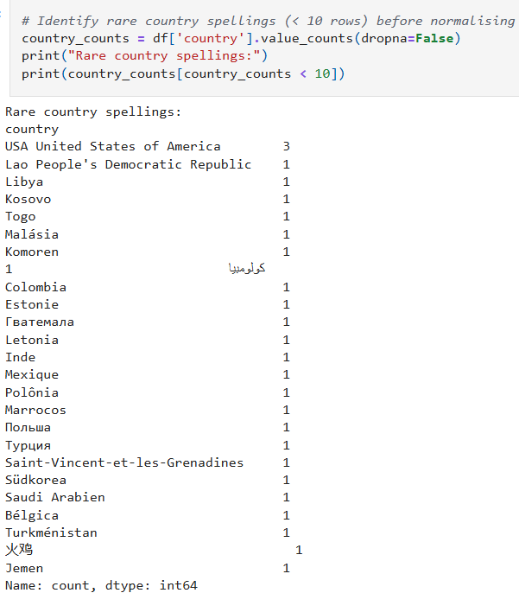
Data Cleaning & Preparation
• Converted timestamp to datetime format.
• Dropped redundant column last updated epoch
• Normalised country names written in non-English scripts (Arabic, Russian, Portuguese, German, French) to their English equivalents

Slide 6
Outlier Detection
Used IQR (1.5 * IQR) and Z-score (±3 std) methods.
Feature | IQR Outliers | Z-score | Note
visibility km/miles | ~21% | 3.0% | Genuine weather variability
precip mm/in | ~18% | 1.4% | Right-skewed, median is 0
Air quality CO, SO₂ | ~9% | ~1% | -9999 = sensor failure
gust mph/kph | ~2.7% | 0.4% | ~1800+ mph physically impossible
humidity, cloud, latitude | 0% | 0% | Bounded variables

Slide 7
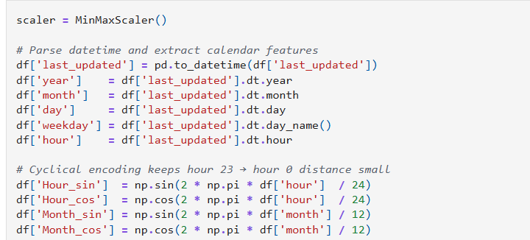
Feature Engineering
Parsed timestamp into year, month, day, weekday, hour
Cyclical sin/cos encoding for hour and month
Sunrise/sunset/moonrise/moonset converted to hour-of-day integers
All features MinMax-scaled to [0, 1]

Slide 8
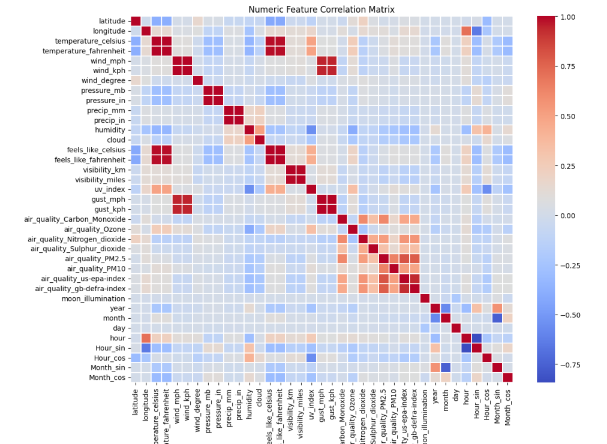
Correlation Analysis
• Unit-duplicate pairs are perfectly collinear
•Air quality features cluster together internally
•Meteorological and air quality signals largely independent

Slide 9
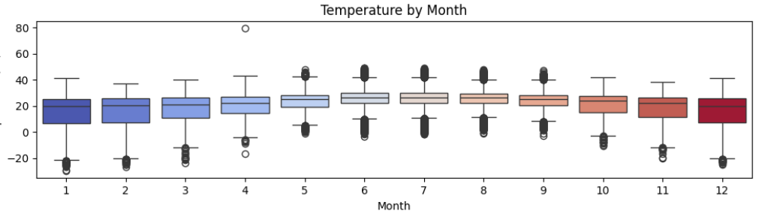
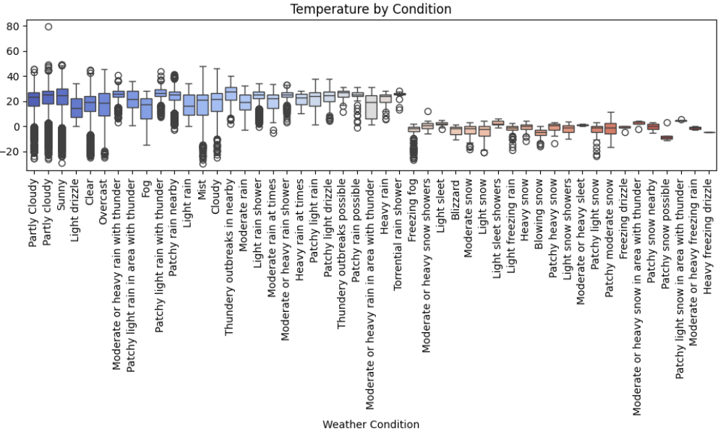
Plots

Slide 10
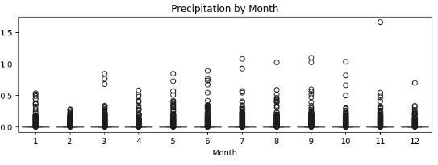
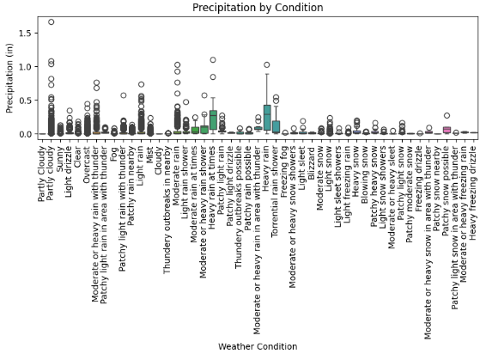

Slide 11
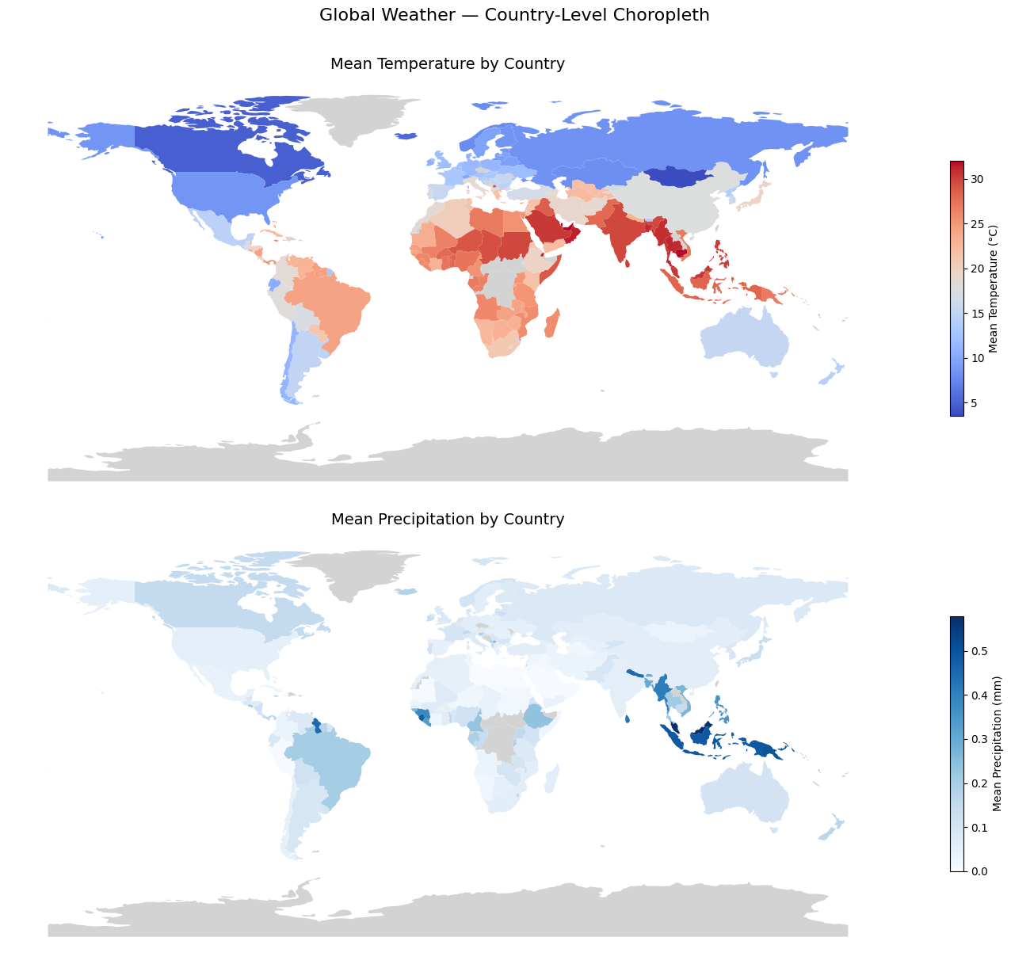

Slide 12
Forecasting Models
All models use a 5-step sliding window and a chronological 80/20 train/test split
Evaluated performance using MAE, RMSE, and R² scores.
Model | Description
LSTM | LSTM(248) → Dense(128) → Dense(64). Captures temporal dynamics across the window
Random Forest | 100 trees on flattened window. Handles non-linear feature interactions
Stack + Linear Regression | Meta-learner learning a fixed blend of both models' outputs
Stack + Random Forest | Meta-learner learning a non-linear input-dependent blend

Slide 13
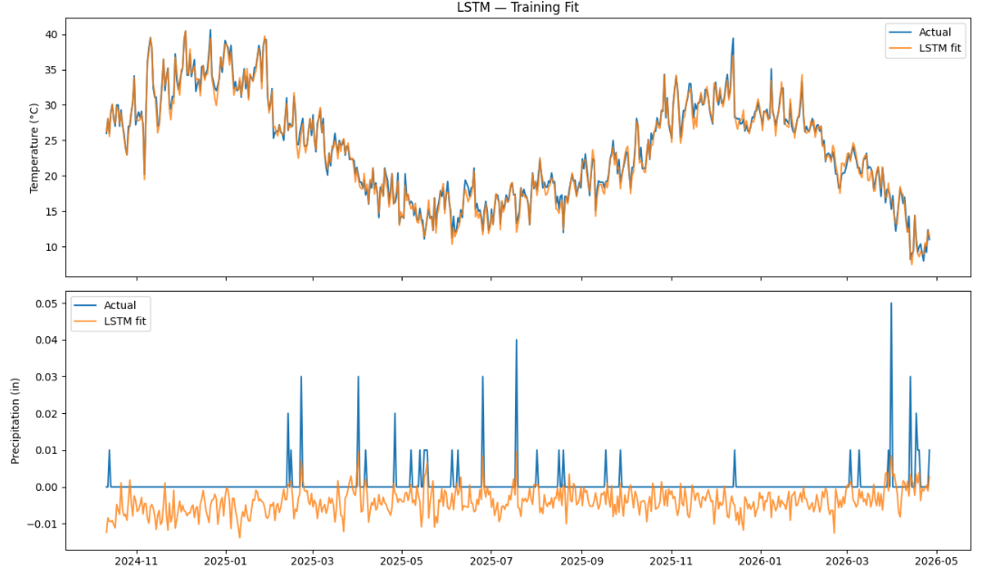
LSTM Train
LSTM Train | MSE=595.2509 RMSE=24.3978 MAE=6.1087

Slide 14
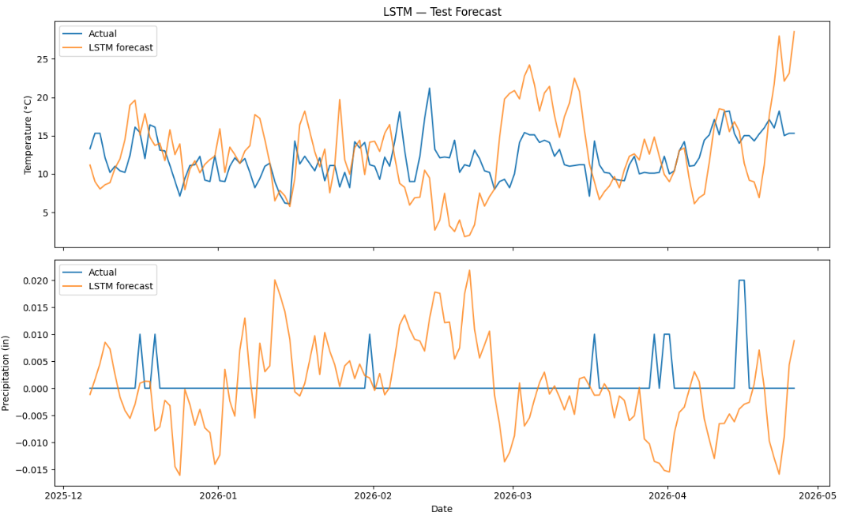
LSTM Test
LSTM Test | MSE=2726.0275 RMSE=52.2114 MAE=18.1409

Slide 15
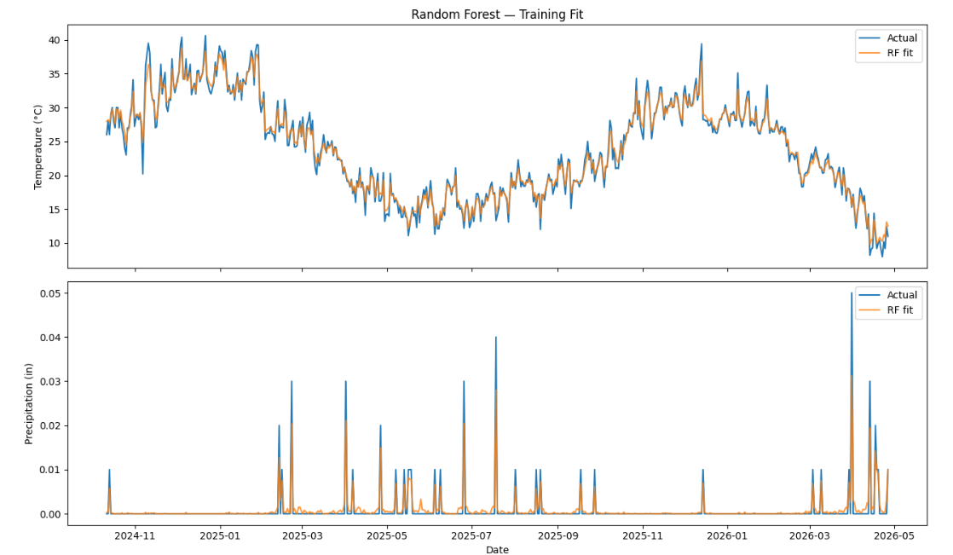
Random Forest Train
RF Train | MSE=66.5981 RMSE=8.1608 MAE=2.5115

Slide 16
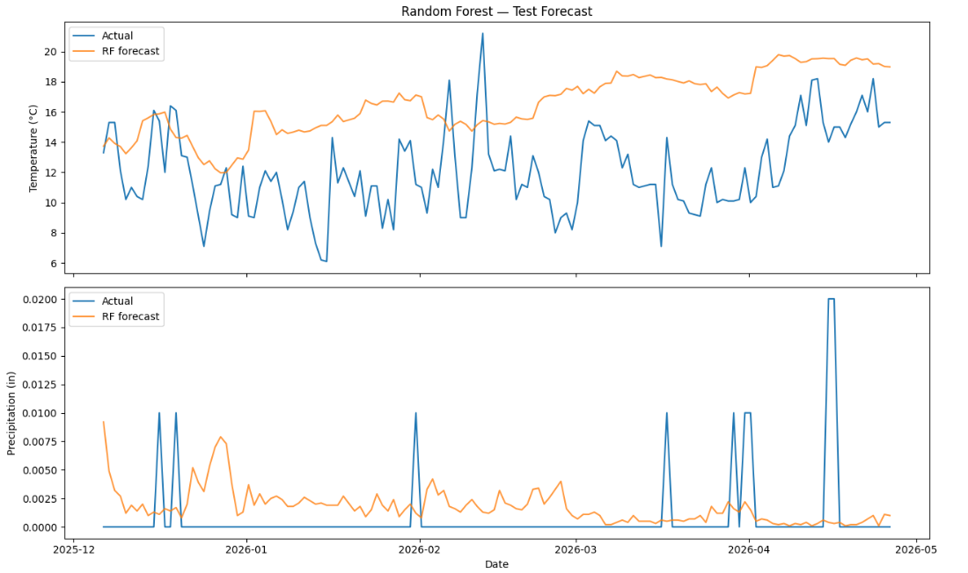
Random Forest Test
RF Test | MSE=1345.8161 RMSE=36.6854 MAE=12.3315

Slide 17
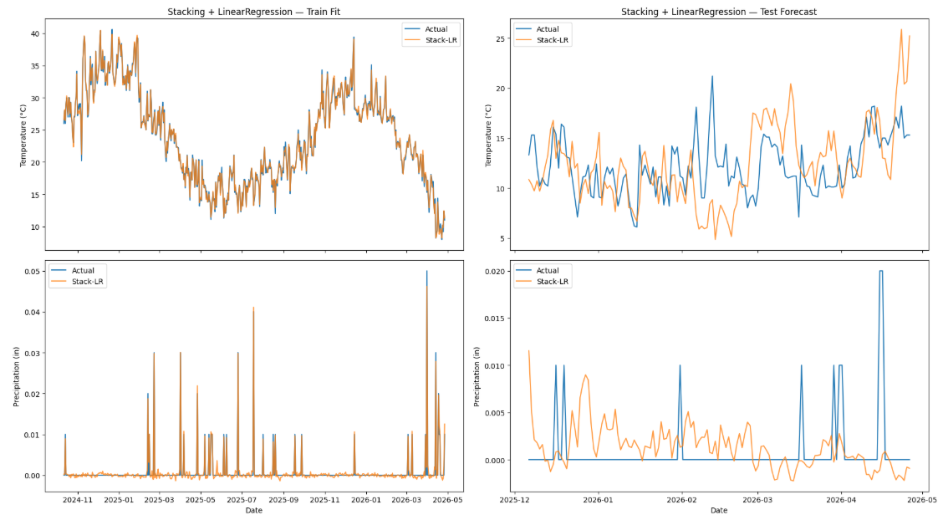
Stacking Ensemble: Linear Regression
Stack-LR Train | MSE=5.8056 RMSE=2.4095 MAE=0.7451
Stack-LR Test | MSE=1053.3264 RMSE=32.4550 MAE=10.9192

Slide 18
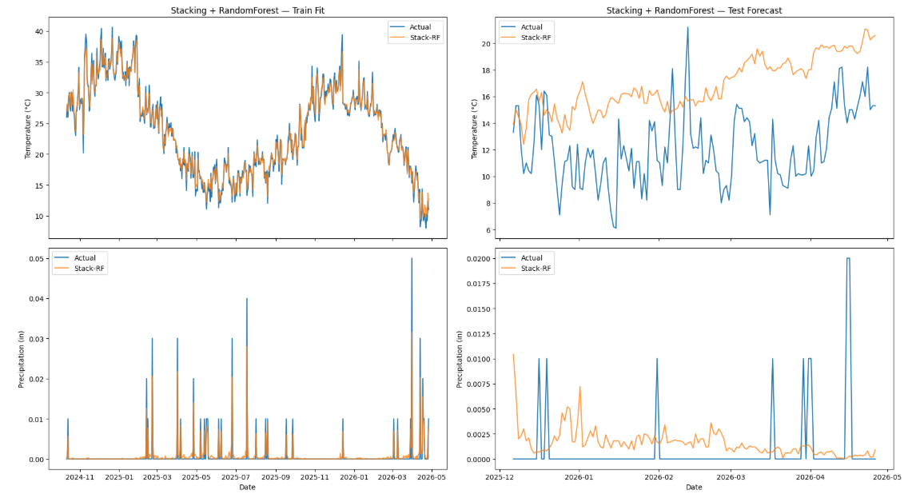
Stacking Ensemble: Random Forest
Stack-RF Train | MSE=27.4493 RMSE=5.2392 MAE=1.7207
Stack-RF Test | MSE=1125.2855 RMSE=33.5453 MAE=11.5357

Slide 19
Model Comparison
Model | RMSE (all) | RMSE Temp | RMSE Precip
Stack + Linear Regression | 32.46 | 3.94 | 0.0041
Stack + Random Forest | 33.55 | 5.55 | 0.0037
Random Forest | 36.69 | 5.26 | 0.0038
LSTM | 52.21 | 5.34 | 0.0092
The stacking ensemble outperforms both base models across all metrics.
The Linear Regression meta-learner achieves the best temperature RMSE and the RF meta-learner achieves the best precipitation RMSE.
The Random Forest outperforms the LSTM in isolation, where the RF's sample efficiency outweighs the LSTM's sequential modelling advantage at this data scale.

Slide 20
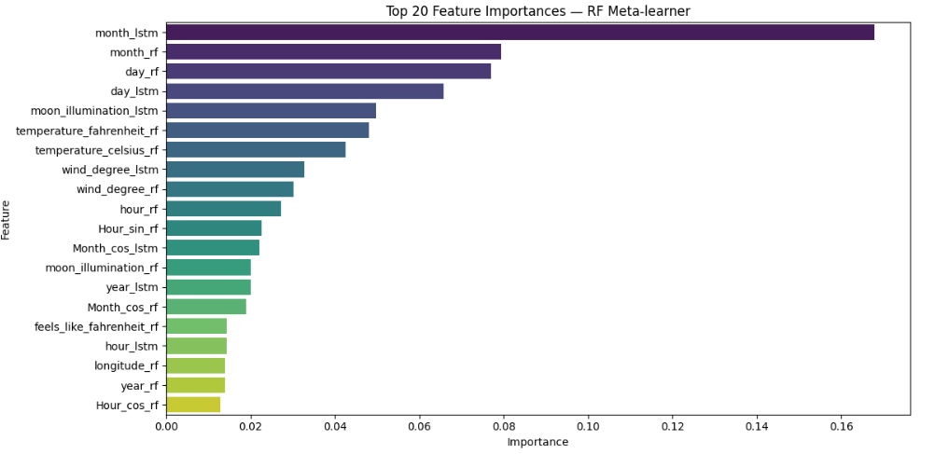
Feature Importance Random Forest

Slide 21
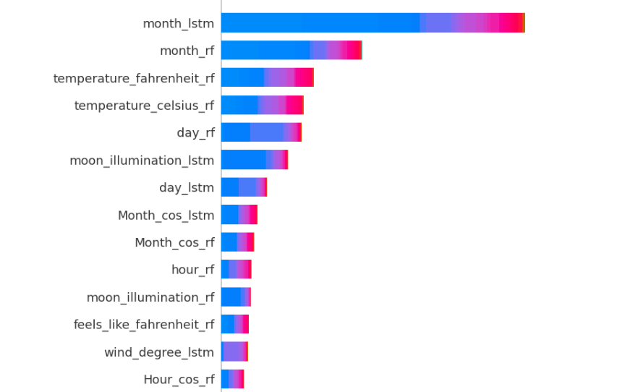
Feature importance Random Forest using SHAP

Slide 22
Conclusion & Next Steps
month is the dominant feature for the RF meta-learner which makes sense, monthly seasonality is the strongest signal in temperature and precipitation in a Mediterranean climate.
day follows, capturing within-month variability.
moon_illumination appearing in the top 5 likely acts as a proxy for the lunar calendar cycle, which correlates with the month signal.
• Future work: Fine-tune models, add more model types to the ensemble model stack, and deploy for real-time forecasting.

Slide 23
Thank You

