Slide 1
Object Recognition and Computer Vision
Video Segmentation using STCN
Presented By:
Saifeddine Barkia - Meddeb Hamza

Slide 2
Plan
STCN vs STM
Reported results on author’s dataset
Using state of the arts algorithm for the first frame segmentation
Mask-RCNN
Swin-transformer
Testing on something to something dataset
Limitations

Slide 3
STM vs STCN

Slide 4
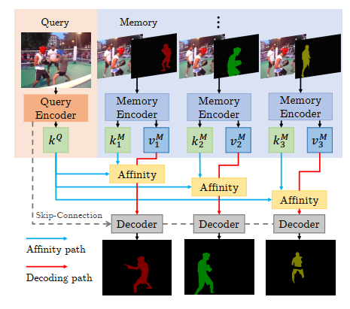
STM

Slide 5
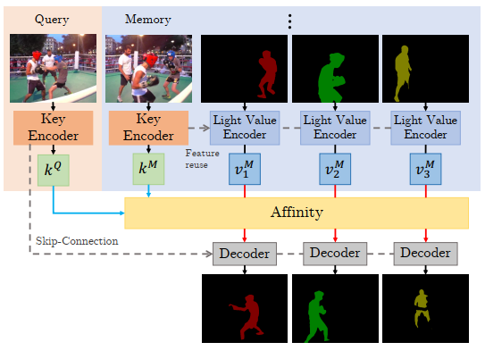
STCN

Slide 6
2. Reproduction of the results

Slide 7


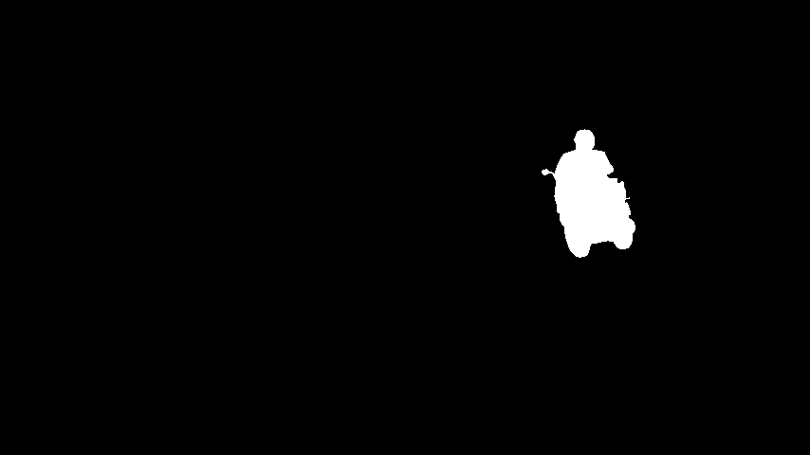
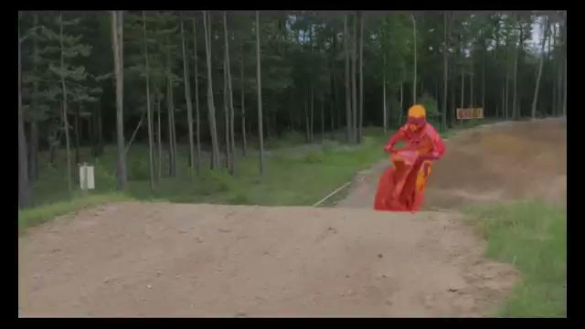
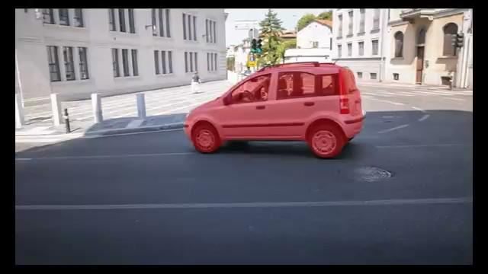
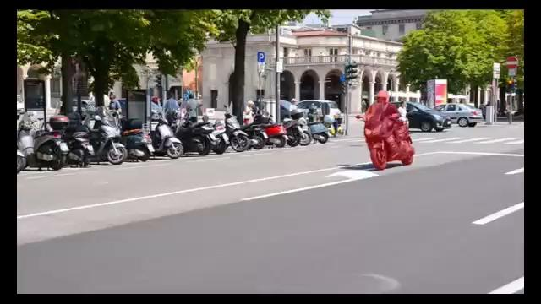
Qualitative results on DAVIS 2016

Slide 8
Quantitative results on DAVIS 2016
 | Paper results | Our reported results
FPS | 26.9 | 17.13
Jaccard index | 90.4% | 90.3%

Slide 9

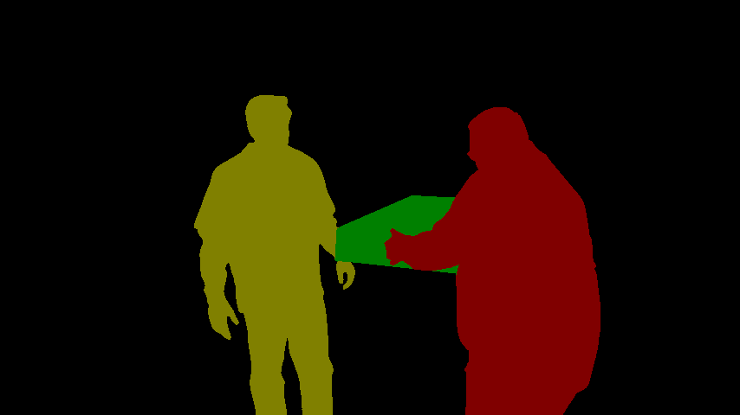

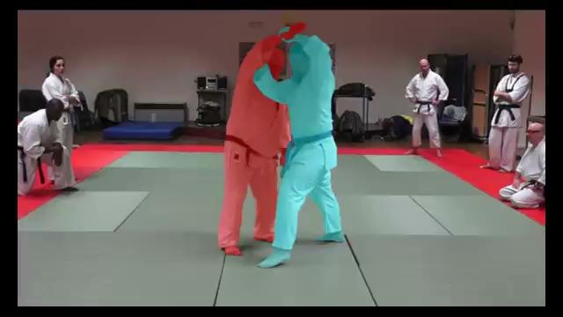

Qualitative results On DAVIS 2017

Slide 10
Quantitative results
 | Paper results | Our reported results
Jaccard Index | 82.0 | 81.7
FPS | 20.2 | 10.99

Slide 11
3. Using state of the arts algorithm for the first frame segmentation

Slide 12
Using state of the art segmentation algorithm
Motivation:
We don’t have the segmentation map all the time , we need an automatization process
→ Swin Transformer : A vision transformer model with a hierarchical way of processing the image
We used a pre-trained model based on ImageNet-1K dataset
→ Mask RCNN
We used a pre-trained models based on Ms Coco dataset

Slide 13
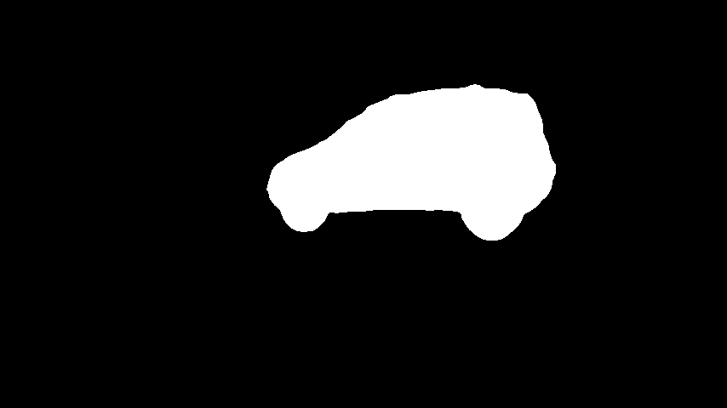
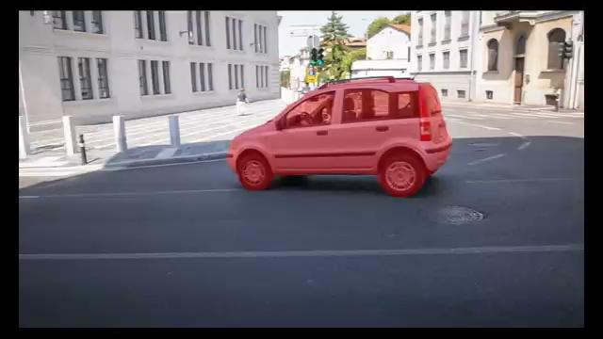
Comparison between Swin-Transformer segmentation and ground truth
Ground truth Swin-Transformer segmentation
Jaccard Index : 0.9738 Jaccard Index : 0.9696

Slide 14


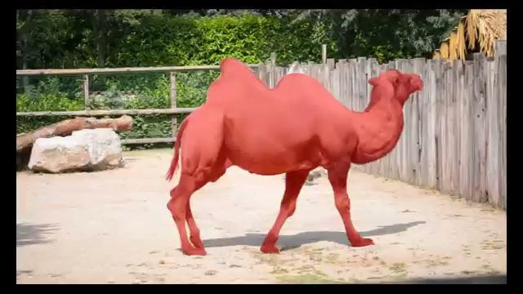

Comparison between Swin-Transformer segmentation and ground truth
Ground truth Swin-Transformer segmentation
Jaccard Index : 0.97138 Jaccard Index : 0.94395

Slide 15


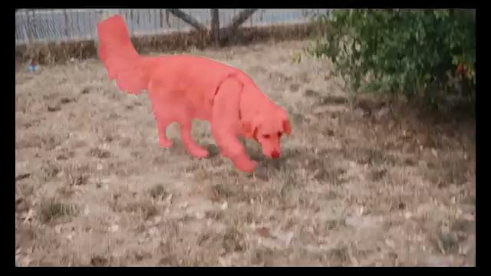
Comparison between Swin-Transformer segmentation and ground truth
Ground truth Swin-Transformer segmentation
Jaccard Index :0.96036 Jaccard Index : 0.8569

Slide 16
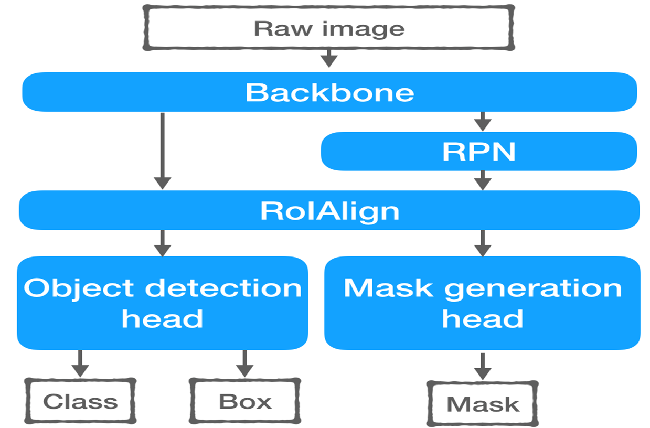
Mask RCNN Architecture
→ Mask R-CNN extends Faster R-CNN

Slide 17
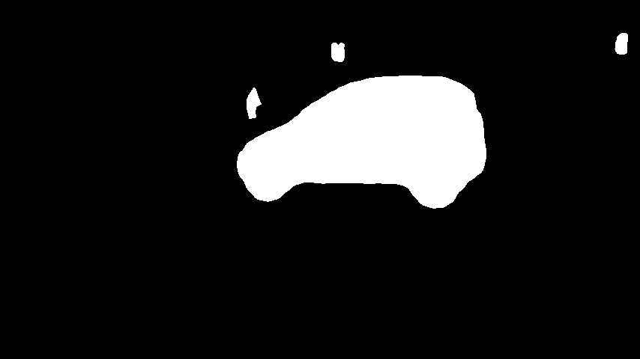
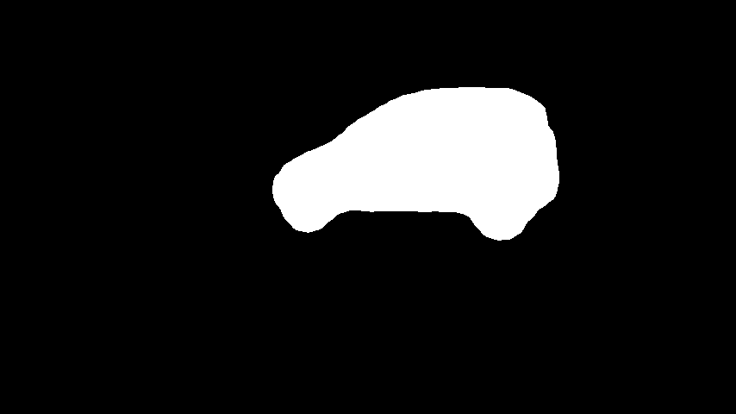
Mask R-CNN Segmentation Result
Ground truth Mask-RCNN segmentation Keep the biggest 8 connected-
component mask

Slide 18
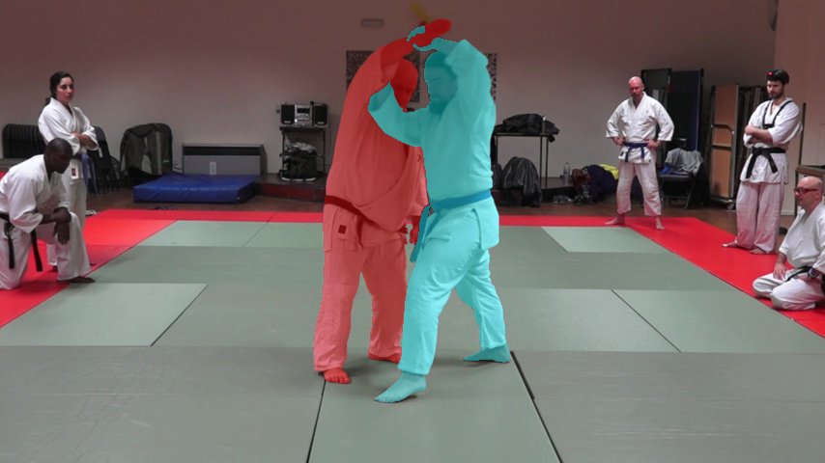
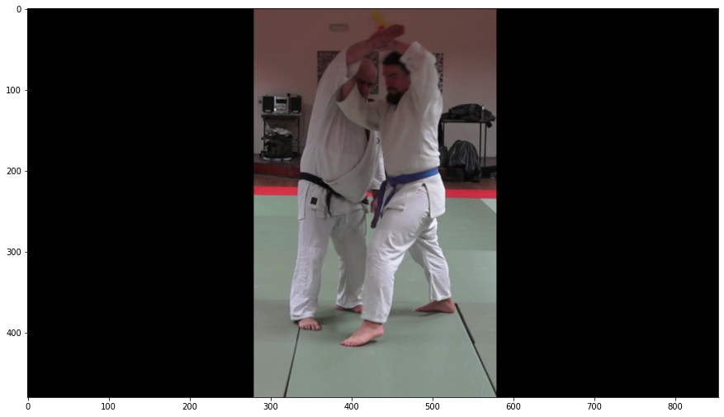

Mask R-CNN Segmentation Result
Ground truth Preprocess the Ground Truth Instance Segmentation Result
Image

Slide 19
Video Segmentation Using Mask R-CNN Initialisation
Ground truth STCN segmentation output
Jaccard Index :0.9738 Jaccard Index :0.9700

Slide 20
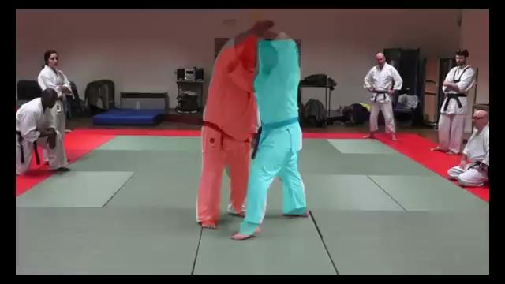
Video Segmentation Using Mask R-CNN Initialisation
Ground truth STCN segmentation output

Slide 21

Video Segmentation Using Mask R-CNN Initialisation
Ground truth Mask-RCNN segmentation
Jaccard Index :0.96036 Jaccard Index : 0.91147

Slide 22


Video Segmentation Using Mask R-CNN Initialisation
Ground truth Mask-RCNN segmentation
Jaccard Index : 0.97138 Jaccard Index : 0.8697

Slide 23
4. Testing on Something to Something dataset

Slide 24
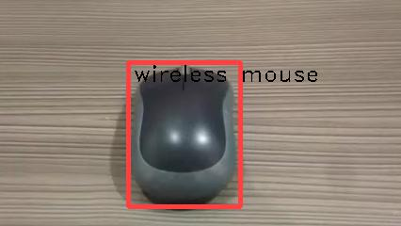
What is S2S Dataset?
S2S dataset provides videos with bounding boxes
The coordinates of the bounding boxes are provided in the annotations.json file

Slide 25

Segmentation Result Using Mask R-CNN
Since we don’t have the first ground truth mask, we need to use mask R-cnn or Swin-Transformer
Ground Truth Result of segmentation using Swin Transformer

Slide 26
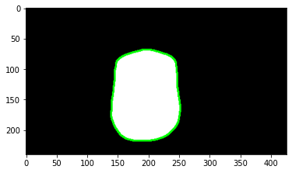
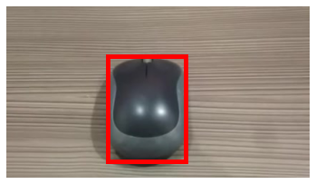
Converting a Mask to a Boundary Box
Ground Truth Detected Boundary Detected Bounding Box

Slide 27
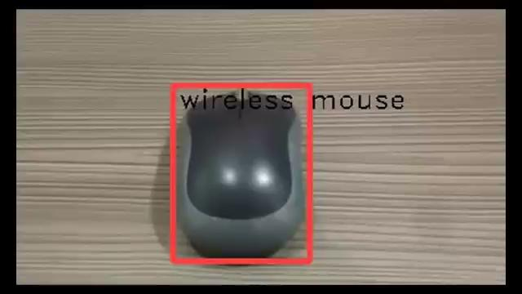
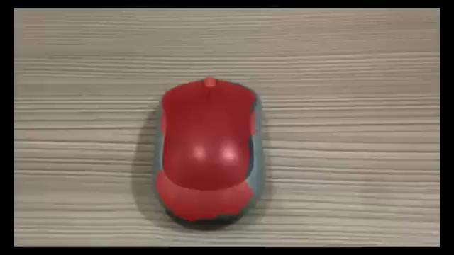
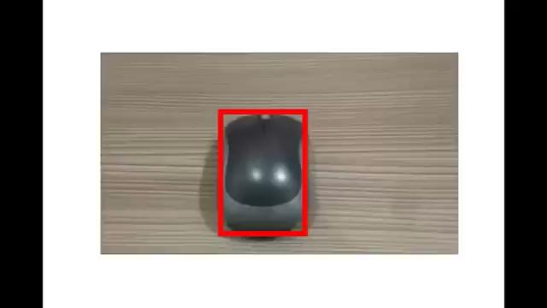
Converting a Mask to a Boundary Box
Ground Truth STCN output Predicted Bounding boxes

Slide 28
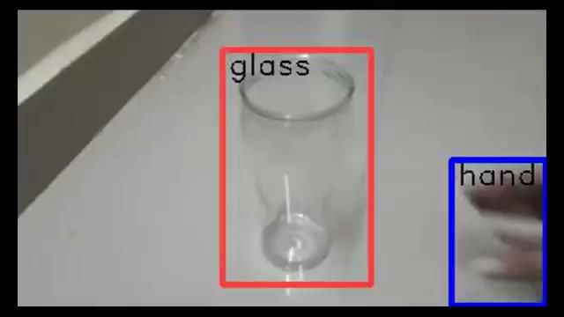
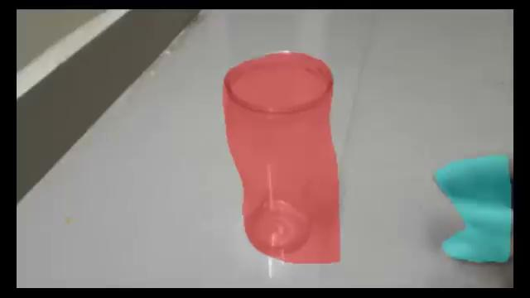
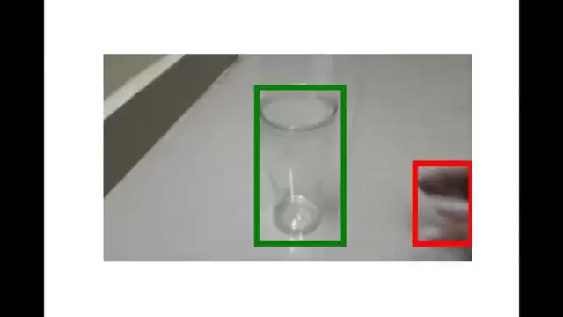
Video Segmentation Result
Ground Truth STCN output Predicted Bounding boxes

Slide 29
Quantitative results on S2S dataset
 | Mean Intersection over Union Score
Wireless mouse | 0.82
Hand / Glass | 0.75/0.85

Slide 30
5. Limitations

Slide 31
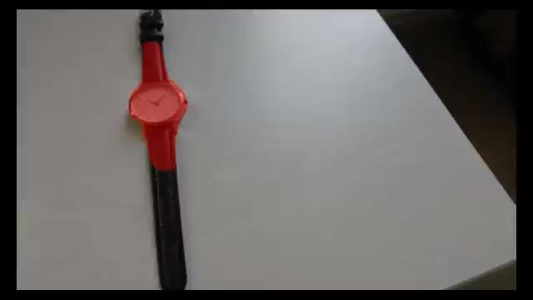
Limitations
The main limitation of the STCN is its sensitivity to the initial mask
Solution: We can feed the STCN with a mask every 10 frames
Both Swin transformers and Mask R-CNN cannot be applied to real time segmentation due to their computational cost

Slide 32
Thanks for your attention

