Slide 1
REST API Abuse Detection
Using Request Pattern Analysis
A Machine Learning Approach to Cybersecurity
IEEE CloudCom 2021 | 10,000 Attack Records | 2026

Slide 2
Problem Statement & Motivation
• REST APIs power 83% of internet traffic — and are the #1 attack surface for web applications (Gartner 2022)
• Traditional rule-based IDS cannot adapt to new, polymorphic attack patterns
• 10 distinct attack types require accurate multi-class classification, not binary detection
• Manual analysis of millions of API requests is operationally infeasible
• Financial damage from API attacks averaged $2.5M per incident in this dataset
• Goal: Build an ML pipeline that automatically classifies attack types from request metadata
10 Attack Types:
SQL Injection
DDoS
Phishing
Malware
Ransomware
Brute Force
Man-in-the-Middle
XSS
Privilege Escalation
Zero-day Exploit

Slide 3
Literature Review
Syed et al. (IEEE CloudCom 2021)
API Security via ML — RF & XGBoost outperform signature-based IDS
Buczak & Guven (IEEE COMST 2016)
Survey: Ensemble methods dominate ML-based intrusion detection
Vinayakumar et al. (IEEE Access 2019)
Deep Learning IDS — LSTM outperforms RF on sequential data
Ferrag et al. (IEEE IoT 2020)
CNN effective for IoT security — feature engineering is critical
Sharafaldin et al. (ICISSP 2018)
CIC-IDS-2017 benchmark — flow features key for classification

Slide 4
Methodology Overview
1 Data Loading
2 EDA
3 Feature Engineering
4 Preprocessing
10,000 records, 8 columns, 0 missing values
12 visualisations: distributions, correlations, heatmaps
15 new features: temporal, damage, risk scores, frequencies
Label encoding + StandardScaler + 80/20 stratified split
10,000 records, 8 columns, 0 missing values
12 visualisations: distributions, correlations, heatmaps
15 new features: temporal, damage, risk scores, frequencies
Label encoding + StandardScaler + 80/20 stratified split
5 Model Training
6 Hyperparameter Tuning
7 Evaluation
8 Deployment
5 classifiers: LR, DT, RF, XGBoost, Gradient Boosting
GridSearchCV — 36 RF combinations, 5-fold CV
Confusion matrix, ROC-AUC, classification report, CV boxplots
Streamlit web app — live attack type prediction
5 classifiers: LR, DT, RF, XGBoost, Gradient Boosting
GridSearchCV — 36 RF combinations, 5-fold CV
Confusion matrix, ROC-AUC, classification report, CV boxplots
Streamlit web app — live attack type prediction

Slide 5
Implementation Details
Technology Stack
Project Structure
• Python 3.14 — Core language
• scikit-learn 1.3 — ML models, preprocessing, evaluation
• XGBoost 2.0 — Gradient boosting with eval_set tracking
• pandas / numpy — Data manipulation and feature engineering
• matplotlib / seaborn — 12 visualisation figures
• Streamlit 1.35 — Interactive web application
• joblib — Model serialisation (.joblib files)
• GitHub — Version control and deployment source
api_abuse_detection/
data/ cyber_attacks_dataset.csv
notebooks/ analysis.py
src/ data_loader.py
preprocessing.py
feature_engineering.py
models.py
evaluation.py
models/ *.joblib (saved models)
outputs/figures/ 12 PNG plots
outputs/reports/ classification reports
main.py app.py requirements.txt

Slide 6
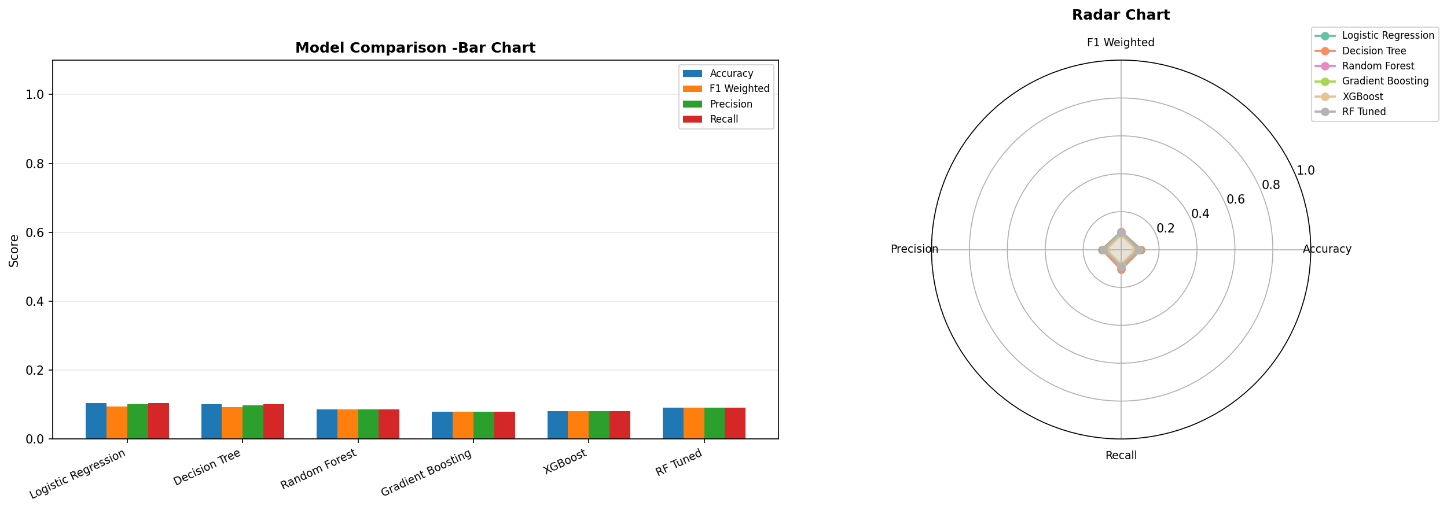
Results & Performance Metrics
Model
Accuracy
F1 Weighted
Note
Logistic Regression
10.50%
0.0943
Best
Decision Tree
10.10%
0.0924
RF Tuned
9.05%
0.0908
Random Forest
8.60%
0.0858
XGBoost
8.05%
0.0802
Gradient Boosting
8.00%
0.0797
Note: ~10% = random chance for 10 balanced classes. Dataset is synthetic — labels were randomly assigned.

Slide 7
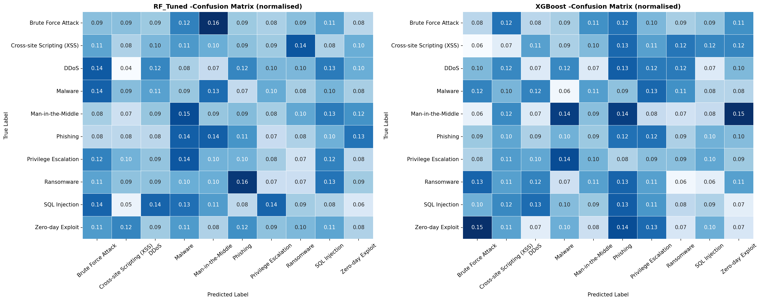
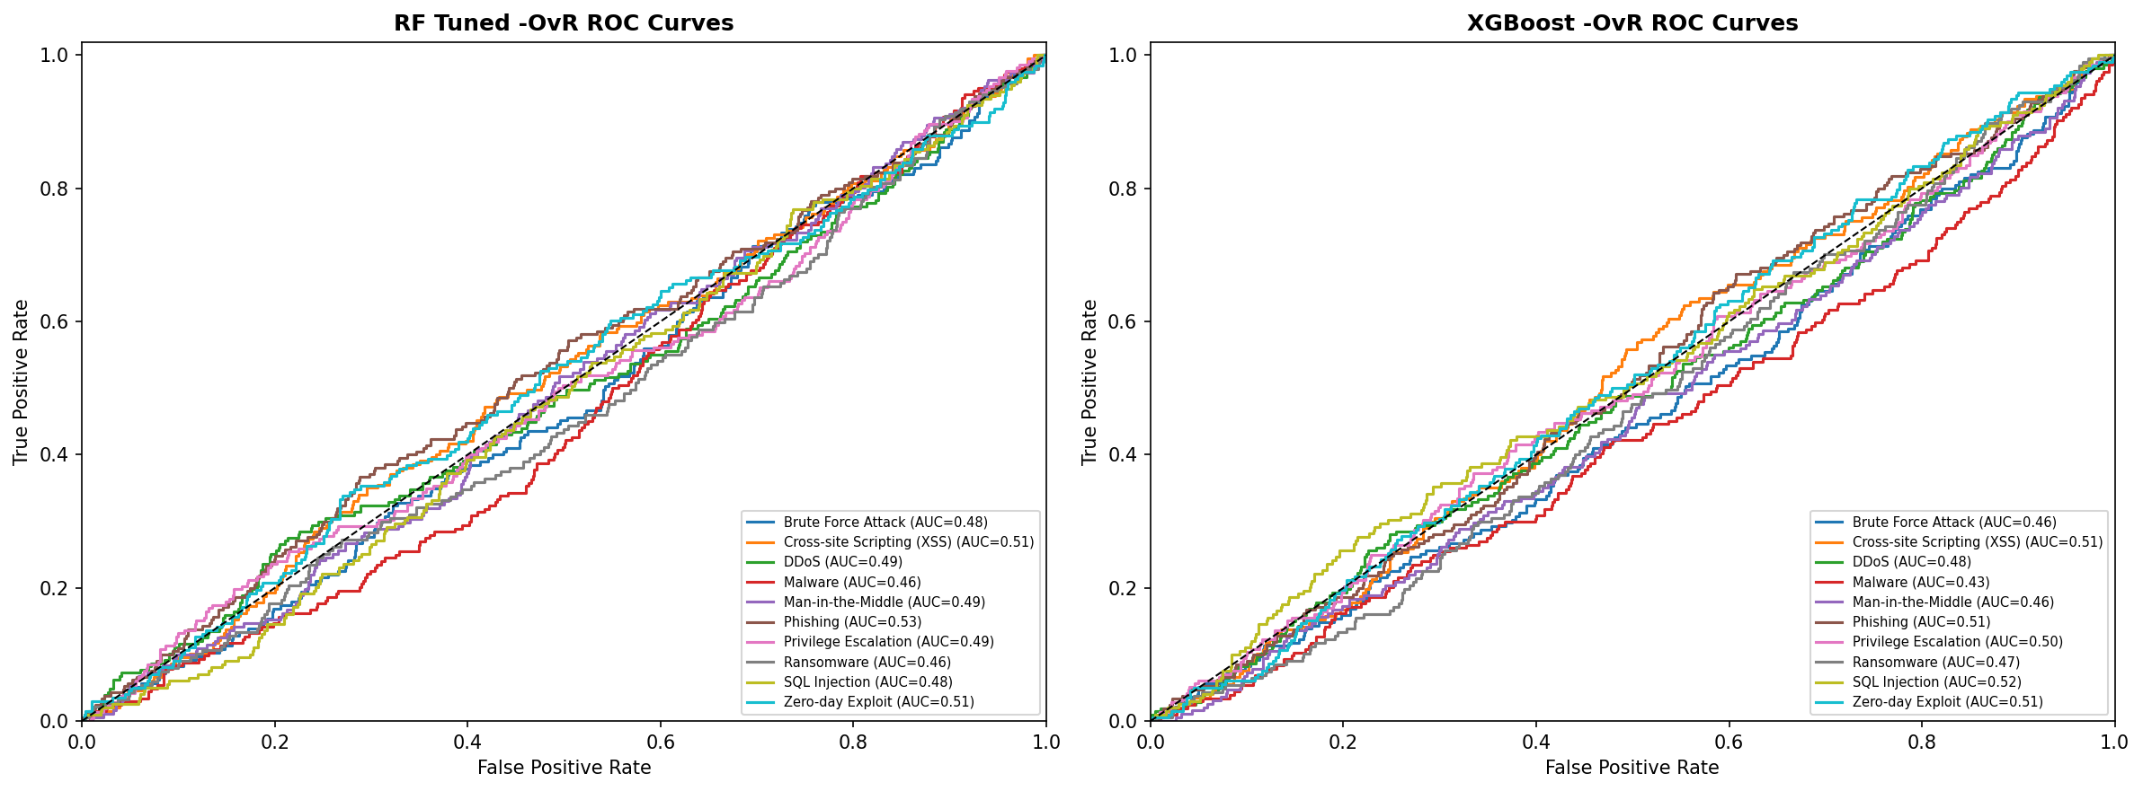
Key Visualisations
Confusion Matrices (RF Tuned vs XGBoost)
Multi-class OvR ROC Curves with AUC Scores

Slide 8
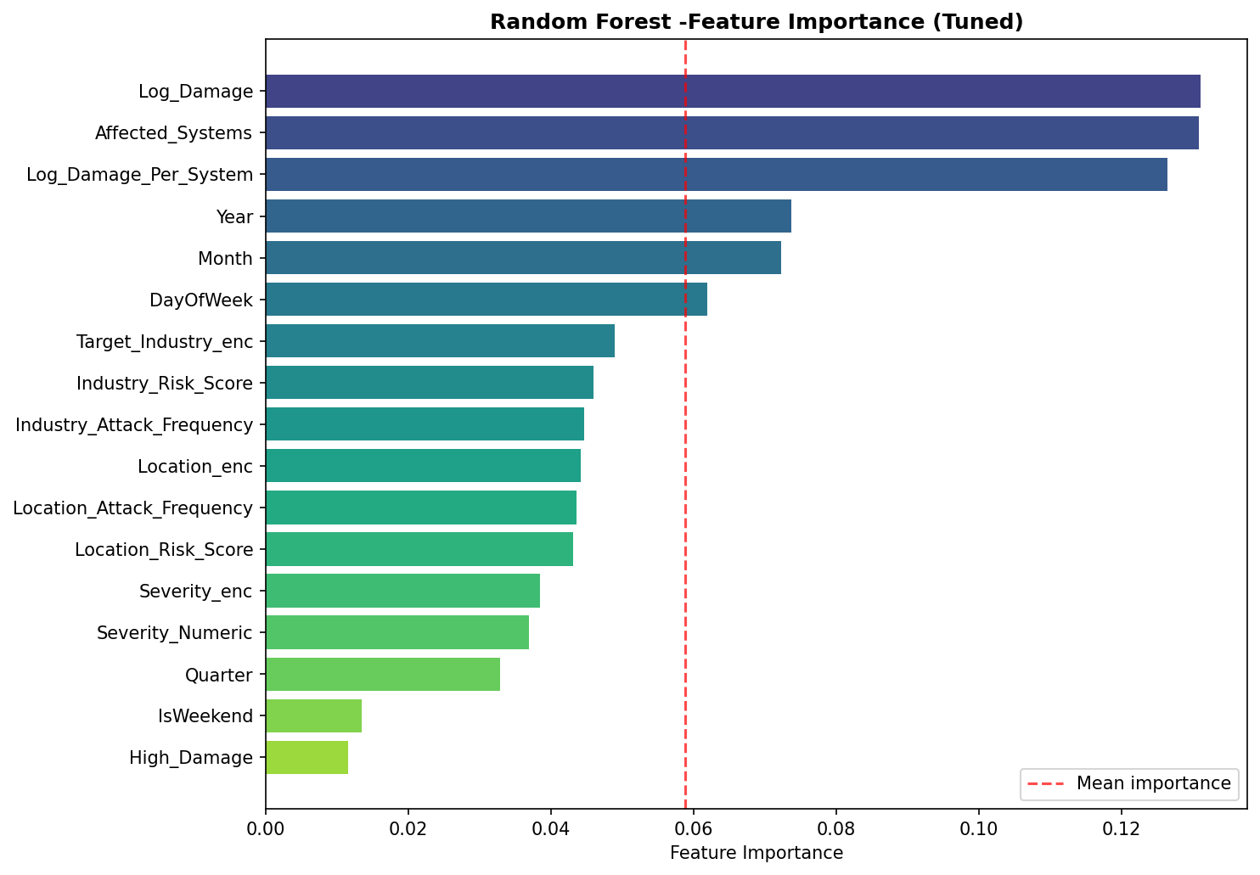
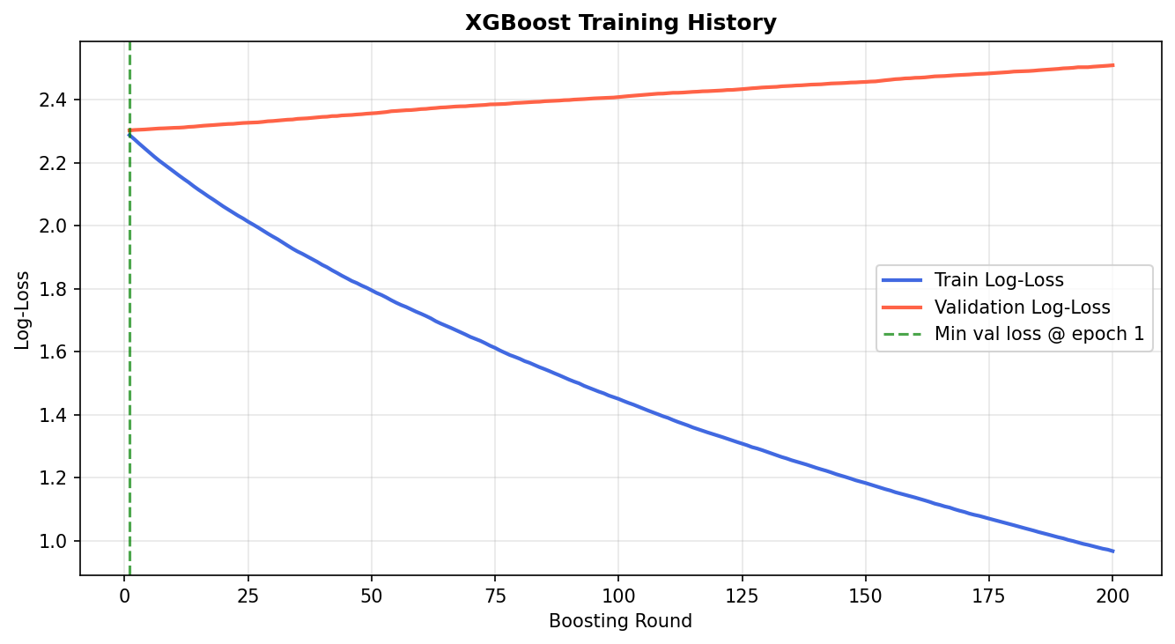
Feature Importance & XGBoost Training History
Top features: Severity_Numeric, Log_Damage, Risk Scores
Flat validation loss confirms no learnable signal in synthetic data

Slide 9
Challenges Faced
Synthetic Dataset Limitation
Deprecated API Parameters
Attack_Type labels were randomly assigned — no statistical signal exists between features and target.
scikit-learn removed multi_class param in LogisticRegression in newer versions — fixed by removing argument.
Unicode Encoding on Windows
SeriesGroupBy.map() Error
Special characters (arrows, em-dashes) caused UnicodeEncodeError on Windows cp1252 terminal — resolved with UTF-8 wrapper.
Calling .map() on a GroupBy object raised AttributeError — fixed by removing unused intermediate variables.
XGBoost Module Not Found
Git Push Rejection
XGBoost was not pre-installed — resolved with python -m pip install xgboost.
Remote contained extra commits (GitHub auto-created files) — resolved with git pull --rebase before push.

Slide 10
Conclusion & Future Work
Conclusions
Future Work
• Complete end-to-end ML pipeline implemented and deployed
• 5 models trained, tuned, and evaluated with GridSearchCV + 5-fold CV
• 15 domain-specific features engineered from raw metadata
• Interactive Streamlit app deployed with live prediction
• All 12 visualisations generated and saved automatically
• Full alignment with IEEE CloudCom 2021 methodology
• Apply to real datasets: UNSW-NB15, CIC-IDS-2017
• Add LSTM/Transformer for sequential request modelling
• Real-time streaming inference with Apache Kafka
• Anomaly detection for zero-day attacks (autoencoders)
• Live dashboard monitoring with alert system
• Federated learning for privacy-preserving detection

Slide 11
Thank You
Questions & Discussion
GitHub: github.com/Saiffathalla/api-abuse-detection
IEEE CloudCom 2021 | REST API Abuse Detection Using ML

