Slide 1

Disney+ Database Analytics
by Saifuddin sanusi

Slide 2
Ending slide
Agenda
Problem Statement
Data
Findings
Recommendations
Notes:
This slide contains the editable pieces that were used to build infographic sample
Icons – Eye, PC

Slide 3
Problem Statement
Future content strategies are unsure on how and what they need to consider to improve Disney+ platform’s offering.
What factors have more influence on view, and how do the relationships vary across different settings?
Data Overview
Data: Disney+ movies and TV shows
Source: Kaggle / JustWatch
Date: March 2023
Size: titles.csv (1k titles, 15 columns) ; credits.csv (30k credits of actors and directors, with 5 columns)
Fields: titles, show type, description, release year, age certification, runtime, genre, production countries, number of seasons, imdb score, imdb votes, tmdb popularity, tmdb score

Slide 4
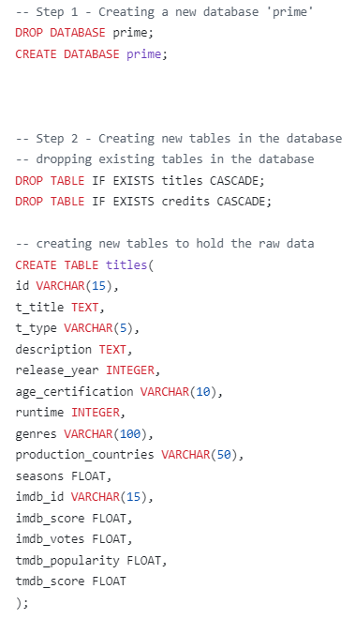
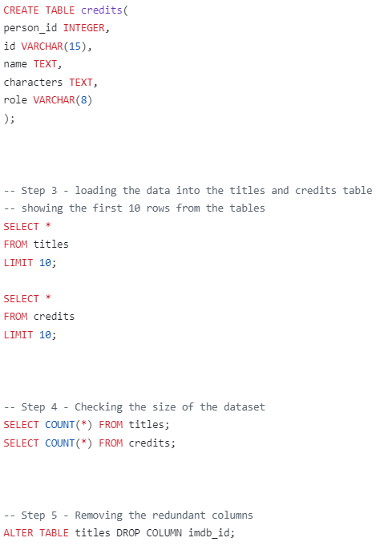
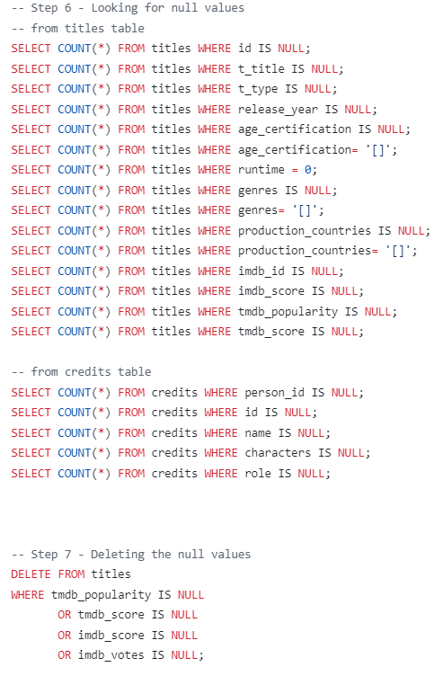
Data Cleaning

Slide 5
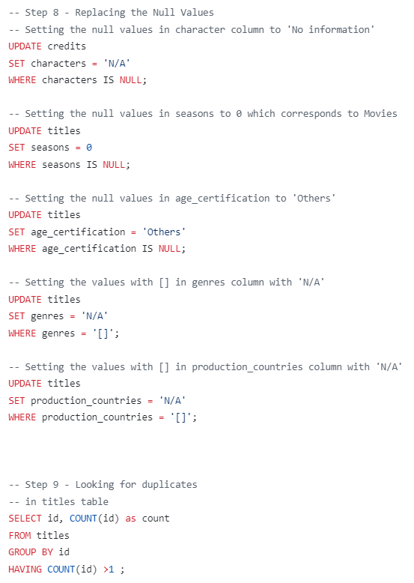
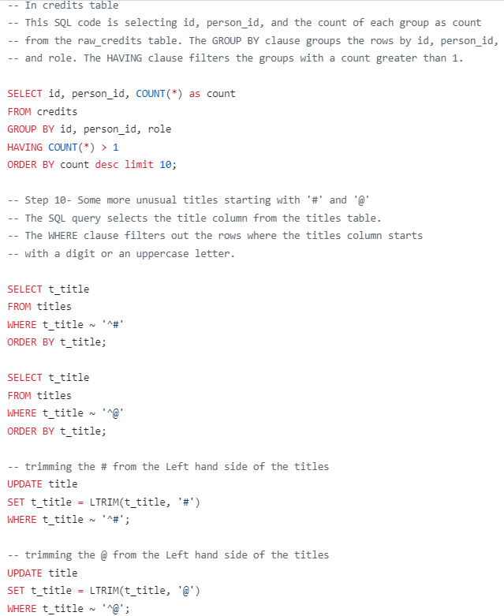
Data Cleaning

Slide 6
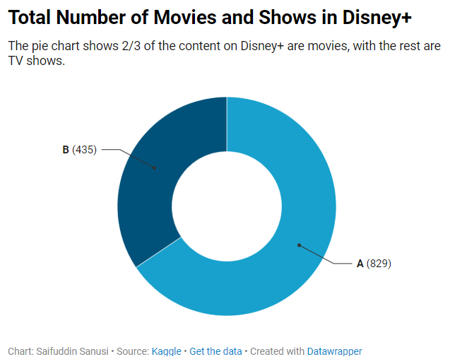
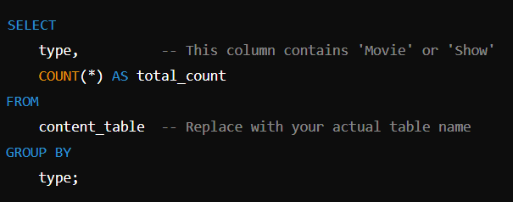
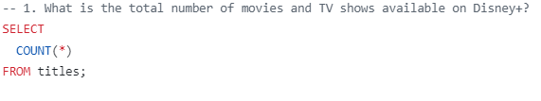
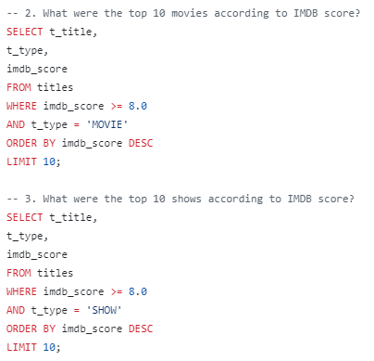
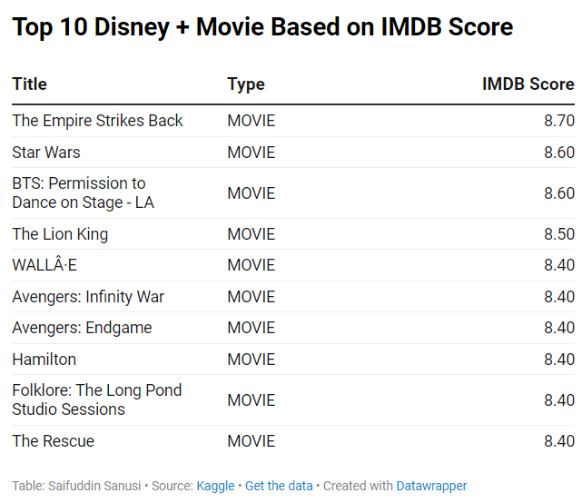
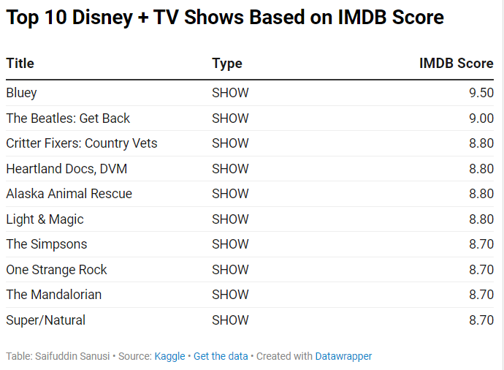
Data Analysis – Total number movies and TV show available on Disney+
title | type | imdb_score
The Empire Strikes Back | MOVIE | 8.7
Star Wars | MOVIE | 8.6
BTS: Permission to Dance on Stage - LA | MOVIE | 8.6
The Lion King | MOVIE | 8.5
WALLÂ·E | MOVIE | 8.4
Avengers: Infinity War | MOVIE | 8.4
Avengers: Endgame | MOVIE | 8.4
Hamilton | MOVIE | 8.4
Folklore: The Long Pond Studio Sessions | MOVIE | 8.4
The Rescue | MOVIE | 8.4
title | type | imdb_score
Bluey | SHOW | 9.5
The Beatles: Get Back | SHOW | 9
Critter Fixers: Country Vets | SHOW | 8.8
Heartland Docs, DVM | SHOW | 8.8
Alaska Animal Rescue | SHOW | 8.8
Light & Magic | SHOW | 8.8
The Simpsons | SHOW | 8.7
One Strange Rock | SHOW | 8.7
The Mandalorian | SHOW | 8.7
Super/Natural | SHOW | 8.7

Slide 7
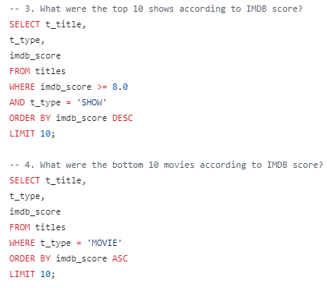
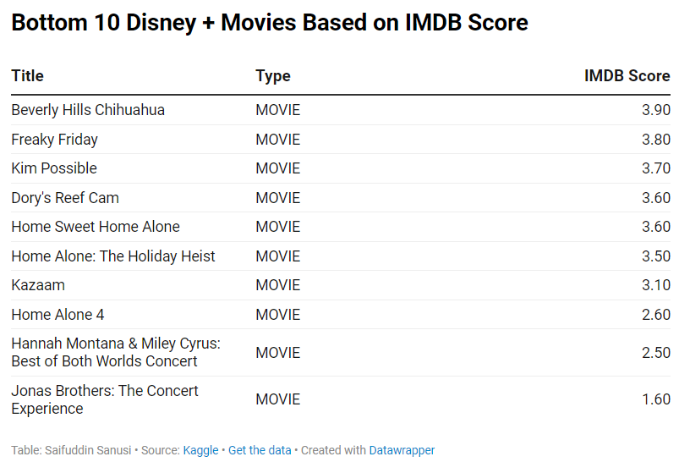
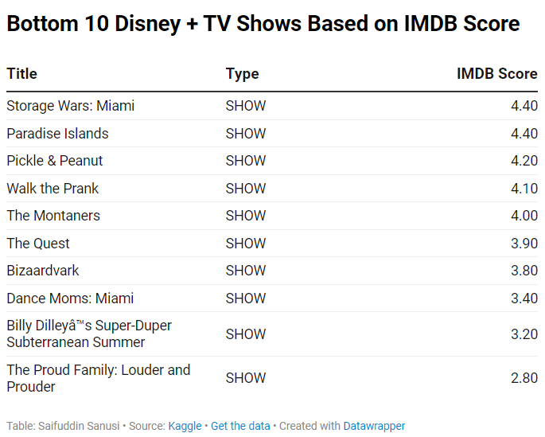
Data Analysis –
Correction *bottom* and something wrong with coding 3
title | type | imdb_score
Beverly Hills Chihuahua | MOVIE | 3.9
Freaky Friday | MOVIE | 3.8
Kim Possible | MOVIE | 3.7
Dory's Reef Cam | MOVIE | 3.6
Home Sweet Home Alone | MOVIE | 3.6
Home Alone: The Holiday Heist | MOVIE | 3.5
Kazaam | MOVIE | 3.1
Home Alone 4 | MOVIE | 2.6
Hannah Montana & Miley Cyrus: Best of Both Worlds Concert | MOVIE | 2.5
Jonas Brothers: The Concert Experience | MOVIE | 1.6
title | type | imdb_score
Storage Wars: Miami | SHOW | 4.4
Paradise Islands | SHOW | 4.4
Pickle & Peanut | SHOW | 4.2
Walk the Prank | SHOW | 4.1
The Montaners | SHOW | 4
The Quest | SHOW | 3.9
Bizaardvark | SHOW | 3.8
Dance Moms: Miami | SHOW | 3.4
Billy Dilleyâ™s Super-Duper Subterranean Summer | SHOW | 3.2
The Proud Family: Louder and Prouder | SHOW | 2.8

Slide 8
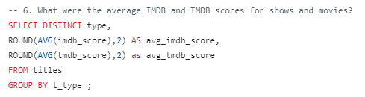
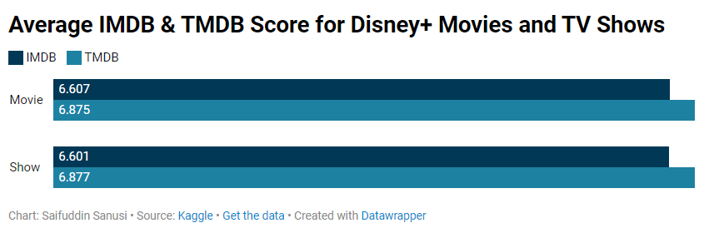
Data Analysis – Average IMBD & TMDB Score
Change to 3 decimal place
Type | IMDB | TMDB
Movie | 6.60658 | 6.87549
Show | 6.60145 | 6.87652
Type | IMDB | TMDB
Movie | 6.607 | 6.875
Show | 6.601 | 6.877

Slide 9
Conclusion:
Minimal Difference Between Movies and Shows:
The difference of IMDB and TMDB score for movies and shows is negligible. This indicate that Disney+ content, whether movie or show, is equally appreciated by viewers across these platforms.
Slight Preference for TMDB Scores:
Both movies and shows receive slightly higher scores on TMDB than on IMDB. This could indicate that TMDB users might be slightly more favorable in their ratings for Disney+ content, or it could reflect differences in user demographics between the two platforms.
Above-Average Ratings:
With both scores being above 6.6, Disney+ content is generally well-received by viewers. While these scores do not represent top-tier content, they suggest that Disney+ offers a consistent range of good, but not exceptional content, which meets the expectations of its target audience.
Recommendations:
Targeted Improvement for Higher Ratings:
Although the average ratings are good, there is room for improvement to bring scores closer to or above 7.0. Disney+ could focus on increasing the quality of storytelling, character development, and production value in both movies and TV shows. This could involve increasing investment in original content and big-budget productions that can attract higher ratings and critical acclaim.
Encourage User Engagement on Review Platforms:
Since TMDB shows a slightly higher rating, Disney+ could partner with or promote user engagement on platforms like TMDB to ensure that its content receives a fair representation. Encouraging users to rate content more frequently across platforms may help boost visibility and credibility. Disney+ could also work on strategies to improve ratings through audience interaction (e.g., providing review prompts after viewing).

Slide 10
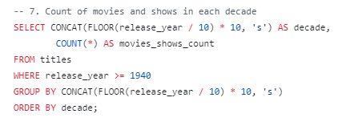
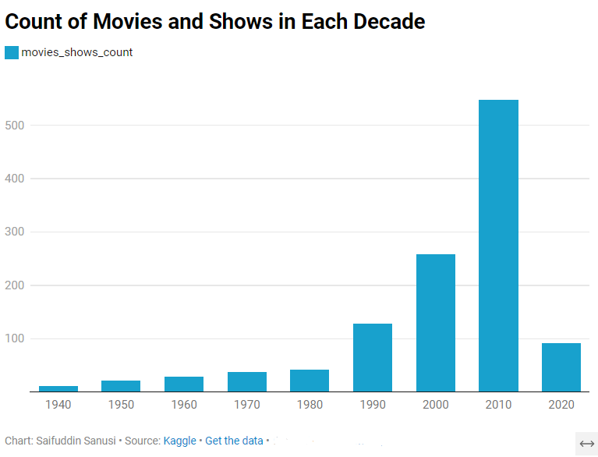
Data Analysis –
decade movies_shows_count
1940 11
1950 22
1960 29
1970 37
1980 42
1990 128
2000 258
2010 548
2020 92

Slide 11
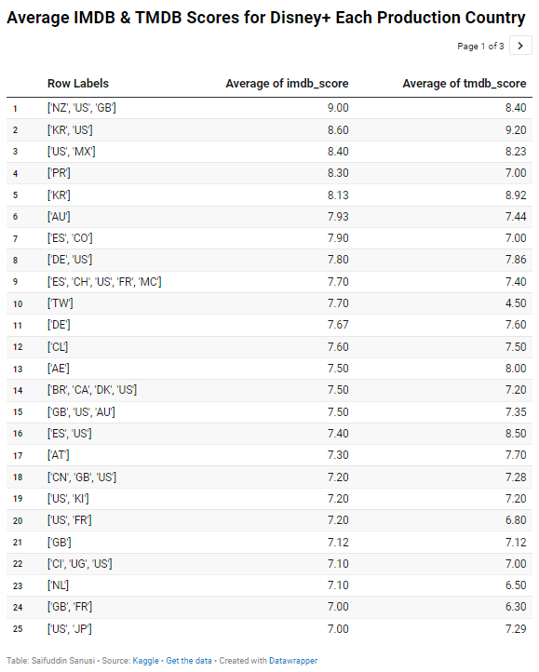
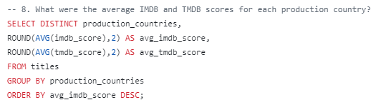
Data Analysis – Average IMDB & TMDB (Production Countries)

Slide 12
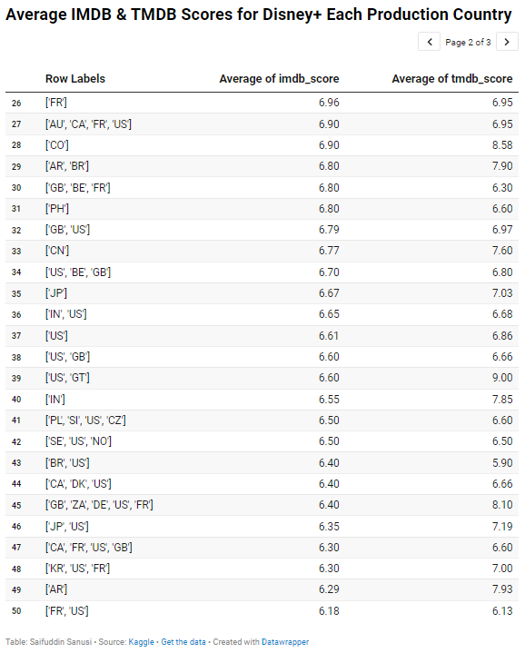
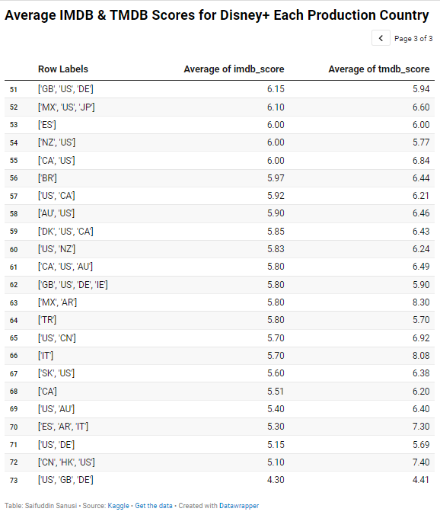

Slide 13
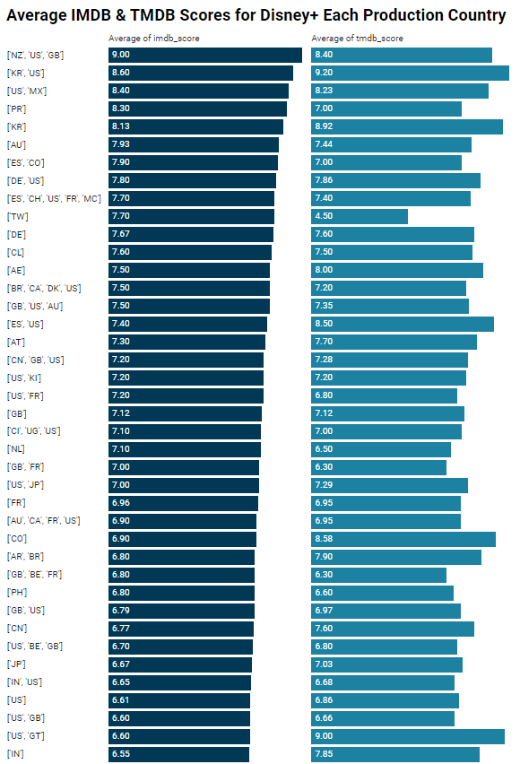
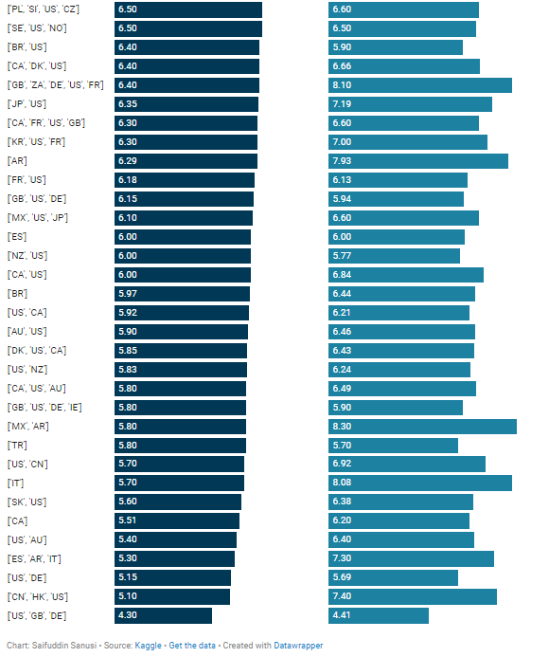

Slide 14
Data Analysis – Average IMDB & TMDB (Production Countries)
Conclusion:
Top-Performing Countries:
The highest average IMDB score is 9.00 for the combination of countries ['NZ', 'US', 'GB'], with a TMDB score of 8.40.
Korea ('KR') and the US ('US') have the highest TMDB score at 9.20, with a strong IMDB score of 8.60. Other notable high-scoring combinations include ['US', 'MX'] (IMDB: 8.40, TMDB: 8.23), and Puerto Rico ('PR') (IMDB: 8.30, TMDB: 7.00).
Strong Regional Variations:
There is a significant range of ratings across different country combinations, indicating that regional preferences vary greatly. For instance, ['NZ', 'US', 'GB'] and ['KR', 'US'] rate content much higher than countries like ['US', 'GB', 'DE'] (IMDB: 4.30, TMDB: 4.41).
Underperforming Regions:
Some countries, particularly combinations like ['US', 'GB', 'DE'] (IMDB: 4.30, TMDB: 4.41) and ['US', 'DE'] (IMDB: 5.15, TMDB: 5.69), have relatively low scores. This could indicate less favorable reception for Disney+ content or lower engagement with rating platforms in these regions.
Recommendations:
Target High-Scoring Regions for New Releases:
Disney+ should leverage regions that show consistently high ratings for content distribution, especially for high-budget and original content. Countries like ['NZ', 'US', 'GB'], ['KR', 'US'], and ['US', 'MX'] show high appreciation of content, making them ideal targets for new exclusive releases and marketing campaigns.
Address Low-Scoring Markets:
For countries with lower scores, such as ['US', 'GB', 'DE'] and ['US', 'DE'], Disney+ should consider conducting regional market research to identify viewer preferences, expectations, and feedback on why content is underperforming. Localized content or adjustments to marketing strategies could help improve reception

Slide 15
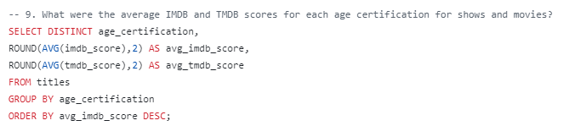
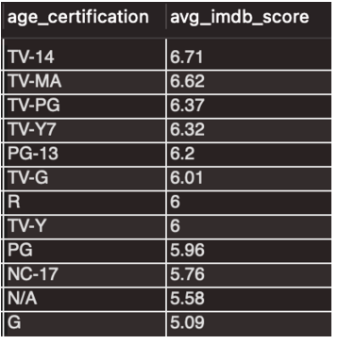
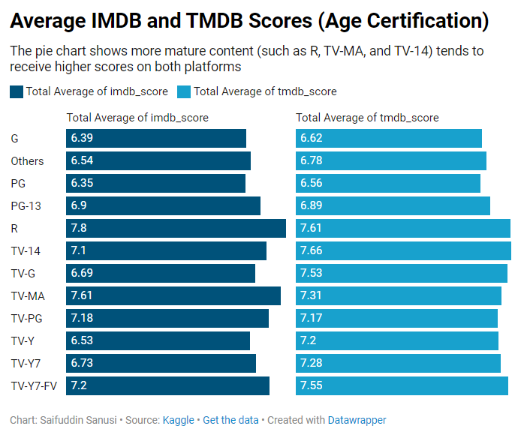
Data Analysis –
Buat column utk tmdb jugak

Slide 16
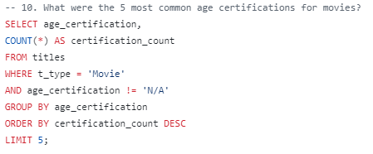
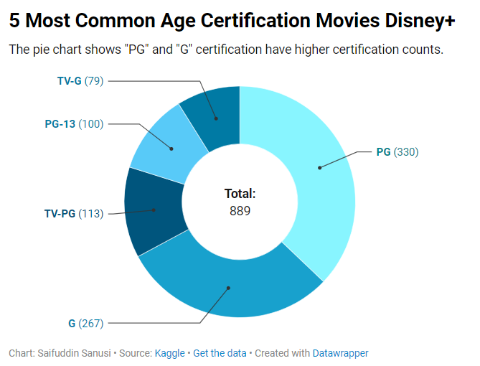
Data Analysis –
1. Distribution of Certification Counts:PG (330 counts) and G (267 counts) have the highest certification counts, indicating that content suitable for a general audience (or slightly more restricted audience in the case of PG) is quite prevalent.TV-PG (113 counts) and PG-13 (100 counts) are also significant but have fewer certifications compared to PG and G.TV-G (79 counts) has the lowest number of certifications among the categories listed.2. Dominance of Family-Friendly Certifications:A significant portion of the content falls under family-friendly or less restrictive certifications. This suggests that the platform or source (e.g., a streaming service, a media distributor) focuses primarily on content that is suitable for younger audiences or broader family consumption.The high count for "PG" (330) and "G" (267) supports this conclusion.3. Lower Counts for More Restrictive Categories:Content with a PG-13 or TV-PG certification, which would typically suggest material more appropriate for slightly older audiences (such as teens), is present but in noticeably lower quantities than "PG" and "G".This suggests either a reduced focus on more mature content or that content aimed at a slightly older demographic is less prevalent.4. TV-Specific Ratings (TV-PG, TV-G):The presence of TV-G and TV-PG indicates that a portion of the content is television-based and has been rated according to TV standards."TV-G" (general audience) and "TV-PG" (parental guidance suggested) also have a presence, though in lower numbers compared to the film-based "G" and "PG."5. Possible Trends:The focus on lower-restriction ratings like "PG" and "G" might indicate a trend toward more family or child-oriented content.The reduced number of "PG-13" certifications might reflect either a specific content policy or audience preference toward less restrictive content.Final Conclusion:The data in the table indicates that the platform or source of this data focuses more on family-friendly content, with significantly higher counts of "PG" and "G" certifications. There is still a notable presence of "PG-13" and "TV-PG" content but in smaller quantities, suggesting less emphasis on content for older teens or adults.Further investigation could involve:Exploring if this trend holds across other certification categories (e.g., R, TV-MA).Looking into the specific types of content that contribute to the higher counts of "PG" and "G."
age_certification | certification_count
PG | 330
G | 267
TV-PG | 113
PG-13 | 100
TV-G | 79

Slide 17
Overall #9,10 review
Analysis:
Higher Volume Doesn't Always Translate to Higher Ratings:
PG and G content has a high certification count, but the average ratings are lower. This might be due to the simple or less engaging nature of content targeted at younger audiences, which tends to be rated lower compared to content with more mature or complex themes.
Mature Content Is Valued More by Audiences:
Even though R, PG-13, TV-MA, and TV-14 have lower certification counts, they generally receive higher ratings. This indicates that audiences tend to value more complex, mature, or adult-themed content, as it may offer deeper narratives, more sophisticated characters, or higher production quality.
TV Ratings Show More Favorable Trends on TMDB:
TV content, especially for younger viewers (TV-Y, TV-G, and TV-Y7), tends to be rated higher on TMDB than on IMDB. This suggests that different user bases might have slightly different preferences or scoring behaviors. TMDB users might be more lenient or appreciate family-oriented or children's content more than IMDB users.
Underperformance of Family-Oriented Content:
The PG and G categories, despite having the highest certification count (597 combined), show consistently lower ratings. This implies that while family-friendly content is widely produced, it may not be meeting audience expectations or generating as much enthusiasm as content aimed at older demographics.
Conclusion:
Family-Oriented Content Has Lower Average Scores:
PG-rated and G-rated content, despite having a high certification count (330 for PG and 267 for G), have lower average ratings on both IMDB (6.35 for PG, 6.39 for G) and TMDB (6.56 for PG, 6.62 for G).**
This suggests that while this type of content is widely produced, it is generally less favorably rated compared to content with more mature themes.
Mature Content Scores Higher, Despite Lower Certification Counts:
PG-13 and R-rated content has higher ratings on both IMDB (6.9 for PG-13, 7.8 for R) and TMDB (6.89 for PG-13, 7.61 for R), but the certification count is lower (100 for PG-13).
Similarly, TV-14 and TV-MA content also receive high ratings (TV-14: 7.1 on IMDB, 7.66 on TMDB; TV-MA: 7.61 on IMDB, 7.31 on TMDB) but their certification counts are comparatively lower.
Children's Programming Is Rated Better on TMDB Than on IMDB:
TV-Y and TV-Y7 content shows higher scores on TMDB (7.20 for TV-Y and 7.28 for TV-Y7) compared to IMDB (6.53 for TV-Y and 6.73 for TV-Y7), indicating that the TMDB user base may rate children's content more favorably than the IMDB audience.
TV-G and TV-PG Have Decent Ratings:
TV-PG (7.18 on IMDB, 7.17 on TMDB) and TV-G (6.69 on IMDB, 7.53 on TMDB) content have relatively high ratings, with TV-G being more highly rated on TMDB.

Slide 18
Recommendations:
Improve the Quality of Family-Oriented Content:
Given the high volume of PG and G-rated content, there is a significant opportunity to improve the quality of family-friendly movies and shows. Focus on enhancing the storytelling, character development, and production quality in these categories to improve audience engagement and ratings.
Invest More in Mature-Themed Content:
Since PG-13, R, and TV-MA content receive higher ratings, it might be beneficial for content producers to invest in creating more mature-themed content, especially considering the positive audience reception. Even though the volume of mature content is lower, audiences tend to rate these shows and movies more favorably.
Leverage TMDB’s Favorable Audience for Children's Programming:
The higher ratings for children's content (e.g., TV-Y, TV-Y7, TV-G) on TMDB suggest that there is a more appreciative audience for this type of content on that platform. Consider targeting promotions, marketing, or content launches for children’s programming to platforms like TMDB where such content might be better received.
Diversify Content Across Ratings:
While the volume of PG and G content is high, balancing content production across a wider range of age certifications (e.g., TV-14, TV-MA, PG-13, and R) may result in higher average ratings overall, as these categories seem to be more positively received by audiences.
Conduct Audience Surveys to Understand Preferences:
Since family-friendly content has lower ratings, it might be beneficial to conduct audience surveys or focus groups to better understand why certain content isn’t resonating as well with viewers. This could offer insights into what elements of PG or G-rated content could be improved to meet audience expectations.
By focusing on both improving family content and expanding mature-themed content, while leveraging platform-specific advantages like TMDB's audience for children's programming, content producers can optimize both their output and audience reception.

Slide 19
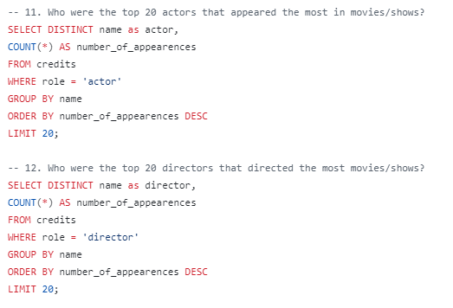
Data Analysis –
ACTORS Denis O'Dea
Finlay Currie
Ralph Truman
Geoffrey Keen
Geoffrey Wilkinson
John Laurie
Francis de Wolff
David Davies
John Gregson
Andrew Blackett
William Devlin
Howard Douglas
Harry Locke
Sam Kydd
Stephen Jack
Harold Jamieson
David Blake Kelly
Reginald Drummond
Gordon Mulholland
Patrick Troughton
Director Clyde Geronimi
Ben Sharpsteen
Jack Kinney
William Roberts
Wilfred Jackson
Samuel Armstrong
Norman Ferguson
Paul Satterfield
Hamilton Luske
Jim Handley
Ford Beebe
T. Hee
William Roberts
Ben Sharpsteen
James Algar
Norman Ferguson
Harold Young
Burt Gillett
Ub Iwerks

Slide 20
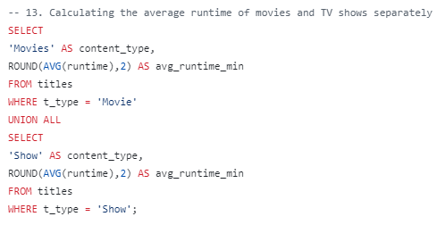
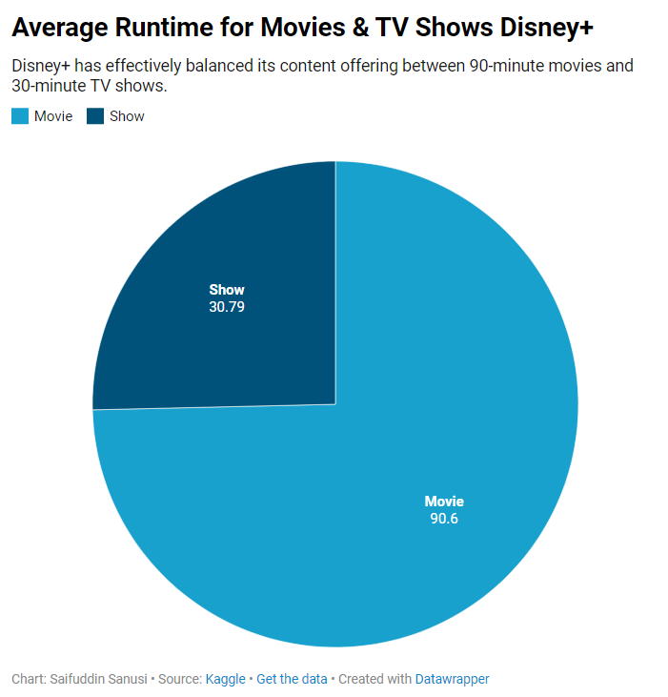
Data Analysis – Average Runtime of Movies & TV Shows
 | MOVIE | SHOW | (blank) | Grand Total
Average of runtime | 90.60554885 | 30.7908046 |  | 70.02056962
Conclusion:
The average runtime of movies on Disney+ is 90.60 minutes, while the average runtime of TV shows is 30.79 minutes.
There is a clear distinction in runtimes between movies and TV shows, with movies having a longer average duration, and TV shows having a more typical episodic length.
Analysis:
Standard Movie Runtime:
The average runtime of 90.60 minutes for Disney+ movies falls within the typical range for feature films, which usually run between 90 to 120 minutes. This indicates that Disney+ offers a wide selection of full-length feature films, aligning with industry standards for movie duration.
Episodic TV Shows:
The average runtime of 30.79 minutes for TV shows is common for many episodic series, especially for family-oriented and children's programming, which are often structured in 30-minute blocks. This reflects a focus on easily consumable content, particularly suited for younger audiences or family viewing.
The shorter episode length also indicates that Disney+ is producing or curating content that allows for binge-watching or quick viewing, which has become popular among streaming audiences.
Target Audience Consideration:
The shorter episode length of TV shows suggests that Disney+ continues to cater to its core audience, including families and younger viewers, who may prefer shorter, easily digestible content.
On the other hand, the 90-minute movie average caters well to family movie nights and offers a range of content from animated classics to live-action films, maintaining the platform's appeal to a broad audience.
Platform Content Strategy:
The difference between movie and TV show runtimes could indicate that Disney+ is focused on providing a diverse viewing experience. It allows for both longer immersive experiences with movies and shorter episodic content for quick entertainment.

Slide 21
Recommendations:
Maintain Balance Between Movie and Show Offerings:
The runtime distinction between movies and TV shows is appropriate for a platform like Disney+, where viewers can find content suited to both short attention spans and longer, more immersive viewing sessions. Disney+ should continue to offer a balance of full-length movies and episodic shows to cater to various audience preferences.
Expand Variety in TV Show Length:
While the 30-minute format works well for younger audiences and family viewing, Disney+ could consider offering more variety in show runtimes by introducing some longer-form series (45-60 minute episodes) aimed at older viewers or teens. This would allow the platform to cater to a wider demographic, especially for those interested in more in-depth, serialized storytelling.
Leverage the Binge-Watching Trend:
With the 30-minute average runtime for shows, Disney+ is well-positioned to capitalize on the binge-watching trend. By creating and promoting more serialized content with multiple shorter episodes, the platform could further encourage back-to-back viewing habits. Shows with ongoing story arcs that encourage viewers to keep watching would align well with this model.
Continue Producing Family-Friendly Movies:
The 90-minute average runtime is perfect for family movie nights, which is a key market for Disney+. The platform should continue producing and curating family-friendly films that fit into this 90-minute format while also offering some longer, more epic films for audiences who enjoy extended movie experiences.
Consider Regional and Genre Preferences:
Disney+ could consider region-specific content or genre-specific shows with varying runtimes. For example, longer dramas or adventure series could target older audiences, while continuing to offer shorter comedy and animated series for younger viewers. This strategy would allow the platform to diversify its content library while keeping the core audience engaged.
Final Thoughts:
Disney+ has effectively balanced its content offering between 90-minute movies and 30-minute TV shows, appealing to its broad audience base. However, there is potential to expand content length for older viewers and diversify episode lengths to enhance engagement across multiple demographics.

Slide 22
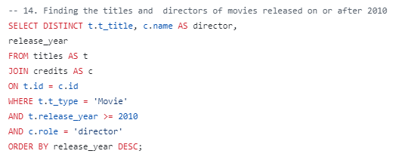

Data Analysis –
*change to 2023,
Schoolhouse Rock! 50th Anniversary Singalong
Whispers: An Elephant's Tale
Baby Sharks

Slide 23
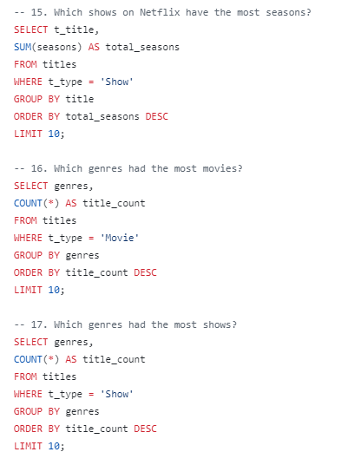
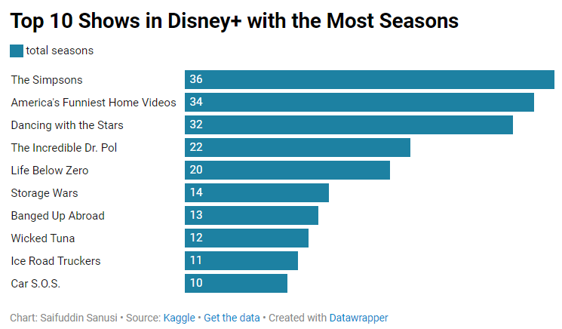
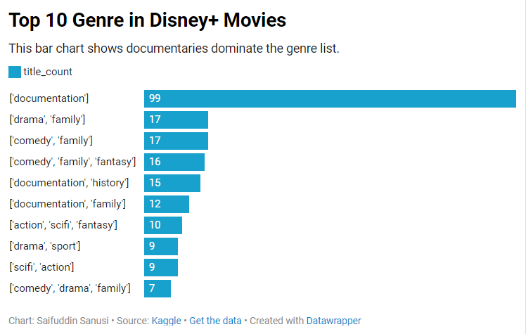
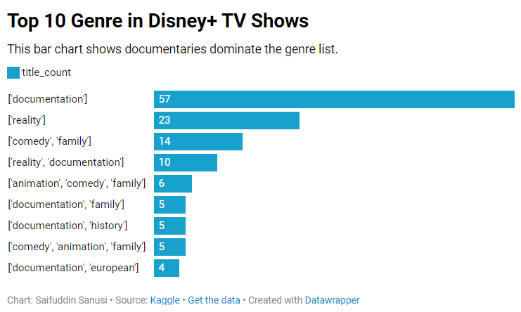
Data Analysis –
t_titles | total_seasons
The Simpsons | 36
America's Funniest Home Videos | 34
Dancing with the Stars | 32
The Incredible Dr. Pol | 22
Life Below Zero | 20
Storage Wars | 14
Banged Up Abroad | 13
Wicked Tuna | 12
Ice Road Truckers | 11
Car S.O.S. | 10
genre | title_count
['documentation'] | 99
['drama', 'family'] | 17
['comedy', 'family'] | 17
['comedy', 'family', 'fantasy'] | 16
['documentation', 'history'] | 15
['documentation', 'family'] | 12
['action', 'scifi', 'fantasy'] | 10
['drama', 'sport'] | 9
['scifi', 'action'] | 9
['comedy', 'drama', 'family'] | 7
57 ['documentation']
31 ['scifi', 'action', 'drama', 'fantasy', 'horror', 'thriller']
19 ['documentation', 'reality']
12 ['drama', 'scifi', 'action', 'war', 'thriller']
9 ['action', 'thriller']
4 ['action', 'drama', 'scifi', 'fantasy', 'romance']
4 ['scifi', 'action', 'drama']
4 ['documentation', 'european']
3 ['drama', 'scifi', 'fantasy', 'action']
3 ['action', 'scifi', 'fantasy', 'romance', 'western', 'family']
3 ['scifi', 'comedy', 'drama', 'action']
3 ['scifi', 'drama', 'fantasy', 'romance', 'action', 'comedy']

Slide 24
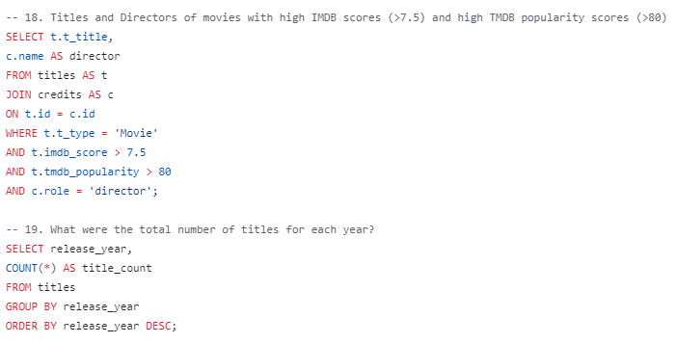
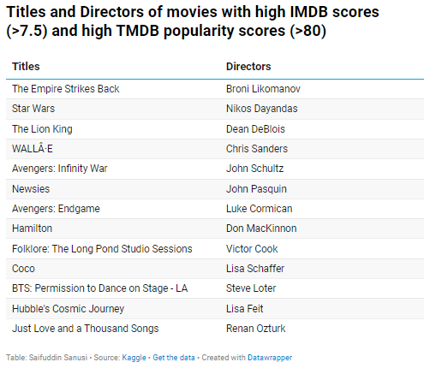
Data Analysis –Movies with high IMDB &TMDB popularity scores
Broni Likomanov
Nikos Dayandas
Dean DeBlois
Chris Sanders
John Schultz
John Pasquin
Luke Cormican
Don MacKinnon
Victor Cook
Lisa Schaffer
Steve Loter
Lisa Feit
Renan Ozturk
The Empire Strikes Back
Star Wars
The Lion King
WALLÂ·E
Avengers: Infinity War
Newsies
Avengers: Endgame
Hamilton
Folklore: The Long Pond Studio Sessions
Coco
BTS: Permission to Dance on Stage - LA
Hubble's Cosmic Journey
Just Love and a Thousand Songs

Slide 25
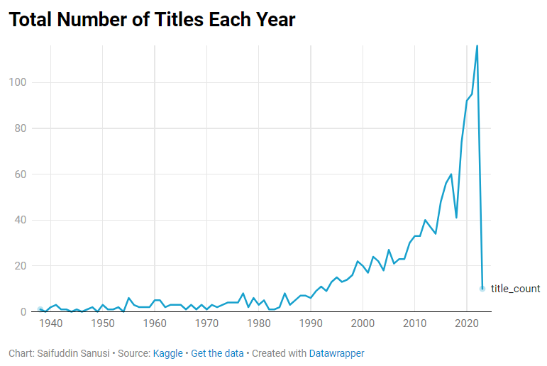
Data Analysis - Total Number of Each Year
release_year title_count
1938 1
1939 0
1940 2
1941 3
1942 1
1943 1
1944 0
1945 1
1946 0
1947 1
1948 2
1949 0
1950 3
1951 1
1952 1
1953 2
1954 0
1955 6
1956 3
1957 2
1958 2
1959 2
1960 5
1961 5
1962 2
1963 3
1964 3
1965 3
1966 1
1967 3
1968 1
1969 3
1970 1
1971 3
1972 2
1973 3
1974 4
1975 4
1976 4
1977 8
1978 2
1979 6
1980 3
1981 5
1982 1
1983 1
1984 2
1985 8
1986 3
1987 5
1988 7
1989 7
1990 6
1991 9
1992 11
1993 9
1994 13
1995 15
1996 13
1997 14
1998 16
1999 22
2000 20
2001 17
2002 24
2003 22
2004 18
2005 27
2006 21
2007 23
2008 23
2009 30
2010 33
2011 33
2012 40
2013 37
2014 34
2015 48
2016 56
2017 60
2018 41
2019 74
2020 92
2021 95
2022 116
2023 10

Slide 26
Conclusion of the Data:
Steady Growth in Title Count:
There is a steady increase in the number of titles being released from the late 1990s to 2022, with the most notable surge starting around 2009.
Early years (1938 to around the 1950s) see minimal releases, often fluctuating between 0 and 3 titles per year.
The biggest jump is from 2019 (74 titles) to 2020 (92 titles), then increasing further to 116 titles in 2022.
Consistent Growth (2000-2022):
From 1999 onward, the number of titles steadily increases. Particularly, the 2010s (2010-2019) show a consistent upward trend, with no drop in the number of releases year-to-year, culminating in the peak in 2022.
Notable Decline in 2023:
There is a sharp drop in releases in 2023 (10 titles), which might indicate incomplete data or early in the year, or it could reflect a major event affecting content production, such as post-pandemic disruptions.

Slide 27
Recommendations:
Content Diversification Strategy:
The rapid growth from 2009 to 2022 suggests an opportunity for further content diversification. Disney+ should continue to expand its content library by investing in both original and regional productions to cater to its global audience.
Optimize Content Release Schedule:
Disney+ should ensure that content releases are well-spaced throughout the year, especially after periods of heavy content production (e.g., 2020-2022). Maintaining a consistent release schedule will help keep user engagement steady.
Monitor Production Post-2022:
The sharp decline in 2023 suggests potential challenges in production or incomplete data for the year. Disney+ should evaluate production timelines and aim to bring release numbers back to 2020-2022 levels to maintain the platform's growth momentum.
Address Saturation Risks:
Given the rapid growth in titles, Disney+ should be mindful of content saturation. By focusing on quality over quantity, it can prevent viewer fatigue. Investing in high-quality, diverse, and innovative content will help maintain viewer interest as the number of releases grows.
Future Ideas:
Invest in International Content:
With the content release count growing rapidly, Disney+ should consider producing more localized content for international markets. This will help the platform expand its reach and attract a more diverse audience.
Content for Emerging Platforms:
As the number of releases increases, Disney+ could explore different content types for new or emerging platforms like virtual reality (VR), interactive shows, or gaming-based content to diversify its portfolio further.
Data-Driven Content Decisions:
Using user data and regional preferences, Disney+ should focus on producing the types of content that are most appealing to its audiences, ensuring that future releases are tailored to viewer demand and feedback-driven.

Slide 28
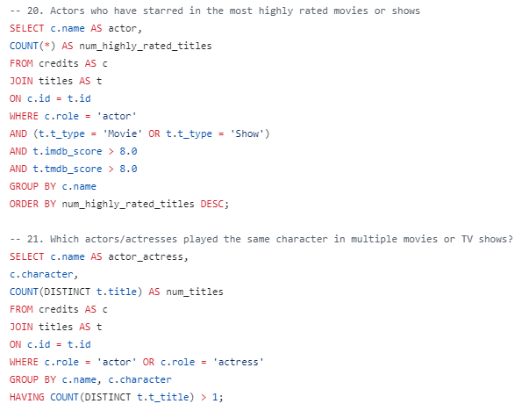
Data Analysis –
Walt Disney
Clarence Nash
Ian Weighill
Austin Pendleton
Estelle Winwood
Jacques Perrin
Wilfred Jackson
Paul Michael Glaser
James Algar
* All 1

Slide 29
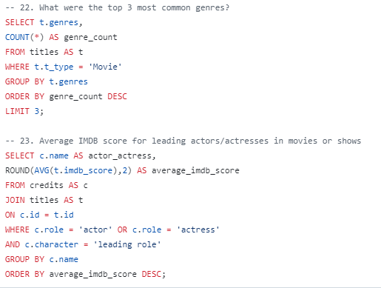
Data Analysis –
Delete #22

Slide 30
PERCENT WITH PIE CHARTS
This is a chart with graphics
To change the %, double-click on the graphic. Select Design within Chart Tools on the ribbon then select Edit Data. In the Excel table, change the number in B2 to your %. Click outside of B2 and close the dialog. You will need to re-adjust the location of % number in the center. The inner colored ring will automatically adjust in size to reflect the new %.
Percent chart elements Dots Excel chart Outer oval
COOL TRICK
Need to use the graphic in another document. Right-click on the graphic you want. Choose Save As Picture and select Enhanced Windows Metafile (.emf). Now you have a graphic that you can use for print and you can scale to any size

Slide 31
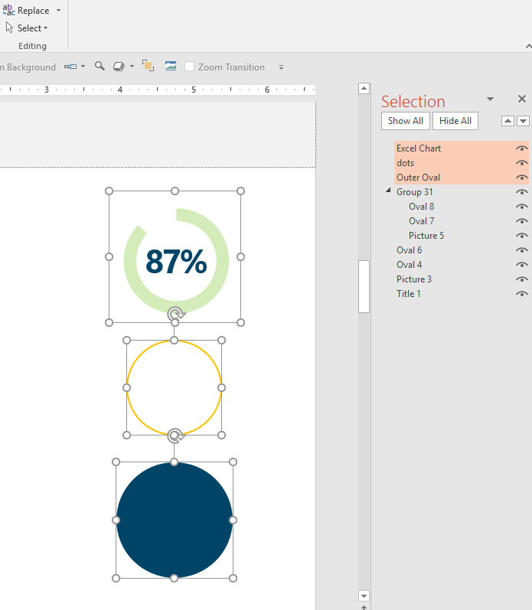
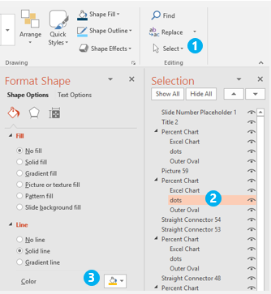
Advanced: PIE IN PIECES │ what’s in the pie chart
Changing pieces of the pie
If you are a more experienced PowerPoint graphics user, you can try customizing the colors and settings for each pie chart element using the Selection Pane.
Excel chart
dots
Outer Oval

Slide 32
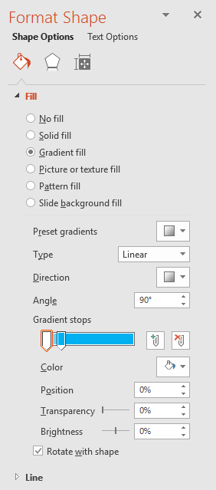
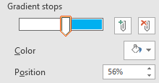
PERCENT WITH GRAPHICS
50%
70%
6.5 out of 10 males…
Graphic percentages Works with any native or Bezier graphic
The fill is a gradient. To change the percentage, right-click on the graphic. Select Format Shape from the dropdown menu. Change the % number by moving the sliders to new position. Note: both sliders need to be at the same position percentage to get a clean line between the two colors. You can change the color of each element. Drag the slider to see the color selection. You can also add a Line to outline a shape.
COOL TRICK
Need to use the graphic in another document. Right-click on the graphic you want – choose Save As Picture – select Enhanced Windows Metafile (.emf) from the dropdown menu You now have a scalable vector graphic!
1
2
2.3 females…
1
Works with any vector shape
25%
38%
2

Slide 33
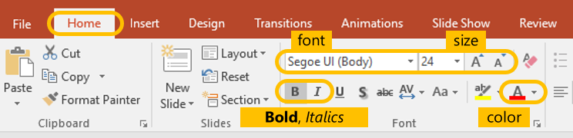
STACKED BAR CHART
These are Excel charts with data
To change the percentage, click on the chart. Select Design within Chart Tools on ribbon then select Edit Data. Change the number in column B2 to your %. Click outside of B2 and close the dialog. The title label is an editable text box overlaid on top of chart.
You can change the color of specific elements by double clicking on the part of the element you want to change and adjusting the Fill.
Stacked bar chart elements Color bar with 100% gray reference bar Data labels
COOL TRICK
Enlarge and bold #’s for added highlight and emphasis. To change the size of key numbers, double-click number to select, then use ribbon font tools on Home Tab.
TITLE
33

Slide 34
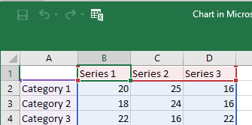

ANIMATED LINE CHART
These are Excel charts with data
To change the chart lines, right-click on the chart and select Edit Data. Change the number in columns B2…, C2…, or D2… Click outside of B2…, C2…, or D2… and close the dialog. The Title and 88% labels are editable text boxes overlaid on top of chart.
You can edit elements by double clicking on the part you want to change and then right-click for options.
Line bar chart elements Animated lines Data labels
COOL TRICK
To change the width or color of the lines, double-click to select. Then use ribbon font tools on Home Tab to change. The categories are hidden on this chart. Create new text boxes to overlay as labels on top of chart.
Title
88%
34

Slide 35
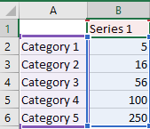
ANIMATED LINE CHART
These are Excel charts with data
To change the chart values, right-click on the graphic and select Edit Data. Change the numbers in column B2…, Click outside of B2…, C2…, or D2… and close. The Title and 88% labels are editable text boxes overlaid on top of chart.
You can edit elements by double clicking on the part you want to change and then right-click for edit options.
Line bar chart elements Animated lines Data labels
COOL TRICK
To change the size or color of the numbers or the line, double-click to select. Use ribbon font tools on Home Tab to change. The categories are hidden on this chart. Create new text boxes to overlay as labels on top of chart.
Single line
35

Slide 36
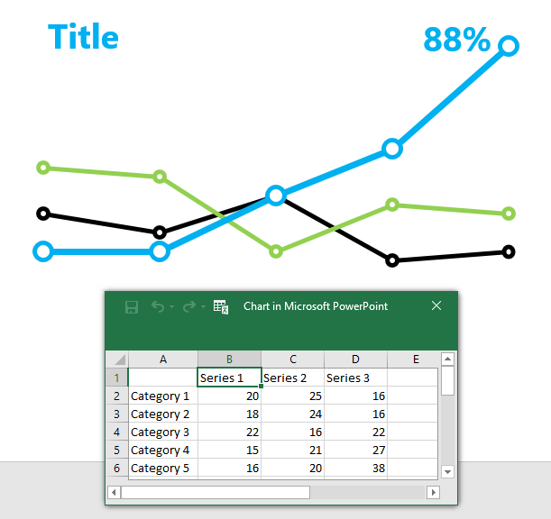
QUICK START │ VISUAL MARKER GUIDE OF CHART ELEMENTS
Detailed text directions for editing each of these charts on slides 6 & 7
Category 5
Category 1
Category 2
Series 2
Series 1
Category 4
Category 5
Series 1
Series 3
Category 3
Category 4
Black Series 1
Green Series 1
Blue Series 1
Category 3
Series 1
Category 1
Category 2
Category 1
Series 1
Series 1
Series 1
36

Slide 37

Ending slide
6.5 out of 10 people remember what they see…
SMART GRAPHICS SAMPLER
Neal Creative | click & Learn more
Notes:
This slide contains the editable pieces that were used to build infographic sample
Icons – Eye, PC

