Slide 1

Syriatel churn analysis
By Saifuddin Anjarwalla

Slide 2
Background
We have data showing which of a telco's customers have churned
The telco has wants to know how they can predict churn
We aim to give the telco insight into what to look for to predict churn

Slide 3
Project outline
Clients aim – Syriatel is a profit making company therefore their aim is to generate as much profit as possible
The Telco’s market has lost some traction in the last few years due to increased competition
Understanding and predicating churn before it happens is evermore important
This will allow the telco to hopefully increase lifetime value of a customer and to keep more customers

Slide 4
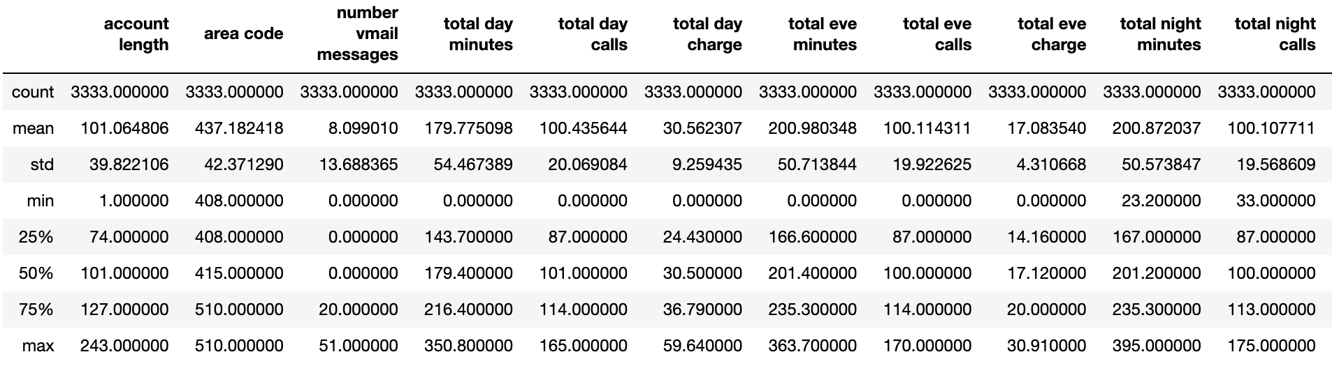
Out data
21 different variables
Key Dependent variable:
‘Churn’ – 1(customer has churned), 0(customer has not churned)
Independent variable examples:
International plan: true if the user has the international plan, otherwise false
Total day minutes: total number of minutes the user has been in calls during the day
Total eve calls: total number of calls the user has done during the evening
Customer service calls: number of customer service calls the user has done

Slide 5
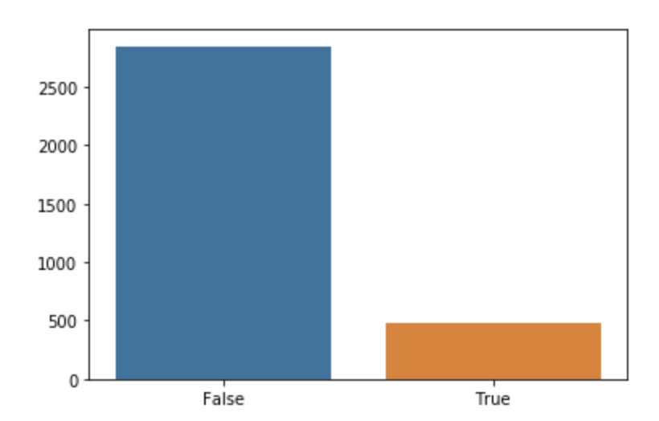
The current status of churn vs non churn

Slide 6
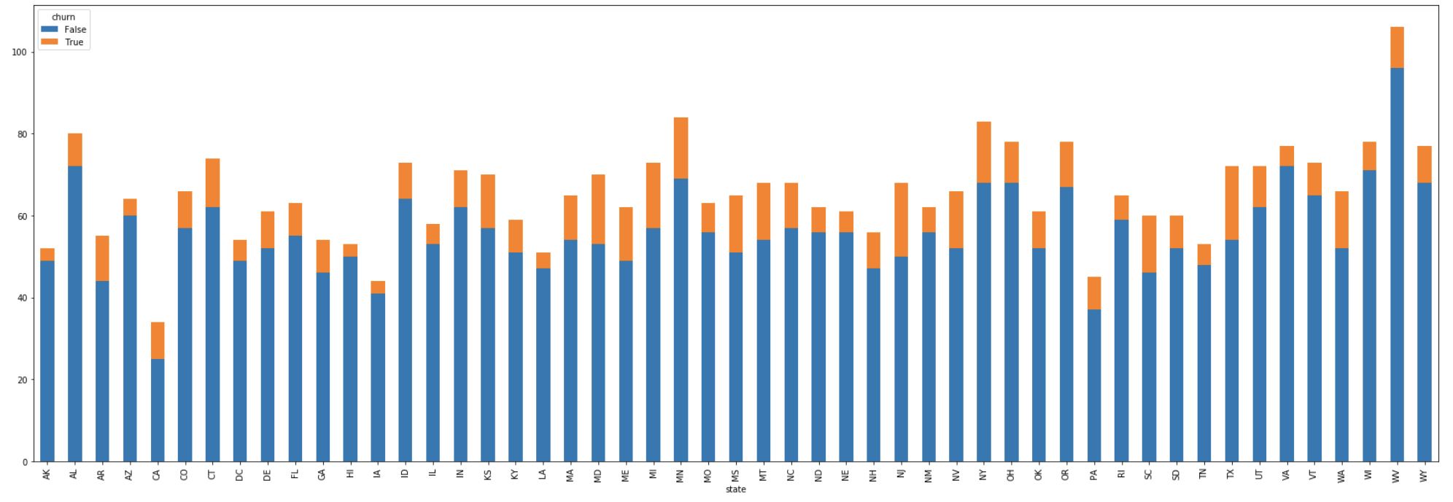
The current status of churn Churn by state

Slide 7
Our churn model
How good is it?
Training Accuracy: 98%
Validation accuracy: 95%
ROC AUC: 0.86
PR AUC score: 0.84
Notes:
A Precision-Recall curve is exactly what it sounds like. It allows us to see the relationship between the precision (the number of true positives over the total number of positives - true positives and false positives combined) and the recall (number of true positives over the total number of real true values - the true positives and false negatives combined).

Slide 8
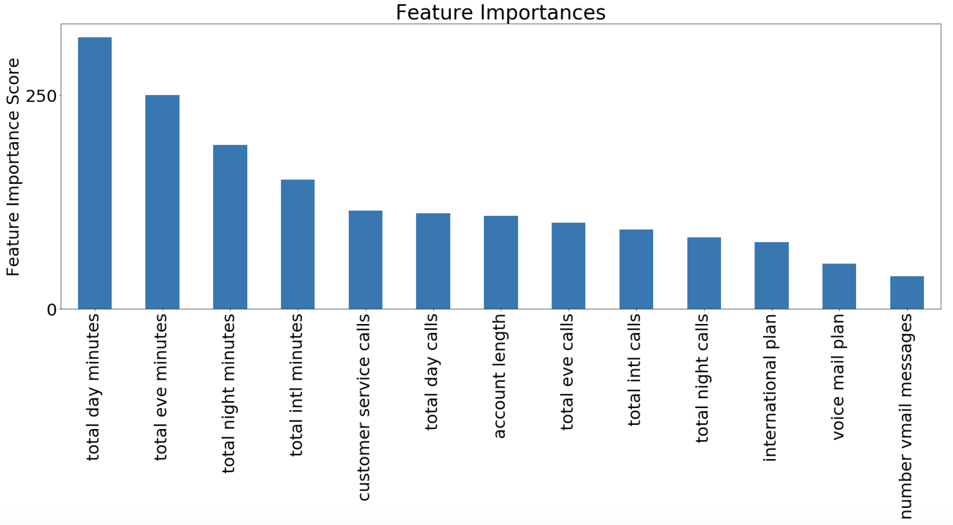
What matters in predicting churn?

Slide 9
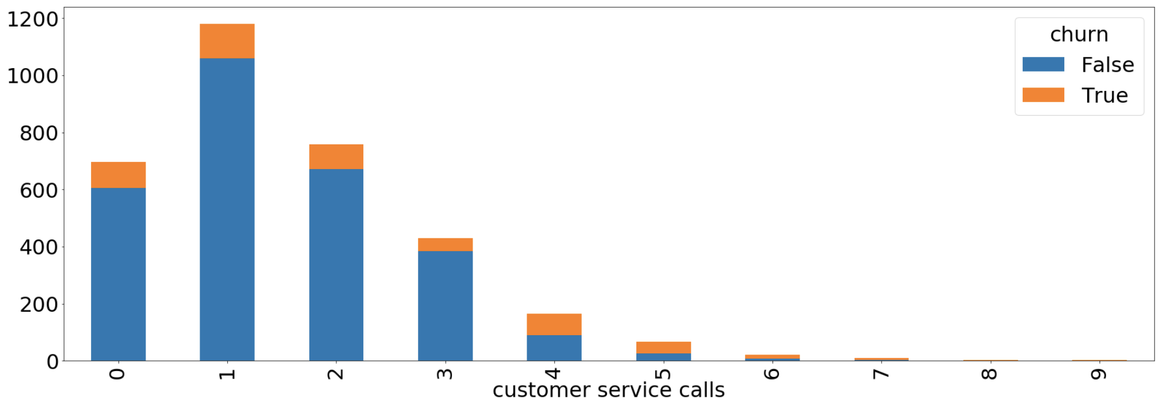
High numbers of Customer service calls are associated with churn
0 service calls = 13% churn
4 service calls = 46% churn
8 and 9 service calls = 100% churn

Slide 10
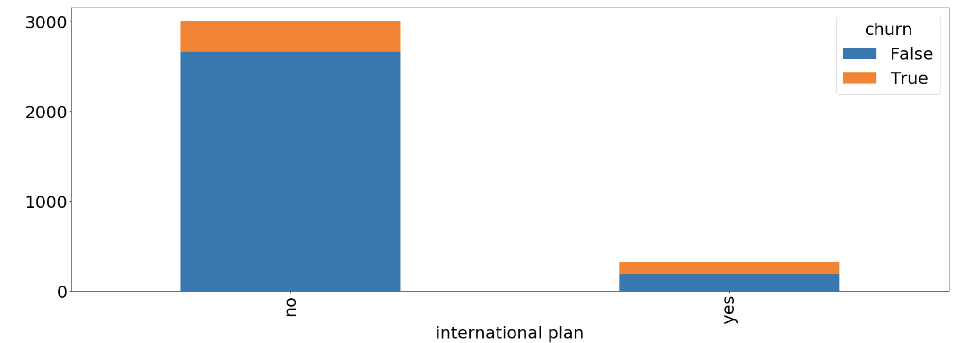
Customers with an International Plan seem to churn
No international plan = 11% churn
Yes international plan = 42% churn

Slide 11
Conclusion
After analyzing the data we created a model to predict churn
We tuned our model to get a PR AUC of 0.84
The Telco and use this model in the future to predict which of its customer will churn
We found a number of features that were important to look at to identify churn. To name a few these were:
Total time spent on the phone (day, night and evening minutes)
Whether the customer has an International plan
How many customer service calls a customer makes

Slide 12
Thank you for your time
Any questions?

