Slide 1

Syriatel churn analysis
By Saifuddin Anjarwalla

Slide 2
Background
We have data showing which of a telco's customers have churned
The telco has wants to know how they can predict churn
How can they use this model to increase profit

Slide 3
Project outline
Clients aim – Syriatel is a profit making company therefore their aim is to generate as much profit as possible
The Telco’s market has lost some traction in the last few years due to increased competition
Understanding and predicating churn before it happens is evermore important
This will allow the telco to hopefully increase lifetime value of a customer and to keep more customers

Slide 4
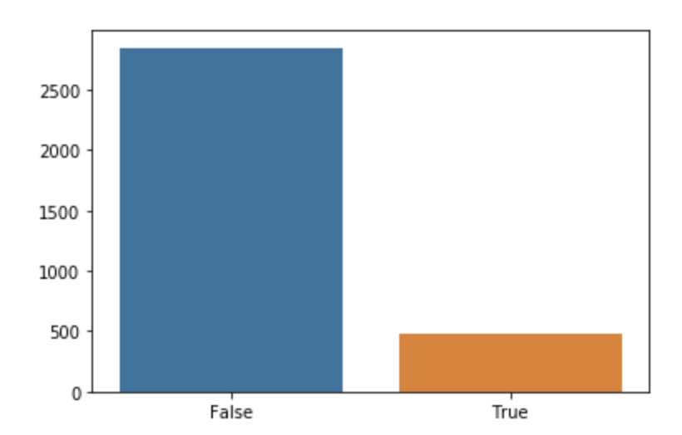
The current status of churn vs non churn

Slide 5
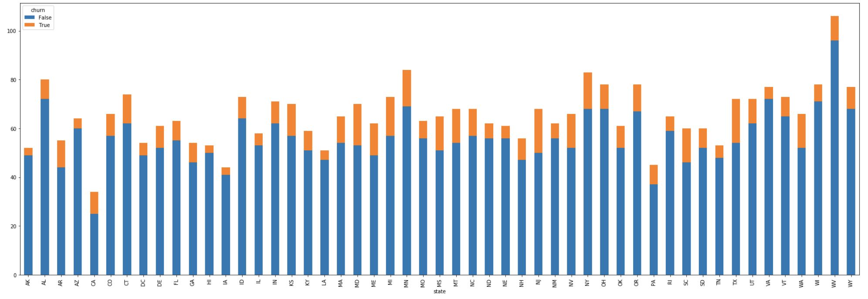
The current status of churn Churn by state

Slide 6
Our churn model
How good is it?
Training Accuracy: 98.17%
Validation accuracy: 95.21%
ROC Area Under Curve: 0.868006993006993
PR AUC score: 0.8429640718562873

Slide 7
What you should use this for
You will know the likely of a client churning before they do
Target them with targeted advertising to stop them from churning
Incentivise them to stay with the company
Cut them off early to avoid spending resources on clients who are likely to churn

Slide 8
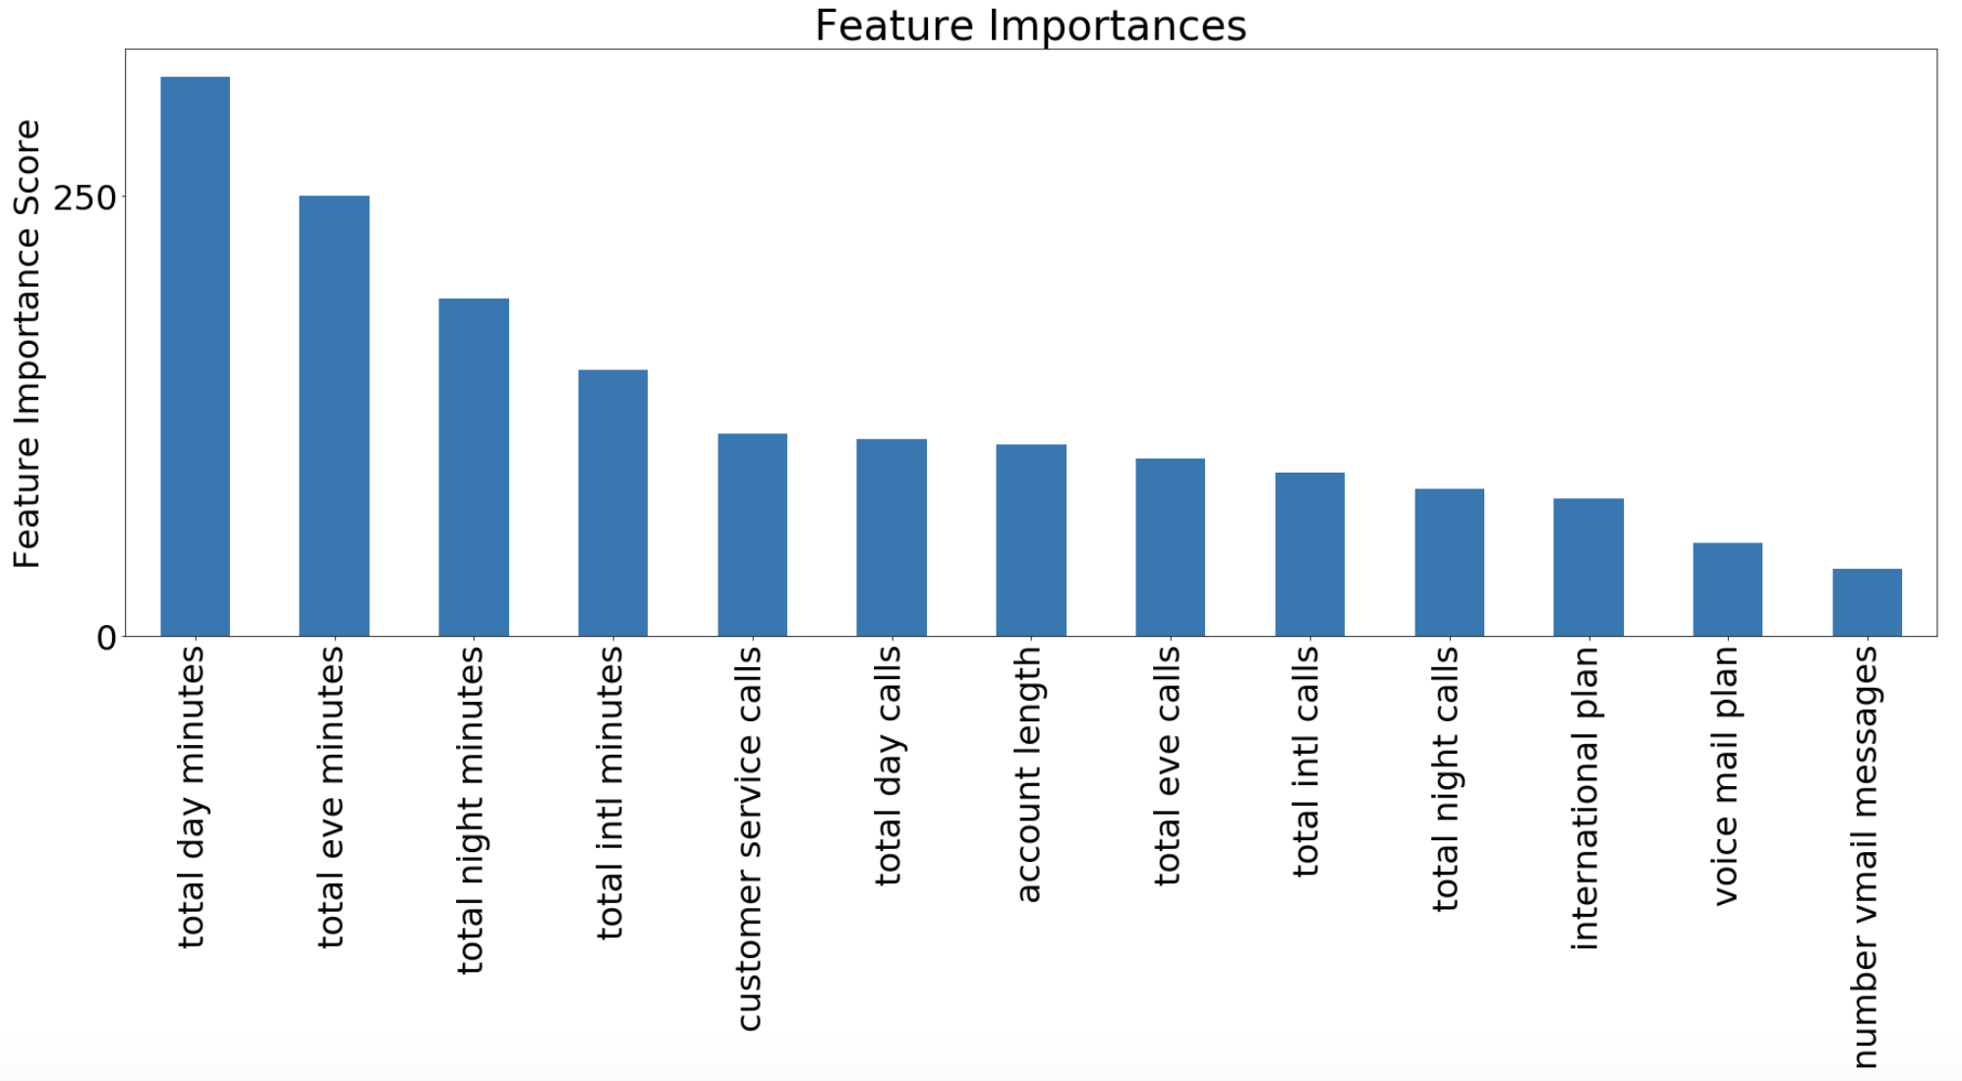
What matters in predicting churn?

Slide 9
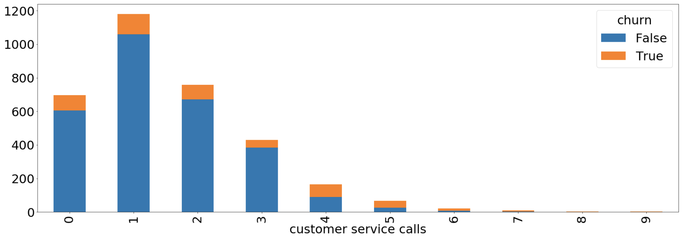
Customer service calls
0 service calls = 13% churn
4 service calls = 46% churn
8 and 9 service calls = 100% churn

Slide 10
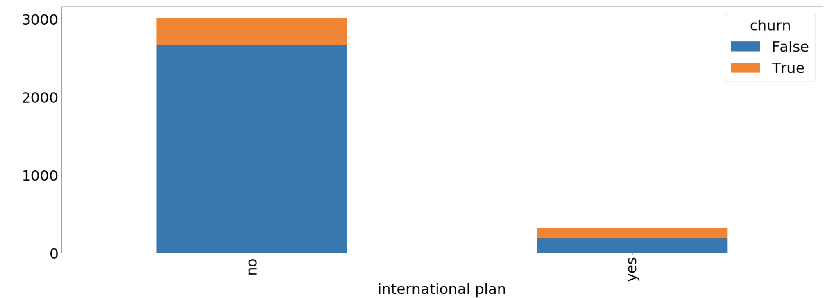
International Plan
No international plan = 11% churn
Yes international plan = 42% churn

