Slide 1

Zillow housing data problem
By Saifuddin Anjarwalla

Slide 2
Background
I have data of house prices 1996 - 2018
I work for a real-estate company looking for new investments
I need to find out which regions would be the bets best to invest in

Slide 3
Project outline
The current economic situation, with low interest rates and high inflation means that people want to invest
The real-estate market is a perfect place to invest in. Thus, competition in the market has risen and all investment decisions need to be taken wisely
Using data to help decide what makes a good investment decision has not been more important than ever
I will use the data available to generate 5 zip codes to invest in. This should help the investment firm make the most appropriate investment decision

Slide 4
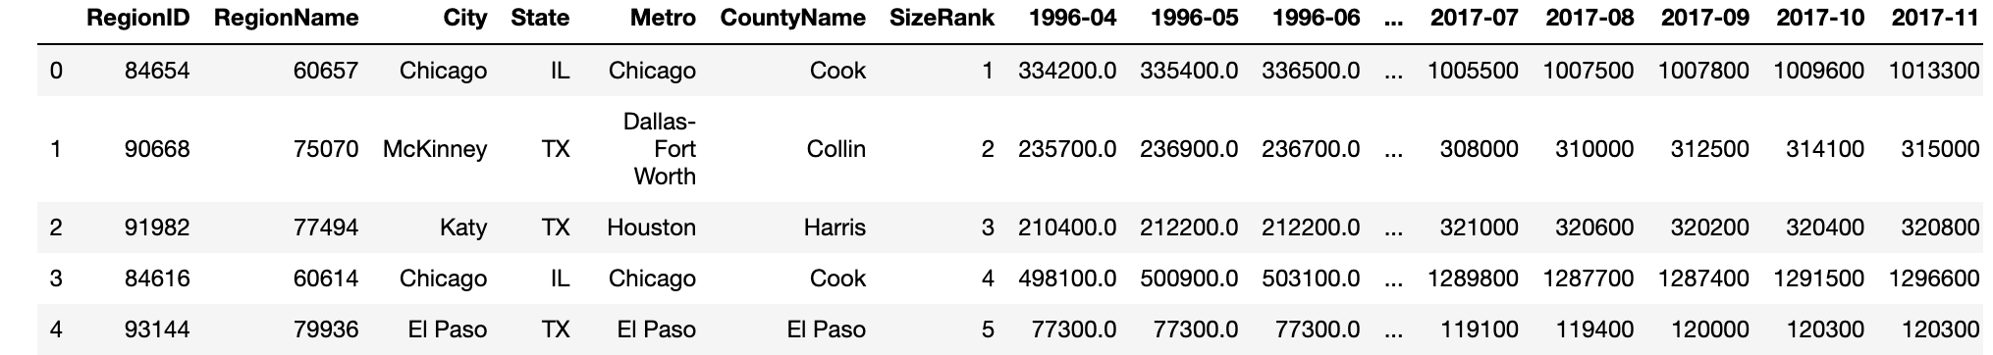
Out data

Slide 5
Finding the top 7 regions to analyze
I decide to filter the data based on zip code.
I take the top 20% of zip codes as this would give me property that is more urbanized. This is preferable to me as an investor.
From the top 20% I decide to filter it down even more.
I choose data that is in the 60th quantile of CV to reduce risk.
I decide to choose properties that are 10% above the average value (of the last 12 months value) and 15% below the average value (of the last 12 months value).
I calculated the ROI for all the remaining properties and chose the properties with the highest ROI.

Slide 6
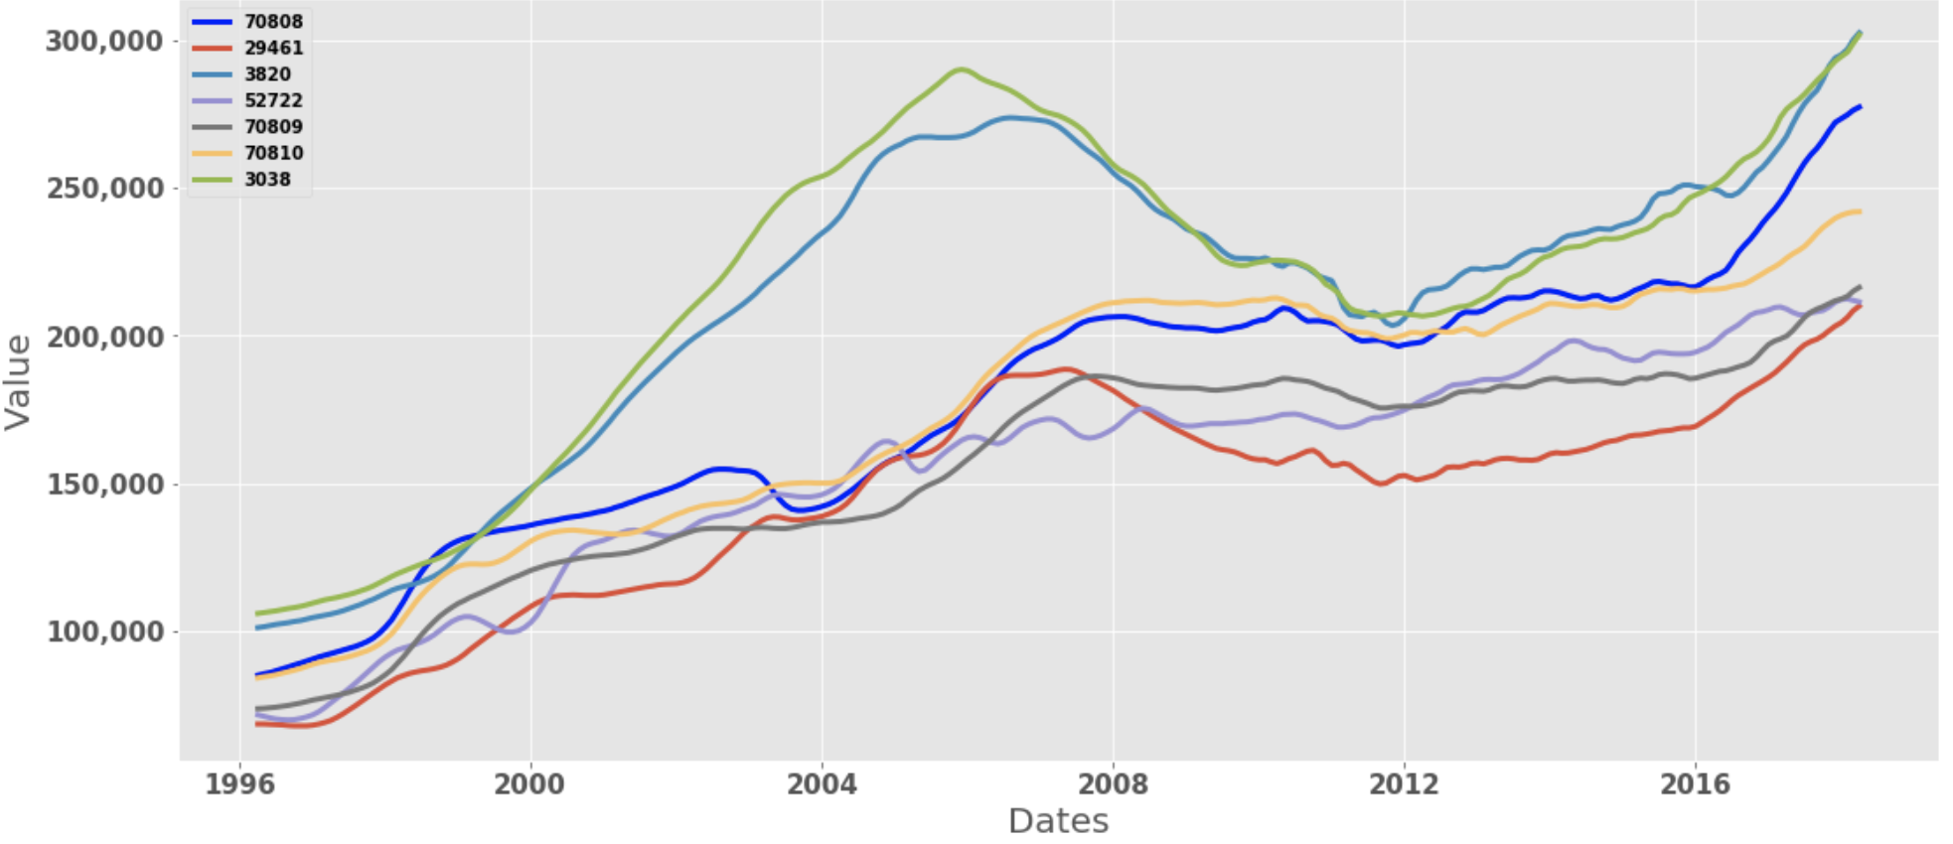
How do they look like (house prices over time)

Slide 7
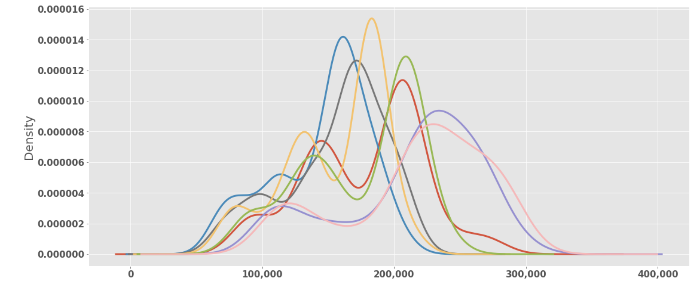
How do they look like (Density plot)

Slide 8
What model did we build?
We build an ARIMA model for each region
We then used this to forecast for the next 1, 5 and 10 years
We choose our investment term of 5 years
We then calculated the ROI over the next 5 years and filtered on which of the 5 house prices had the highest ROI

Slide 9
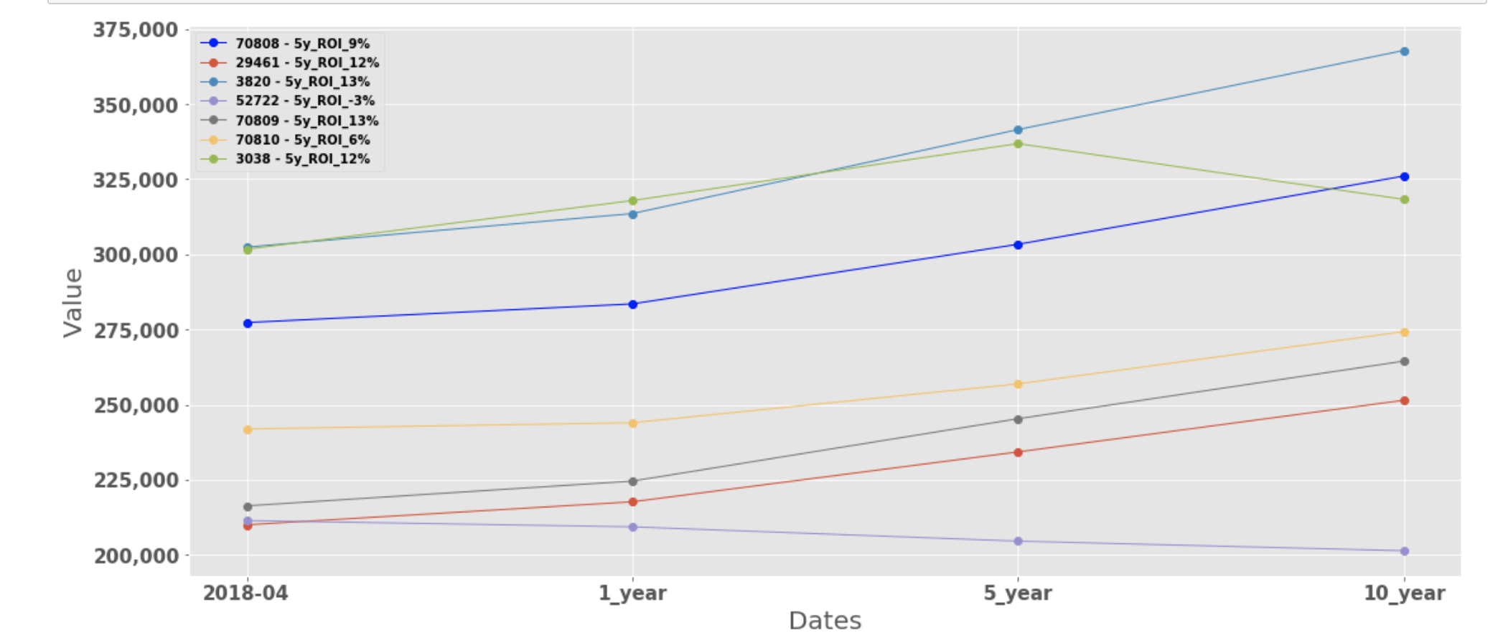
So which ones are they?
The Regions I would invest in, in order of preference are.
1. 70809
2. 03820
3. 03038
4. 29461
5. 70808
This is because the ROI's for these 5 properties were highest after 5 years.

Slide 10
Conclusion
We first analyzed the data.
We came up with a subset of regions to analyze.
We created a time series model on these regions and forecasted them into the future.
We then calculated the ROI in the future and narrowed down the top 5.

Slide 11
Thank you for your time
Any questions?
Email: Saifuddinanjarwalla@gmail.com
Phone number: +447516369953

