Slide 1

Airbnb price prediction
By Saifuddin Anjarwalla

Slide 2
Background
I have data of Airbnb listings from November and December 2021
I aim to sell this prototype to Airbnb so that they can add it as an additional functionality for their users
I believe that this function will ultimately increase Airbnb revenue and make it a more dominant player in the market.

Slide 3
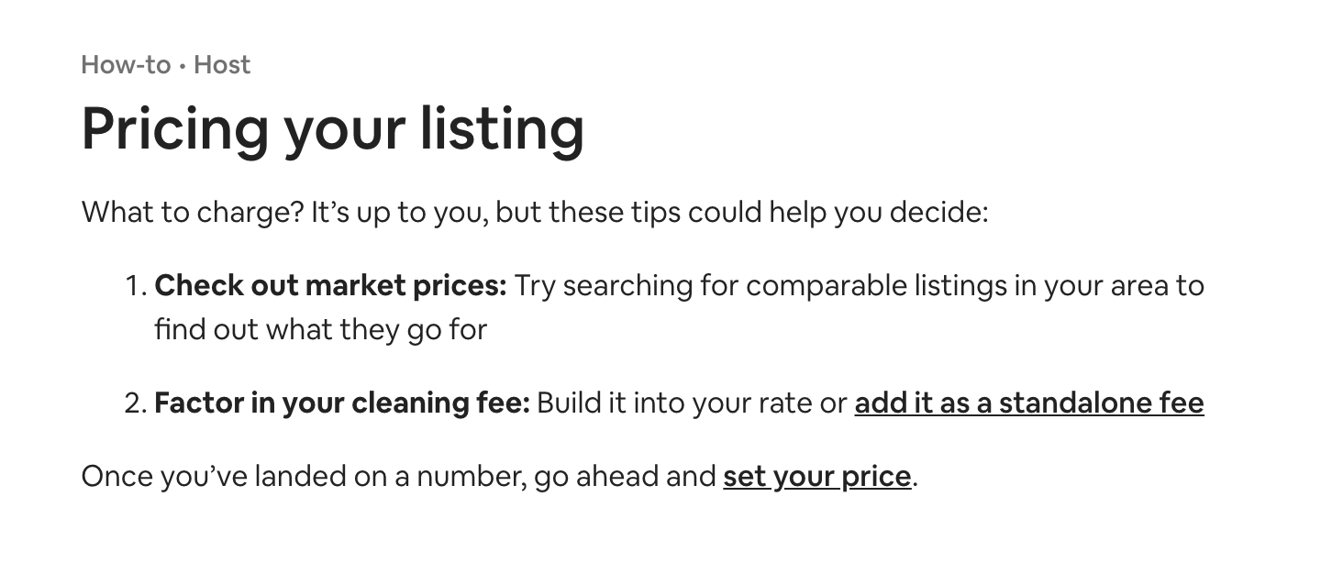
Project outline
I wanted to list a spare room I had on Airbnb. After much effort I had no idea how to even start thinking about the price.
I thought that benchmarking my property against other would be a great way to start. Airbnb has readily available data.
If I experienced this issue I assume others must have done so as well. I decided to build a prototype that I could pitch to Airbnb to buy from me.
I believe that this prototype will (1) Increase Airbnb client satisfaction, (2) increase Airbnb client sales, (3) increase Airbnb revenue.

Slide 4
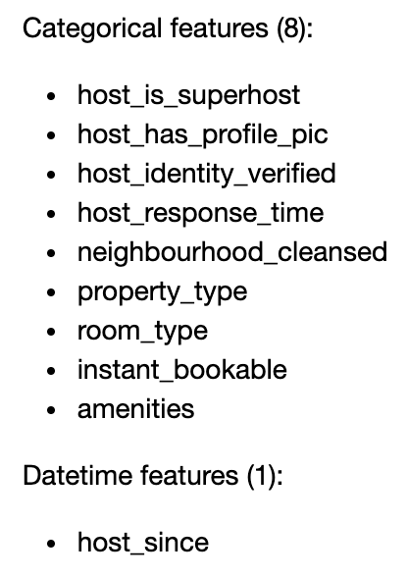
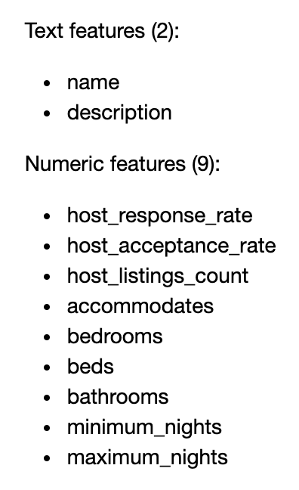
Out data

Slide 5
What did I do to the data
We had to clean of our variables into a readable mannor
Make categorical features
Make numeric features
Datetime features
Make amenities feature into a numeric value
We deleted all Airbnb’s who’s price was two SD above the mean

Slide 6
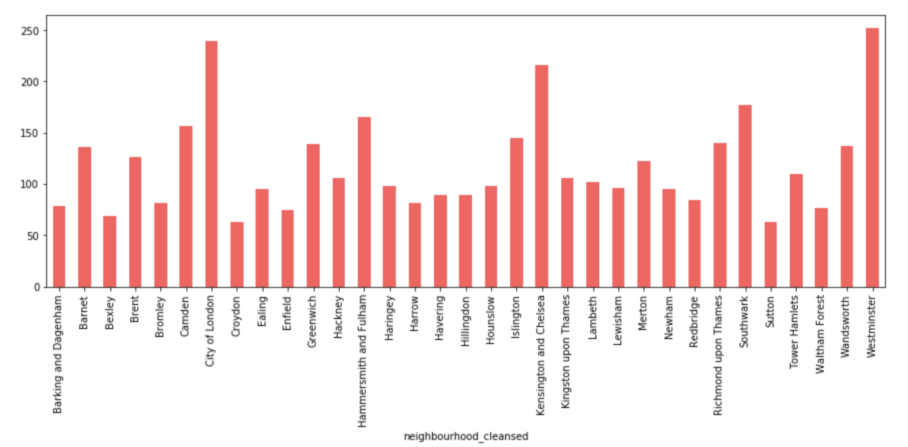
House prices by borough of London

Slide 7
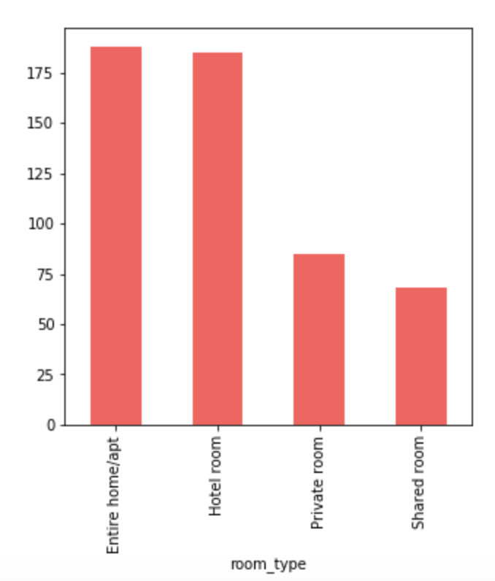
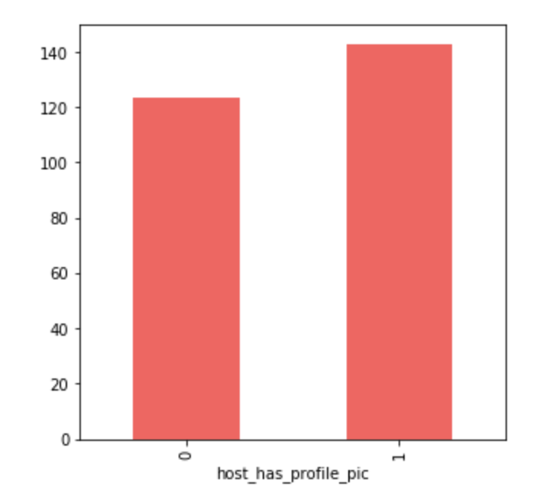
House prices by room type and by whether the host has a profile picture

Slide 8
What model did we build?
We built an Xgboost model
We hyper trained our parameters
Our RMSE is 42.97
If we limit our prices to $400 our RMSE is 32.91

Slide 9
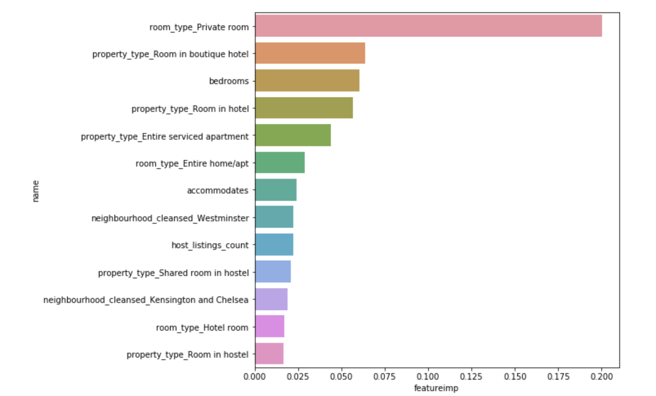
Feature importance

Slide 10
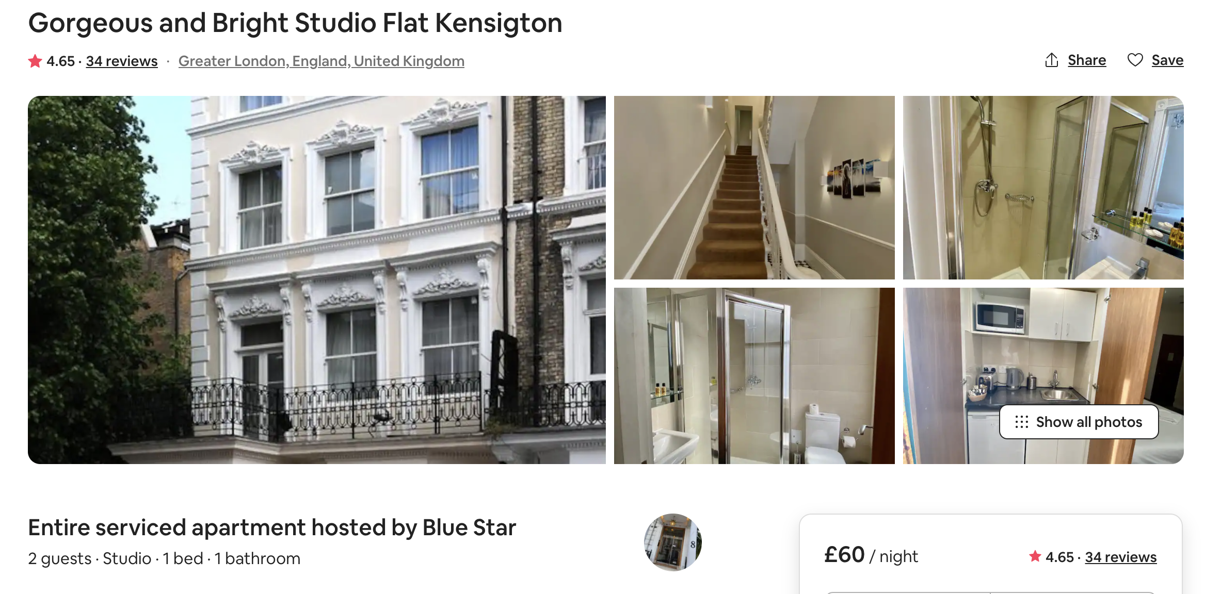
Live demo

Slide 11

Conclusion
I found great and extensive data from Airbnb.
I analysed this data and performed a lot of data manipulation to make sure that it is usabel for us.
We then saved this model and created a dashboard to predict the value of a new property.
We used dash to create the dashboard. We had to manipulate the data that is inputted into the dashboard so that it is in the right format for the model.
We created an XGBoost model to predict the value of an airbnb property. We hyper tuned this model to find the ideal parameters.
We then run the imputed data through our model and we thus generate a price which we display in our dashboard.

Slide 12

Thank you for your time
Any questions?
Email: Saifuddinanjarwalla@gmail.com
Phone number: +447516369953

