Slide 1

MumbaiHacks
2024
SaaS | Productivity
CleverOps AI
Get the exact data you need from any of your
data sources in minutes.
https://clever-ops-landing.vercel.app
Made in Mumbai ❤️

Slide 2
MumbaiHacks
2024
The Problem
The average company uses 10+ different SaaS platforms
Product teams juggle between CRM, support tickets, analytics dashboards, and databases, Product Roadmap Tools, Product Docs.
Each platform has its own interface, learning curve, and isolated data
Made in Mumbai ❤️

Slide 3
MumbaiHacks
2024
Business Impact
$157B lost annually to poor data integration (IDC estimate)
5.5 hours lost per employee per week searching for information
73% of data never analyzed due to access complexity
Missed opportunities due to delayed insights
Made in Mumbai ❤️

Slide 4
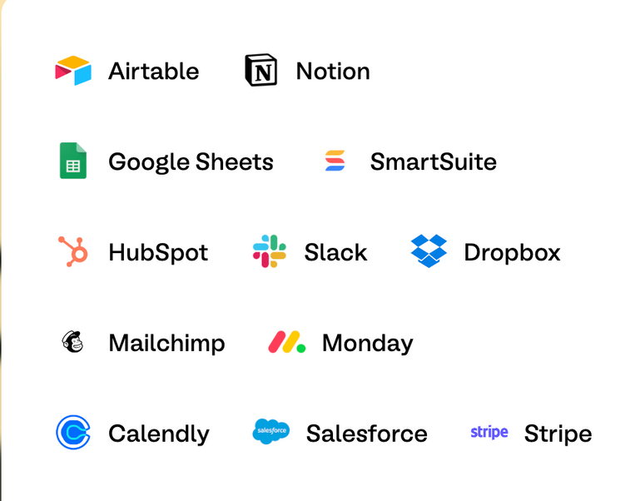
MumbaiHacks
2024
Presenting
CleverOps AI
CleverOps AI is a unified intelligence layer that connects all your business platforms through advanced LLM agents.
Ask Anything
Natural language queries: "Show me Average customer rating for Q3”
Smart AI Engines
Connects your tools (Intercom, Jira, Hubspot, etc.)
Intelligently correlates cross-platform data
Delivers unified insights in seconds
Made in Mumbai ❤️

Slide 5

MumbaiHacks
2024
Immediate Benefits
Time Savings
70% reduction in data gathering time
15-20 hours saved per employee monthly
Instant access to cross-platform insights
Improved Collaboration
Shared understanding across teams
Reduced dependency on data specialists
Faster onboarding for new employees
CRM
Customer Service
Analytics
Product Docs
Get easy answers to all of your questions.
Powered by AI.
Made in Mumbai ❤️

Slide 6
MumbaiHacks
2024
Future Scope
Unified Platform (CleverOps Suite)
Native alternatives to common SaaS tools
Seamless migration path from existing platforms
Built-in cross-platform analytics
Single unified data model
CleverOps Copilot
AI assistant for every role
Contextual recommendations
Proactive insights delivery
Personalized workflow optimization
Automated Business Workflow for customer and product management
Made in Mumbai ❤️

