Slide 1
ASSESSMENT 3 · MOBILE APPLICATION DEVELOPMENT · LA TROBE UNIVERSITY
STEMMLab
New Feature Analysis
A React Native (Expo) app that transforms real-world physical activities
into gamified STEMM learning experiences for school students.
Multi-Language Translation
Text-to-Speech
Performance Charts
Saiful Islam Shihab · Student ID-21732977 · La Trobe University

Slide 2



Feature Overview
Three New Features Implemented
01
02
03
Multi-Language Translation
Text-to-Speech (TTS)
Performance Charts
Switches entire app UI between English, Spanish, Arabic, and Chinese
Custom TypeScript i18n system — no external API or internet required
Language preference persists via AsyncStorage across sessions
100+ translation keys covering every screen in the app
"Read Aloud" toggle button on every Activity Detail screen
Reads full content: title, instructions, objectives, tags, and more
Language-aware — speaks in the user's currently selected language
Fully on-device using native OS speech synthesis APIs
Animated bar charts on the History screen
Two modes: attempt overview across activities, or trend per activity
Shows whether student performance is improving over time
Respects app theme — dark mode and font scale settings

Slide 3
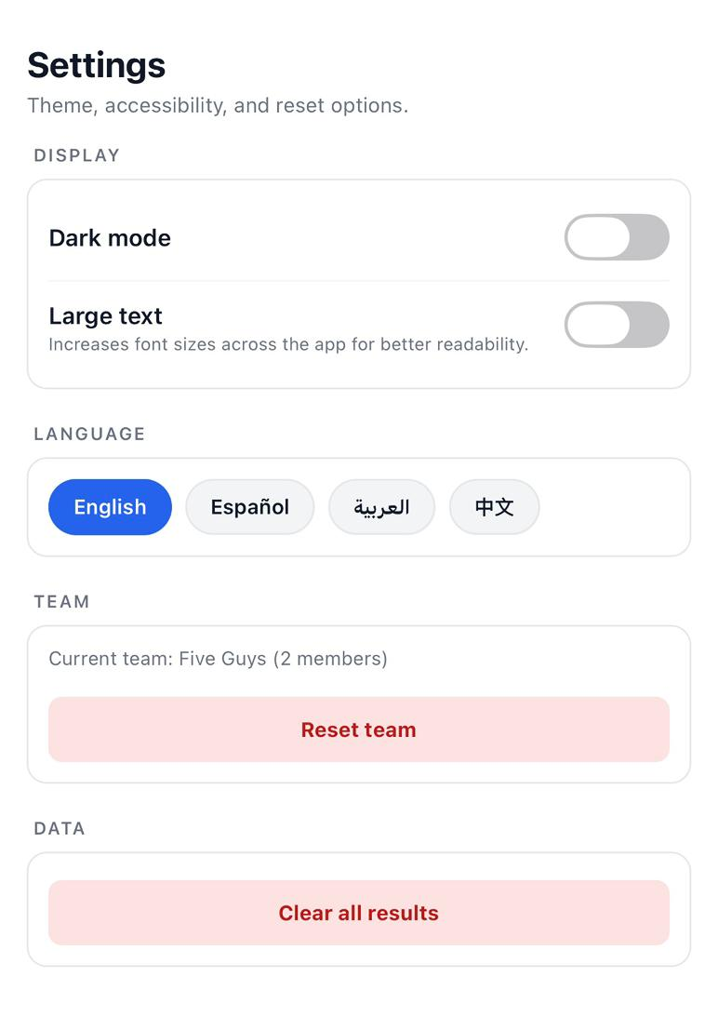
Feature 1: Multi-Language Translation
WHAT IT DOES
The full app UI switches between 4 languages — English, Spanish, Arabic, and Chinese. Every element updates instantly: tab labels, headings, activity titles, buttons, alerts, and all instructional content. The selected language is saved via AsyncStorage and persists across app restarts.
EN English
ES Español
AR العربية
ZH 中文
WHY IT IS NEEDED
STEMMLab targets primary and high school students from diverse backgrounds. An English-only app creates direct barriers for:
EAL (English as an Additional Language) learners
Students from non-English-speaking families
Students in multicultural Australian classrooms
No internet connection or paid translation API required — fully offline.

Slide 4
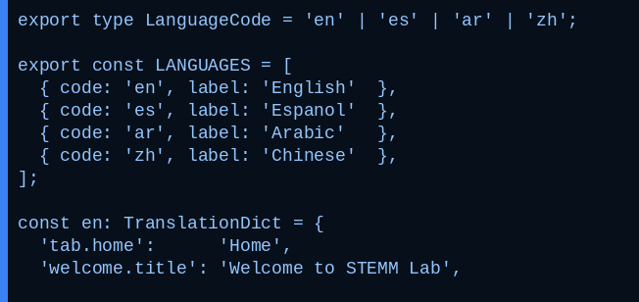
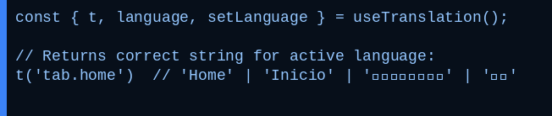

Feature 1: Installation & Architecture
No external library — custom TypeScript i18n architecture
ARCHITECTURE FLOW
translations.ts
LanguageContext
useTranslation()
translations.ts — language type & dictionary structure
→
→
Dictionary
4 langs × 100+ keys
React Context
+ AsyncStorage
Hook used by
every screen
KEY DESIGN DECISIONS
Zero runtime overhead — O(1) in-memory dictionary lookup, no API latency
Persistent — selected language restored from AsyncStorage on every app launch
Consuming translations in any screen:
Extensible — adding a 5th language requires only one new dictionary object
Type-safe — LanguageCode union type prevents invalid language values at compile time
Self-contained — no external npm dependency, no internet, no API cost

Slide 5
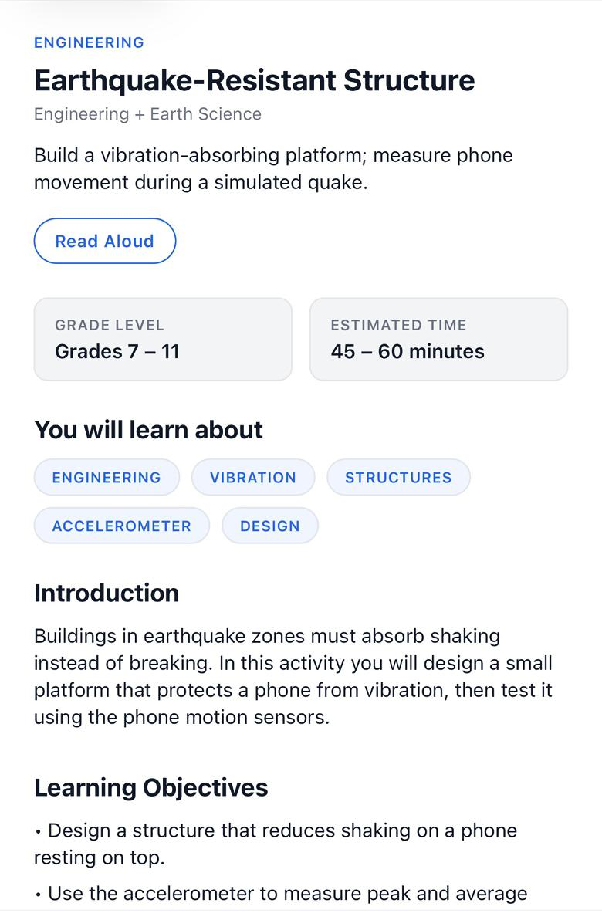
Feature 2: Text-to-Speech (TTS)
WHAT IT DOES
A "Read Aloud" toggle button on every Activity Detail screen. When pressed, expo-speech reads the complete activity content aloud — title, short description, grade level, time estimate, topic tags, and all instructional sections. The button becomes "Stop Reading" while active. Speech stops automatically when navigating away.
▶ Read Aloud
→ pressed
■ Stop Reading
expo-speech ~14.0.8
INSERT SCREENSHOT HERE
WHY IT IS NEEDED
Activity Detail screen showing
"Read Aloud" button below the
activity description
(Earthquake-Resistant Structure)
Students with dyslexia or reading difficulties face barriers with text-heavy instructions
Visual impairments — audio becomes the primary interface for content
EAL learners benefit from hearing content spoken while reading it simultaneously
Hands-free use: listen to instructions while physically preparing activity materials

Slide 6
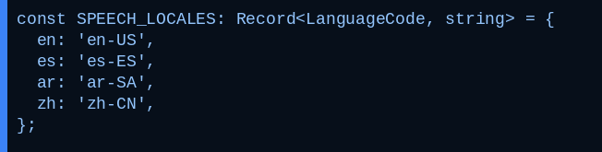
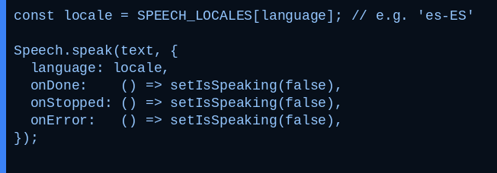
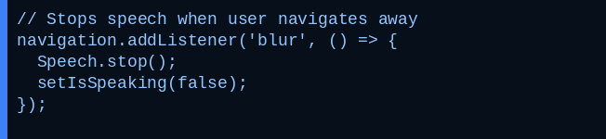
Feature 2: Installation & How It Works
LANGUAGE-TO-LOCALE MAPPING
KEY BEHAVIOURS
Language-aware
Reads in whichever language is selected in Settings. Locale automatically updated from SPEECH_LOCALES map — no extra configuration.
SPEECH PLAYBACK
Auto-stop on navigation
Speech stops on screen blur event and component unmount. No memory leaks, no audio continuing in the background.
Toggle control
Single button starts and stops reading. isSpeaking state prevents duplicate speech instances being spawned.
AUTO-STOP ON NAVIGATION
Fully on-device privacy
No microphone accessed. No audio recorded or transmitted. Uses iOS AVSpeechSynthesizer / Android TextToSpeech natively.

Slide 7
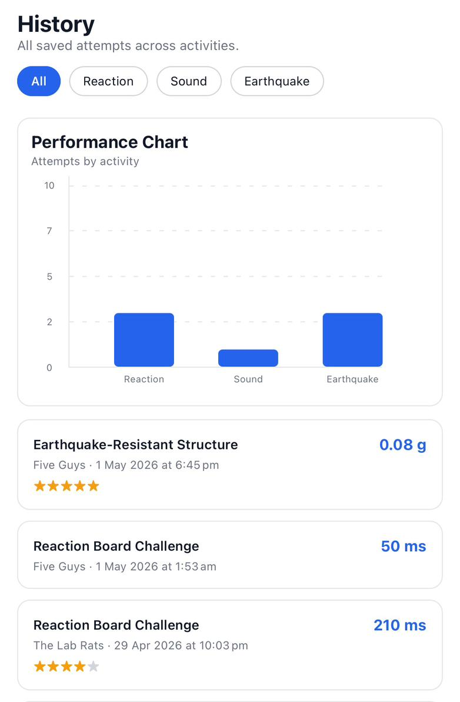
Feature 3: Performance Charts & Graphs
WHAT IT DOES
An animated BarChart at the top of the History screen, controlled by filter chips. Two display modes:
ALL MODE
PER-ACTIVITY MODE
One bar per activity — shows total attempt count. See which activities the team has engaged with most at a glance.
Last 10 results for a selected activity in chronological order — reveals whether performance is improving over time.
react-native-gifted-charts ^1.4.76
WHY IT IS NEEDED
Without visual feedback, students cannot see whether they are actually improving over time
A raw list of results requires mental effort — a chart makes trends instantly obvious
E.g. reaction time dropping from 350ms to 188ms across 5 attempts is immediately visible
Teachers can use overview mode to assess team engagement across all activities at a glance

Slide 8
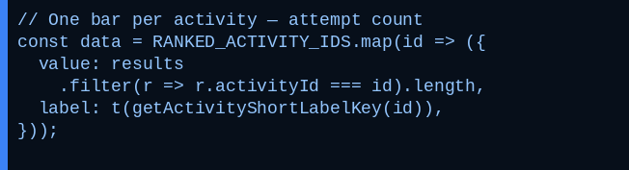
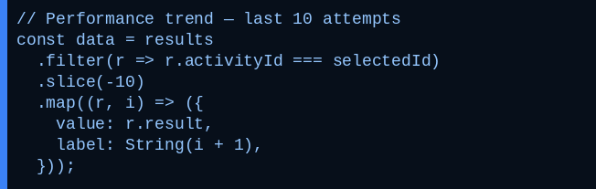

Feature 3: Installation & How It Works
ALL-ACTIVITIES MODE — attempt frequency
KEY FEATURES
Animated bars
React Native native driver animations on chart load — hardware-accelerated and smooth on mid-range devices.
PER-ACTIVITY MODE — last 10 results
Dark mode & theme aware
Bar colour, axis labels, grid lines drawn from ThemeContext — automatically adapts between light and dark mode.
Fully responsive layout
adjustToWidth fills available screen width. Spacing dynamically computed. Works on all phone sizes.
BARCHART COMPONENT
useMemo optimised
Chart data only recomputes when results or activeFilter change — prevents unnecessary re-renders.

Slide 9
Critical Analysis
TECHNICAL FEASIBILITY
Translation
Fully feasible — no external API or network dependency. Custom dictionary scales linearly; adding a language is one new object in translations.ts. Limitation: translation quality depends on the manual translator.
TTS
expo-speech wraps native OS APIs (iOS AVSpeechSynthesizer, Android TextToSpeech) with no extra permissions required. Limitation: Arabic and Chinese voice quality depends on device language packs being installed.
Charts
react-native-gifted-charts is actively maintained (2,800+ GitHub stars) and uses React Native's native driver for animations. Limitation: First SVG render may show a slight delay on very low-end Android devices.
PERFORMANCE & COMPATIBILITY
Translation
TTS
Charts
Zero overhead — O(1) in-memory lookup. Works on iOS, Android, and Web. No latency, no bundle size increase.
Fully async — runs on native thread, never blocks JS or UI thread. Properly released on unmount — no memory leaks.
Hardware-accelerated animations. useMemo prevents unnecessary re-renders. Responsive to screen width via adjustToWidth.

Slide 10
Critical Analysis — Accessibility, Privacy & Verdict
TRANSLATION
TEXT-TO-SPEECH
CHARTS
Removes language barriers for EAL students in diverse Australian schools — directly serves the app's target demographic.
Supports dyslexia, reading difficulties, EAL learners, and visual impairments. Aligns with WCAG 2.1 Guideline 1.1.
Visual trends complemented by the text list below. Font scale accessibility settings apply to all chart labels.
Accessibility
No data sent externally. Language preference stored locally via AsyncStorage only. Zero network calls.
100% on-device. No audio recorded or transmitted. Microphone never accessed.
Chart data from locally stored results only. No analytics, tracking, or external reporting of any kind.
Privacy
FINAL VERDICT — INCLUDE IN FINAL APP?
YES — INCLUDE IN FINAL APP
YES — INCLUDE IN FINAL APP
YES — INCLUDE IN FINAL APP
Translation
Text-to-Speech
Charts
Essential for inclusivity in a multicultural school demographic. Zero cost, no dependency.
Strong accessibility value. Hands-free benefit during real-world activities. 100% on-device.
Directly enhances learning feedback and tracks student improvement over time.

