Slide 1
Welcome

Slide 2
HELLO!
We are
Saiful Islam Sakib
Rofiqul Islam
Shariqa Trina
Gazi Mahedee Hasan

Slide 3
Obstacle Avoiding Robot

Slide 4
Introduction
An Obstacle Avoidance Robot is an intelligent robot, which can automatically sense and overcome obstacles on its path. It contains of a Microcontroller to process the data, and Ultrasonic sensors to detect the obstacles on its path.
Obstacle avoidance is one of the most important aspects of mobile robotics.

Slide 5
Purpose
The primary purpose of the project is to create a robot
which can make decision itself about movement on different terrain. The functionalities of the robot can
be extended as needed. It can be used to collect information about it’s surroundings without a
human guide.

Slide 6
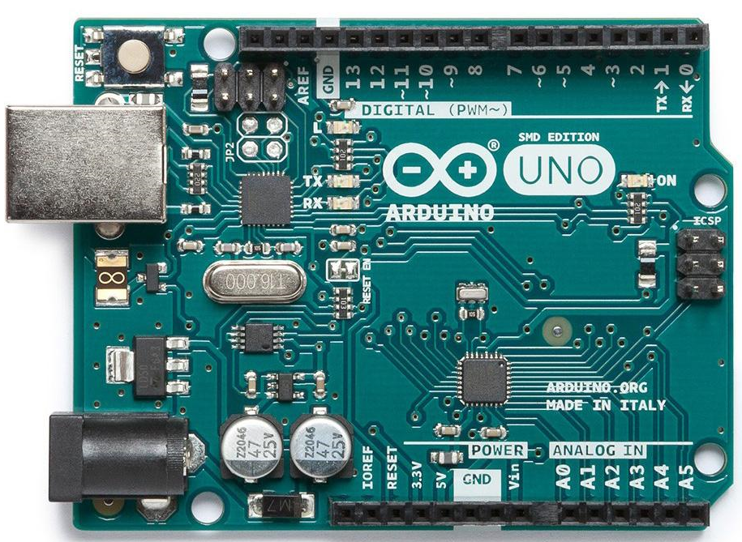
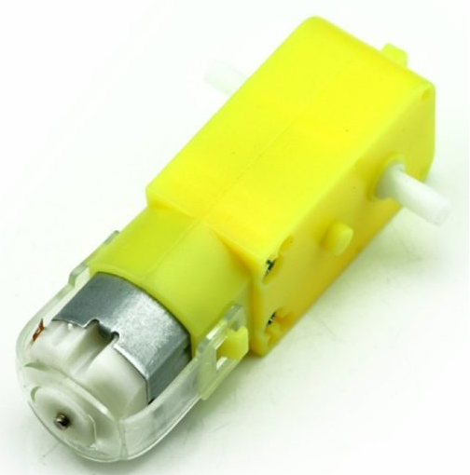
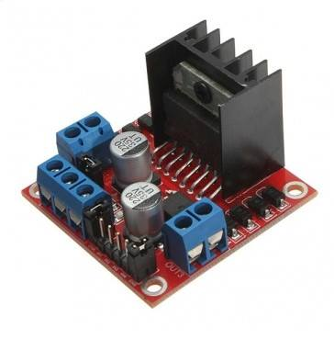
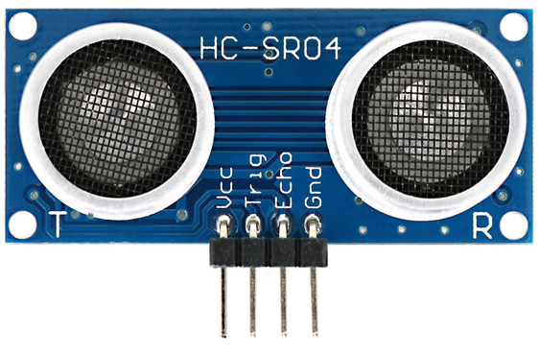
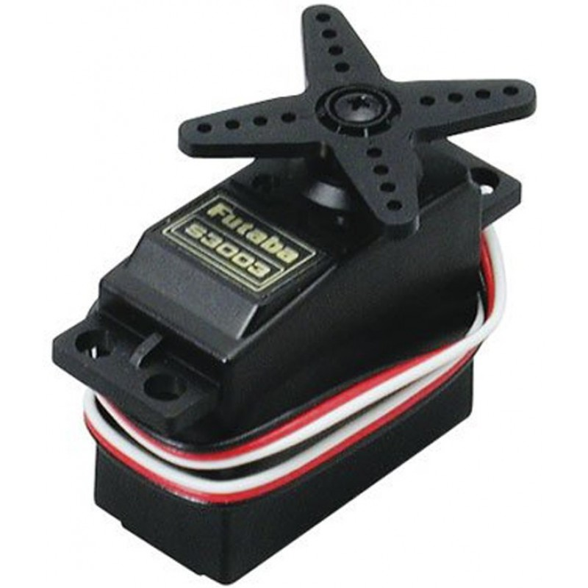
Equipments
Arduino
Gear Motor
Motor Driver
Ultrasonic sensor
Servo Motor

Slide 7
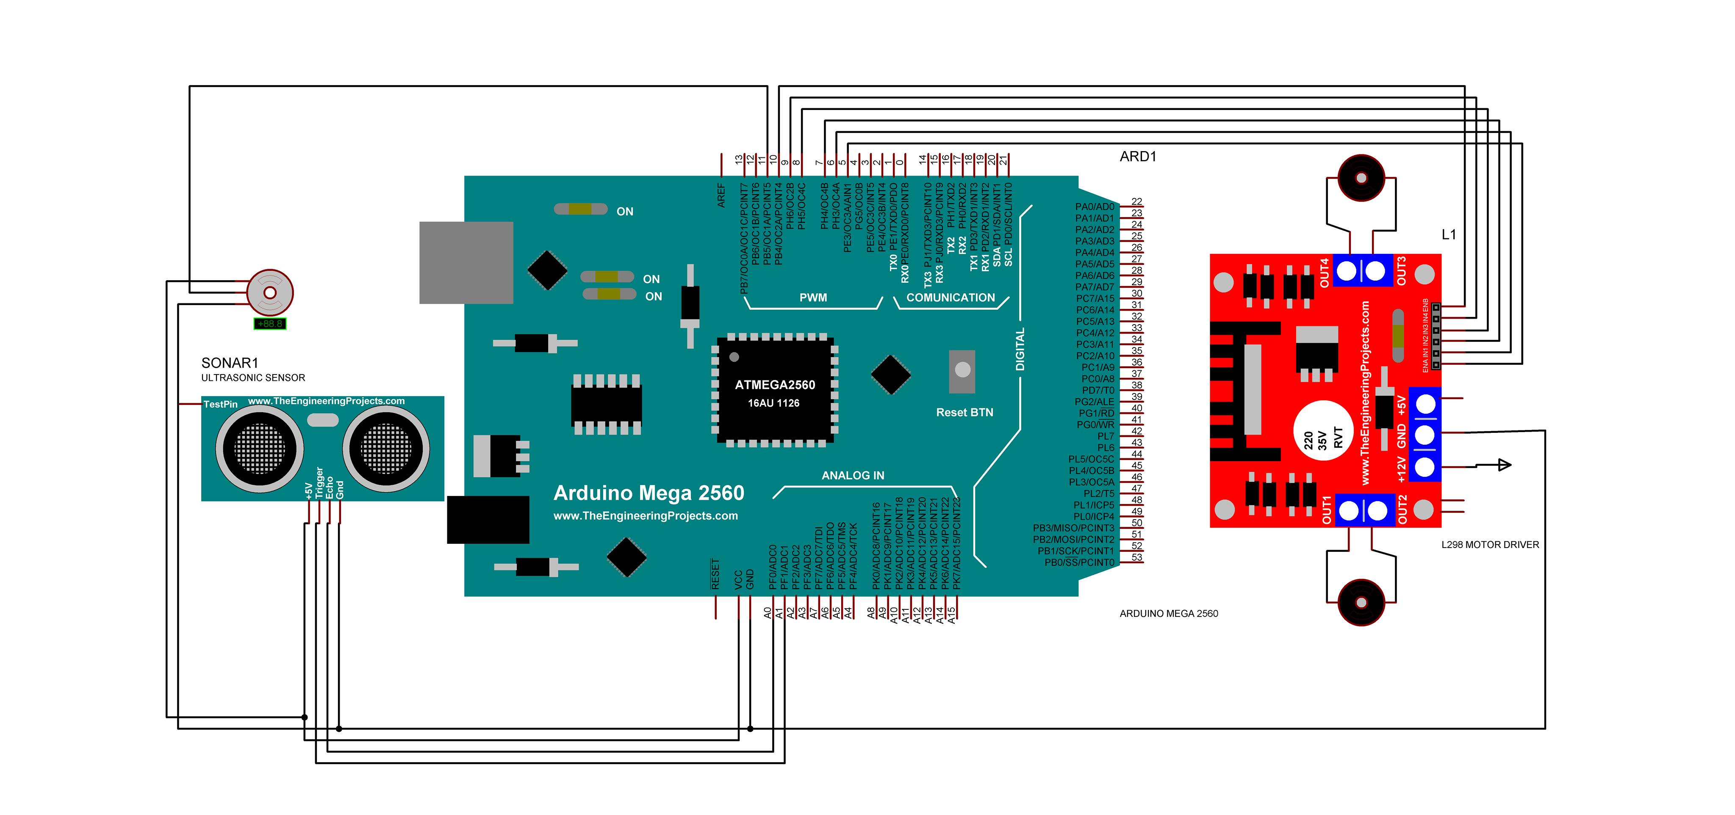
Circuit Design

Slide 8
Feature
Detecting Obstacle
1
Avoiding Collision
Move where no obstacle
2
3

Slide 9
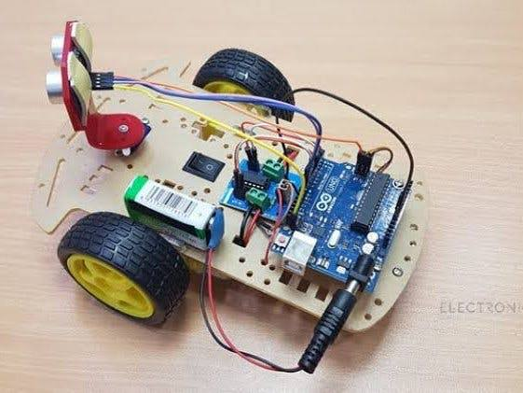
An Image of Similar Robot

Slide 10
Conclusion
Obstacle avoidance is one of the most important aspects of mobile robotics. Without it robot movement would be very restrictive and fragile.
From a learner’s point of view it helped us a lot to learn about the world of robotics.

Slide 11
THANKS!
Any questions?

