Slide 1
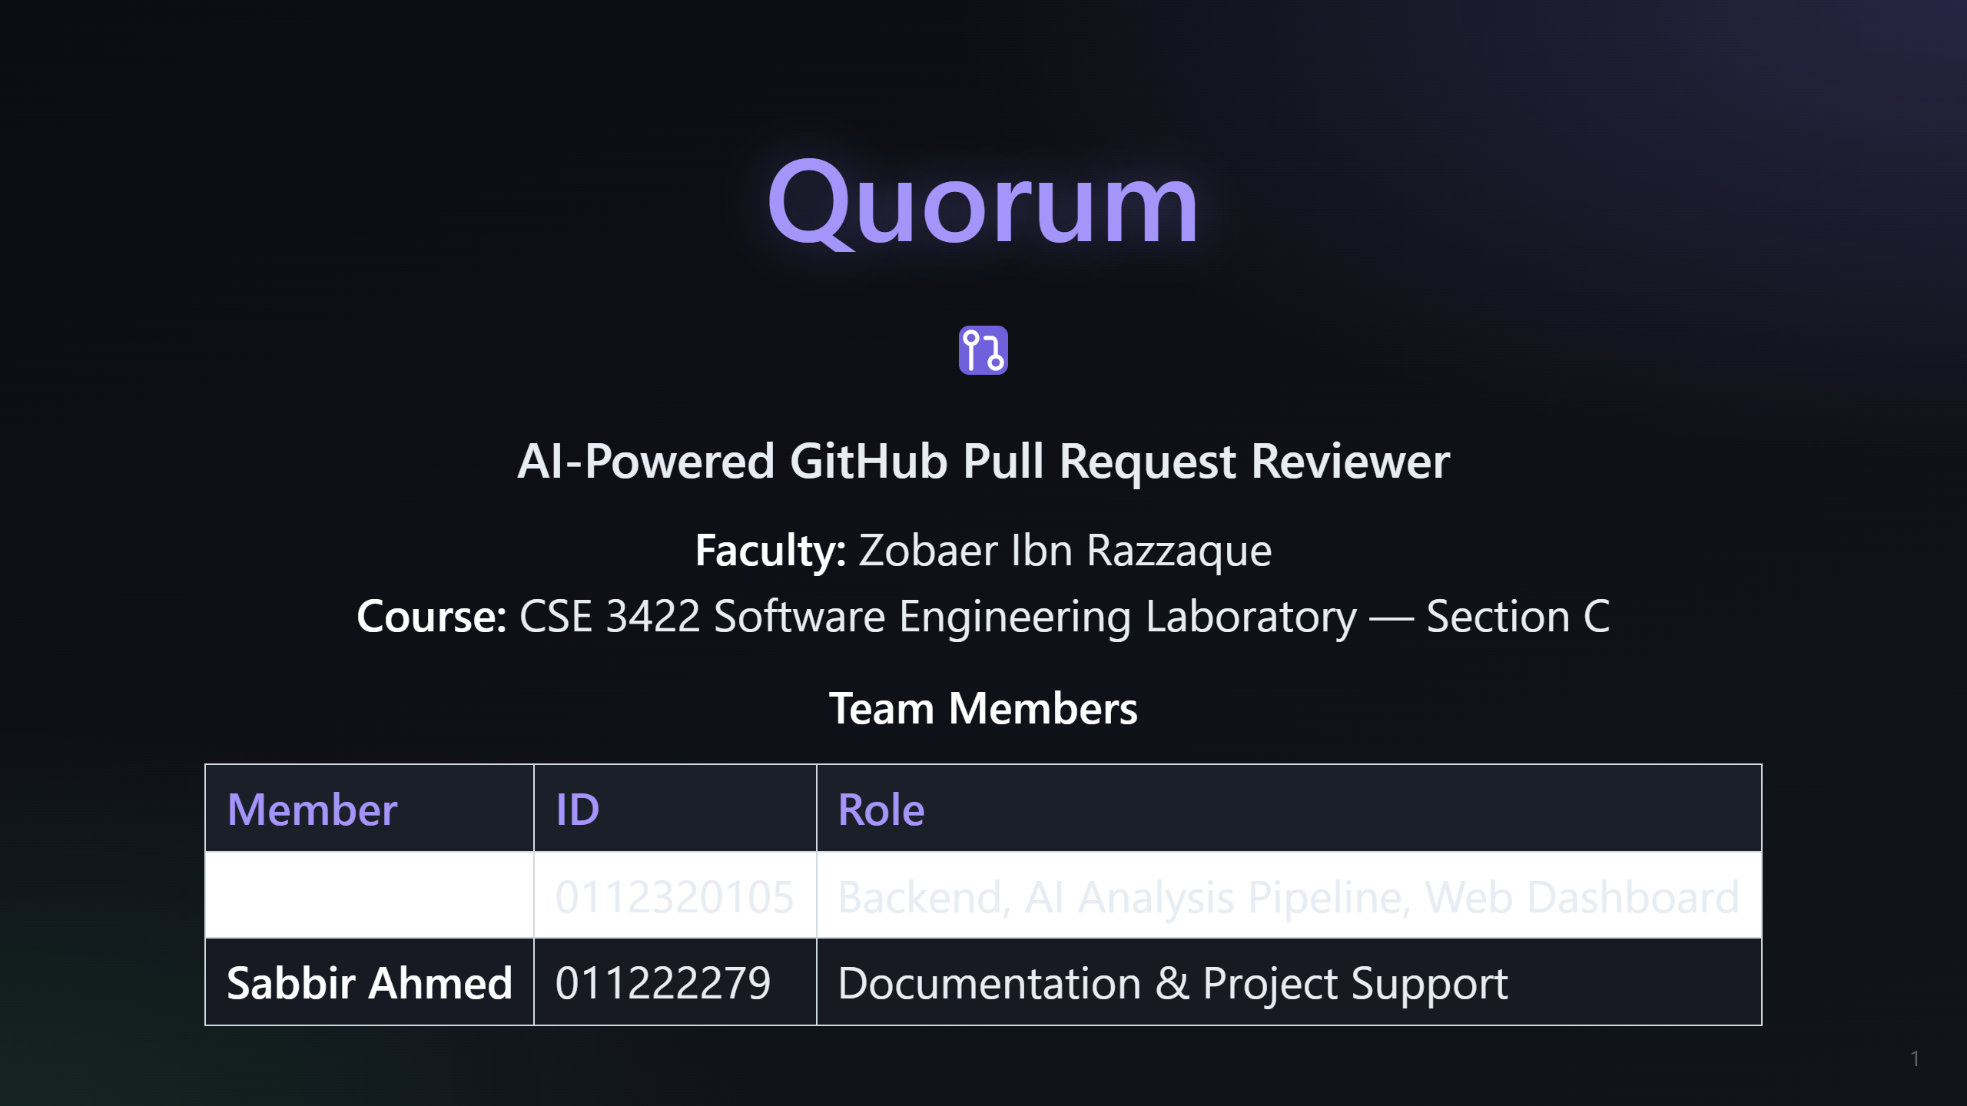
Notes:
Slide 1: Title / Team

Slide 2
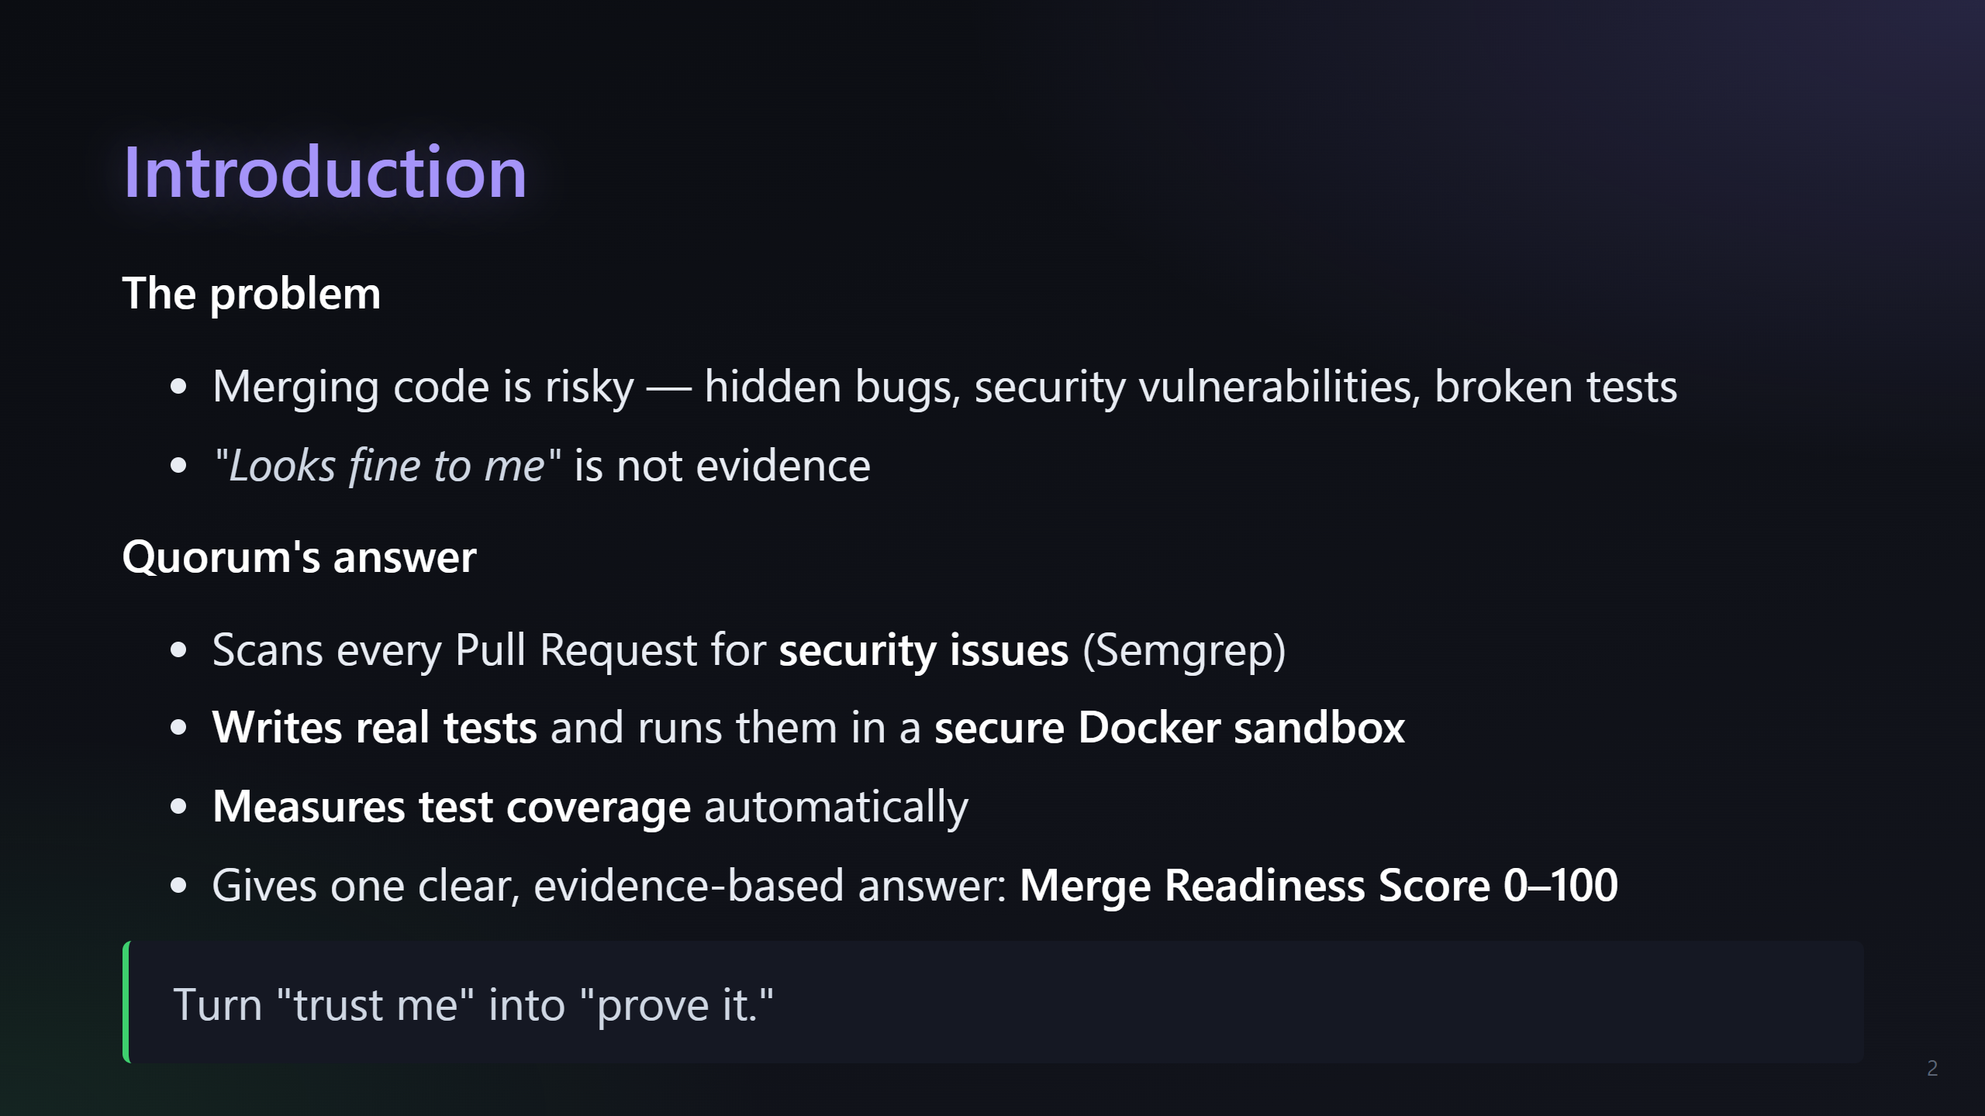
Notes:
Slide 2: Introduction

Slide 3
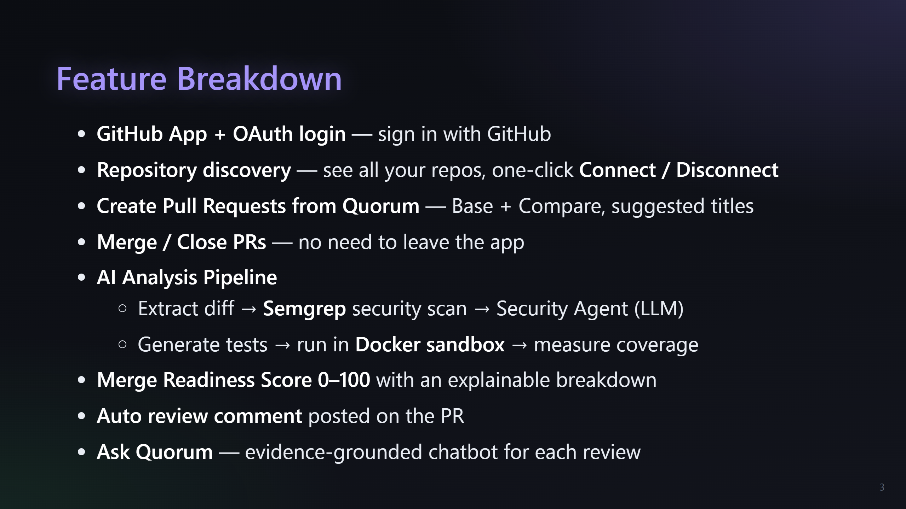
Notes:
Slide 3: Feature Breakdown (show the app while presenting)

Slide 4
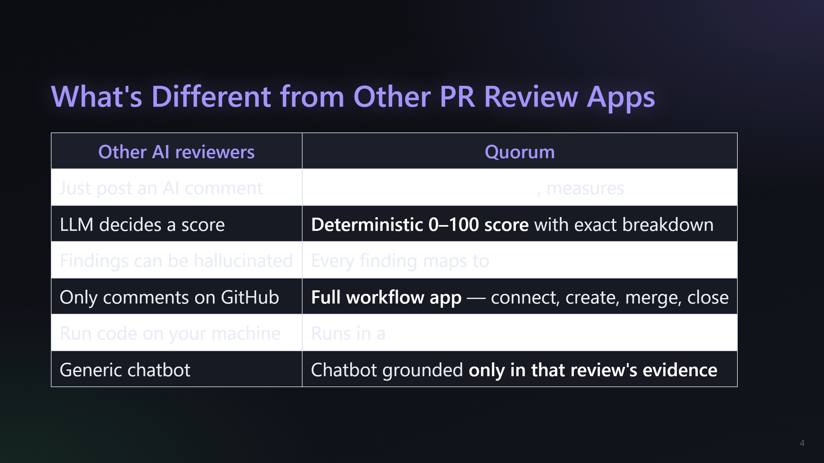
Notes:
Slide 4: What's different from other PR review apps

Slide 5
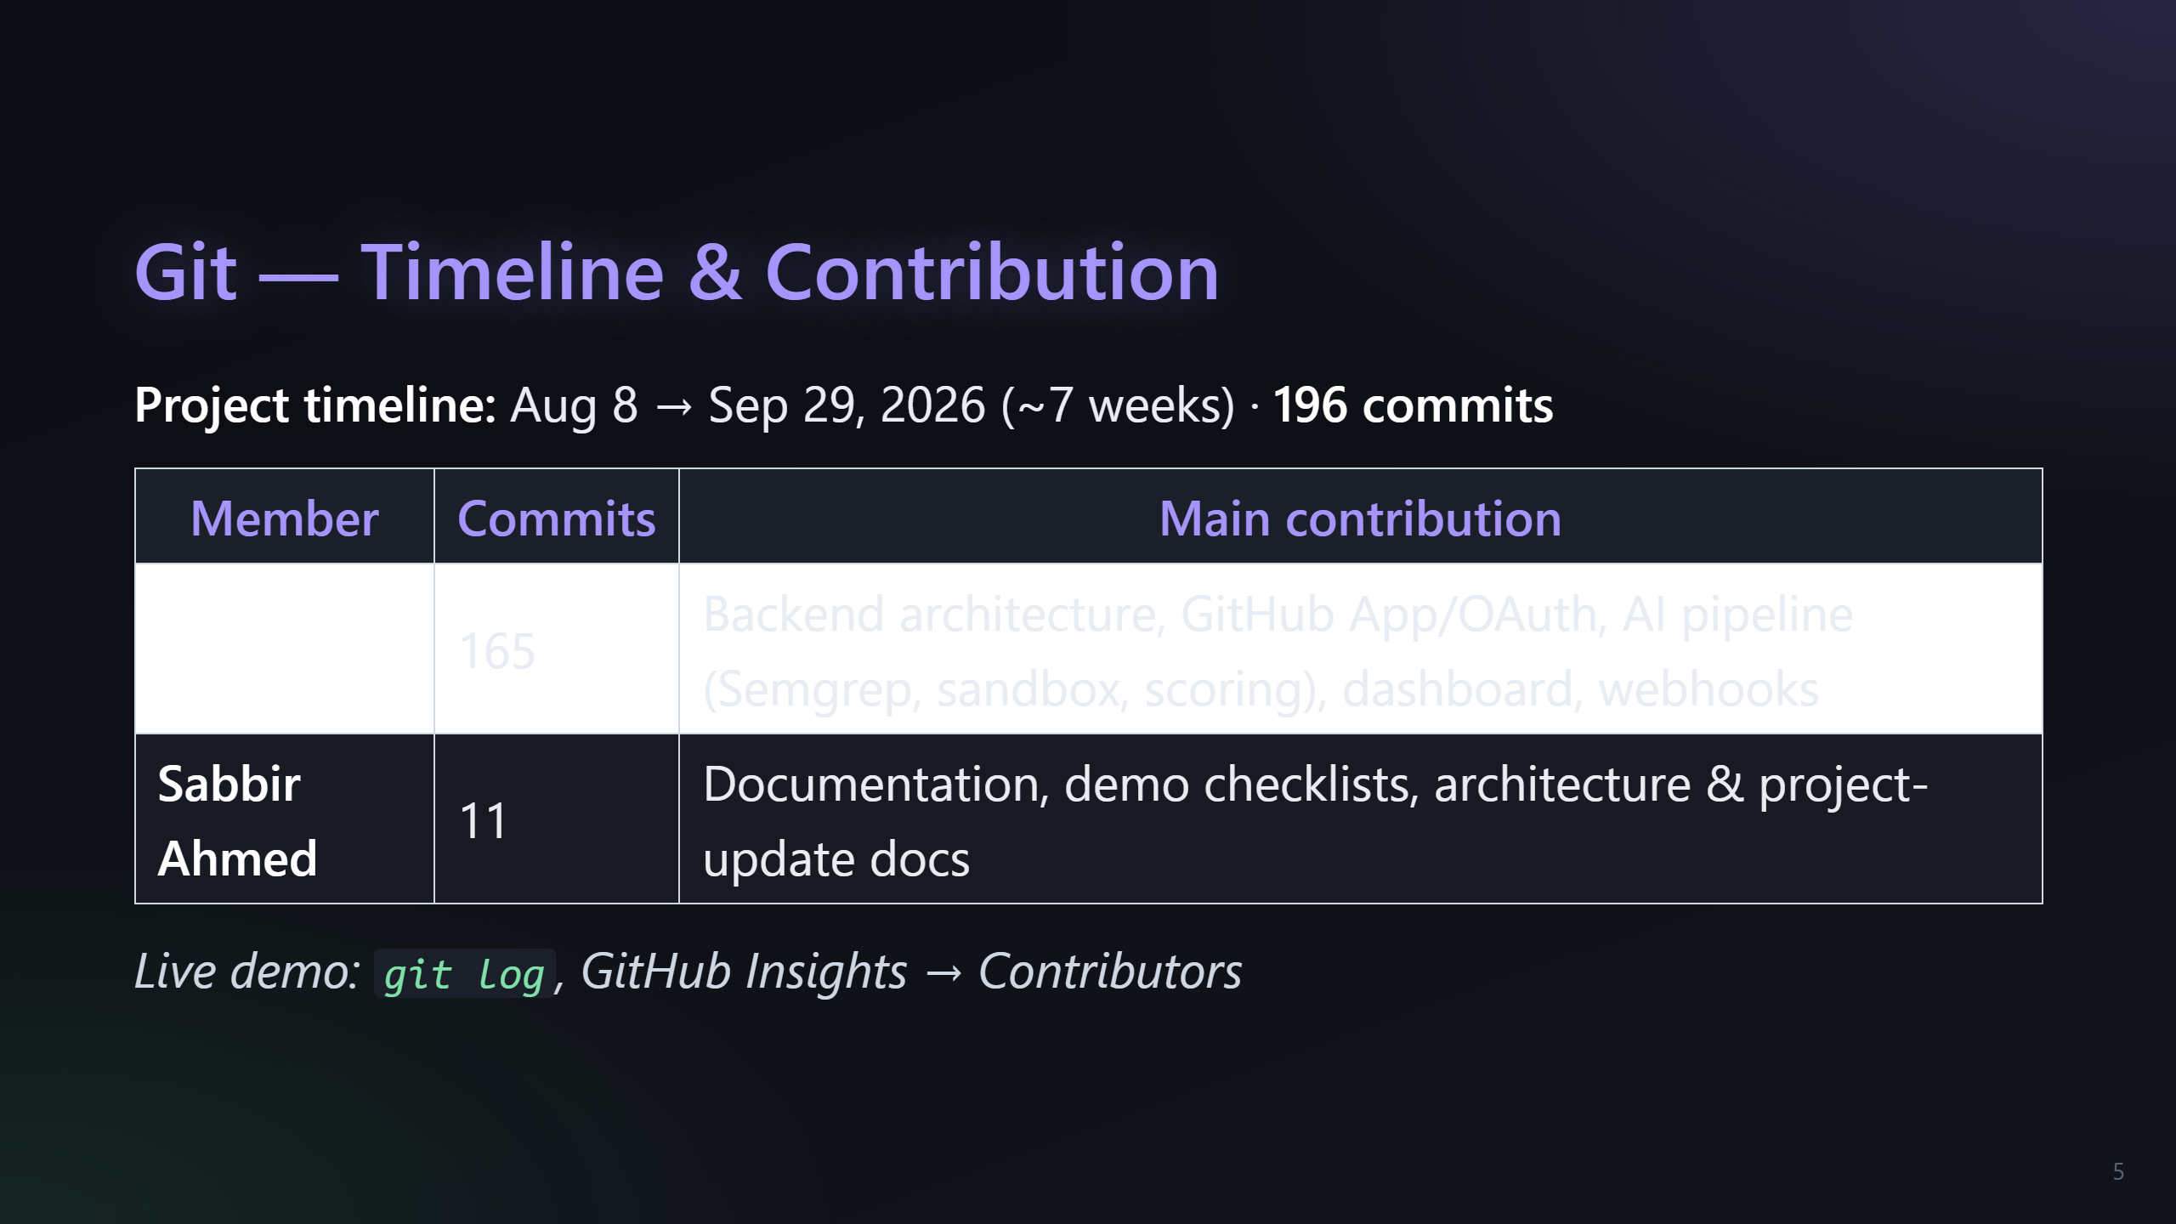
Notes:
Slide 5: Git / Timeline (show live git while presenting)

Slide 6
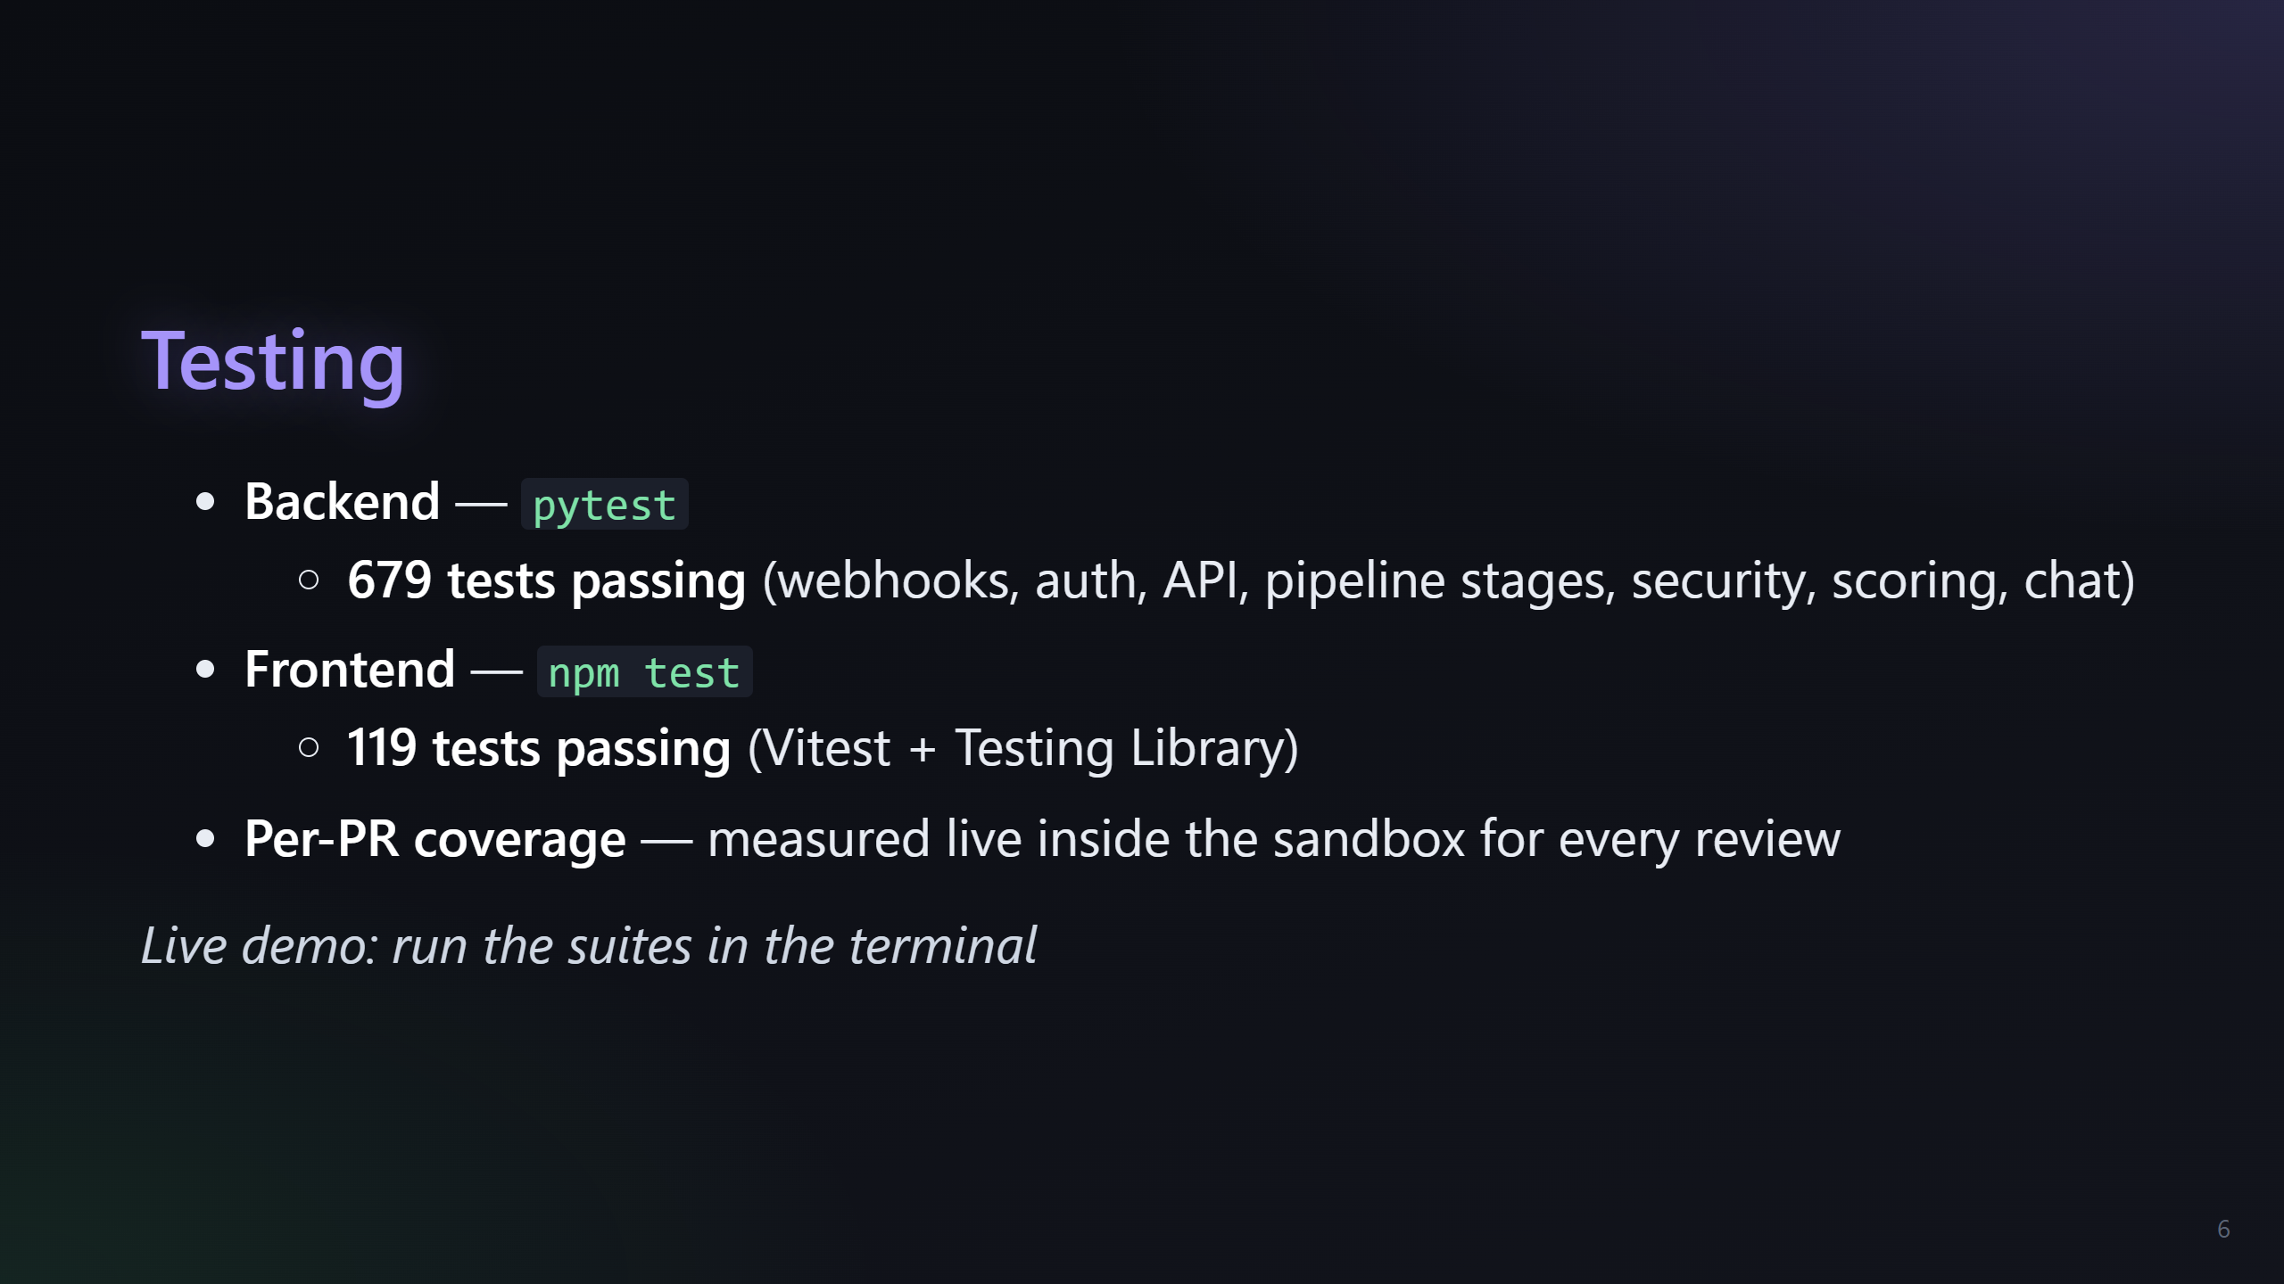
Notes:
Slide 6: Testing (run in terminal while presenting)

Slide 7
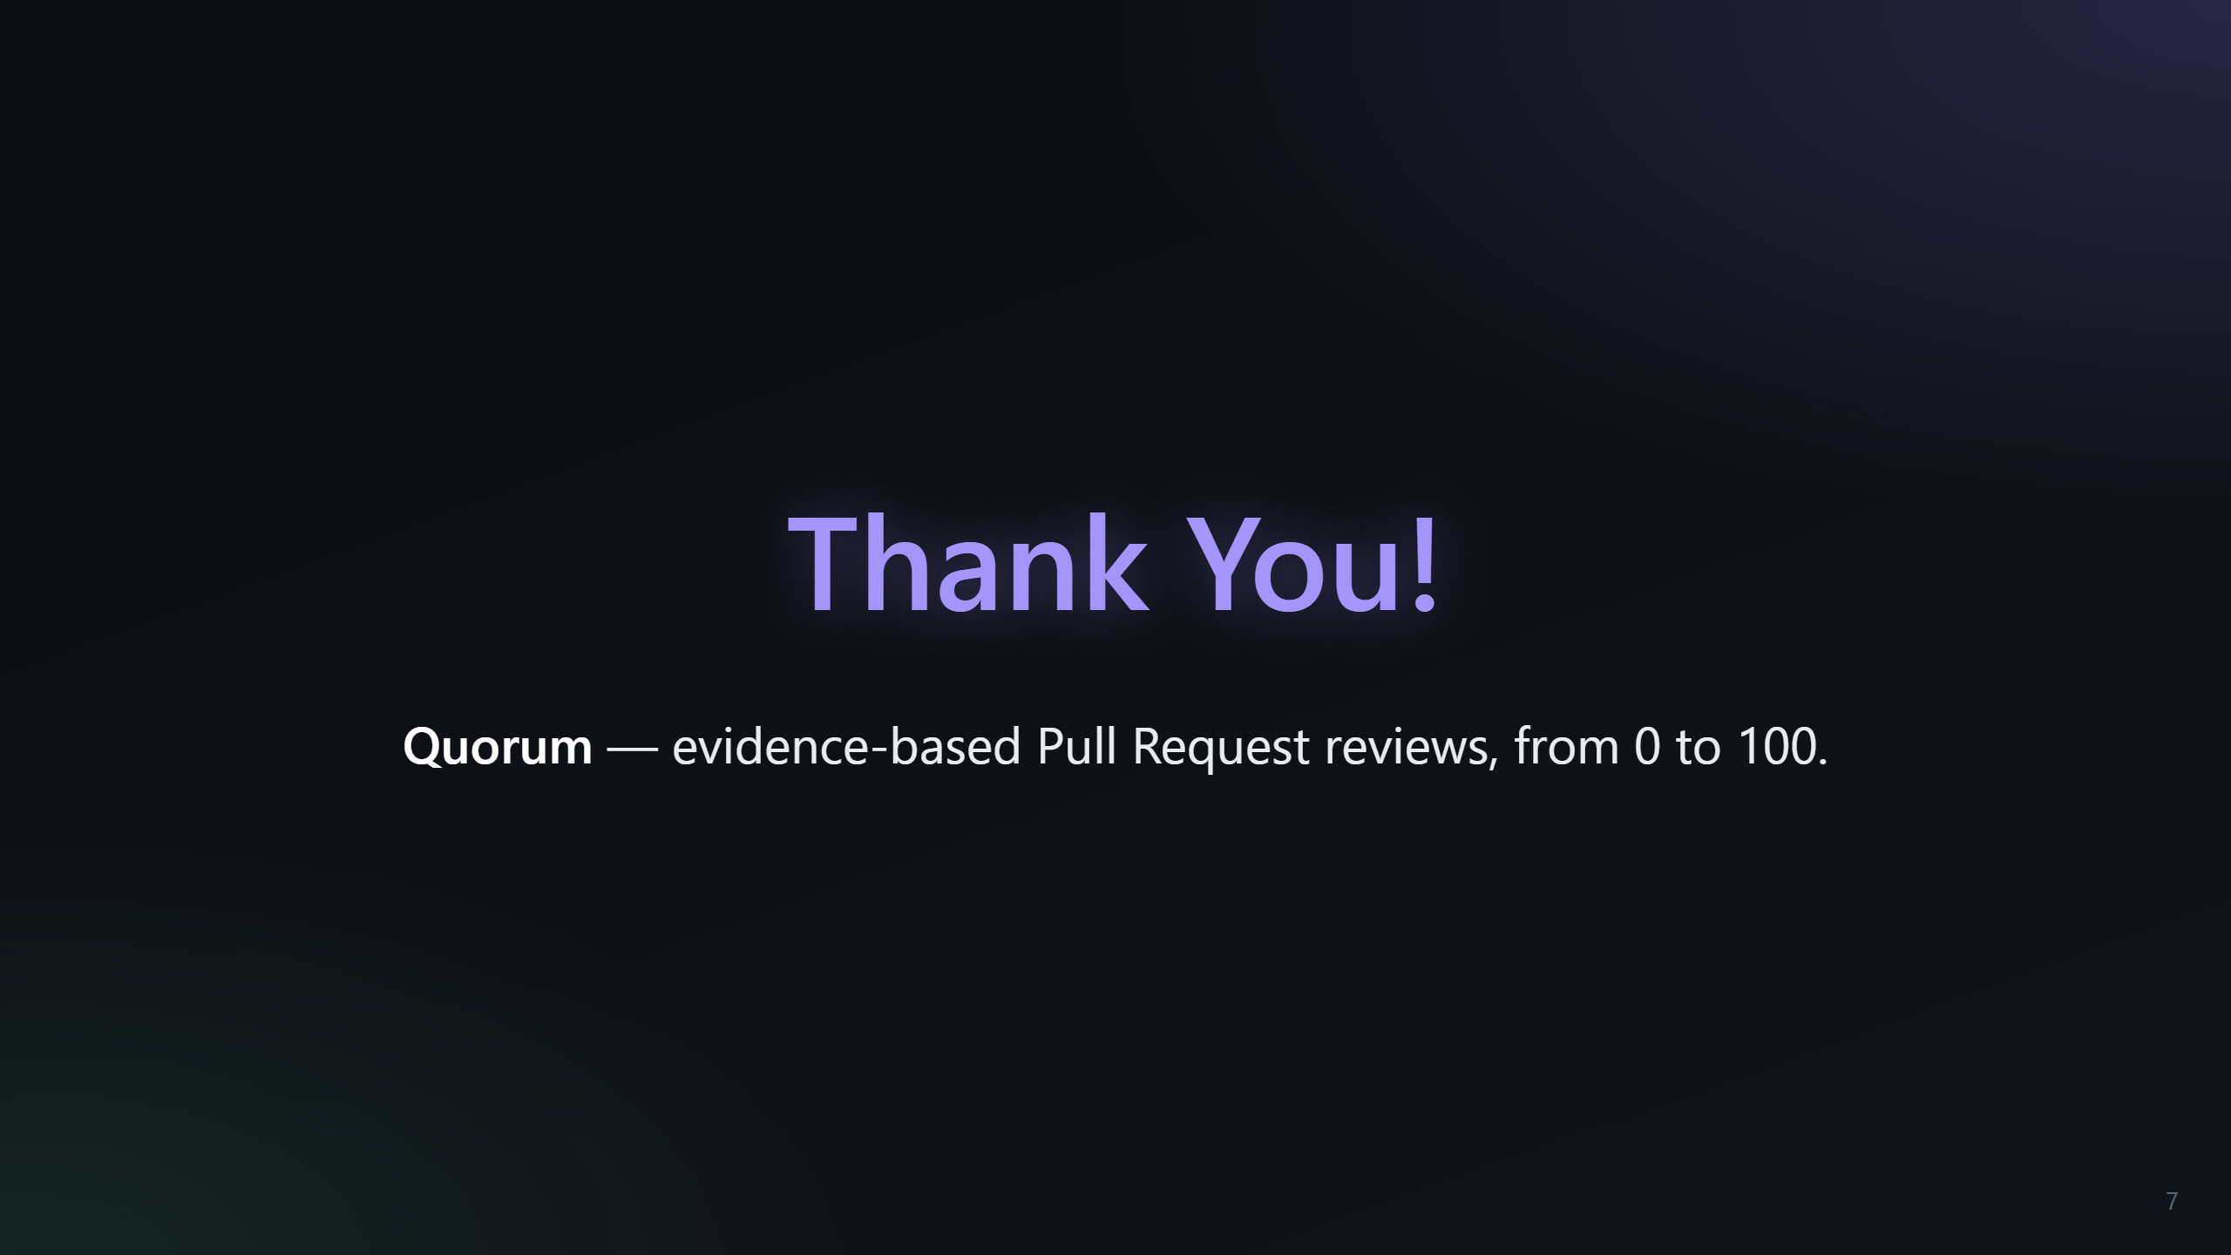
Notes:
Slide 7: Thank You
CSE 3422 Software Engineering Laboratory — Section C
Faculty: Zobaer Ibn Razzaque
Team: Saiful Alam (0112320105), Sabbir Ahmed (011222279)

