Slide 1
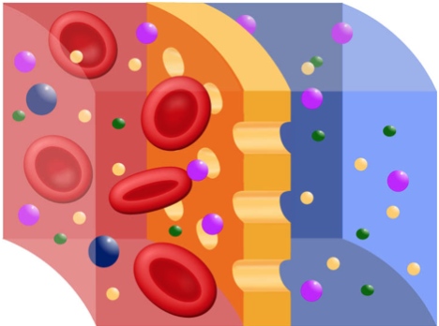
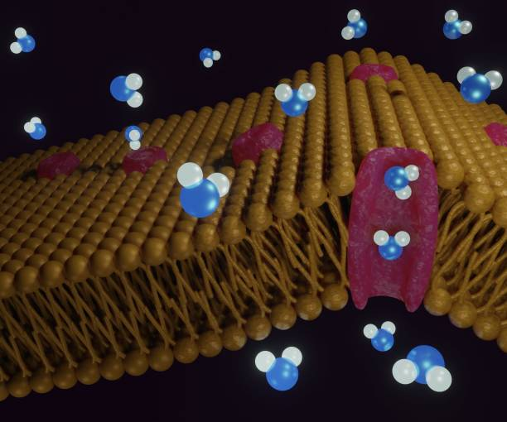
PHYSIOLOGY
DIFFUSION

Slide 2







PRESENTED BY
SANJIDA AFROZ MARIA
ROLL- 56
15TH BATCH

Slide 3
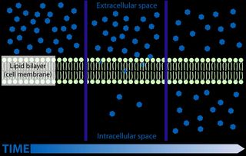
Diffusion
The movement of substances by the normal kinetic motion from a higher concentration to lower concentration is called diffusion.

Slide 4
Characteristics of Diffusion
Particles move from an area of high concentration to low concentration.
Moves with the concentration gradient.
Doesn’t need energy except the facilitated diffusion.
It may or may not require a membrane.

Slide 5
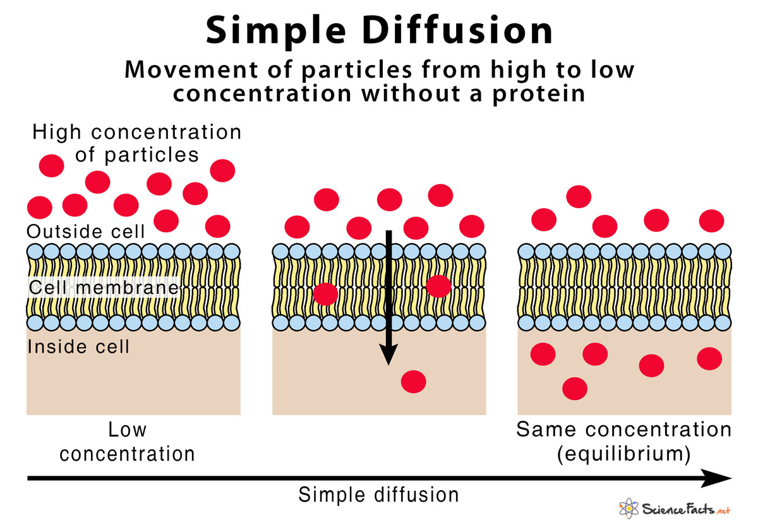
Simple
Diffusion
Facilitated
Types of Diffusion
Simple Diffusion
Simple diffusion : Doesn’t require carrier protein.
Example: Simple diffusion of O₂, CO₂ etc.
It uses 3 types of channels
01
Aquaporins Channel
02
Legand-gated Channel
02
Voltage-gated Channel

Slide 6
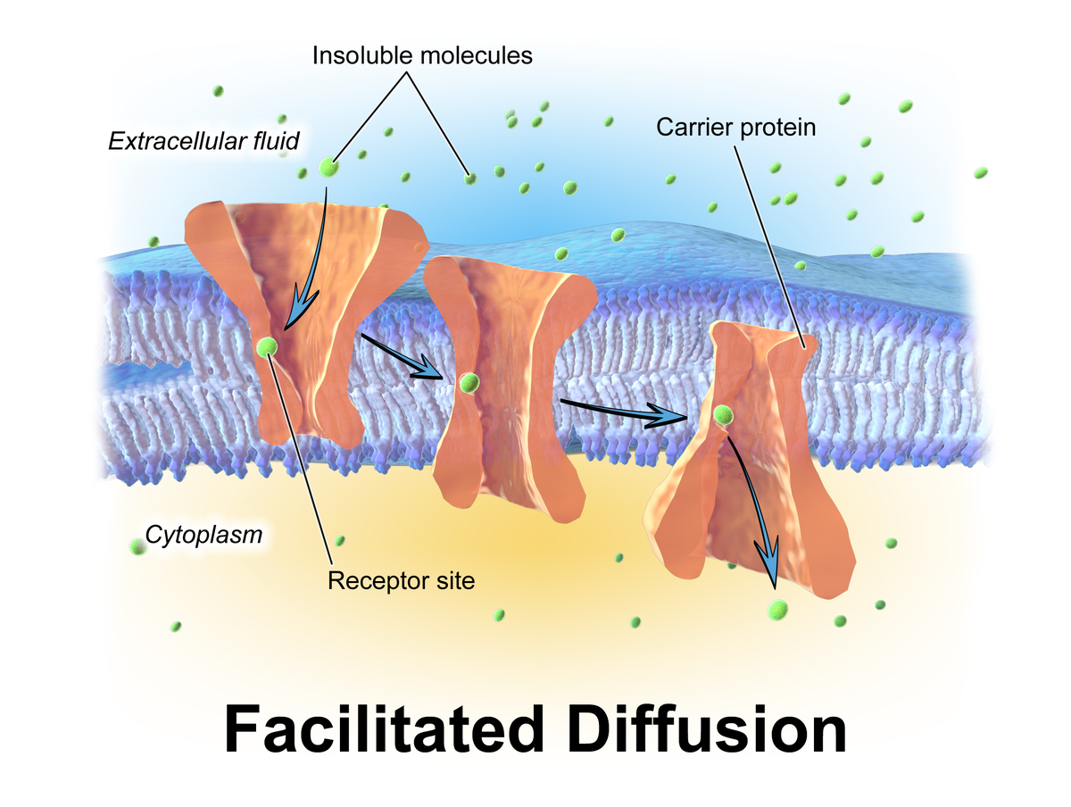
Facilitated Diffusion
Facilitated diffusion : Requires carrier protein.
Example: facilitated diffusion of glucose.

Slide 7
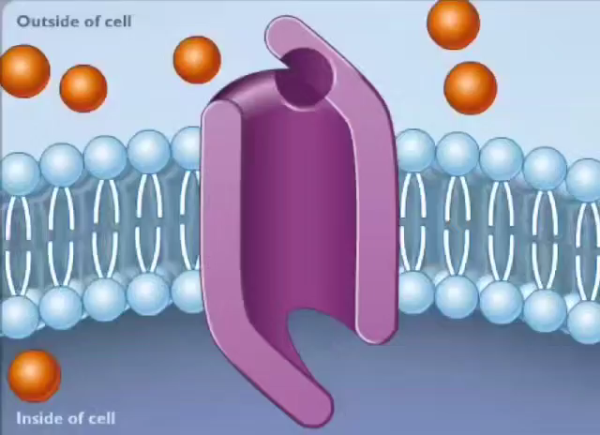
Mechanism of Facilitated Diffusion
The diffusion which requires carrier protein is called facilitated diffusion.
First, ions or other substances bind with the carrier protein and it causes the conformational change of the protein. Then the protein rotates and facilitates the ion or substance to go outside to inside or inside to outside of the membrane.
It is also called carrier meditate diffusion because substances are diffused with the help of carrier protein.

Slide 8


