Slide 1
Software Engineering
These courseware materials are to be used in conjunction with Software Engineering: A Practitioner’s Approach, 6/e and are provided with permission by R.S. Pressman & Associates, Inc., copyright © 1996, 2001, 2005

Slide 2
Why worry about SW Engineering?
History of SW failures from http://www.wired.com/software/coolapps/news/2005/11/69355
  “…Toyota announced a recall of 160,000 of its Prius hybrid vehicles following reports of vehicle warning lights illuminating for no reason, and cars' gasoline engines stalling unexpectedly.”
  1985-1987 -- Therac-25 medical accelerator. Software replaces electromechanical safety controls. Operating system race condition kills 5 people.
  November 2000 -- National Cancer Institute, Panama City. Doctors “work-around” software problem that wouldn’t allow them to use 5 radiation shields. Their work-around had unintended consequences that killed 8 patients. Doctor’s indicted for murder.
  Many more incidents…
These courseware materials are to be used in conjunction with Software Engineering: A Practitioner’s Approach, 6/e and are provided with permission by R.S. Pressman & Associates, Inc., copyright © 1996, 2001, 2005

Slide 3
Why is it so hard?
Lots of “parts”. Many more than mechanical devices
  Dishwasher - 128 parts
  Car - 14,000 parts
  Space shuttle - 2.5 million parts
  Red Hat Linux 7.1 - 30 million source lines of code (SLOC)
  Mac Office - 30 million SLOC
    Using 70 programmers = 428,000 SLOC / programmer
  But those are big… what about “normal size programs”?
    Average programmer SLOC (Source lines of code) / day = 100
    5 days/week * 52 weeks/year = 26,000 SLOC / year
    15 programmer team = 390,000 SLOC / year
These courseware materials are to be used in conjunction with Software Engineering: A Practitioner’s Approach, 6/e and are provided with permission by R.S. Pressman & Associates, Inc., copyright © 1996, 2001, 2005
Notes:
Average cell phone has 2 million lines of code
Larger and larger teams building more complex software

Slide 4
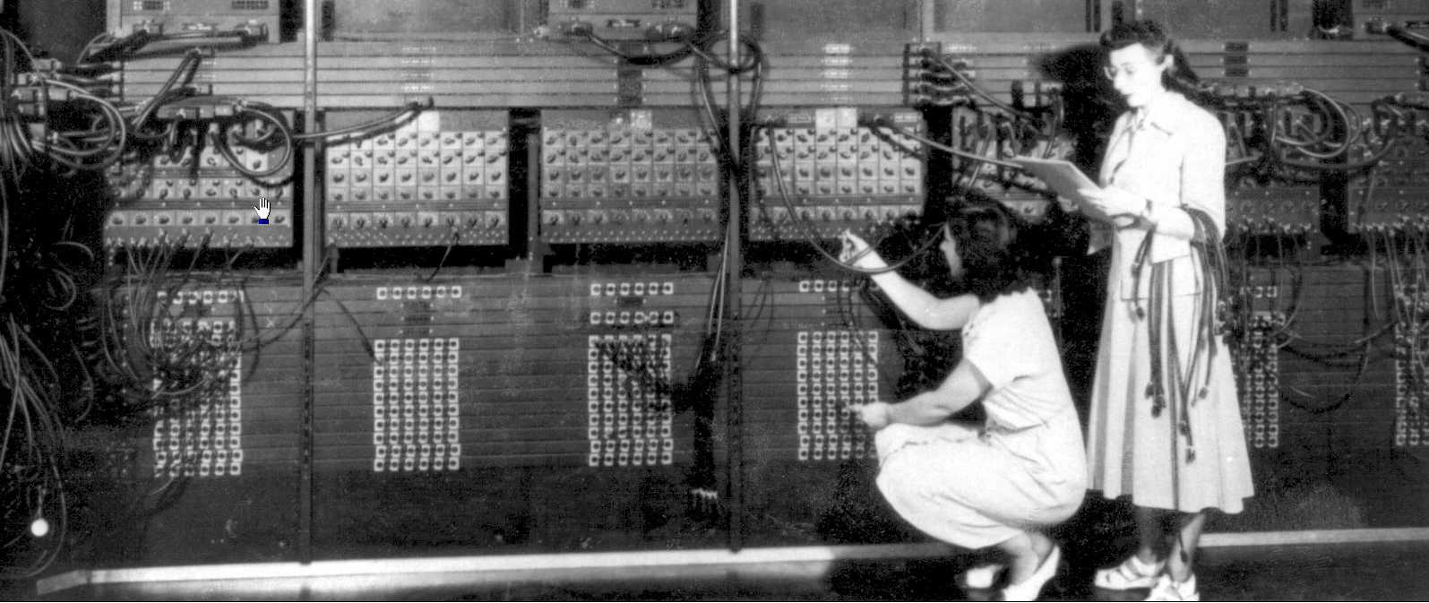
Why is it so hard? (continued)
We’re a young field
  ENIAC/ MARK-I in 1946
  FORTRAN - 1957
But giant - As of 2004, the U. S. Bureau of Labor Statistics counts 760,840 software engineers holding jobs in the U.S.; for comparison, in the U.S. there are some 1.4 million practitioners employed in all other engineering disciplines combined.
- http://en.wikipedia.org/wiki/Software_engineering
Still more art than science
Everything we do is “new”. (We don’t build the exact same house 30 times.)
Need to have more reproducible results
Need to have more measurements
These courseware materials are to be used in conjunction with Software Engineering: A Practitioner’s Approach, 6/e and are provided with permission by R.S. Pressman & Associates, Inc., copyright © 1996, 2001, 2005
Notes:
Where is one place we *do* reuse a lot? Graphical components

Slide 5
Why do projects fail?
Why do projects fail so often?
Unrealistic or unarticulated project goals
Inaccurate estimates of needed resources
Badly defined system requirements
Poor reporting of the project's status
Unmanaged risks
Poor communication among customers, developers, and users
Use of immature technology
Inability to handle the project's complexity
Sloppy development practices
Poor project management
Stakeholder politics
Commercial pressures
List from: http://www.spectrum.ieee.org/sep05/1685
These courseware materials are to be used in conjunction with Software Engineering: A Practitioner’s Approach, 6/e and are provided with permission by R.S. Pressman & Associates, Inc., copyright © 1996, 2001, 2005
Notes:
None of these are really technical reasons. The hard part of making software is rarely the technical challenge, and almost always a process challenge.

Slide 6
How do we fix it?
Need to have more reproducible results
  Standard processes / procedures to produce good outcomes
  Design patterns
  Object oriented programming (reuse)
More measurements of both the software and the process
More testing at all stages of development
By creating a better understanding of the process we use to create software, we’ll create better software faster.
“Software engineering is the application of a systematic, disciplined, quantifiable approach to the development, operation, and maintenance of software.” - IEEE Standard Glossary of Software Engineering Terminology
These courseware materials are to be used in conjunction with Software Engineering: A Practitioner’s Approach, 6/e and are provided with permission by R.S. Pressman & Associates, Inc., copyright © 1996, 2001, 2005
Notes:
UML will help standardize some of these

Slide 7
Software Engineering: A Practitioner’s Approach, 6/e
Chapter 1
Software and Software Engineering
(Slides modified by Dan Fleck) copyright © 1996, 2001, 2005
R.S. Pressman & Associates, Inc.
For University Use Only
May be reproduced ONLY for student use at the university level when used in conjunction with Software Engineering: A Practitioner's Approach.
Any other reproduction or use is expressly prohibited.
These courseware materials are to be used in conjunction with Software Engineering: A Practitioner’s Approach, 6/e and are provided with permission by R.S. Pressman & Associates, Inc., copyright © 1996, 2001, 2005

Slide 8
Software’s Dual Role
Software is a product
  Delivers computing potential
  Produces, manages, acquires, modifies, displays, or transmits information
Software is a vehicle for delivering a product
  Supports or directly provides system functionality
  Controls other programs (e.g., an operating system)
  Effects communications (e.g., networking software)
  Helps build other software (e.g., software tools)
These courseware materials are to be used in conjunction with Software Engineering: A Practitioner’s Approach, 6/e and are provided with permission by R.S. Pressman & Associates, Inc., copyright © 1996, 2001, 2005

Slide 9
What is Software?
Software is a set of items or objects
that form a “configuration” that
includes
• programs
• documents
• data ...
These courseware materials are to be used in conjunction with Software Engineering: A Practitioner’s Approach, 6/e and are provided with permission by R.S. Pressman & Associates, Inc., copyright © 1996, 2001, 2005

Slide 10
What is Software?
software is engineered
software doesn’t wear out
software is complex
These courseware materials are to be used in conjunction with Software Engineering: A Practitioner’s Approach, 6/e and are provided with permission by R.S. Pressman & Associates, Inc., copyright © 1996, 2001, 2005
Notes:
NOT Manufactured. Early attempts at software tried to manufacture it, but this is the wrong approach because costs are distributed differently. Software is easy to prototype and modify. Manufacturing isn’t. No “manufacturing” problems are introduced

Slide 11
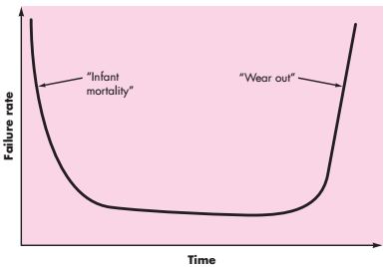
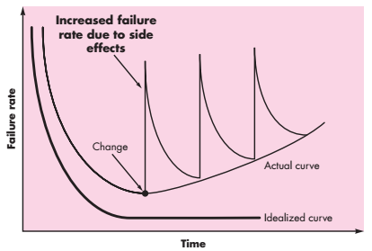
Wear vs. Deterioration
Hardware System
Software System
These courseware materials are to be used in conjunction with Software Engineering: A Practitioner’s Approach, 6/e and are provided with permission by R.S. Pressman & Associates, Inc., copyright © 1996, 2001, 2005
Notes:
Since changes come out so frequently the software never gets to settle in to the original (low) failure rate
No mechanical parts to replace due to failure… a failure is much more complex to fix in software

Slide 12
Software Applications
system software - OS, file management, networking, drivers, etc…
application software - data processing, point of sale, other business functions…
engineering/scientific software - CAD, stress analysis, orbital mechanics
embedded software - microwave oven keypad, automobile control, cell phone software, etc…
product-line software - word processing, inventory control, etc…
WebApps (Web applications) - many different things today
AI software - robotics, data mining, expert systems
These courseware materials are to be used in conjunction with Software Engineering: A Practitioner’s Approach, 6/e and are provided with permission by R.S. Pressman & Associates, Inc., copyright © 1996, 2001, 2005
Notes:
Different engineering processes/practices for all
Product line creates a specific capability used by many different customers

Slide 13
Software—New Categories
Ubiquitous computing—wireless networks
Netsourcing—the Web as a computing engine
Open source—”free” source code open to the computing community (a blessing, but also a potential curse!)
Also … (see Chapter 32)
  Data mining
  Grid computing
  Cognitive machines
  Software for nanotechnologies
These courseware materials are to be used in conjunction with Software Engineering: A Practitioner’s Approach, 6/e and are provided with permission by R.S. Pressman & Associates, Inc., copyright © 1996, 2001, 2005

Slide 14
Legacy Software
Why must it change?
    software must be adapted to meet the needs of new computing environments or technology.
    software must be enhanced to implement new business requirements.
    software must be extended to make it interoperable with other more modern systems or databases.
    software must be re-architected to make it viable within a network environment.
These courseware materials are to be used in conjunction with Software Engineering: A Practitioner’s Approach, 6/e and are provided with permission by R.S. Pressman & Associates, Inc., copyright © 1996, 2001, 2005
Notes:
Legacy software exists because it is business critical
Frequently no extensibility, no documentation, no design, no requirements,

Slide 15
Software Evolution
The Law of Continuing Change (1974): E-type systems must be continually adapted else they become progressively less satisfactory.
The Law of Increasing Complexity (1974): As an E-type system evolves its complexity increases unless work is done to maintain or reduce it.
The Law of Self Regulation (1974): The E-type system evolution process is self-regulating with distribution of product and process measures close to normal.
The Law of Conservation of Organizational Stability (1980): The average effective global activity rate in an evolving E-type system is invariant over product lifetime.
The Law of Conservation of Familiarity (1980): As an E-type system evolves all associated with it, developers, sales personnel, users, for example, must maintain mastery of its content and behavior to achieve satisfactory evolution.
The Law of Continuing Growth (1980): The functional content of E-type systems must be continually increased to maintain user satisfaction over their lifetime.
The Law of Declining Quality (1996): The quality of E-type systems will appear to be declining unless they are rigorously maintained and adapted to operational environment changes.
The Feedback System Law (1996): E-type evolution processes constitute multi-level, multi-loop, multi-agent feedback systems and must be treated as such to achieve significant improvement over any reasonable base.
Source: Lehman, M., et al, “Metrics and Laws of Software Evolution—The Nineties View,” Proceedings of the 4th International Software Metrics Symposium (METRICS '97), IEEE, 1997, can be downloaded from: http://www.ece.utexas.edu/~perry/work/papers/feast1.pdf
These courseware materials are to be used in conjunction with Software Engineering: A Practitioner’s Approach, 6/e and are provided with permission by R.S. Pressman & Associates, Inc., copyright © 1996, 2001, 2005

Slide 16
Software Myths
Affect managers, customers (and other non-technical stakeholders) and practitioners
Are believable because they often have elements of truth,
but …
Invariably lead to bad decisions,
therefore …
Insist on reality as you navigate your way through software engineering
These courseware materials are to be used in conjunction with Software Engineering: A Practitioner’s Approach, 6/e and are provided with permission by R.S. Pressman & Associates, Inc., copyright © 1996, 2001, 2005

Slide 17
Software Myths
Selected myths
  If we get behind schedule we can add more programmers to catch up
  A general statement of objectives is sufficient to begin writing programs - we can fill in the details later
  Project requirements change, but change can be easily accommodated because software is flexible
  Once we write the program and get it working our job is done
  Software engineering will make us create unnecessary documentation and will invariably slow us down
These courseware materials are to be used in conjunction with Software Engineering: A Practitioner’s Approach, 6/e and are provided with permission by R.S. Pressman & Associates, Inc., copyright © 1996, 2001, 2005

Slide 18
A Generic Framework
Communication
  Heavy collaboration with the customer, other stakeholders and encompasses requirements gathering and related activities
Planning
  Establish a plan for the work. Technical task to be conducted, risks, needed resources, work products to be created, and a schedule
Modeling
  Creation of models to allow the customer and the developer to better understand the requirements and design that will achieve those requirements
Construction
  Combines code generation and testing required to uncover errors in the code
Deployment
  The software (as a complete entity or partially complete increment) is delivered to the customer who evaluates it and provides feedback.
These courseware materials are to be used in conjunction with Software Engineering: A Practitioner’s Approach, 6/e and are provided with permission by R.S. Pressman & Associates, Inc., copyright © 1996, 2001, 2005

