Slide 1


AUTOMATED CLASS ROUTINE GENERATOR
An Intelligent Timetable Management System Using Python
Presented By:
Md. Sabbir Khan( 230204)
Jannatul Ferdousi Riti(230209)
Saiful Islam Reyad (230214)

Slide 2

Motivation
As academic scheduling becomes more complex, manual methods are error-prone, time-consuming, and unsustainable.
This project automates timetable generation, addressing key academic challenges like:
1
Teacher preferences & availability
2
Course credit-based scheduling
3
Conflict-free class slots
4
Fair, priority-based distribution

Slide 3
Objectives
What we aimed to achieve:
Automate routine generation with minimal manual input
Respect credit hours, time slots, and teacher availability
Honor teacher preferences & ranks to maximize satisfaction
Avoid scheduling conflicts between classes and teachers
Export professional routines in Excel format

Slide 4
Challenges
Problems we needed to solve:
Dynamically assign slots by credit hours
Respect teacher rankings and availability
Prevent overlapping class schedules
Prioritize teachers with higher ranks for better slots
Ensure fairness while generating a complete, usable routine

Slide 5
Constraints
Teacher Ranking:
Higher rank = Higher slot priority
Slot Availability:
Class assigned only if teacher is free
Conflict-Free:
No overlapping classes for any teacher
Course Credit:
Theory: Hours = Credit
Lab: Fixed 3-hour block
Time Slots:
Theory: 9 AM – 1 PM
Lab: 2 PM – 5 PM

Slide 6
Requirement analysis
Course list and credit hours for all semesters (1st–4th year)
Teacher information including availability and designation
Weekly time slots (Sunday to Thursday, 9 AM – 1 PM and 2 PM - 5 PM)
Constraints to prevent class overlaps and teacher conflicts
Rules for priority-based scheduling

Slide 7
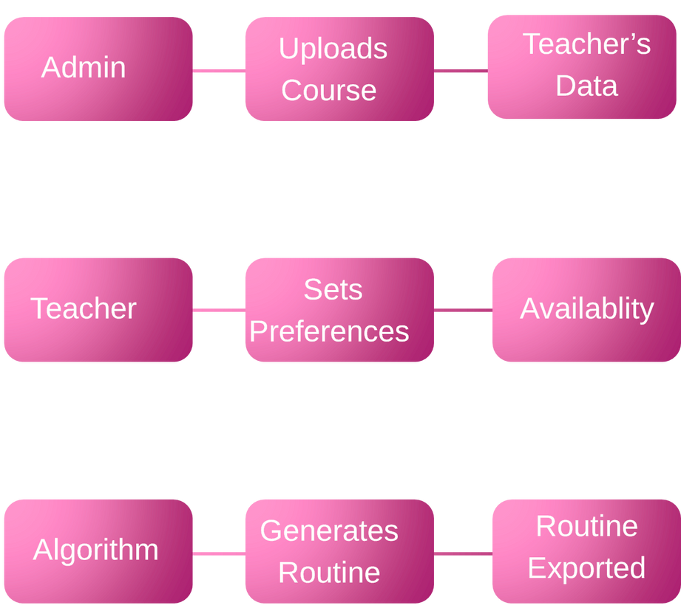
System overview

Slide 8
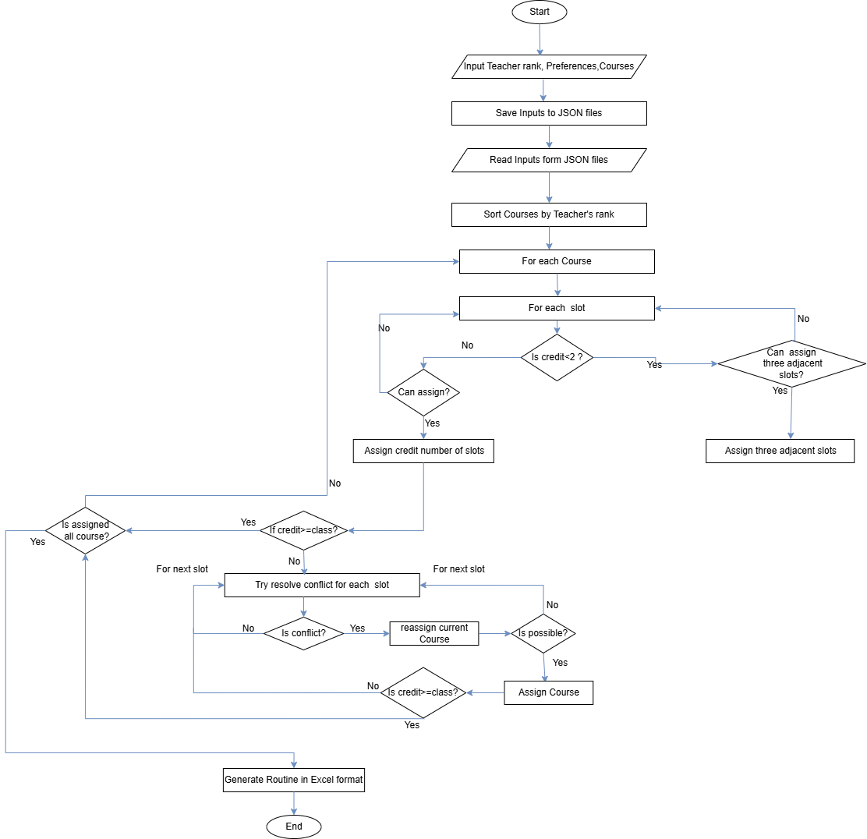
Flow Chart

Slide 9
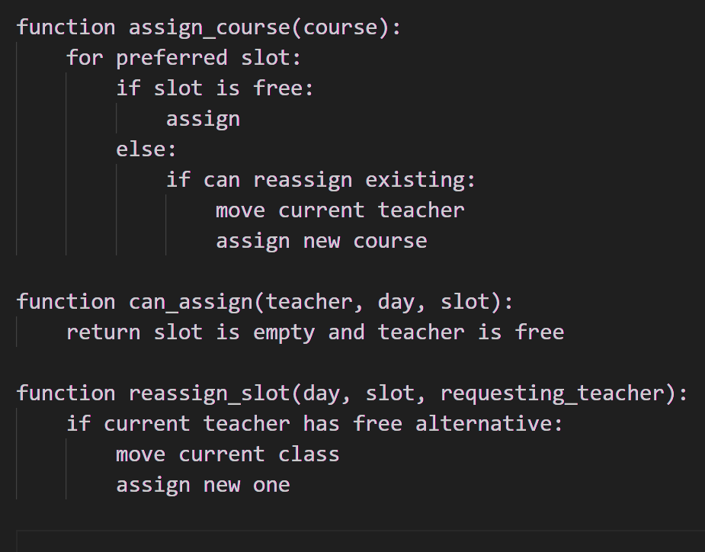
Logic & Pseudocode
If a preferred slot is free ➜ Assign the class
If there is no free slots ➜ Try to reassign existing teacher
Reassign only if the current teacher has alternative free slots
Ensure:
-No teacher/class conflict
-Teacher doesn’t take classes of the same slot same day
-Fair distribution based on rank & preferences
-Labs occupy 3 consecutive slots

Slide 10
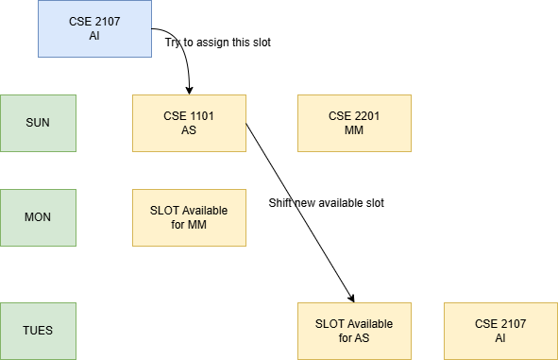
Visualisation of backtracking

Slide 11

Visualisation of backtracking

Slide 12

Visualisation of backtracking

Slide 13
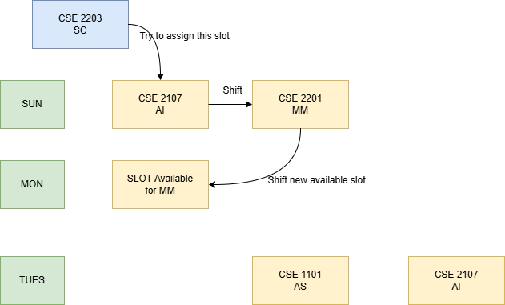
Visualisation of backtracking

Slide 14

Visualisation of backtracking

Slide 15

Visualisation of backtracking

Slide 16

Visualisation of backtracking

Slide 17
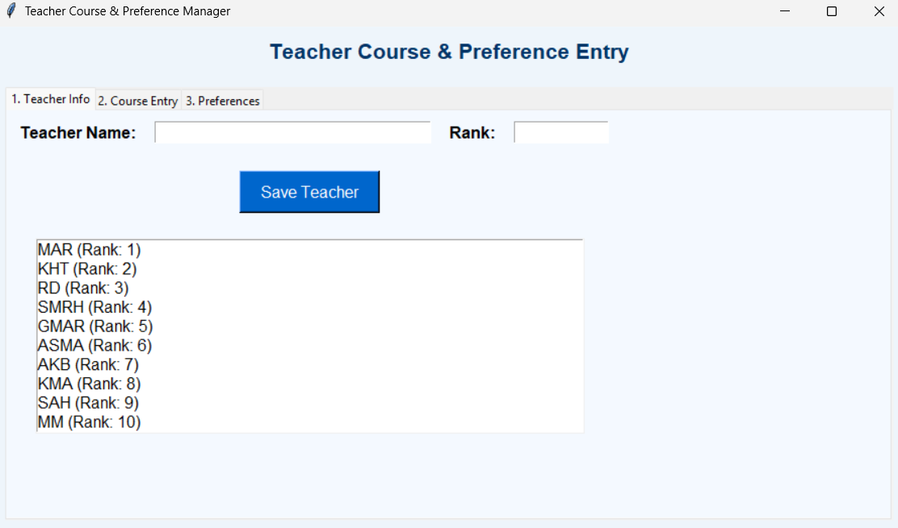
GUI – Tab 1: Teacher Info
Add teacher names and ranks
Stores information in JSON format
Higher ranks are prioritized during scheduling

Slide 18
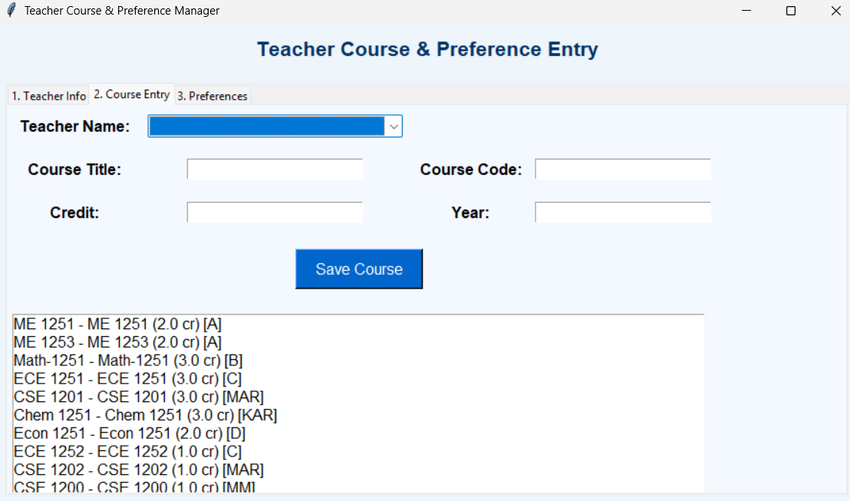
GUI – Tab 2: Course Entry
Assign courses to teachers
Input course code, credit, and academic year
All data is saved for future use in the scheduling algorithm

Slide 19
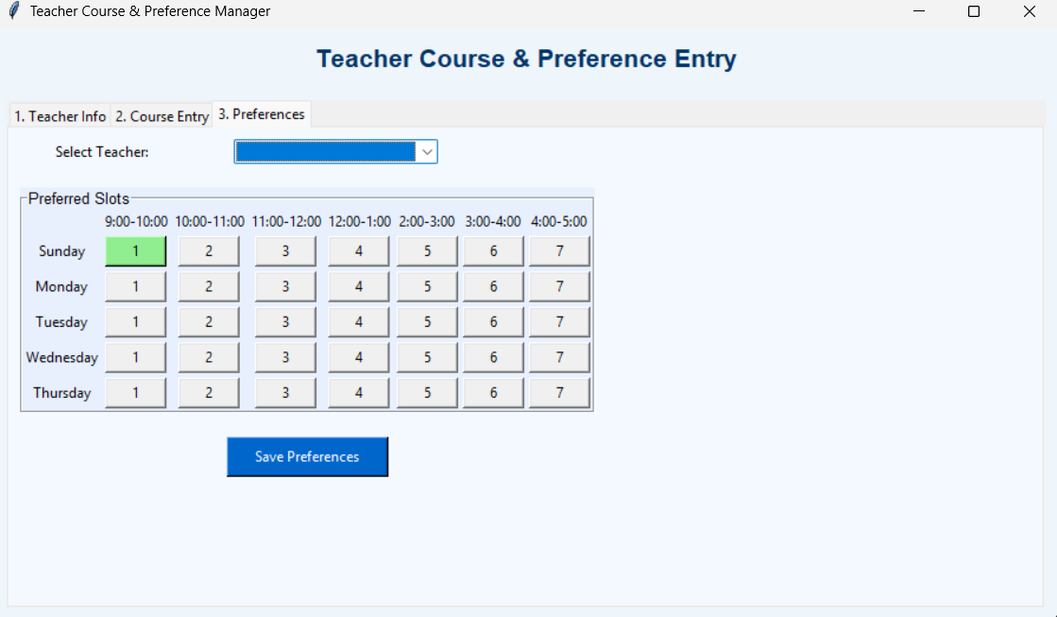
GUI – Tab 3: Teacher Preferences
Teachers select preferred days and time slots
Preferences are saved
These preferences influence slot assignment

Slide 20
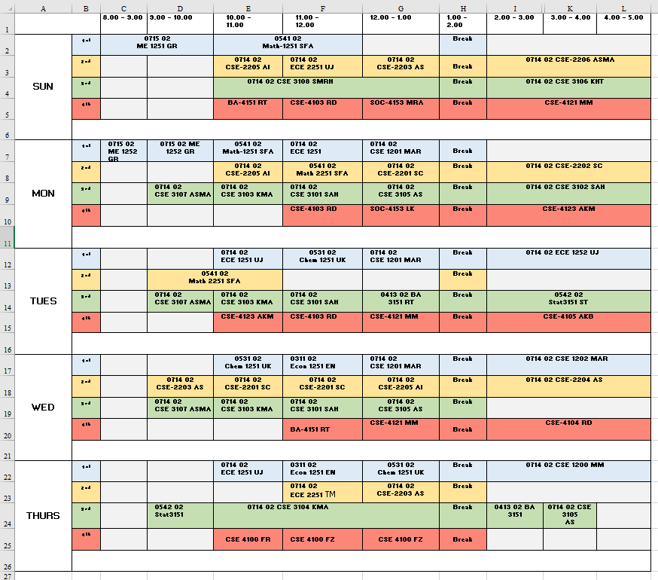
Output – Final Routine (Excel)
Well-organized tabular format
No overlapping classes
Matches teacher availability
Reflects course credit hours

Slide 21

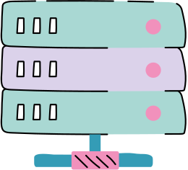
Implementation Highlights
Tech Stack & Methods Used
Language: Python
GUI: Tkinter
Excel: Openpyxl
Algorithm: Greedy with Backtracking
Data Handling: JSON

Slide 22



Conclusion
Efficient, automated routine generation
Saves time, avoids human error
Honors preferences and avoids clashes
Ensure maximum teacher satisfaction with available slots
Future work
Add student batch-based scheduling
Real-time visual calendar generation
Integration with web platforms or institutional systems

Slide 23

Thank You

