Slide 1
Estimating Cosmological Parameters
from the Matter Power Spectrum
Amortized simulation-based inference with neural posterior estimation
Group members: Md Saiful Islam · Sumon Ahmed Masum · Mohammed Rehan
Simulation-Based Inference (SoSe26) · TU Dortmund · Supervisor: Aayush
θ = { H₀ , Ωₘ , nₛ , Aₛ } ← P(k)

Slide 2
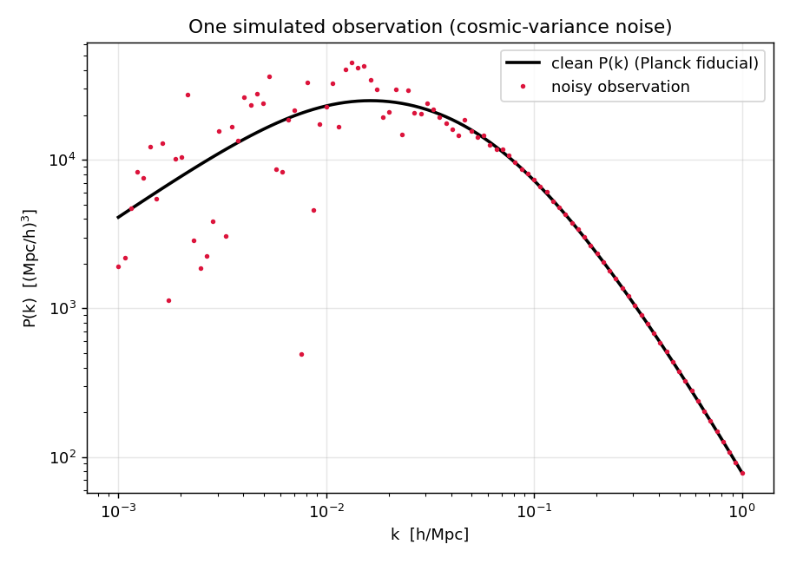
Why this problem matters
The Universe is not smooth — matter clumps into the cosmic web.
The matter power spectrum P(k) measures how much structure exists at each scale; galaxy surveys (DESI, Euclid) measure it.
The inverse problem:
We can simulate parameters → P(k) (forward), but we want P(k) → parameters, with honest uncertainty (backward).
Why SBI:
• Realistic simulators have no tractable likelihood.
• Amortized inference: train once, infer any new spectrum instantly.
• Calibrated error bars → trustworthy cosmology (e.g. the Hubble tension).
One noisy observation of P(k) (cosmic-variance noise)

Slide 3
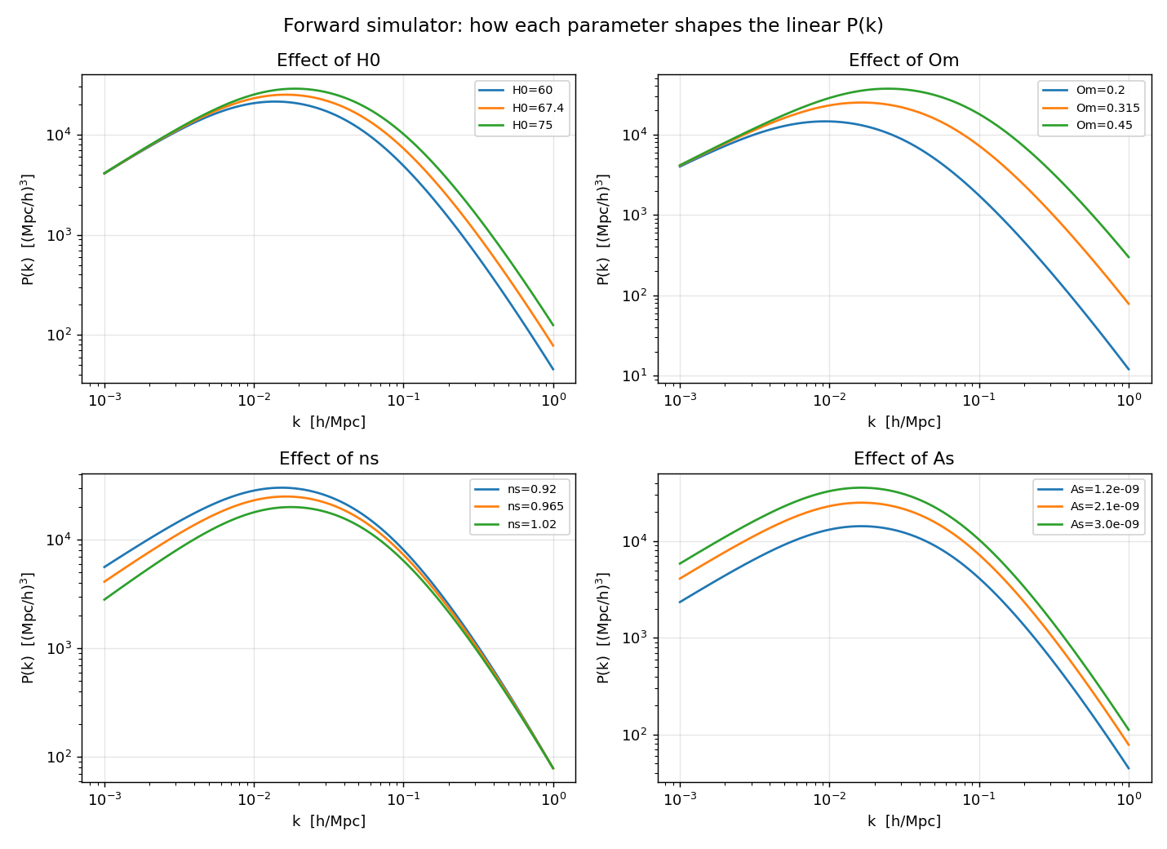
The four parameters shape P(k)
Aₛ amplitude
vertical scaling of P(k)
nₛ spectral index
tilts / pivots the spectrum
Ωₘ matter density
moves the turnover scale
H₀ Hubble constant
weak effect — enters only via shape → hard to constrain alone
Each parameter leaves a distinct imprint on the spectrum

Slide 4
Method: amortized neural posterior estimation
Prior θ = {H₀,Ωₘ,nₛ,Aₛ}
Simulator CAMB / BBKS + noise
P(k) noisy spectrum
Train once on many simulations →
inference for any new spectrum is one fast forward pass (amortized).
Neural Posterior q(θ | P(k))
posterior over θ
Built with: CAMB / BBKS simulator · Gaussian NPE (Python, NumPy, autograd) · BayesFlow for production · Go + HTML live demo
Likelihood-free: we only need to simulate, never to write p(data | θ). Maps to course Ch10 (ABC) → Ch12 (NPE/BayesFlow).

Slide 5
Simulator, priors & noise
Forward model
Linear P(k) at z=0 on 100 log-spaced k ∈ [10⁻³,1] h/Mpc.
Prototype: BBKS+Sugiyama transfer fn (≈ CAMB); production: CAMB.
Priors (proper, uniform)
H₀ ~ U(60, 80) km/s/Mpc
Ωₘ ~ U(0.10, 0.50)
nₛ ~ U(0.90, 1.05)
ln(10¹⁰Aₛ) ~ U(2.5, 3.5) (log-amplitude)
fixed ω_b = 0.0224, ω_c derived
Cosmic-variance noise
σᵢ = P(kᵢ) √(2 / Nᵢ)
Nᵢ = kᵢ² Δk V / (2π²), V = 10⁹ (Mpc/h)³
Few modes at low k → noisy; many at high k → precise.
Preprocessing
log₁₀ P(k), then standardize (raw P spans orders of magnitude).
Data: 12k train / 2k val / 3k test; fresh noise each batch.

Slide 6
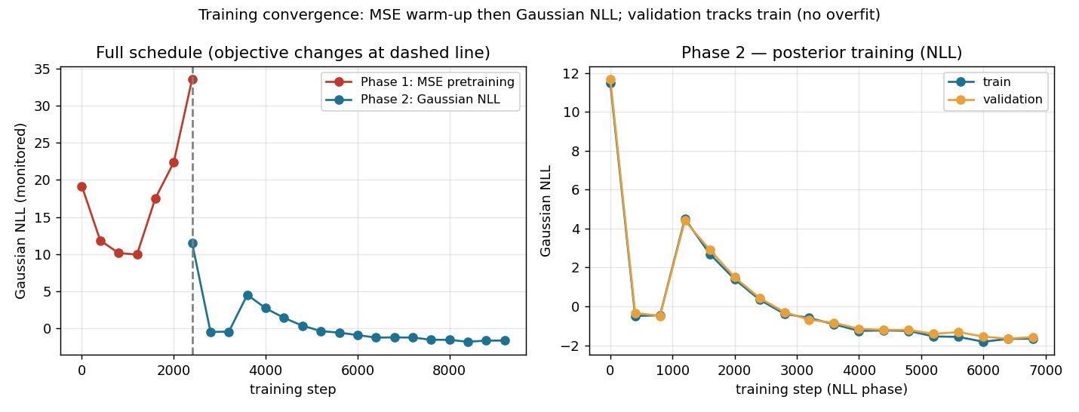
Network & training
Architecture (≈31k params)
• Input: standardized log P(k) — 100 values
• MLP: 100 → 128 → 128, tanh (hidden layers = summary)
• Output 14 = mean(4) + Cholesky(10) → 4-D Gaussian, full covariance
• No dropout / weight decay — online noise acts as regularization
Training
• Loss: Gaussian negative log-likelihood (NLL)
• Two-phase: MSE warm-up (2.5k) → NLL (7k steps)
• Adam, batch 256, step LR decay (2e-3 → 1e-3)
• Offline sims + fresh online noise per batch
• ~20 s on CPU; val tracks train → no overfit
Tools: Python · NumPy · autograd
Production → CNN summary + BayesFlow normalizing flow
Training / validation convergence
Network internals (forward pass)
P(k) 100
Dense 128 tanh
Dense 128 tanh
14 outputs mean + Cholesky
4-D Gaussian posterior

Slide 7
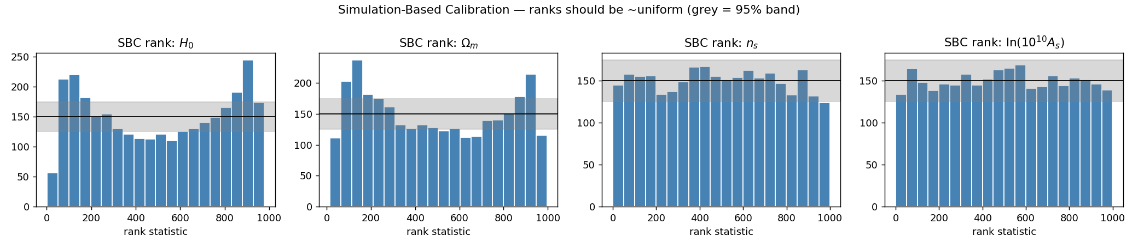
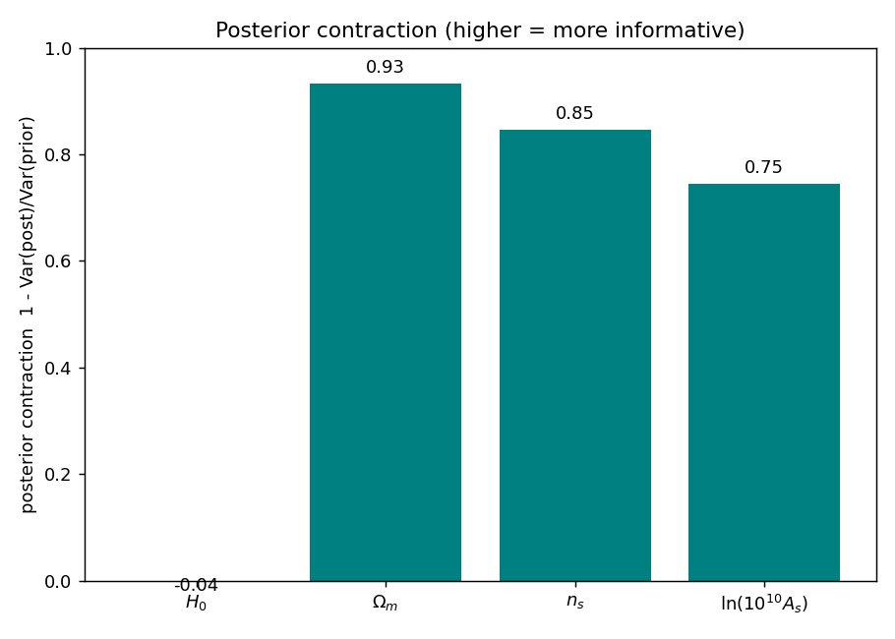
Calibration — is the posterior trustworthy?
nₛ, Aₛ ranks flat → well calibrated.
Ωₘ, H₀ mild ∪-shape → slight tail overconfidence (typical for a Gaussian posterior; a normalizing flow would improve it).
z-score std ≈ 0.95, 95% coverage ≈ 0.96–1.00.
Contraction high for Ωₘ/nₛ/Aₛ, ≈ 0 for H₀.

Slide 8
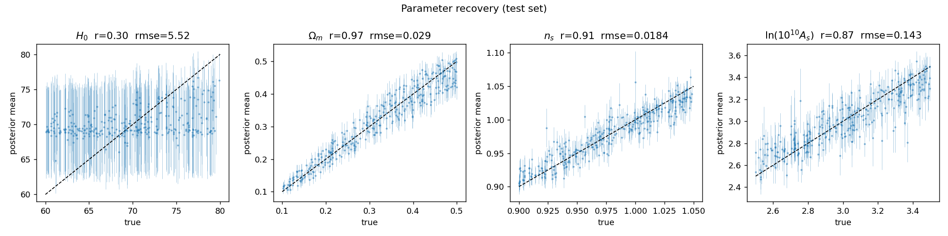
Parameter recovery
Posterior mean vs true (test set). r = correlation, rmse = error.
Ωₘ: r = 0.97 nₛ: r = 0.91 Aₛ: r = 0.87 — strongly recovered.
H₀: r = 0.30 — weakly constrained, as physics predicts (next slide).

Slide 9
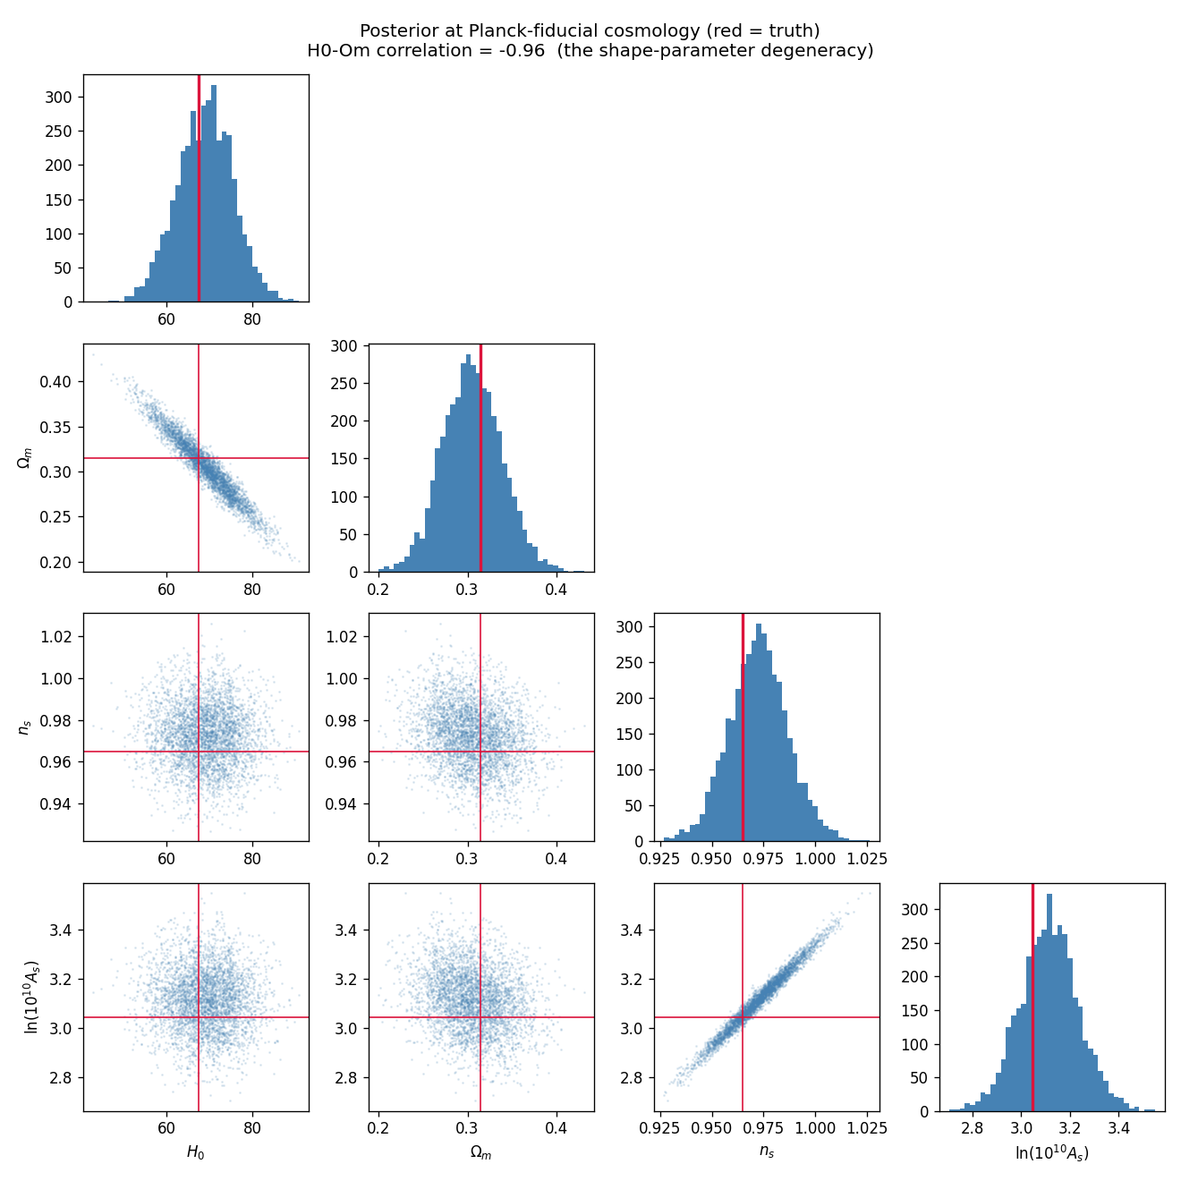
Inference at the Planck-2018 cosmology
Truth is recovered:
Ωₘ = 0.305 ± 0.033 (true 0.315)
nₛ = 0.972 ± 0.014 (true 0.965)
H₀ = 69.0 ± 6.4 (true 67.4) — broad
The H₀–Ωₘ degeneracy
Correlation = −0.96. The linear spectrum's shape depends on Γ ≈ Ωₘ h, so H₀ and Ωₘ trade off along constant Γ.
A broad, calibrated H₀ is the correct scientific result — not a failure.
Posterior corner; red = truth

Slide 10
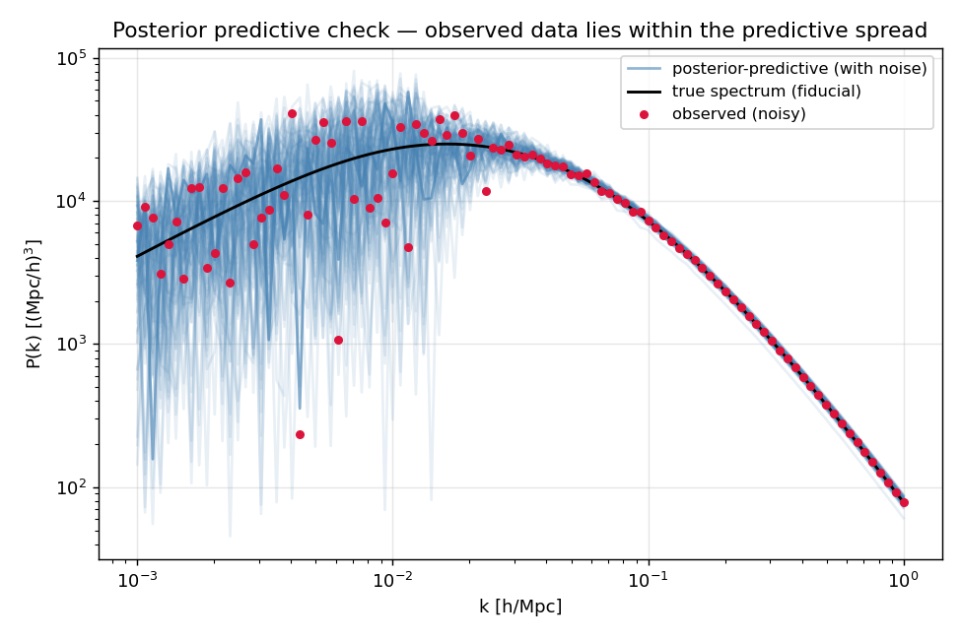
Model check & limitations
Posterior predictive check passes
Predicted spectra tightly bracket the observed P(k) at all scales.
Honest limitations
• Gaussian posterior → mild tail overconfidence (→ use a normalizing flow / BayesFlow).
• BBKS analytic simulator, linear only → use CAMB; no BAO / nonlinear.
• Idealized diagonal noise; no galaxy bias / RSD / survey window.
• H₀ weak by design (h-unit shape degeneracy).
Posterior predictive spectra bracket the observation

Slide 11
Take-home
1. We built a calibrated, amortized neural posterior estimator for ΛCDM parameters from the linear P(k).
2. Ωₘ, nₛ, Aₛ are well constrained and recovered; SBC + coverage confirm calibration.
3. H₀ is weakly constrained with a strong H₀–Ωₘ degeneracy (−0.96) — the correct shape-parameter physics.
Maps the whole course: Monte Carlo · priors · PPC · SBC · likelihood-free · NPE. Contact: [email]

