Slide 1
AI-Powered Food Freshness Detection with Blockchain-Based Product Authentication.
B.Sc. Final-Defense
Name : Saiful Islam Sumon
ID : 221-15-5664
&
Name : Md. Shahinur Alam Rabbi
ID : 221-15-4673
Department : CSE
Daffodil International University

Slide 2
Outline
Introduction
Objective
Background Study
Gap Analysis
Methodology
Results & Analysis
Novelty of the Work
Sample Dataset & Expected Output
Web Interface
Conclusion
References
B.Sc. Final-Defense

Slide 3
Introduction
Food adulteration and counterfeit packaging are widespread problems in many developing countries due to weak regulatory enforcement.
Existing food inspection and traceability systems are largely manual, centralized, and prone to manipulation.
Consumers often buy products with altered expiry dates or misleading labels, with no reliable way to verify freshness or authenticity.
This project addresses these issues by combining AI-based food freshness detection with blockchain-based secure and immutable product authentication.
The result is a transparent, trustworthy, and technology-driven approach to modern food safety.
B.Sc. Final-Defense

Slide 4
Objective
ntegrate AI and blockchain to build a secure food safety and authentication system, where AI models (Random Forest, XGBoost, LSTM) classify food items as fresh or expired using image analysis.
Design and deploy Ethereum smart contracts on the Sepolia test network to store immutable product data (ID, brand, production and expiry dates), with product images stored on IPFS and access handled through MetaMask-enabled Web3 authentication.
Implement a blockchain-based security and verification framework using SHA-256 QR codes, decentralized smart contracts, and immutable records to ensure transparency, integrity, and consumer trust.
B.Sc. Final-Defense

Slide 5
Background Study
Author | Focus | Method | Key Point
Balta et al. [1] | AI in food safety | Literature review + SWOT | AI enables early detection using CNNs and imaging, but suffers from high cost, opacity, and data scarcity
Zhou et al. [2] | AI, Big Data & Blockchain | Systematic review by data lifecycle | Combined technologies improve monitoring and security but demand large labeled datasets and high computation
Duan et al. [3] | Blockchain in supply chains | Review with strategic analysis | Blockchain enhances traceability and speeds response to food safety incidents
Dimitrakopoulou & Garre [9] | AI reliability in food safety | Conceptual implementation cycle | AI supports outbreak detection and fraud tracking, but performance drops with biased or imbalanced data
B.Sc. Final-Defense

Slide 6
Gap Analysis
Author(s) | Focus | Key Gap
Balta et al. [1] | AI in food safety | Lack of clear data governance, standards, and adoption policies
Zhou et al.[2] | AI, big data & blockchain | Shortage of labeled data, weak infrastructure, poor model generalization
Duan et al. [3] | Blockchain in supply chains | Legal delays, interoperability issues, low awareness, need for standardization
Hema & Manickavasaga [4] | Blockchain for food safety | Limited research on new adoption drivers and regions
B.Sc. Final-Defense

Slide 7
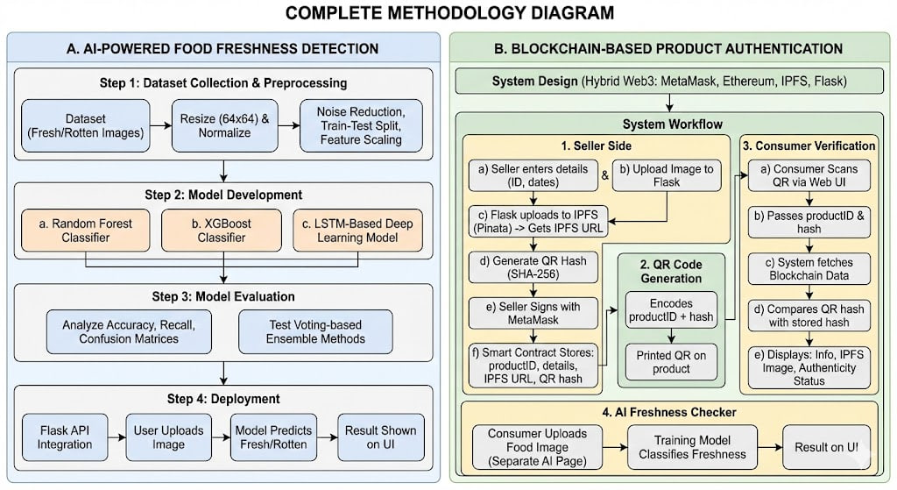
Methodology
B.Sc. Final-Defense

Slide 8
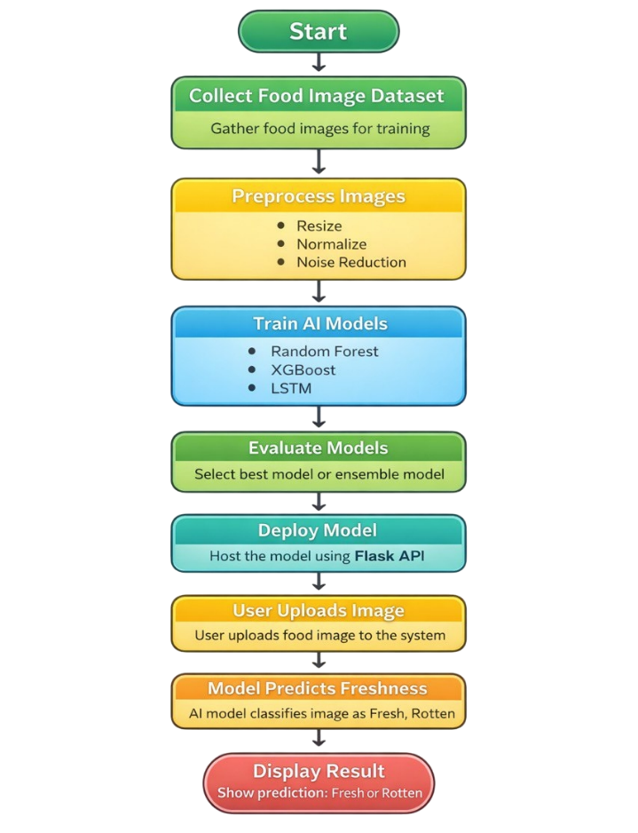
Methodology
Algorithm 1
Input: Food images ( .jpg, .jpeg, .png, .bmp)
Output: Food freshness results
B.Sc. Final-Defense

Slide 9
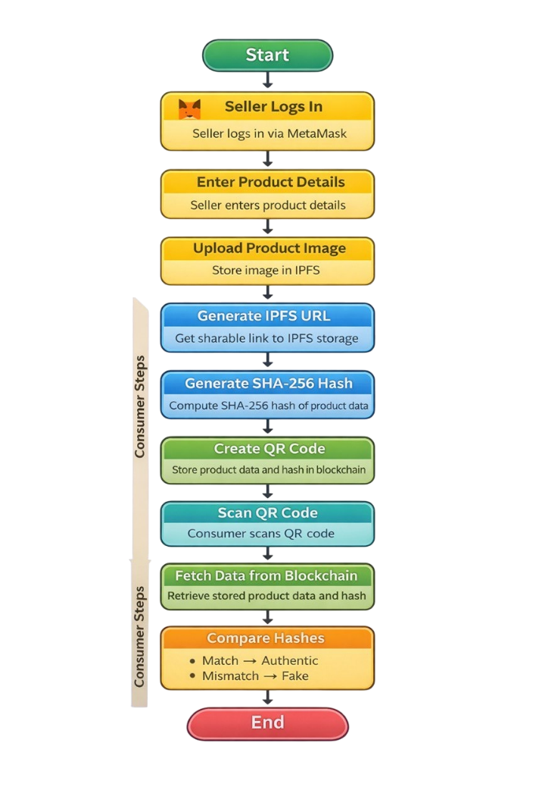
Methodology
Algorithm 2
Input: QR generation by entering product details.
Output: Fetching product information from QR images.
B.Sc. Final-Defense

Slide 10
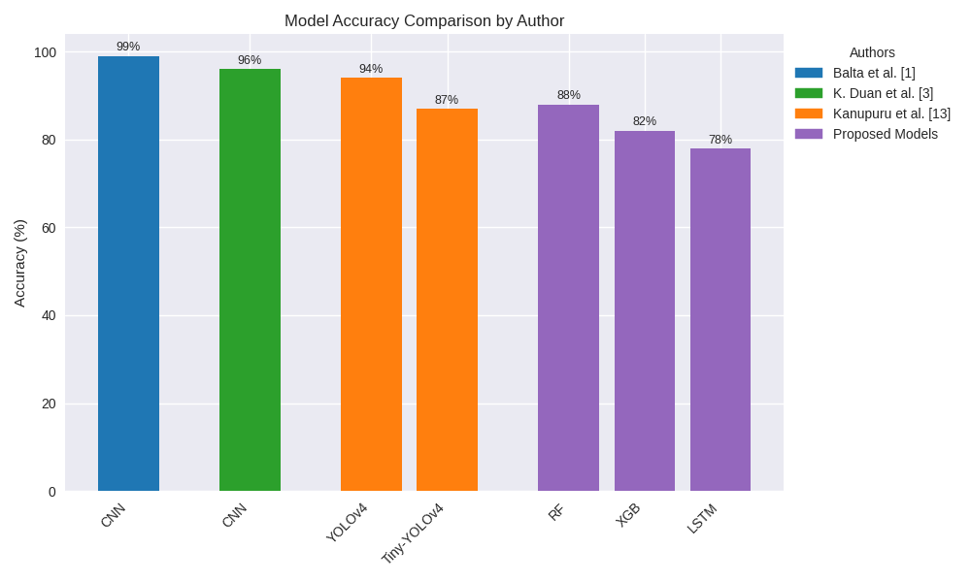
Result and Analysis
Authors | Model Used | Accuracy | Limitations
Balta et al. [1] | CNN | >99% | Data scarcity, “black‑box” opacity, and limited labelled datasets
K. Duan et al. [2] | CNN | >96% | Need for standardized protocols, interoperability issues, lacking diversity
Kanupuru et al. [5] | YOLOv4 Tiny‑YOLOv4 | 94% 87% | Small dataset, higher mis‑classification for the lightweight model
Proposed Models | RF XGB LSTM | 88% 82% 78% | ×
B.Sc. Final-Defense

Slide 11
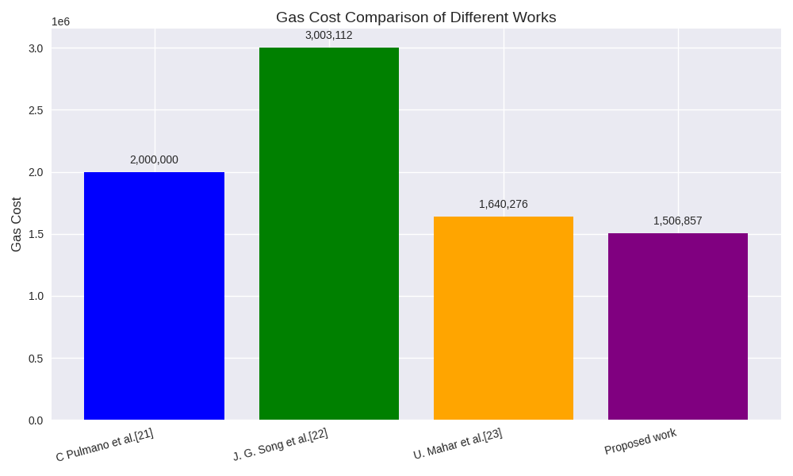
Result and Analysis
Function Name | Transaction cost (ETH) | Execution cost (ETH) | Gas uses | In USD ($)
Contract deploy | 0.0004 | 0.0004 | 1,506,857 | 1.29
Product Registration | 0.0007376475 | 0.0007 | 491,765 (1.5 Gwei) | 2.26
B.Sc. Final-Defense

Slide 12
Result and Analysis
Reference | Immutability | Transparency | Security | Privacy Data | Integrity | Accountability
K. Duan et al. [3] | Yes | Yes | Yes | No | Yes | Yes
V. S. Hema et al. [4] | Yes | Yes | Yes | No | Yes | No
A S Patel et al. [6] | Yes | Yes | Yes | No | Yes | No
A Singh et al. [7] | Yes | Yes | Yes | No | Yes | No
M. Tripoli et al. [8] | Yes | Yes | Yes | Yes | Yes | No
Proposed system | Yes | Yes | Yes | Yes | Yes | Yes
B.Sc. Final-Defense

Slide 13
Novelty of the Work
First integrated solution combining LSTM, Random Forest, XGBoost with Blockchain.
Public Ethereum Sepolia deployment instead of costly private networks.
SHA-256 QR binding physical product to blockchain record.
Independent dual-layer architecture for system reliability.
Fully decentralized IPFS image storage.
B.Sc. Final-Defense

Slide 14
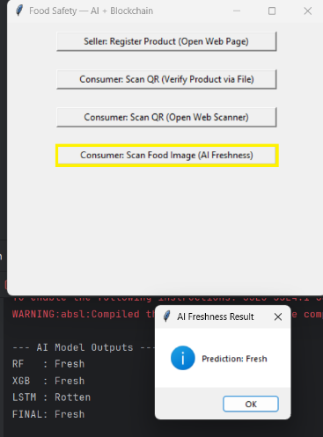

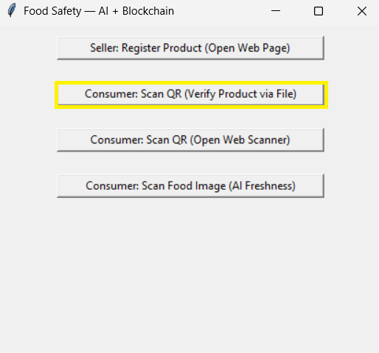
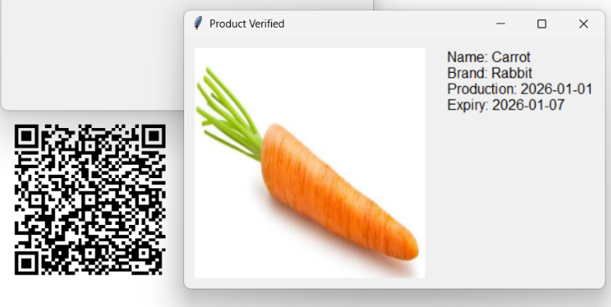


Sample dataset and Expected output
Input: Food Image
Output:
Fresh or Rotten label
Confidence via ensemble voting
QR Verification Output:
Product ID
Brand name
Manufacturing & expiry date
IPFS product image
Authentic / Tampered status
B.Sc. Final-Defense

Slide 15
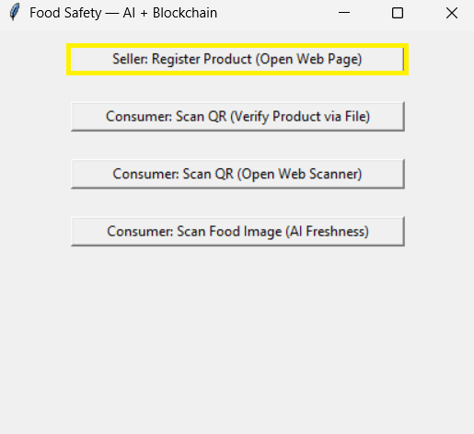
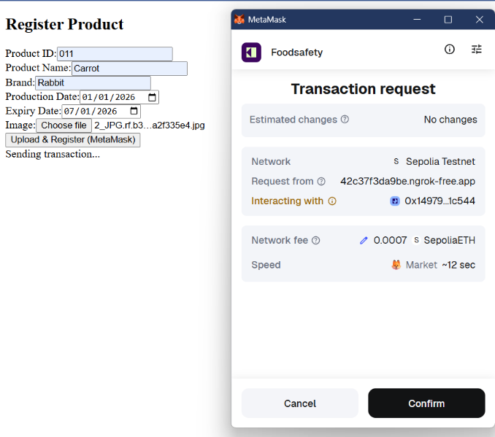
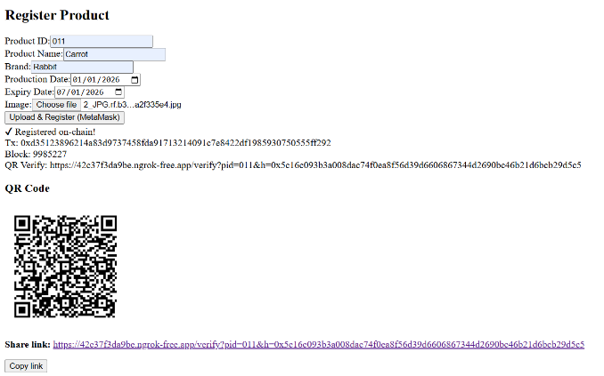
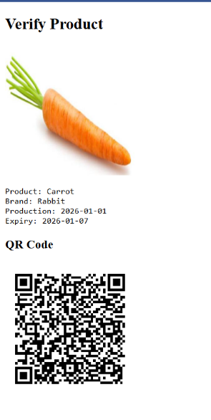
Web Interface of Image Enhancement
B.Sc. Final-Defense

Slide 16
Conclusion
This project successfully demonstrates an integrated AI and Blockchain-based framework for ensuring food freshness detection and product authentication. The AI module, powered by Random Forest, XGBoost, and LSTM models with an ensemble voting strategy, accurately classifies food images as fresh or rotten, providing an automated and reliable assessment of food quality. At the same time, the blockchain module deployed on the Ethereum Sepolia network ensures tamper-proof storage of product information using smart contracts, decentralized IPFS image storage, and SHA-256 based QR codes for instant consumer verification. The dual-layer architecture enhances transparency, traceability, and consumer trust while remaining cost-effective and scalable, making the system suitable for real-world deployment, particularly in developing countries.
B.Sc. Final-Defense

Slide 17
References
I. Balta, J. Lemon, C. A. Popescu, D. McCleery, T. Iancu, et al., “Food safety the transition to artificial intelligence (AI) modus operandi,” Trends in Food Science & Technology, vol. 165, Art. 105278,Nov. 2025
Q. Zhou, H. Zhang, S. Wang, “Artificial intelligence, big data, and blockchain in food safety,” International Journal of Food Engineering, vol. 2021, no. 29, 2021. DOI: 10.1515/ijfe-2021-0299.
K. Duan, H. Onyeaka, G. Pang, Z. Meng, “Pioneering food safety: Blockchain’s integration in supply chain surveillance,” Journal of Agriculture and Food Research, vol. 2024, article 101281, 2024. DOI: 10.1016/j.jafr.2024.101281.
V. S. V. Hema and A. Manickavasagan, “Blockchain implementation for food safety in supply chain: A review,” Comprehensive Reviews in Food Science and Food Safety, 2024.
P. Kanupuru, N. V. U. Reddy, “A Deep Learning Approach to Detect the Spoiled Fruits,” WSEAS Transactions on Computer Research, vol. 10, no. 10, 2022. DOI: 10.37394/232018.2022.10.10.
B.Sc. Final-Defense

Slide 18
References
A. S. Patel, M. N. Brahmbhatt, A. R. Bariya, J. B. Nayak, V. K. Singh, “Blockchain technology in food safety and traceability concern to livestock products,” Heliyon, vol. 9, no. e16526, 2023. DOI: 10.1016/j.heliyon.2023.e16526.
A. Singh, A. Shenoy, and N. Thanekar, “Chain Thread: Blockchain‑Powered Product Verification and Authenticity Tracking,” Int. J. for Research in Applied Science and Engineering Technology, vol. 13, no. 4, pp. 8, Apr. 2025.
M. Tripoli and J. Schmidhuber, “Emerging Opportunities for the Application of Blockchain in the Agri‑food Industry,” FAO &amp; ICTSD, 2018.
M.‑E. Dimitrakopoulou and A. Garre, “AI’s intelligence for improving food safety: only as strong as the data that feeds it,” Current Food Science and Technology Reports, vol. 3, no. 1, p. 15, May 2025
B.Sc. Final-Defense

Slide 19
THANK YOU
B.Sc. Final-Defense

