Slide 1
Presentation on Research Project Automated Hospital ICU Emergency Signaling System
Supervisors
Dr. Tarem Ahmed, SMIEEE
Dr. Mohammad Faisal Uddin
Presentation by
Nazifa M Shemonti
Saifur Rahman
Shifat Uddin

Slide 2
KOAD Algorithm Background
Kernel-based Online Anomaly Detection
Development and application in ICU conceptualized by Dr. Ahmed
Previously implemented in network traffic anomaly detection, intruder detection

Slide 3
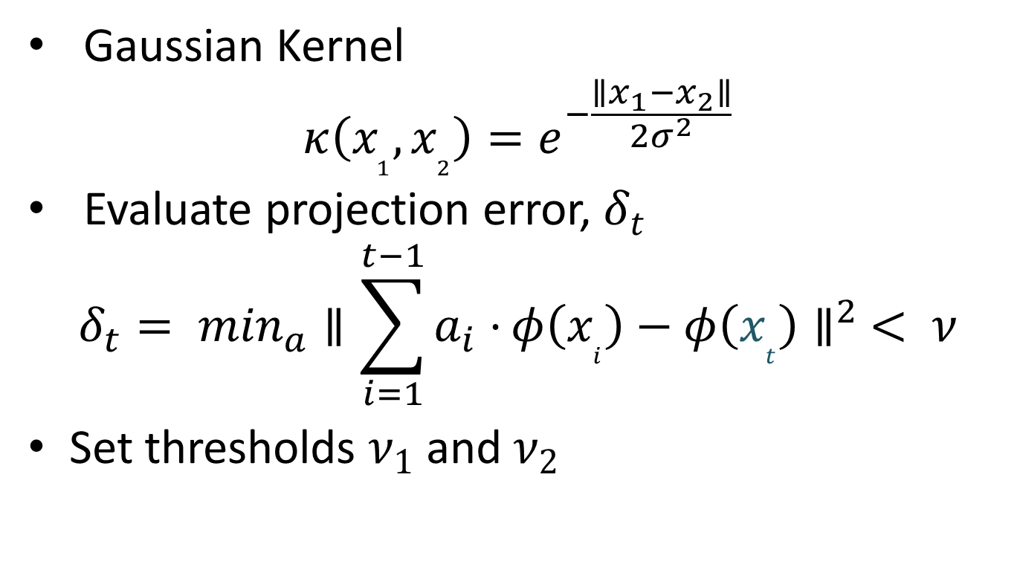
KOAD Algorithm Properties
Gaussian Kernel
$$κ\left(x_{1}, x_{2}\right)=e^{−\frac{∥x_{1}−x_{2}∥}{2σ^{2}}}$$
Evaluate projection error, $δ_{t}$
$$δ_{t}= \min_{a}{∥\sum_{i=1}^{t−1}{a_{i}⋅}φ\left(x_{i}\right)−φ\left(x_{t}\right)∥}^{2} < ν$$
Set thresholds $ν_{1}$and $ν_{2}$

Slide 4
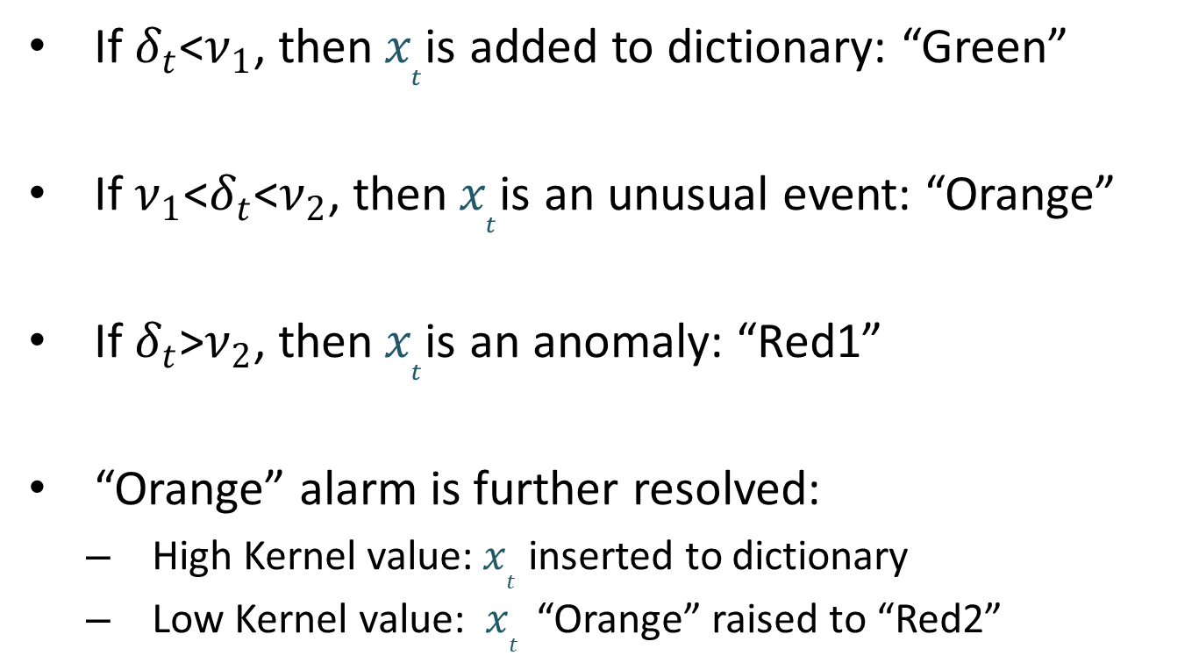
KOAD Algorithm Anomaly Detection and Signaling
If $δ_{t}$<$ν_{1}$, then${ x}_{t}$is added to dictionary: “Green”
If $ν_{1}$<$δ_{t}$<$ν_{2}$, then${ x}_{t}$is an unusual event: “Orange”
If $δ_{t}$>$ν_{2}$, then${ x}_{t}$is an anomaly: “Red1”
“Orange” alarm is further resolved:
High Kernel value:${ x}_{t}$ inserted to dictionary
Low Kernel value: ${ x}_{t}$ “Orange” raised to “Red2”

Slide 5
KOAD Algorithm Case for Hospital ICU Implementation
Tackles storage and computational complexity
Dictionary size does not grow indefinitely
Possible to process multiple readings

Slide 6
KOAD Algorithm Case for Implementation in Bangladesh
Convenient for hospitals
Manual recording can be phased out
User friendly interface

Slide 7
ICU Survey
Conducted at:
Islami Bank Hospital
Euro-Bangla Heart Hospital
Chittagong Medical Hospital
National Heart Foundation Hospital & Research Institute
Outcomes:
Patient Monitoring Unit (PMU) used
Method of recording vital statistics

Slide 8
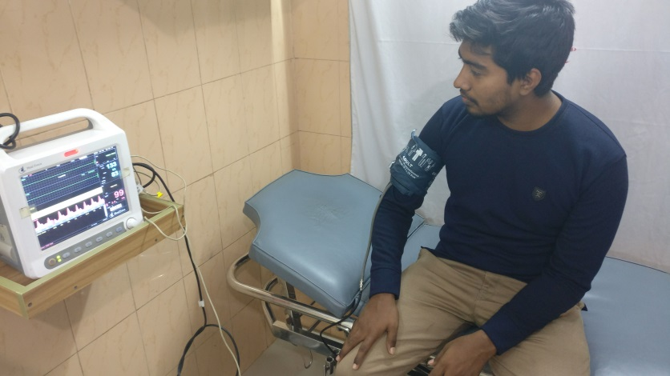
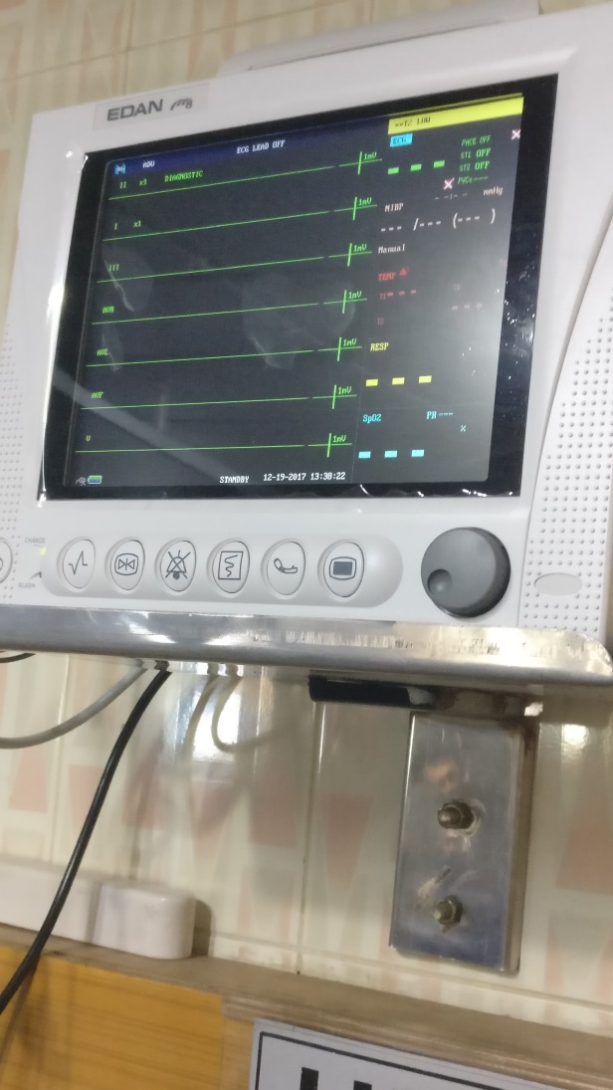
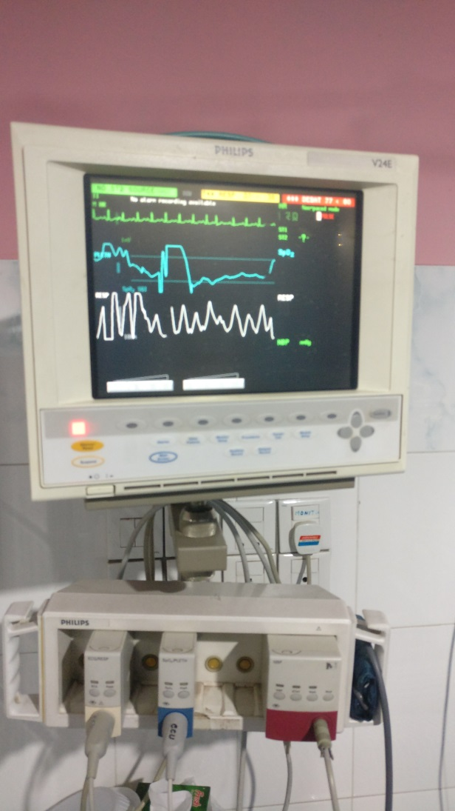
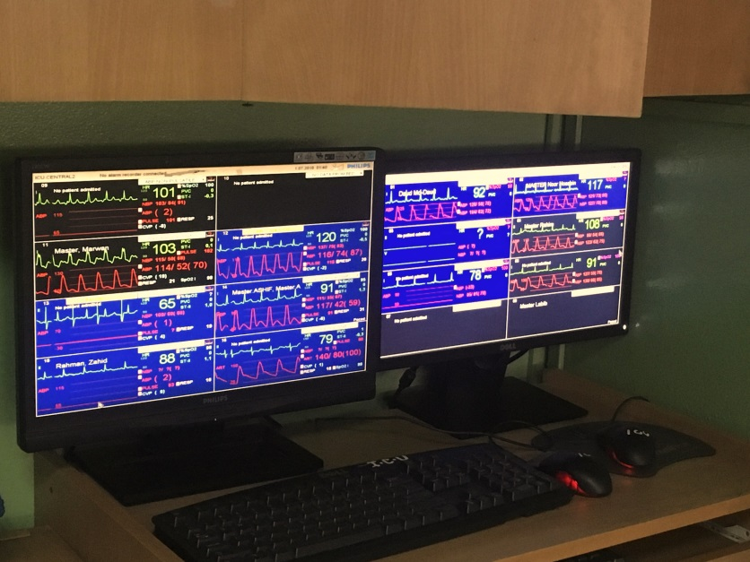
PMU

Slide 9
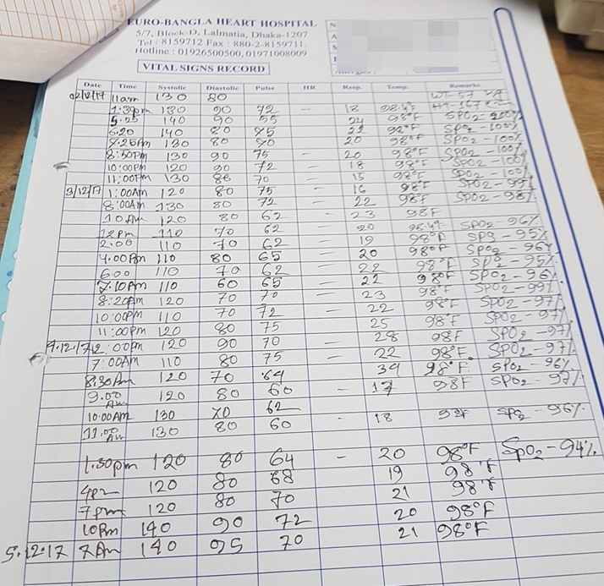
Manual Recording of Vital Statistics at Euro-Bangla Heart Hospital

Slide 10
NHFH&RI Access
Approvals from both Academic Council and Ethical Review Committee
Conditions:
Data nondisclosure to third party
Protect anonymity of subjects
Follow international guideline for data protection

Slide 11
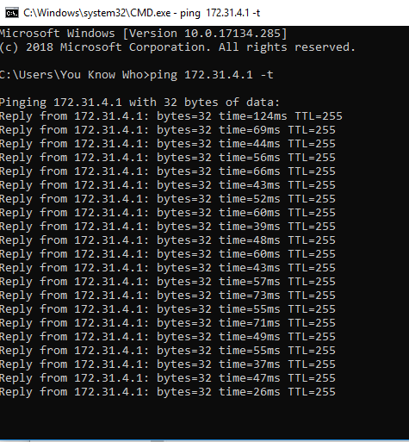
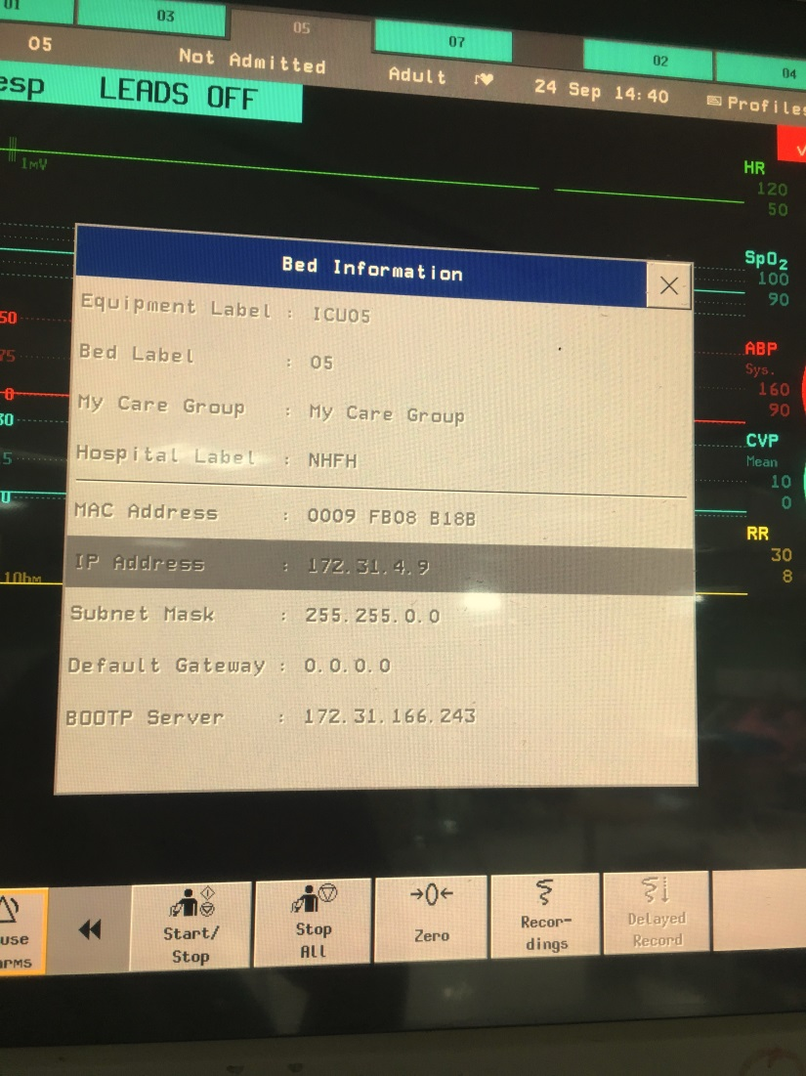
Data Extraction Connectivity via LAN

Slide 12
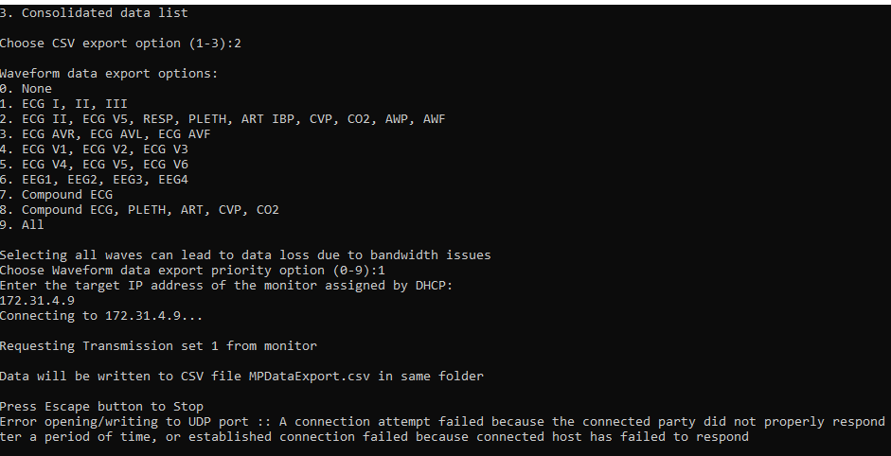
Data Extraction (Applying Virtual Signal)

Slide 13
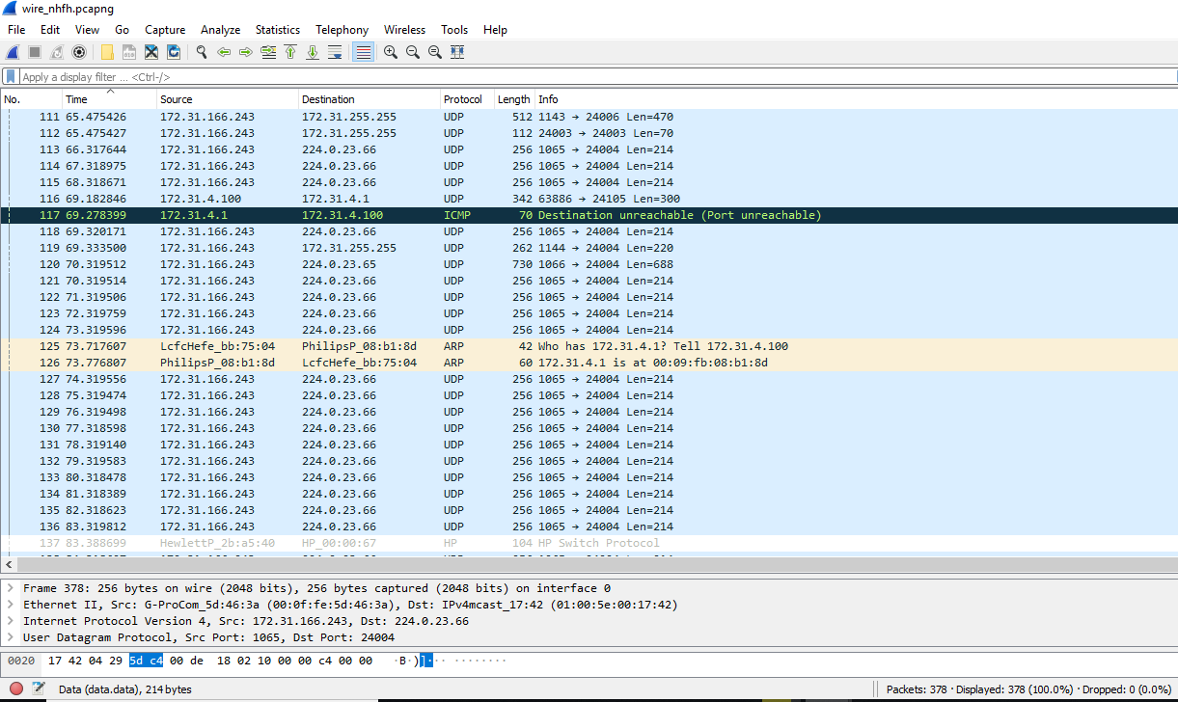
Data Extraction (Debugging Packets)

Slide 14
Data Extraction (Data Export Test Tool by Philips)

Slide 15
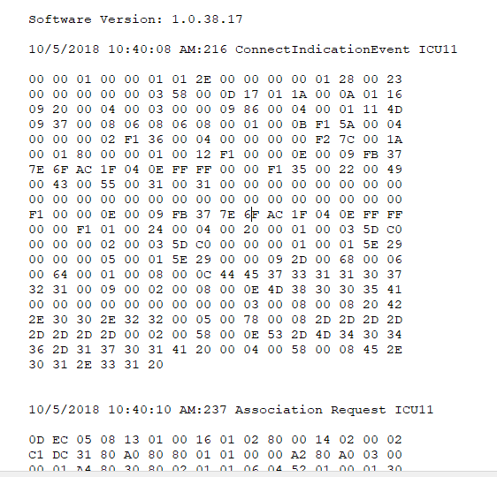
Data Extraction (Data Export Test Tool by Philips)

Slide 16
Data Extraction
Map the parameters from the log file
Convert existing MATLAB code to more optimized code readable by microprocessor
Centralize the prototypes into one network

Slide 17
Generic Block Diagram of ICU Emergency Signalling System
Network Information
Patient Monitor Unit(PMU)
Converter
RS 232
LAN
USB feed
Automated Hospital ICU Emergency Signalling System
Processor (Circuit design)
KOAD algorithm computation
Alarm Signal

Slide 18
Research Goal
Prototype Design:
Relevant Peripherals Design
Data extraction methodology

Slide 19
Research Goal
Interface Design:
Maintain Alarming system properties
Approaches for false alarm deduction & reduction

Slide 20
Research Goal
Interface Design:
Control Room Design
IEC guideline 60601-1-11

Slide 21
Research Objective
A Humanitarian Project:
Research Publication
Patent

Slide 22

Questions & Feedback

