Slide 1





Welcome

Slide 2




Slide 3
INDEX SHEET FOR CO1
State Diagram
Moore Machine & Mealy Machine
Von Neuman architecture
Hardware implementation of Arithmetic and Logic Unit
Buses Types
Specifications of a computer
Concepts of Machine level programming
Assembly level programming
High-level programming
Various addressing modes
Instruction set
Concepts of subroutine and subroutine call
use of stack for handling subroutine call and return

Slide 4
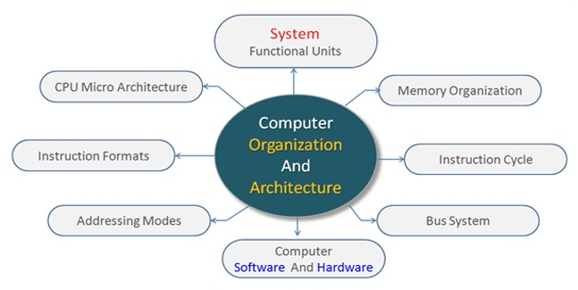
Introduction
Computer Organization and Architecture is the study of internal working, structuring, and implementation of a computer system.

Slide 5
Introduction Cont.….
Computer architecture refers to those parameters of a computer system that are visible to a programmer and which have a direct impact on the logical execution of a program such as instruction set, the number of bits used to represent different data types, I/O mechanisms, and techniques for addressing memory.
Computer organization refers to the operational units and their interconnections that realize the architectural specifications such as control signals, interfaces between the computer and peripherals, and the memory technology used.

Slide 6
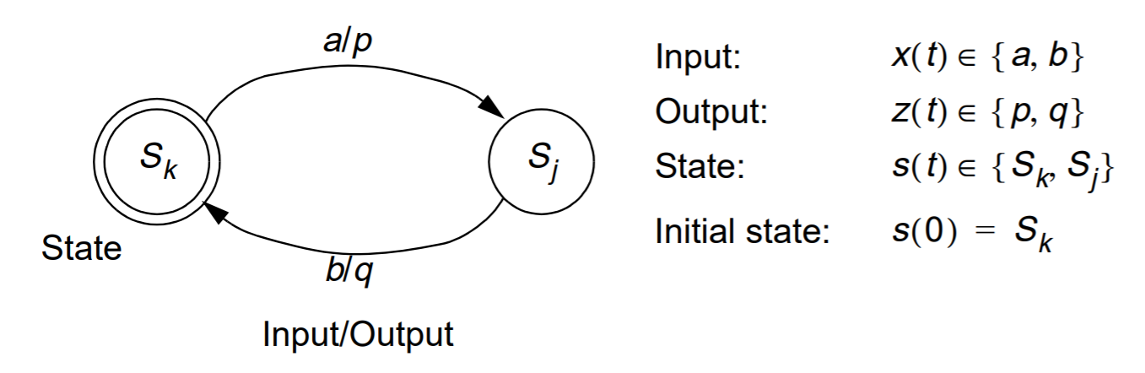
Finite State machine and its State Diagram
A state machine is a behavior model of sequential circuits consisting of a finite number of states known as finite-state machine (FSM).
Based on the current state and a given input the machine performs state transitions and produces outputs.
The pictorial representation of the behavior of sequential circuits is known as state diagram.

Slide 7
Finite State machine and its State Diagram Cont.….
FSM are classified into two types:
- Mealy Machine
- Moore Machine
The applications of finite state machines include vending machines, video games, traffic lights, controllers in CPU, recognition of speech, language processing, etc.

Slide 8
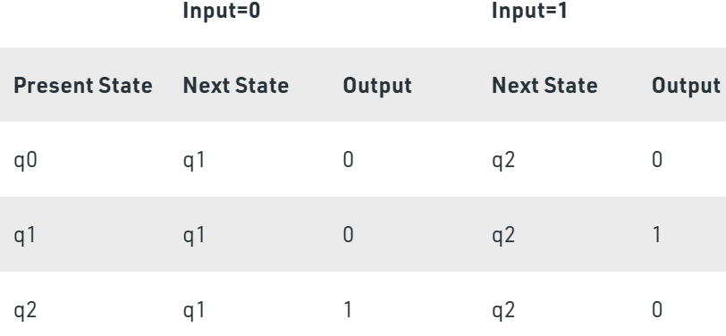
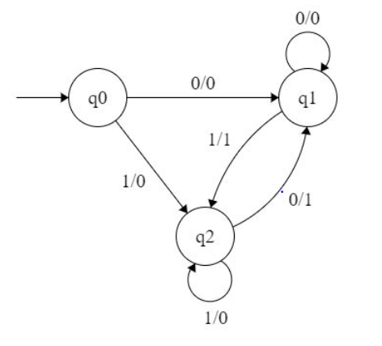
Mealy machine and its state diagram
In Mealy finite state machines, the output depends on present state and present input.
Inputs
Next State
State
Output
Outputs
Combinational logic
Register
Combinational logic
(Mealy-type)
Clock

Slide 9
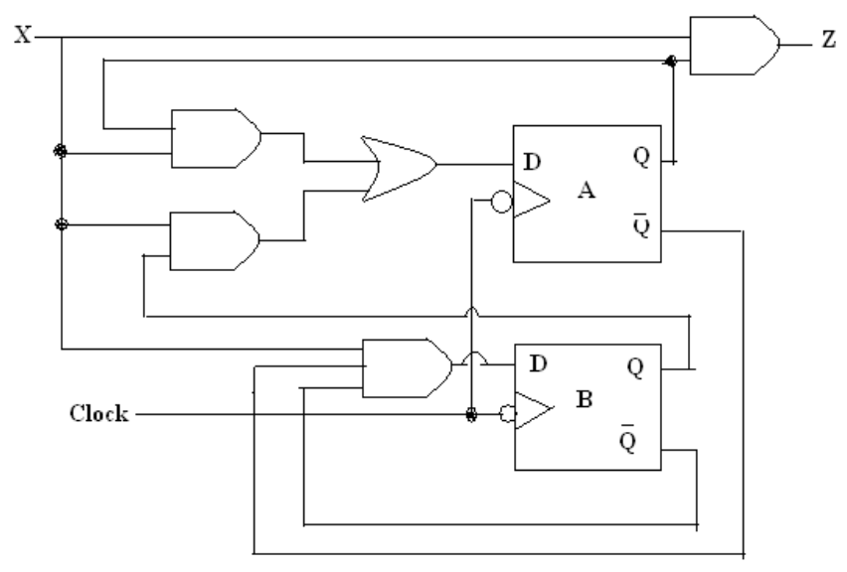
Mealy State machine
Example for 111 Sequence detection circuit implementation

Slide 10
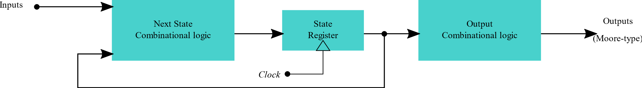
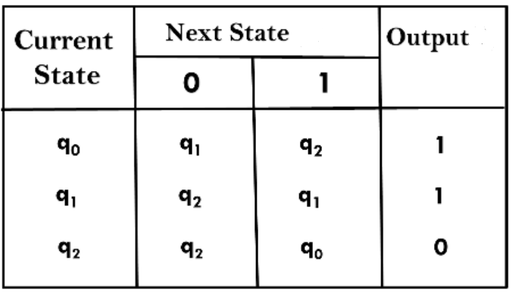
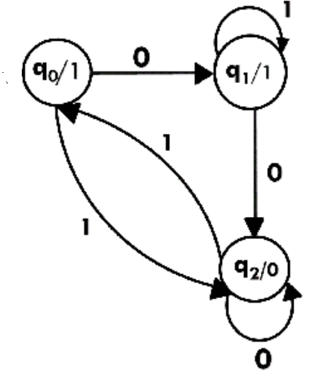
Moore machine and its state diagram
In Moore finite state machines, the output depends only on present state.

Slide 11
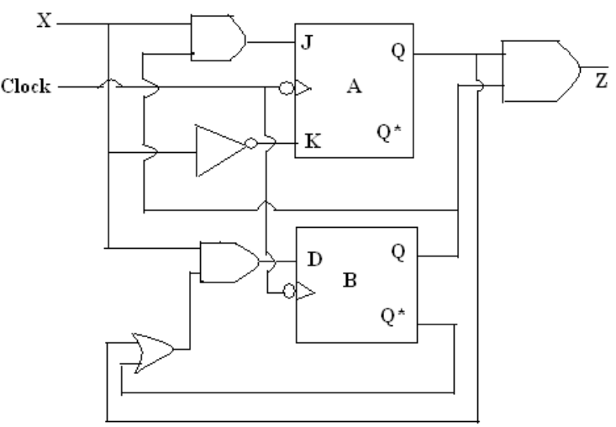
Moore machine
Example for 111 Sequence detection circuit implementation

Slide 12
Architecture of Micro computer
Architecture of a micro computer or a micro controller refers to the arrangement of the CPU with respect to the RAM and ROM.
There are two types of digital computer architectures that describe the functionality and implementation of computer systems.
. 1. Von Neumann architecture
2. Harvard architecture

Slide 13
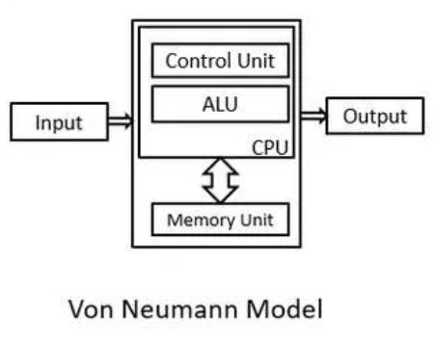
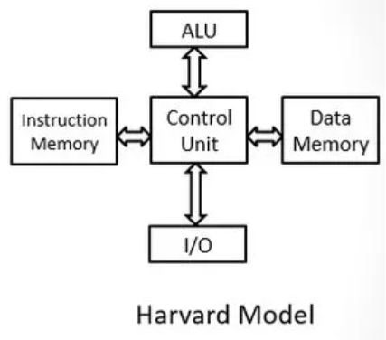
Von Neumann Architecture Vs Harvard architecture
Point of Comparison | Harvard Architecture | Von Neumann Architecture
 | In Harvard architecture, the CPU is connected with both the data memory (RAM) and program memory (ROM), separately. | In Von-Neumann architecture, there is no separate data and program memory. Instead, a single memory connection is given to the CPU.
Arrangement

Slide 14
Von Neumann Architecture Vs Harvard architecture
Point of Comparison | Harvard Architecture | Von Neumann Architecture
Hardware requirements | It requires more hardware since it will be requiring separate data and address bus for each memory. | It requires less hardware since only a common memory needs to be reached.
Space requirements | It requires more space. | It requires less space.
Speed of execution | Speed of execution is faster because the processor fetches data and instructions simultaneously . | Speed of execution is slower since it cannot fetch the data and instructions at the same time.
Controlling | Controlling becomes complex since data and instructions are to be fetched simultaneously. | Controlling becomes simpler since either data or instructions are to be fetched at a time.

Slide 15
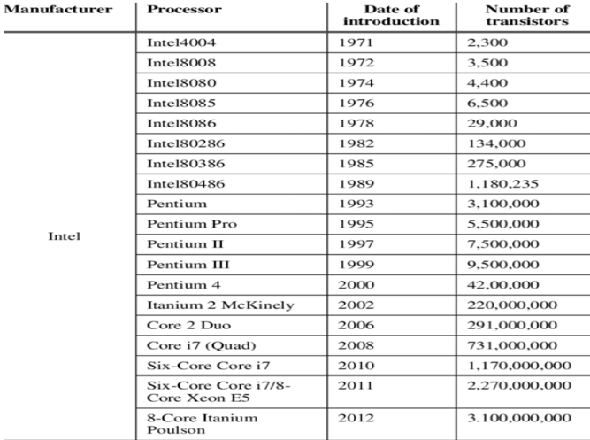
Evolution of Processor

Slide 16
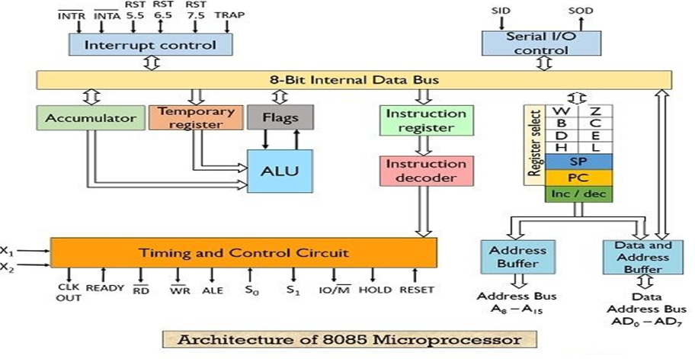
8085 Microprocessor Architecture

Slide 17
Functional units of 8085
1. Registers: These are nothing but set of flip flops. These are basically used to hold (store) the data.
General purpose registers– 8085 microprocessors contain 6 general purpose registers that are present inside the microprocessor and stores 8-bit data in order to execute a program.
These general-purpose registers are B, C, D, E, H and L. These registers can be combined to form pairs – BC, DE and HL in order to execute the 16-bit operation.
Temporary registers: These registers are used by the ALU to store the data on temporary basis and these are not accessed by the programmer. These are of 2 types:
Temporary data register – It is an 8-bit register that holds the operand and provides it to the ALU for
program execution. Also, the immediate results are stored by the ALU in this register.
2. W and Z register – These registers are also used to hold the temporary values. It is used by the
control section of the microprocessor so as to store the data during operations.

Slide 18
Functional units of 8085
2. Program Counter (PC):
It is basically a special purpose register that is used to store the memory location of the instruction to be performed. As in order to fetch an instruction from the memory the microprocessor needs to know about its address.
It is a 16-bit register as it stores address.
This register is used by the microprocessor to line up the instructions that are to be executed in a sequential manner.
3. Stack Pointer (SP):
It is also a 16-bit register and is a part of memory.
The data is stored in the stack in serial format and stack pointer generally stores the address of the last data element stored in the stack. Thus, the stack is based on LIFO.
Whenever a new data is added in the stack, then the stack pointer starts pointing towards the very next memory location.

Slide 19
Functional units of 8085
4. Accumulator:
It is an 8-bit register that stores the result of the operation performed by the ALU.
It is also known as register A.
5. Flags:
Flag register basically holds the status of the current result generated by the ALU and not the actually generated result. Thus we can say it is used to test the data conditions.
8085 has 5 flags that shows 5 different data conditions. These are carry, sign, zero, parity and auxiliary carry flags.

Slide 20
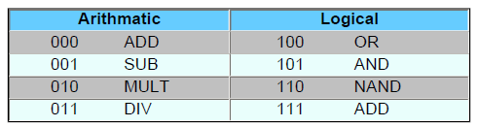
Arithmetic & Logical Unit
Consider an ALU which can perform four arithmetic operations and four logical operations To distinguish between arithmetic and logical operation, we may use a signal line,
0 - in that signal, represents an arithmetic operation and
1 - in that signal, represents a logical operation.

Slide 21
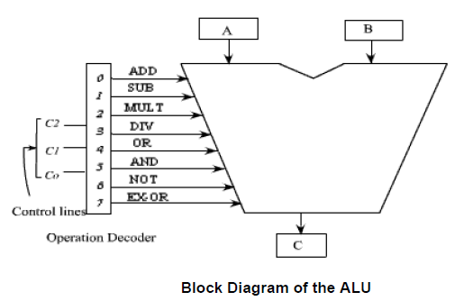
Block Diagram of the ALU

Slide 22
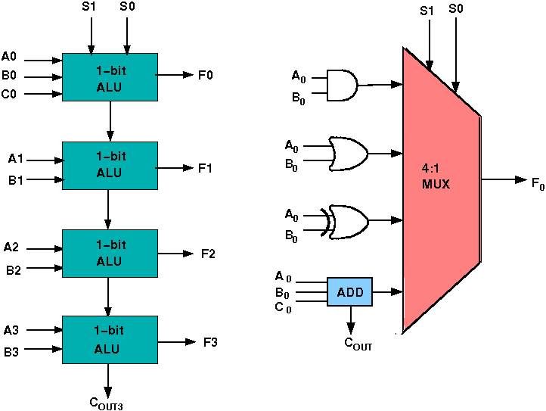
Design of the ALU

Slide 23
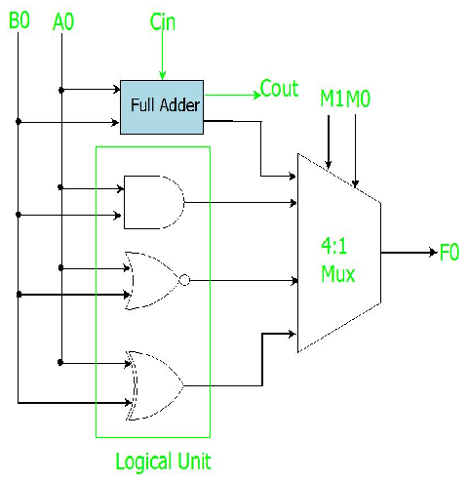
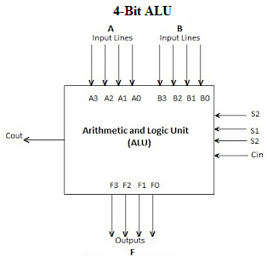
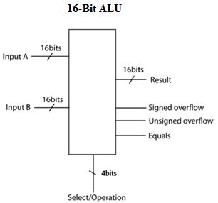
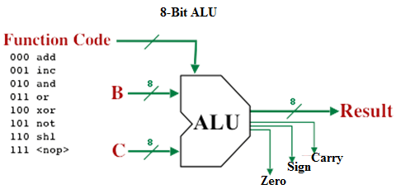
ALU-Arithmetic & Logical Unit

Slide 24
Buses
Three types of bus are used.
Address bus - carries memory addresses from the processor to other components such as primary storage and input/output devices.
Data bus - carries the data between the processor and other components.
Control bus - carries control signals from the processor to other components.

Slide 25
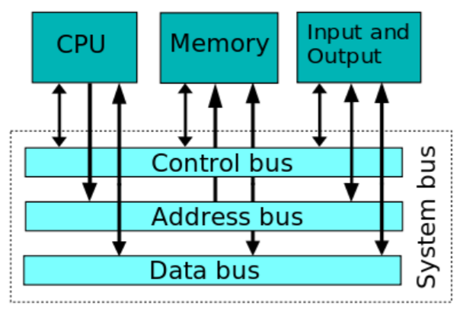
Buses

Slide 26
Programming language
A program is a set of instructions that the computer executes.
Machine language
Assembly language
High level language

Slide 27
Machine level programming
Machine language is the language written as stings of binary 1’s & 0’s. it is the only language which a computer can understands without a translation program.
A machine language instruction has two parts.
Operation code: Which tells the computer what function to perform
Operand: Which tells the computer on which the function is operating & storing (Register or memory & so on)

Slide 28
Machine level programming
Disadvantages of Machine level programming
It is machine dependent i.e., it differs from computer to computer
It is difficult to program & write
It is prone to errors
It is difficult to modify

Slide 29
Assembly level programming
It is a low level programming language that allows the user to write a program using alphanumeric mnemonic codes, instead of numeric codes for a set of instructions.
It requires a translator known as Assembler to convert assembly language into machine language.
It assembles the machine language program in the main memory of the computer and makes it ready for execution.
Eg: Mov R1,R2
Add A,B

Slide 30
Assembly level programming
Advantages of Assembly level programming
It is easy to understand and use
It is easy to locate and correct errors
It is easier to modify
Disadvantages Assembly level programming
It is machine dependent

Slide 31
High level programming
It is machine independent language. It enables the user to write programs in a language which resembles English words and familiar mathematical symbols.
COBOL was the first high level language developed for business.
Each statement in a high level language is a micro instruction which is translated into several machine language instructions.
A Compiler is a translator program which translates a high level programming language into its equivalent machine language programs.

Slide 32
High level programming
Source code : It is the input or the programming instructor of a procedural language. The compiler translates the source code into machine level language which is known as object code. Object code can be saved and executed as and when desired by the user.
Source Code Language translator program Object code
High level language Machine level language

Slide 33
High level programming
Linker : A program used with a compiler to provide links to the libraries needed for an executable program. It takes one or more object code generated by a compiler and combines them into a single executable program.
Interpreter : It is a translator used for translating high level language into the desired output. It takes one statement, translates it into machine language instructions and then immediately executes the result. Its output is the result of program execution.

Slide 34
High level programming
Advantages of High level programming
It is machine independent
It is easier to learn & use.
It is easier to maintain and gives few errors.
Disadvantages of High level programming
It lowers efficiency
It is less flexible

Slide 35
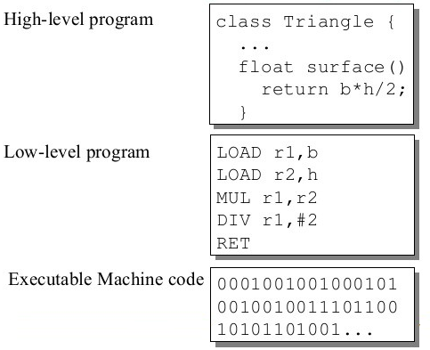
Example of programming languages

Slide 36
Instruction Format
Zero Address Instruction
One Address Instruction
Two Address Instruction
Three Address Instruction
Op-Code
Op-Code | Address
Op-Code | Address-1 | Address-2
Op-Code | Address-1 | Address-2 | Address-3

Slide 37
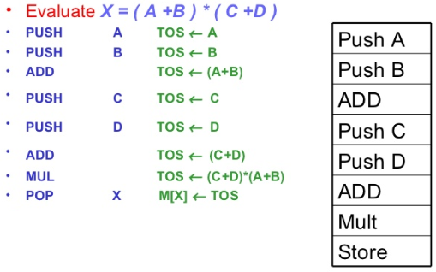
Zero address instructions

Slide 38
One address instructions
LOAD A A C <- M [ A ]
ADD B A C <- A C + M [ B ]
STORE T M [ T ] <- A C
LOAD C A C <- M [ C ]
ADD D A C <- A C + M [ D ]
MUL T A C <- A C • M [ T ]
STORE X M [ X ] <- A C

Slide 39
Two address instructions
MOV R1 , A R 1 <--M [ A ]
ADD R1 , B R 1 <--R 1 + M [ B ]
MOV R2 , C R 2 <--M [ C ]
ADD R2 , D R 2 <--R 2 + M [ D ]
MUL R1 , R2 R 1 <--R 1 * R 2
MOV X , R1 M [ X ] <--R 1

Slide 40
Three address instructions
ADD R1 , A , B R 1 <--M [ A ] + M [ B ]
ADD R2 , C , D R 2 <--M [ C ] + M [ D ]
MUL X , R1 , R2 M [ X ] <--R 1 * R 2

Slide 41
Addressing modes
The term addressing modes refers to the way in which the operand of an instruction is specified.
The most common addressing techniques are:
Immediate Stack
Direct
Indirect
Register
Register Indirect
Displacement

Slide 42
Addressing modes
To explain the addressing modes, the following notations are used:
A = contents of an address field in the instruction that refers to a memory
R = contents of an address field in the instruction that refers to a register
EA = actual (effective) address of the location containing the referenced operand
(X) = contents of location X

Slide 43
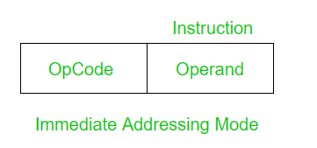
Immediate Addressing
In Immediate addressing mode the source operand is always data.
Eg: MOV AX, 2000H
ADD AL,45H

Slide 44
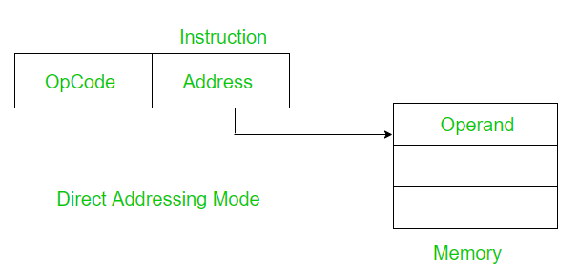
Direct Addressing
A very simple form of addressing is direct addressing, in which the address field contains the effective address of the operand:
EA = A
It requires only one memory reference and no special calculation.
Eg: MOV AX, [1592H]
MOV BL,[0300H]

Slide 45
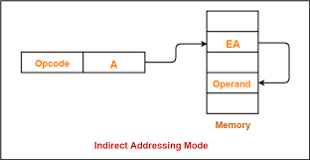
Indirect Addressing
In Direct Addressing, the length of the address field is usually less than the word length, thus limiting the address range. One solution is to have the address field refer to the address of a word in memory, which in turn contains a full-length address of the operand. This is known as indirect addressing.
EA = (A)
Eg: MOV AX, @2005H
LOAD R1, (1345H)

Slide 46
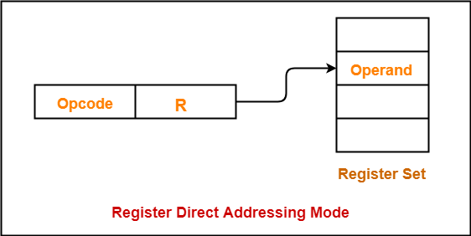
Register Addressing
Register addressing is similar to direct addressing. The only difference is that the address field refers to a register rather than a main memory address.
EA = R
The advantages of register addressing are that only a small address field is needed in the instruction and no memory reference is required. The disadvantage of register addressing is that the address space is very limited.
Eg: MOV AX,BX
ADD R1,R2

Slide 47
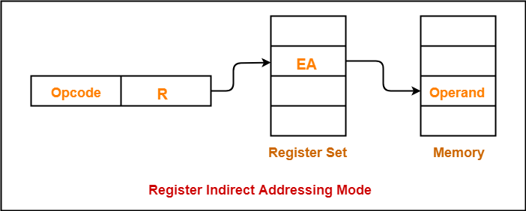
Register Indirect Addressing
Register indirect addressing is similar to indirect addressing, except that the address field refers to a register instead of a memory location.
It requires only one memory reference and no special calculation.
EA = (R)
Eg: ADD AL, [BX]
MOV AX,[BX]

Slide 48
Displacement Addressing
A very powerful mode of addressing combines the capabilities of direct addressing and register indirect addressing, which is broadly categorized as displacement addressing.
EA = A + (R)
Displacement addressing requires that the instruction have two address fields, at least one of which is explicit. The value contained in one address field (value = A) is used directly. The other address field, or an implicit reference based on opcode, refers to a register whose contents are added to A to produce the effective address.

Slide 49
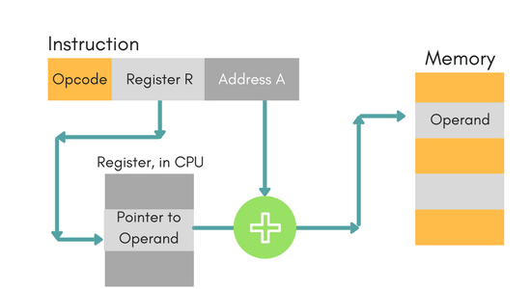
Displacement Addressing Cont.….

Slide 50
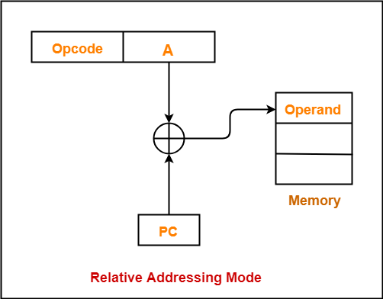
Displacement Addressing Cont.….
Three of the most common use of displacement addressing are:
Relative addressing
Base-register addressing
Indexing
Relative Addressing:
For relative addressing, the implicitly referenced register is the program counter (PC). That is, the current instruction address is added to the address field to produce the EA. Thus, the effective address is a displacement relative to the address of the instruction.

Slide 51
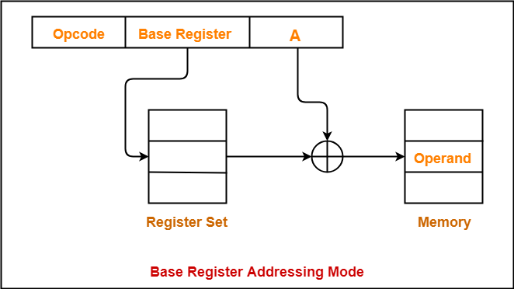
Displacement Addressing Cont.….
Base mode Addressing:
In this the effective address is the sum of base register and displacement.
Eg: MOV AL, [BP+0100].

Slide 52
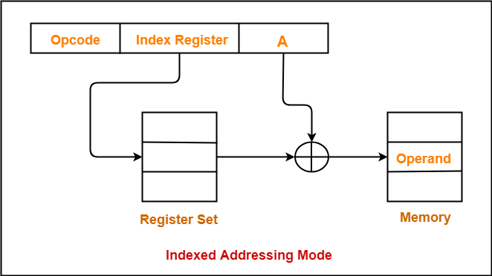
Displacement Addressing Cont.….
Indexing:
In this type of addressing mode the effective address is sum of index register and displacement.
Eg: MOV AX, [SI+2300]

Slide 53
Stack Addressing
Stack Addressing
The stack mode of addressing is a form of implied addressing. The machine instructions need not include a memory reference but implicitly operate on the top of the stack.

Slide 54
Operation of the Stack
During pushing, the stack operates in a “decrement then store” style.
The stack pointer is decremented first, then the information is placed on the stack.
During poping, the stack operates in a “use then increment” style.
The information is retrieved from the top of the stack and then the pointer is incremented.
The SP pointer always points to “the top of the stack”.

Slide 55
Operation of the Stack
The order of PUSHs and POPs must be opposite of each other in order to retrieve information back into its original location.
PUSH B
PUSH D
...
POP D
POP B
Reversing the order of the POP instructions will result in the exchange of the contents of BC and DE.

Slide 56
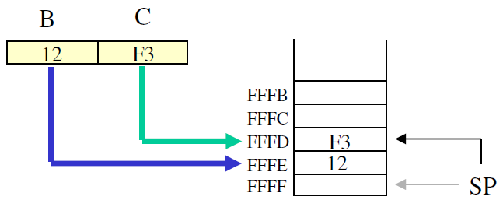
The PUSH Instruction
PUSH B (1 Byte Instruction)
Decrement SP
Copy the contents of register B to the memory location pointed to by SP
Decrement SP
Copy the contents of register C to the memory location pointed to by SP

Slide 57
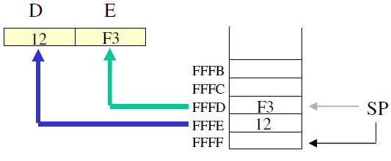
The POP Instruction
POP D (1 Byte Instruction)
Copy the contents of the memory location pointed to by the SP to register E
Increment SP
Copy the contents of the memory location pointed to by the SP to register D
Increment SP

Slide 58
Instruction Set
An instruction set is a list of all the instructions that a processor can execute.
Types of Operations
Data Transfer
Arithmetic
Logical
Input Output [ I/O ]
System Control
Transfer Control

Slide 59
Data Transfer
Move (Transfer) :Transfer word or block from source to destination
Example: mov A, 09h
mov AX, A
Store: Transfer word from processor to memory
Example: STR T
STR [R1], R3
Load (fetch): Transfer word from memory to processor
Example: Load A, [R1]
Load C

Slide 60
Data Transfer
Exchange: Swap contents of source and destination
Example: xchg ah, al
xchg ax, bx
Clear (reset): Transfer word of 0s to destination
Example: clr ax
clr a
Set: Transfer word of 1s to destination
Example: set A

Slide 61
Data Transfer
Push: Transfer word from source to top of stack
Example: Push A
Push B
Pop: Transfer word from top of stack to destination
Example: Pop B
Pop A

Slide 62
Arithmetic
Add: Compute sum of two operands
Example: add al, 07h
add ax,bx
Subtract: Compute difference of two operands
Example: sub ah, 05h
sub ah, al
Multiply: Compute product of two operands
Example: mov ax,1234h
mov bx,100h

Slide 63
Arithmetic
mul bx
Divide: Compute quotient of two operands
Example: mov ax,8003h
mov cx,100h
div cx
Absolute: Replace operand by its absolute value
Example: abs RT, RA

Slide 64
Arithmetic
Negate: Change sign of operand
Example: neg RT, RA
Increment : Add 1 to operand
Example: inc A
Decrement: Subtract 1 from operand
Example: dec A

Slide 65
Logical
AND: Performs the logical operation AND bitwise
Example: AND AL, 0Fh
AND AL, 01h
OR: Performs the logical operation OR bitwise
Example: OR AH, 0Bh
OR AH, 05h
NOT: Performs the logical operation NOT bitwise
Example: Operand1: 0101 0011
After NOT -> Operand1: 1010 1100

Slide 66
Logical
Exclusive OR: Performs the specified logical operation Exclusive-OR bitwise
Example: Operand1: 0101, Operand2: 0011
After XOR -> Operand1: 0110
Test: Test specified condition; set flag(s) based on outcome
Example: TEST AL, 01H
JZ EVEN_NUMBER
Compare: Make logical or arithmetic comparison Set flag(s) based on outcome
Example: CMP destination, source
CMP DX, 00 ; Compare the DX value with zero
JE L7 ; If yes, then jump to label L7
.
. L7: ...

Slide 67
Logical
Set Control Variables: Class of instructions to set controls for protection purposes, interrupt handling, timer control etc.
Shift: Left (right) shift operand, introducing constant at end
Example: SHR AX, 2
SHL AX, 2
Rotate: Left (right) shift operation, with wraparound end
Example: ROR AH, 4
ROL AH, 4

Slide 68
Input/output
Input (Read): Transfer data from specified I/O port or device to destination (e.g., main memory or processor register)
Output (Write): Transfer data from specified source to I/O port or device.
Start I/O: Transfer instructions to I/O processor to initiate I/O operation.
Test I/O: Transfer status information from I/O system to specified destination

Slide 69
System Control
System control instructions are those which are used for system setting and it can be used only in privileged state.
Typically, these instructions are reserved for the use of operating systems.

Slide 70
Transfer of Control
The most common transfer-of-control operations found in instruction set are:
Branch
Skip
Procedure call.
BRP X: Branch to location X if result is positive
BRN X: Branch to location X if result is negative
BRZ X: Branch to location X is result is zero
BRO X: Branch to location X if overflow occurs

Slide 71
Subroutine and Subroutine call
A routine or subroutine, also referred to as a function, procedure, and subprogram, is a portion of code that may be called and executed anywhere in a program.
In different programming languages, a subroutine may be called a procedure, a function, a routine, a method, or a subprogram. The generic term callable unit is sometimes used

Slide 72
Subroutine and Subroutine call
A routine or subroutine, also referred to as a function, procedure, and subprogram, is a portion of code that may be called and executed anywhere in a program.
In different programming languages, a subroutine may be called a procedure, a function, a routine, a method, or a subprogram. The generic term callable unit is sometimes used

Slide 73
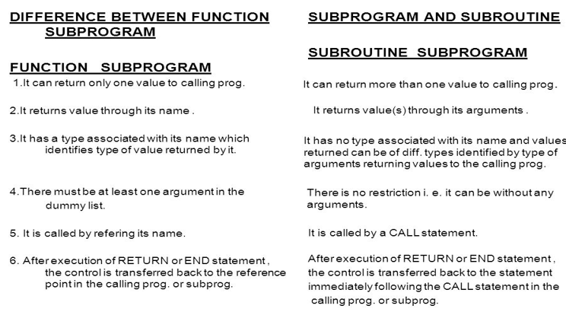
Function subprogram Vs Subroutine subprogram

Slide 74
Subroutine and Subroutine call
A subroutine is a reusable program module. A main program can call or jump to the subroutine one or more times. The stack is used in several ways when subroutines are called.
Important points to remember
How to write subroutines and call them from the main program.
Ways to pass parameters to and from subroutines.
The function of the stack and the stack pointer.
How to create and use software delays.

Slide 75
Subroutine and Subroutine call
The stack is an area of memory identified by the programmer for temporary storage of information.
The stack is a LIFO structure.
Last In First Out.
The stack normally grows backwards into memory.In other words, the programmer defines the bottom of the stack and the stack grows up into reducing address range.

Slide 76
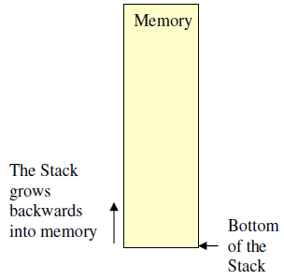
Subroutine and Subroutine call

Slide 77
Subroutine and Subroutine call
Given that the stack grows backwards into memory, it is customary to place the bottom of the stack at the end of memory to keep it as far away from user programs as possible.
In the 8085, the stack is defined by setting the SP (Stack Pointer) register.
LXI SP, FFFFH
This sets the Stack Pointer to location FFFFH (end of memory for the 8085).

Slide 78
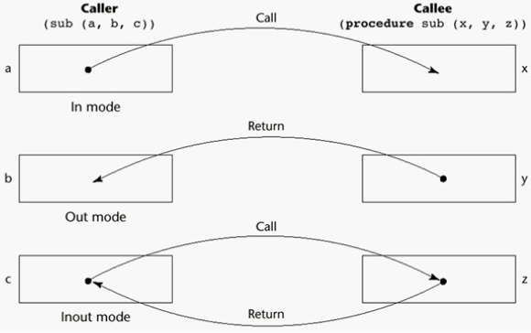
Subroutine Call

Slide 79
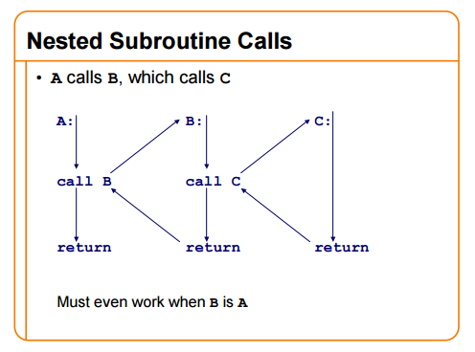
Subroutine Call

Slide 80
Types of CALLS
S.No. | Type | Description
1 | Call by value | Argument is evaluated and copy of value is passed to subroutine
2 | Call by reference | Reference to argument, typically its address is passed
3 | Call by result | Parameter value is copied back to argument on return from the subroutine
4 | Call by value-result | Parameter value is copied back on entry to the subroutine and again on return
5 | Call by name | Like a macro – replace the parameters with the unevaluated argument expressions
6 | Call by constant value | Like call by value except that the parameter is treated as a constant

Slide 81
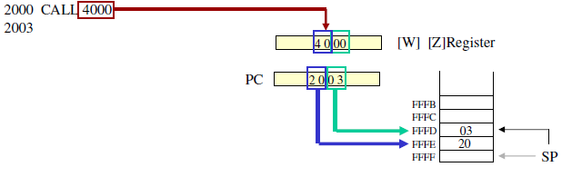
The CALL Instruction
CALL 4000H (3 byte instruction)
– When CALL instruction is fetched, the MP knows that the next two Memory location contains 16bit subroutine address in the memory.

Slide 82
The CALL Instruction
MP Reads the subroutine address from the next two memory location and stores the higher order 8bit of the address in the W register and stores the lower order 8bit of the address in the Z register
Push the address of the instruction immediately following the CALL onto the stack [Return address]
Loads the program counter with the 16-bit address supplied with the CALL instruction from WZ register.

Slide 83
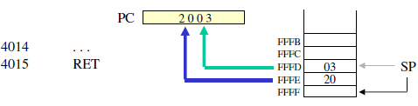
The RET Instruction
RET (1 byte instruction)
– Retrieve the return address from the top of the stack
– Load the program counter with the return address.

Slide 84
Conditional CALL and RTE Instructions
The same conditions used with conditional JUMP instructions can be used.
– CC, call subroutine if Carry flag is set.
– CNC, call subroutine if Carry flag is not set
– RC, return from subroutine if Carry flag is set
– RNC, return from subroutine if Carry flag is not set
– Etc.

