Slide 1


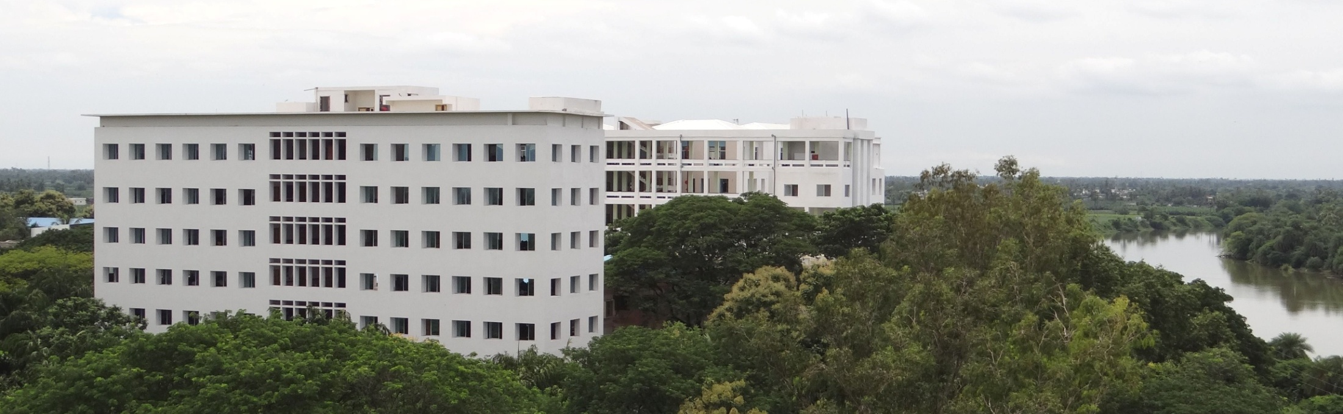


Welcome

Slide 2
19EC1202
COMPUTER ORGANIZATION AND ARCHITECTURE
CO2

Slide 3
CPU Design

Slide 4
Introduction to CPU
The operation or task that must perform by CPU are:
    Fetch Instruction
    Interpret instruction
    Fetch Data
    Process data
    Write data

Slide 5
The major components of the CPU are an arithmetic and logic unit (ALU) and a control unit (CU).
The ALU does the actual computation or processing of data.
The CU controls the movement of data and instruction into and out of the CPU and controls the operation of the ALU.

Slide 6
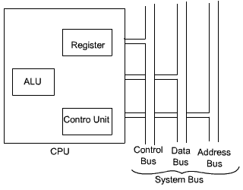
CPU system Bus

Slide 7
CPU System Bus
The system bus may have three components:
Data Bus
Address Bus
Control Bus

Slide 8
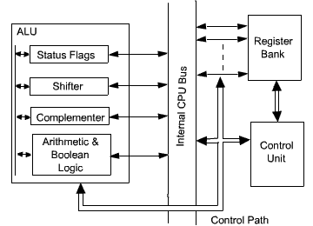
Internal Structure of the CPU

Slide 9
There are three basic components of CPU:
        Register bank
        ALU and
        Control Unit.
There are several data movements between these units and for that an internal CPU bus is used.

Slide 10
Register Organization
The registers in the CPU can be categorized into two groups:
  User-visible registers
  Control and status registers
User-visible Registers:
  General Purpose Registers
  Data Registers
  Address Registers
  Condition Codes

Slide 11
Address registers:
  Segment pointer
  Index registers
  Stack pointer
Four registers are essential to instruction execution:
  Program Counter (PC)
  Instruction Register (IR)
  Memory Address Register (MAR)
  Memory Buffer Register (MBR)

Slide 12
Processor Status Word
    Sign
    Zero
    Carry
    Equal
    Overflow
    Interrupt enable/disable
    Supervisor

Slide 13
Concept of Program Execution
1. Fetch the contents of the memory location pointed at by the PC. The contents of this location are interpreted as an instruction to be executed. Hence, they are stored in the instruction register (IR). Symbolically this can be written as:
IR = [ [PC] ]
2. Increment the contents of the PC by 1.
PC = [PC] + 1
3. Carry out the actions specified by the instruction stored in the IR.

Slide 14
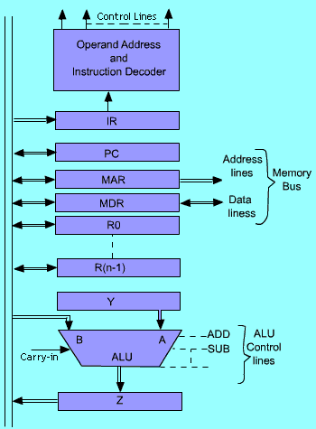
Single bus organization of the data path inside the CPU

Slide 15
The processor interprets the instruction and performs the required action. In general, the actions fall into four categories:
Processor-memory
Processor-I/O
Data processing
Control

Slide 16
Control Unit
To execute an instruction, the control unit of the CPU must generate the required control signal in the proper sequence.
To generate the control signal in proper sequence, a wide variety of techniques exist. Most of these techniques, however, fall into one of the two categories,
Hardwired Control :
Microprogrammed Control :

Slide 17
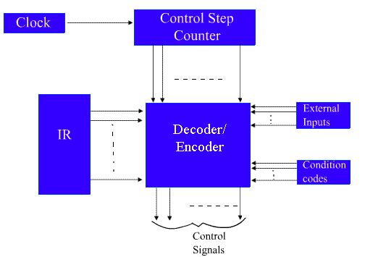
Hardwired Control : In this hardwired control techniques, the control signals are generated by means of hardwired circuit. The main objective of control unit is to generate the control signal in proper sequence.

Slide 18
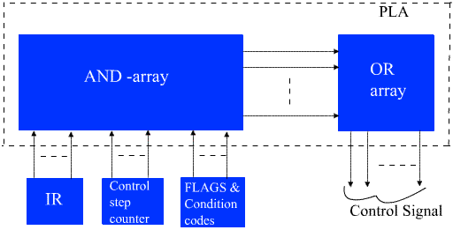
Eg: Programmable Logic Array

Slide 19
Microprogrammed Control
There is an alternative approach by which the control signals required inside the CPU can be generated . This alternative approach is known as microprogrammed control unit.
In microprogrammed control unit, the logic of the control unit is specified by a microprogram.
A microprogrammed control unit is a relatively simple logic circuit that is capable of (1) sequencing through microinstructions and (2) generating control signals to execute each microinstruction.

Slide 20
Common Micro-Ops
There are 4 types of Micro-Ops:
Transfer: transfers data from one register to another
R0 <- R1
Arithmetic: performs arithmetic on data in registers
R0 <- R1 + R2
Logic/bit manipulation: performs bit (Boolean) operations on data
R0 <- R1 & R2 ; or R0 <- R1 | R2
Shift: shift data in registers by one or more bit positions
R0 <- R1 << 3; or R0 <- R2 >> 2

Slide 21
Micro-Ops Transfer Memory
  Memory transfers are similar to register transfers, but…
  Memory to register transfers are called read operations, while register to memory transfers are called write operations
    RTL expressions for a read operation, assuming the use of an address registers:
    AR <- address
    DR <- M[AR]
    RTL expressions for a write operation, assuming use of a data register:
    AR <- address
    DR <- value
    M[AR] <- DR

Slide 22
MAPPING OF INSTRUCTIONS
Direct Mapping
Address
OP-codes of Instructions
0000
0001
0010
0011
0100
ADD Routine
ADD
AND
LDA
STA
BUN
0000
0001
0010
0011
0100
AND Routine
.
.
.
LDA Routine
STA Routine
BUN Routine
Control
Storage
Mapping
Bits
10 xxxx 010
Address
10 0000 010
ADD Routine
10 0001 010
AND Routine
10 0010 010
LDA Routine
10 0011 010
STA Routine
10 0100 010
BUN Routine

Slide 23
MACHINE INSTRUCTION FORMAT
Machine instruction format
15
14
11
10
0
I
Opcode
Address
Micro-instruction Format
3
3
3
2
2
7
F1
F2
F3
CD
BR
AD
F1, F2, F3: Microoperation fields
CD: Condition for branching
BR: Branch field
AD: Address field

Slide 24
DESIGN OF CONTROL UNIT
microoperation fields
F1
F2
F3
3 x 8 decoder
3 x 8 decoder
3 x 8 decoder
7
6
5
4
3
2
1
0
7
6
5
4
3
2
1
0
7
6
5
4
3
2
1
0
AND
AC
DR
ADD
Arithmetic
DRTAC
logic and
shift unit
PCTAR
DRTAR
From
From
PC
DR(0-10)
Load
AC
Select
0
1
Multiplexers
Load
AR
Clock

Slide 25
MICROINSTRUCTION FIELD DESCRIPTIONS - F1,F2,F3
F1 | Micro operation | Symbol
000 | None | NOP
001 | AC  AC + DR | ADD
010 | AC  0 | CLRAC
011 | AC  AC + 1 | INCAC
100 | AC  DR | DRTAC
101 | AR  DR(0-10) | DRTAR
110 | AR  PC | PCTAR
111 | M[AR]  DR | WRITE
F2 | Micro operation | Symbol
000 | None | NOP
001 | AC  AC - DR | SUB
010 | AC  AC  DR | OR
011 | AC  AC  DR | AND
100 | DR  M[AR] | READ
101 | DR  AC | ACTDR
110 | DR  DR + 1 | INCDR
111 | DR(0-10)  PC | PCTDR
F3 | Micro operation | Symbol
000 | None | NOP
001 | AC  AC DR | XOR
010 | AC  AC' | COM
011 | AC  shL AC | SHL
100 | AC  shr AC | SHR
101 | PC  PC + 1 | INCPC
110 | PC  AR | ARTPC
111 | RESERVED

Slide 26
Sample machine instructions
Symbol | Opcode | Description
ADD | 0000 | AC  AC + M[EA]
BRANCH | 0001 | if (AC < 0) then (PC   EA)
STORE | 0010 | M[EA]   AC
EXCHANGE | 0011 | AC   M[EA], M[EA]   AC
EA is the effective address

Slide 27
Memory
1. Concept of Memory.
2. Cache Memory.
3. Memory Management
4. Virtual memory
The memory of computer is broadly categories into two categories:
Internal Memory or Primary Memory
External Memory or Secondary Memory

Slide 28
Primary Memory
RAM: Random Access Memories are volatile in nature. As soon as the computer is switched off, the contents of memory are also lost.
Types: SRAM, DRAM
ROM: Read only memories are non volatile in nature. The storage is permanent, but it is read only memory. We can not store new information in ROM.
Types: PROM, EPROM, EEPROM, UVPROM

Slide 29
Main Memory Organization
16X4 Means 16 Locations & 4 bits in each Location
Read – Retrieve data from memory to CPU registers
Write – Store data to memory from CPU registers
To transfer data we require data bus
To specify or to identify a particular memory location we require address bus

Slide 30
Semiconductor Memory Classification
Non-Volatile
Read-Write
Memory
Read-Write Memory
Read-Only Memory
Random
Non-Random
EPROM
Mask-Programmed
Access
Access
E
2
PROM
Programmable (PROM)
SRAM
FIFO
FLASH
DRAM
LIFO
Shift Register
Content
Addressable
Memory (CAM)

Slide 31
RAM
Random write and read operation for any cell
Volatile data
Most of computer memory
DRAM
  Low Cost
  High Density
  Medium Speed
SRAM
  High Speed
  Ease of use
  Medium Cost

Slide 32
ROM
Non-volatile Data
Method of Data Writing
Mask ROM
  Data written during chip fabrication
PROM
  Fuse ROM: Non-rewritable
  EPROM: Erase data by UV rays
  EEPROM: Erase and write through electrical means
    Speed 2-3 times slower than RAM
    Upper limit on write operations
    Flash Memory – High density, Low Cost

Slide 33
FLASH
Extension of EEPROM
  Same floating gate principle
  Same write ability and storage permanence
Fast erase
  Large blocks of memory erased at once, rather than one word at a time
  Blocks typically several thousand bytes large
Writes to single words may be slower
  Entire block must be read, word updated, then entire block written back
Used with embedded microcomputer systems storing large data items in nonvolatile memory
  e.g., digital cameras, MP3, cell phones

Slide 34
CPU and Memory
CPU can interact with main memory in two ways:
  It can write a byte/word to a given memory location.
    The previous bits that were in that location are destroyed
    The new bits are saved for future use.
  It can read a byte/word from a given memory location.
    The CPU copies the bits stored at that location and stores them in a CPU register
    The contents of the memory location are NOT changed.

Slide 35
Main Memory Characteristics
Very closely connected to the CPU.
Contents are quickly and easily changed.
Holds the programs and data that the processor is actively working with.
Interacts with the processor millions of times per second.
Nothing permanent is kept in main memory.

Slide 36
Secondary Storage Characteristics
Connected to main memory through a bus and a device controller.
Contents are easily changed, but access is very slow compared to main memory.
Only occasionally interacts with CPU.
Used for long-term storage of programs and data.
Much larger than main memory (GBs vs. MBs).

Slide 37
CPU --- Memory
16-bit CPU Byte Organized
Data Size
Hi Lo
Hi
Lo
15-8 | 7-0
Lower order byte first or little endian CPU
Lo
Hi
Higher order byte first or Big endian CPU

Slide 38
The data transfer between main memory and the CPU takes place through two CPU registers.
MAR : Memory Address Register
MDR : Memory Data Register.
If the MAR is k-bit long, then the total addressable memory location will be 2^{k}.
If the MDR is n-bit long, then the n bit of data is transferred in one memory cycle.

Slide 39
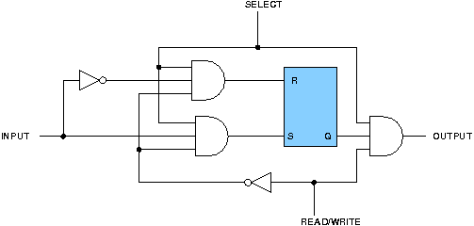
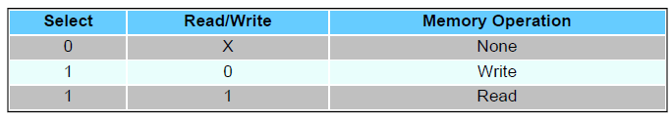
Binary Storage Cell

Slide 40
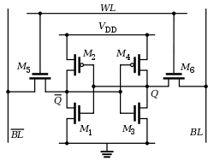
Depending on the technology used to construct a RAM, there are two types of RAM –
SRAM: Static Random Access Memory.
DRAM: Dynamic Random Access Memory

Slide 41
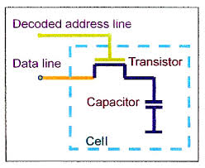
DRAM
SRAM & DRAM both are volatile
DRAM packing density is more & Less expensive
DRAM requires supporting refresh circuitry
SRAM is faster than DRAM

Slide 42
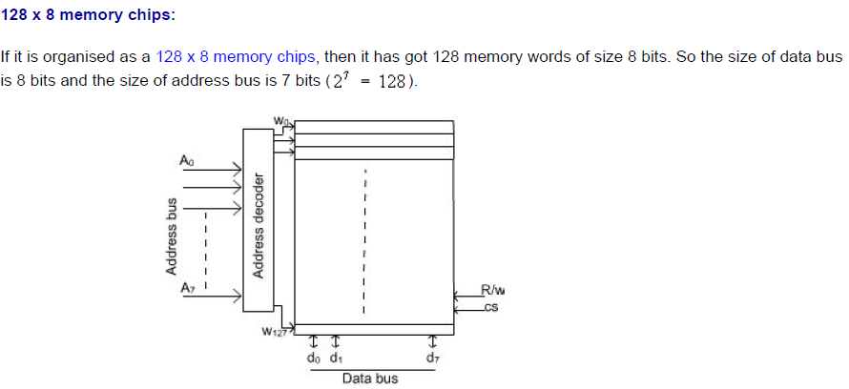

Slide 43
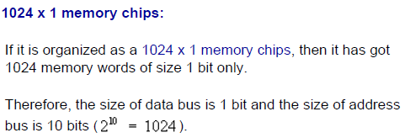
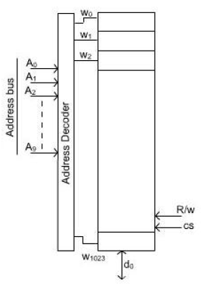

Slide 44
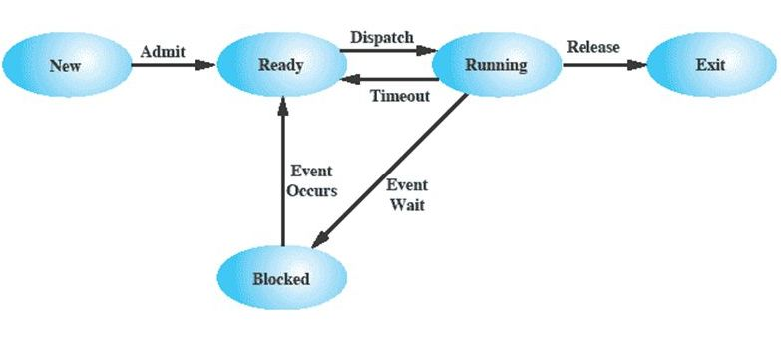
Memory Management
Five State Process Model

Slide 45
Memory Management
Uni- Program
Multi –Program
Uni-Program:
  Memory split into two
    For operating system
    For currently executing program
Memory
User Program
Operating System
Uni-Program

Slide 46
Memory Management
Memory
Multi-Program:
  Memory split into multiple
    For operating system
    User part of memory is subdivided to accommodate multiple processes.
User Program 2
Operating System
User Program 1
User Program 3
Multi-Program

Slide 47
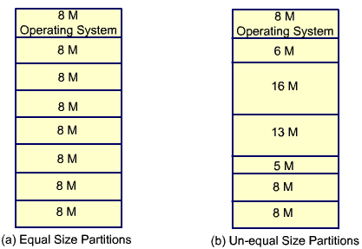
Partitioning
1) Fixed size partitions
2) Variable size partitions

Slide 48
Paging
The memory is partitioned into equal fixed size chunks that are relatively small. This chunk of memory is known as frames or page frames.
Each process is also divided into small fixed chunks of same size. The chunks of a program is known as pages.
At a given point of time some of the frames in memory are in use and some are free. The list of free frame is maintained by the operating system.

Slide 49
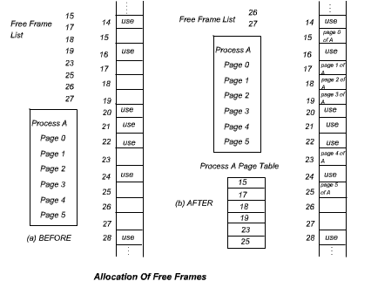

Slide 50
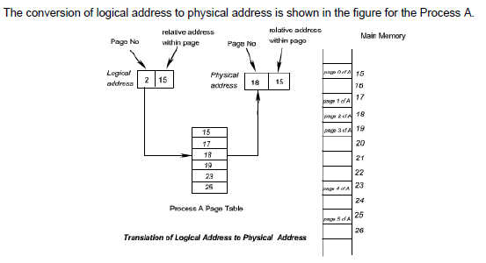

Slide 51
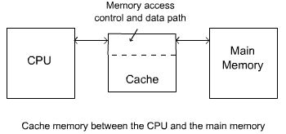
Cache Memory
It is the fact that CPU is a faster device and memory is a relatively slower device.
Memory access is the main bottleneck for the performance efficiency. If a faster memory device can be inserted between main memory and CPU, the efficiency can be increased.
The faster memory that is inserted between CPU and Main Memory is termed as Cache memory.

Slide 52
Cache Memory
High speed (towards CPU speed)
Small size (power & cost)
_{Access} = 0.95 _{Cache} + 0.05 _{Mem}
Main
Memory
(Slow)
_{Mem}
Miss
CPU
Cache
(Fast)
_{Cache}
Hit
95% hit ratio

Slide 53
Cache Memory
Main
Memory
1 Gword
CPU
30-bit Address
Cache
1 Mword
Only 20 bits !!!

Slide 54
Cache Mapping
Direct mapping
Associative mapping
Block-set-associative mapping

Slide 55
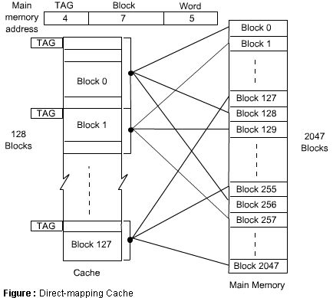
Direct Mapping
A particular block of main memory can be brought to a particular block of cache memory.
It is not flexible

Slide 56
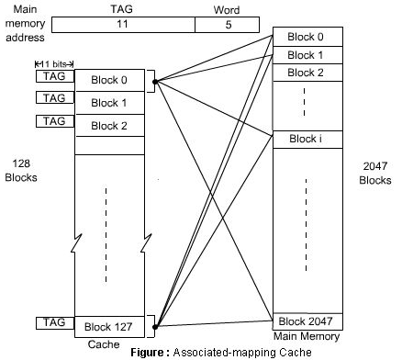
Associative Mapping
In this mapping function, any block of Main memory can potentially reside in any cache block position.
This is much more flexible mapping method.

Slide 57
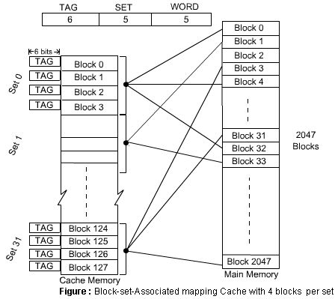
Block Set Associative Mapping
In this method, blocks of cache are grouped into sets, and the mapping allows a block of main memory to reside in any block of a specific set. From the flexibility point of view, it is in between to the other two methods

Slide 58
Cache Replacement Policies
Least Recently Used (LRU) replacement policy
First In First Out (FIFO) replacement policy
Random replacement policy

Slide 59
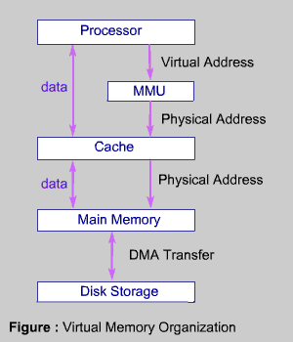
Virtual Memory
The virtual address space is used to develop a process. The special hardware unit , called Memory Management Unit (MMU) translates virtual address to physical address. When the desired data is in the main memory, the CPU can work with these data. If the data are not in the main memory, the MMU causes the operating system to bring into the memory from the disk.

Slide 60
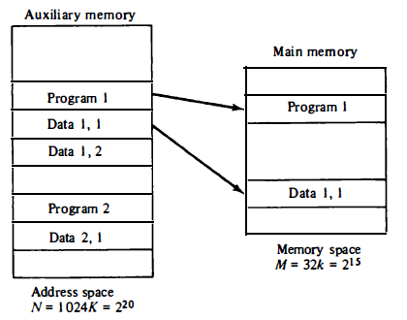
VIRTUAL MEMORY
Relation between memory space and address in a virtual memory system

Slide 61
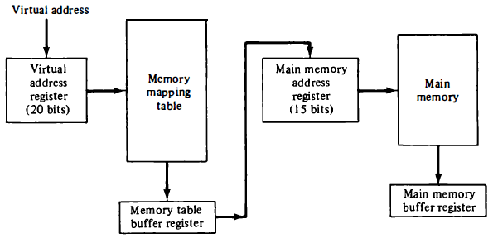
Memory table for mapping a virtual address

Slide 62
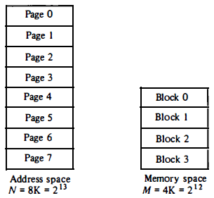
Address space and memory space split into groups of lK words.

Slide 63
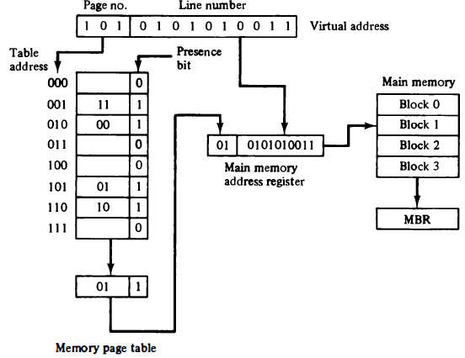
Memory Table in a paged system

Slide 64
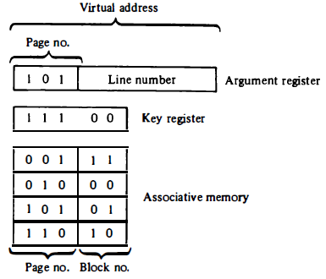
An associative memory page table.

