Slide 1
KLU Design Thinking for Innovation Project Title:Waste management Work In Progress Submission 1
Department: CS-IT Section:3 Batch:6 Date:06-03-2022

Slide 2
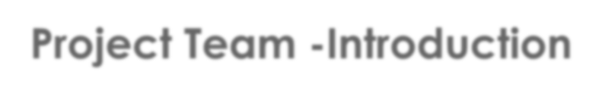
Project Team -Introduction
S.NO | NAME | ID NUMBER | ROLE IN THE PROJECT
1 | Wajid Ali | 2100090052 | Breakout Activities
2 | A. Hemanth | 2100090112 | Survey
3 | Rupesh | 2100090119 | Designer
4 | N. Jahnavi | 2100090120 | Survey
5 | Narashimha | 2100090121 | Data Processor
6 | Srinija | 2100090122 | Survey
7 8 | Brahmini Chowdary Ziya Afreen | 2100090127 2100090133 | Breakout Activities Representer
10 11 12 | K. Hemanth Kumar Rahul Varma Mohith Vardhan | 2100090136 2100090141 2100090142 | Group Leader Survey Designer
13 | MD Saif | 2100090144 | Breakout Activities

Slide 3
Project Identification : Submitted Together with this Report
Projecttemplate
(https://docs.google.com/document/d/1EJRt_8obx0m-xHOWP3KHynX8ZUfhRgR7/edit?usp=sharing&ouid=107730242151129265068&rtpof=true&sd=true)
Group Participationreport 1
(https://docs.google.com/document/d/1czg6ck5eB0jaVMgPaN2DUhDD8uwQHplK/edit?usp=sharing&ouid=107730242151129265068&rtpof=true&sd=true)

Slide 4
PROJECT DESCRIPTION
Waste management refers to the various schemes to manage and dispose of wastes. It can be by discarding, destroying, processing, recycling, reusing, or controlling wastes.
COMMUNITY
We mainly focus on household waste like dry waste, wet waste, e-waste.
PARTNERS
Municipal Corporations , Scavengers, Recycling Centers.

Slide 5
.
GOAL
The primary goal of waste management is reducing and eliminating impacts of waste materials on human health and the environment to support economic development and superior quality of life.
WORK DIVISION TO ACHIEVE GOAL
Smart Bins which seperate wet and dry waste, wet waste composter for every community, finally we the people should be responsible to achieve the goal.
.

Slide 6
1. Our Most Important Learnings
Utilizing the best from the waste
reduces the negative impacts of environment

Slide 7
Empathy : Submitted Together with this Report
Group intreviews
https://docs.google.com/presentation/d/1jstWJbovSSn304LODpe3jOd-rXo4mHvN/edit?usp=sharing&ouid=107730242151129265068&rtpof=true&sd=true
Participation report 2
https://docs.google.com/document/d/1HJmXePtK6gW7yyWraGc4JPBH4wGSPXPU/edit?usp=sharing&ouid=107730242151129265068&rtpof=true&sd=true

Slide 8
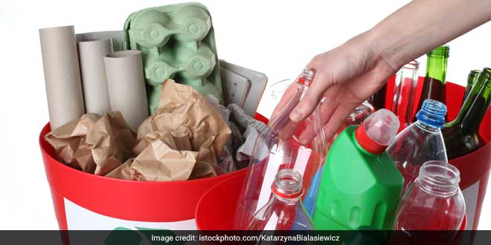

DRY WASTE
Dry waste such as metal, aluminium foils, glass, fabrics/textiles, and plastics, are
non-biodegradable but can be recycled to
create new products.
RECYCLING OF DRY WASTE
Dry recyclable waste generated in houses is approx 30% which needs to be handed over to recycling units via kabadiwalas.
Paper items can even be handed over to institutions like ITC.
This way we can reduce almost 90% of the trash from reaching the landfill

Slide 9
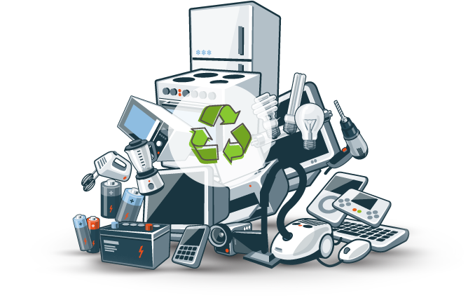
E WASTE RECYCLE
The vast majority of electronics can be recycled, and the items within them that can be recovered include plastic, steel, aluminium, copper, gold, silver, and other precious metals.
Those metals can be given a second life, and that's why recycling is such an ideal solution to this problem.
VIDEO OF LARGEST E WASTE DUMP
https://youtu.be/mleQVO1Vd1I

Slide 10
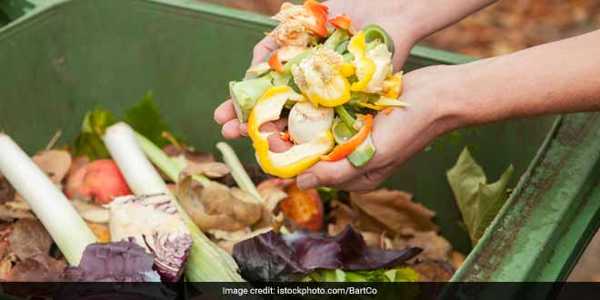
WET WASTE
Wet waste consists of kitchen waste – including vegetable and fruit peels and cooked food etc.
RECYCLING OF WET WASTE
Wet waste can be used as composter, bio mass which is created through wet
waste used to generate electricity.
.

Slide 11
1. Our Most Important Learnings
I have came to know
about extracting gold from e waste.
recycling of books to ITC centers.
Generating electricity from Dry waste.

Slide 12
2. Things we Saw and Heard
some of the important things that we saw and heard during interviews and focus groups.
They are confused in separation of different wastes.
They are less aware about recycling of wastes.
We saw people burning the wastes.

Slide 13
1. Our Most Important Learnings
Proper waste removal helps improve air and water quality as well as reduces greenhouse gas emissions.
One of the most significant benefits of waste management is the protection of the environment and the health of the population.

Slide 14
Ideate: Submitted Together with this Report
Rapid estimation form for the project
https://docs.google.com/document/d/1YsW4nQDoEmlJ6f9ZKCKGzXEIGaz62n9t/edit?usp=sharing&ouid=107730242151129265068&rtpof=true&sd=true
Group participation report for this portion of the project
https://docs.google.com/document/d/1czg6ck5eB0jaVMgPaN2DUhDD8uwQHplK/edit?usp=sharing&ouid=107730242151129265068&rtpof=true&sd=true

Slide 15
Define : Submitted Together with this Report
Nugget Forms and posters
https://docs.google.com/document/d/11OTUiPttsnUOh1BaDajgqPy_LjS6YAyv/edit?usp=sharing&ouid=107730242151129265068&rtpof=true&sd=true
One form with 5 PoV Statements and questions
https://docs.google.com/document/d/10LOTaeWp0OSd2WLMAweIUBCutoLmyf67/edit?usp=sharing&ouid=107730242151129265068&rtpof=true&sd=true

Slide 16
1. Our Most Important Learnings
Some of video links
Here is a video of recycling heroine
https://youtu.be/R305FF4fOJs.
Interview of a person concerned about enviorment
https://youtu.be/y7DfnI0nDUo.

Slide 17
1. Our Most Important Learnings on prototype
The most important three things we learned about Prototyping
1: Don't aim to make it perfect the first time. ...
2: Sometimes the best solutions are not the most structured ones. ...
3: Communication is KEY.

Slide 18
Things we Learned about Design Thinking
Design Thinking is extremely useful in tackling problems that are ill-defined or unknown, by re-framing the problem in human-centric ways

