Slide 1
Gen AI Exercise
Peter Van den Broeck

Slide 2
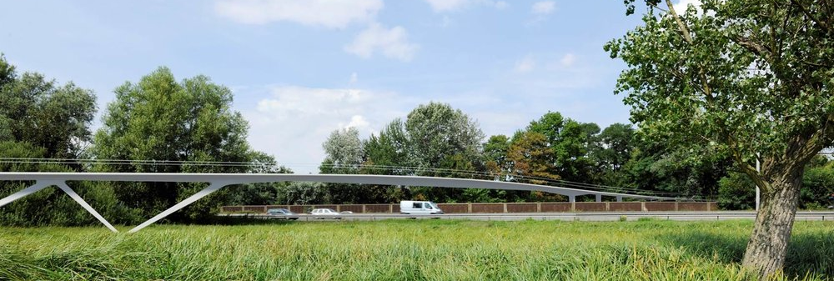
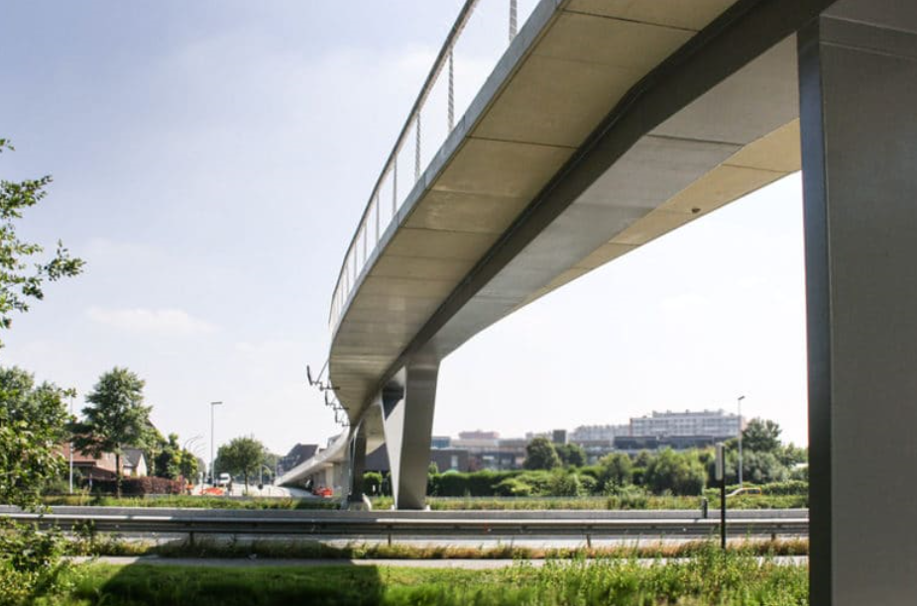
Box girder footbridge
Inspired by Parkbos footbridge
Steel box section
Concrete deck

Slide 3
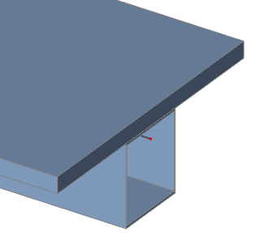
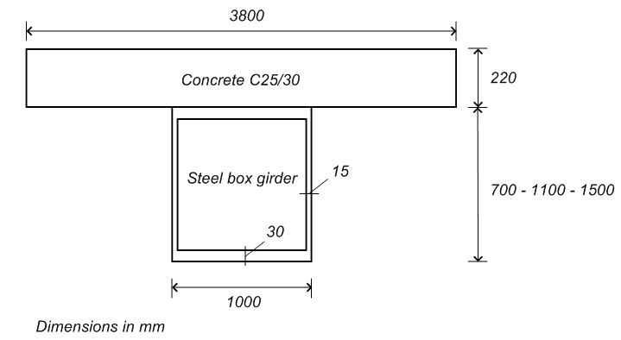
Box girder footbridge
Characteristics
Box girder – Simply supported Span L: 40 m
Girder height H: 700 mm
L
H

Slide 4
Box girder footbridge
Questions
Fundamental vertical natural frequency in Hz?
What is the required mass of a Tuned Mass Damper (TMD) attached at midspan to reduce the contribution of the first mode to the acceleration level with a factor of 10 (corresponding to a increase in damping from 0.4% to 4%)
Present the frequency response function (FRF) for input and output at midspan without and with the TMD

Slide 5
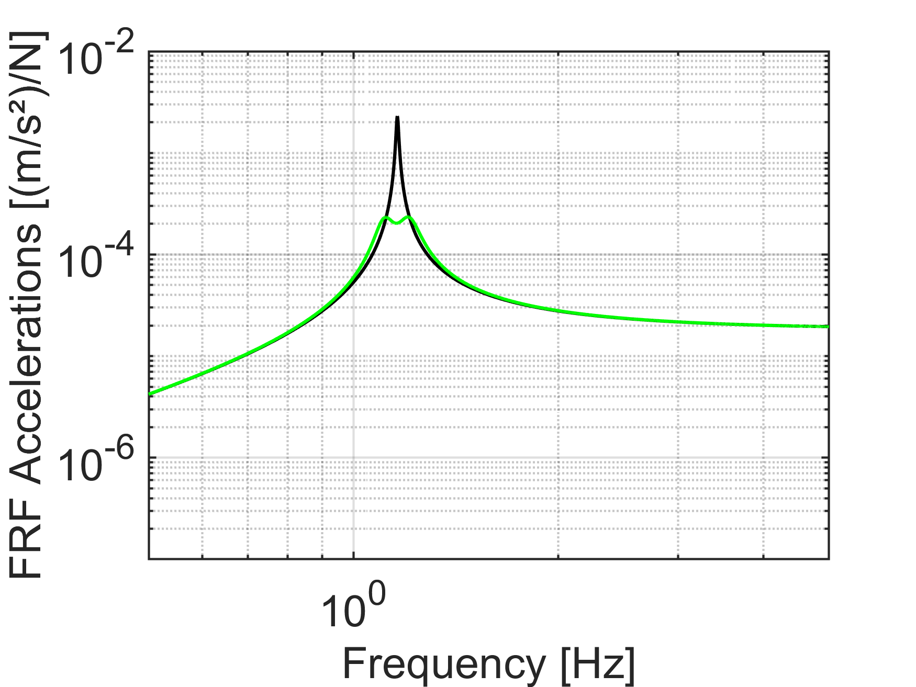
Box girder footbridge
Answers (± 5% is ok)
Fundamental vertical natural frequency in Hz:
1.16 Hz
TMD mass: 557 kg
FRF

