Slide 1
¢¥ltAim8085 - 8085 £4icroprooessor
'imuIator
Fil€' Reset
Assembler
Debu9
Hill
Registers
A
DaLa
SLack
KeyPad
38ernory
I/O PorCs
00
Load me at
BC | 27 | 00 | 1 | MVI | C,C’0 | Start | 8050
DF | 00 | 00 Z 0 | 2 | LDA | 8J5G
OK
MOV B,A
LDA 8'J5:
ADD B
JNC LOOK
Address (Flex) 1F72
Addl ess Datn 8050 39
/-/l
VC
00
00
00
00
AC 1
1F73 | 8051 | 90
1F74 | 8052 | 129
1F75 | 8053 | 0
« reg
00
U 0 | 9 | MOV | A C | 1F76 | 8054 | 0
 | 10 | STA | 8'J53 | 1F77 | 8055 | 0
Decfiual - Hex Convertiorr |  |  |  |  | 11 | HLT | 1F78 | 8056 | 0
Decimal Hex |  |  |  |  |  |  | 1F79 | 8057 | 0
0 |  |  | 0 |  | 1F7A |  |  | 805B | 0
 |  |  |  |  | 1F7B |  |  | 8059 | 0
 | •@To Hex |  |  | %•To Dec | 1F7C |  |  | 8060 | 0
 |  |  |  |  | 1F7D |  |  | 8061 | 0
Line tJo Assemhlei I.Message
0
- e 00
/J Update Port Value
0
Program assembled successfully
8050 — -I- 27
Update Nemory

Slide 2
¢¥ltAim8085 - 8085 £4icroprooessor
'imuIator
Fil€' Reset
Assembler
Debu9
Hill
Registers
A
DaLa
SLack
KeyPad
38ernory
I/O PorCs
00
Load me at
BC | 08 | 00 | 1 | MVI | C,C’0 | Start | 8050
DF | 00 | 00 Z 0 | 2 | LDA | 8J5G
OK
MOV B,A
LDA 8'J5:
SUB B
JC LOOP
Address (Flex) 1F72
1F73
1F74
Addl ess Datn 8050 6
8051 2
8052 6
/-/l 00
UPS' 00
K 42
IP FF
Jfit-Rep
00
00
18
AC 0
p j
FF | 8 | IWR A |  | 1F75 | 8053 | 0
 | 9 | HR C |  | 1F76 | 8054 | 0
 | 10 | LGOP: STA | %J-2 | 1F77 | 8055 | 0
00
Decfiual - Hex Convertiorr |  |  |  |  | 11 | MOV | A,C | 1F78 | 8056 | 0
Decimal Hex |  |  |  |  | 12 | STA | %U63 | 1F79 | 8057 | 0
0 |  |  | 0 |  | 1F7A |  |  |  | 805B | 0
 |  |  |  |  | 1F7B |  |  |  | 8059 | 0
 | •@To Hex |  |  | %•To Dec | 1F7C |  |  |  | 8060 | 0
 |  |  |  |  | 1F7D |  |  |  | 8061 | 0
Line tJo 0
Assemhlei I.Message
Program assembled successfully
0
- e 00
/J Update Port Value
xn Memory
050 — -I-
8
Update Nemory

Slide 3
¢¥ltAim8085 - 8085 £4icroprooessor
'imuIator
Fil€' Reset Assembler Debu9
Hill
Registers A
BC DF
Flag
Load me at
DaLa
SLack
KeyPad
38ernory
I/O PorCs
04
00
08
00
00
S 0
LDA
MOV B,A
Start 8050
Address (Flex)
OK
8
Addl ess
Datn
/-/l W | 00 00 | 00 00 | AC | 4 MOV C,A 0 | 1F72 1F73 | 8050 8051 | 4 2
 | 42 | 12 | p | 6 LCCP: ADD B g | 1F74 | 8052 | 8
5
A
IP
Jfit-Rep
FF
FF
8 | JNZ | LOOK | 1F75 | 8053 | 0
 |  | 1F76 |  | 8054 | 0
10 | HL'£J | 1F77 |  | 8055 | 0
00
Decfiual - Hex Convertiorr |  |  |  |  | 1F78 | 8056 | 0
Decimal Hex |  |  |  |  | 1F79 | 8057 | 0
0 |  |  | 0 |  | 1F7A | 805B | 0
 |  |  |  |  | 1F7B | 8059 | 0
 | •@To Hex |  |  | %•To Dec | 1F7C | 8060 | 0
 |  |  |  |  | 1F7D | 8061 | 0
Line tJo Assemhlei I.Message
0
- e 00
/J Update Port Value
0
Program assembled successfully
8051 — -I- 02
Update Nemory

Slide 4



ile Reset Asśembler Oebug'
Help'
toad me al
Ó8
Of 0’0
H1’ OÓ
£T1r OD
OD ’0’0’ ’0’O J0
Sa4 8D50
#
•%..t.:. -r ::‹t..‹ 8050 B
8051 2
805Z 8
8053 0
80M 0
8055 0
8056 0
I F72
1F73
] F74
1F75
1F76
1f77
1F78
1F79
1F7A
\F7B
Jc LOOPl
swa U
Eł?
FF
KF
i0
il MOV A,C
12 .sTA .:’-...
13 R?T
, Dechnat - Hęx €onvertłon
Oecimąl Hex
L.%.J:2’i:
STA ..’
8058
809
0
0

Slide 5

¢¥ltAim8085 - 8085 £4icroprooessor
'imuIator
Fil€' Reset Assembler Debu9
Hill
Registers x
BC
DF
Flag
Load me at
DaLa
SLack
KeyPad
38ernory
I/O PorCs
02
FF
Hi 1F
UPS' 00
K 42
:S’P FF
Jfit-Rep
02
2D FB 73
00
10
FF
S 0
LDA
MOV B,A
Start 8050
Address (Flex) 1F72
OK
Z 0
Addl ess Datn 8050 2
AC 0
CMP B
JC STORE
MOV A,B
STORE: STA 80-5
HLT
1F73 | 8051 | 8
1F74 | 8052 | 0
1F75 | 8053 | 0
1F76 | 8054 | 0
1F77 | 8055 | 2
p j
00
0
Decfiual - Hex Convertiorr |  |  |  |  | 1F78 | 8056 | 0
Decimal Hex |  |  |  |  | 1F79 | 8057 | 0
0 |  |  | 0 |  | 1F7A 1F7B | 805B 0 8059 0
•@To Hex |  |  |  | %•To Dec | 1F7C | 8060 0
 |  |  |  |  | 1F7D | 8061 0
 |  |  |  |  | Line tJo | Assemhlei I.Message
0 - | e |  |  | 00 | 0 | Program assembled successfully
/J Update Port Value
xnMemory
8052 —
-I- 00

Slide 6

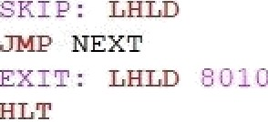
¢¥ltAim8085 - 8085 £4icroprooessor
'imuIator
Fil€' Reset Assembler Debu9
Hill
Registers
A
BC DF
/-II
Flag
DaLa
SLack
KeyPad
38ernory
I/O PorCs
00
S 0
Load me at
00
FF 00
04
FB 14
1 LXI H, 8''?'
Start
8000)
OK
8
2 3 | MOV MVI | C, B, | M OG | Arldi ess (Hex) | Addl ess | Datn
4 | INX | H |  | 1E40 | 8000 | 4
AC 0
5 MOV A, M
6
MOV E, A
MVI D, GFFH
1E41 | 8001 | 5
1E42 | 8002 | 0
1E43 | 8003 | 0
IP FF
Jfit-Rep 00
FF
O 0 | 9 | MOV | A, | B | 1F44 | 8004 | 0
 | 10 |  |  |  | 1E45 | 8005 | 0
Decfiual - Hex Convertiorr
Decimal Hex
0 0
MOV D, A
INX D
LXI H, '?'JG'3
NEXT: DAD B
15
1E46 | 8006 | 0
1E47 | 8007 | 0
1E48 | 8008 | 0
1E49 | 8009 | 0
•@To Hex |  | %•To Dec | 16 | LGGP: DAD | D | 1E4A | 8010 | 20
 |  |  | 17 | JNC SKIP |  | 1E4B | 8011 | 0
18 MDV A, H
1 9 ORA L
20 JZ EXIT
21 JMP LOOK
22
23
2 4
25
Line I4o Assemhlei I.Message
0
- e 00
/J Update Port Value
0
Program assembled successfully
xnMemory
8001 -
e 05
Update Nemory

Slide 7

¢¥ltAim8085 - 8085 £4icroprooessor
'imuIator
Fil€' Reset
Assembler
Debu9
Hill
Registers
A
BC
DF
Flag
Load me at
DaLa
SLack
KeyPad
38ernory
I/O PorCs
0F
S 0
OF
FF
2D
FB
LXI H, 809U
MOV A, M
IMX H
Start 8050)
Arldi ess (Hex) 1F72
1F73
1F74
1F75
OK
8
Addl ess Datn 8050 45
8051 60
8052 0
8053 0
HP UPS' | IF 00 42 | 73 00 1B | AC p | 0 \ | 4 5 6 | MOV B, M LCGP: CMP B Z S'I'ORE
IP | FF | FF |  |  | 8 | DC EXT
 |  | SUB | B | 1F76 | 8054 | 0
 |  |  | LOOK | 1F77 | 8055 | 0
Decfiual - Hex Convertiorr | 11 |  |  | 1F78 | 8056 | 0
Decimal
Hex
EXG: MOV C, B
MOV B, A
14
15
1F79 | 8057 | 0
1F7A | 805B | 0
1F7B | 8059 | 15
0
0
MOV A, C
LOOP
•@To Hex | %•To Dec | 16 |  |  | 1F7C | 8060 | 0
 |  | 17 | STCRE: STA | %'5? | 1F7D | 8061 | 0
18
HLT
Line tJo 0
Assemhlei I.Message
Program assembled successfully
0
- e 00
/J Update Port Value
8051 — -I- 3C
Update Nemory

Slide 8

¢¥ltAim8085 - 8085 £4icroprooessor
'imuIator
Fil€' Reset Assembler Debu9
Hill
Registers A
BC 03
DF 00
/-f£ IF
W 00
42
FF
Flag
Load me at
DaLa
SLack
KeyPad
38ernory
I/O PorCs
03
00
FB
74
00
1D
FF
S 0
LXI H, 8''l
MOV C, M
Start 8050
Address (Flex) 1F72
OK
8
Addl ess Datn 8050 4
AC 0
LCGP@: MOV D, C
LXI H, 809
LOCP2: MOV A, M IMX H
8 CMP M
1F73 | 8051 | 3
1F74 | 8052 | 5
1F75 | 8053 | 8
IP
Jfit-Rep
p g
00
9 | JC LOOP1 | 1F76 | 8054 | 9
10 | MDV B, M | 1F77 | 8055 | 0
11 | MOV M, A | 1F78 | 8056 | 0
Decfiual - Hex Convertiorr
Decimal Hex
0 0
DCX H
MOV M, B
IMX H
LGCP1: DCR D
1F79 | 8057 | 0
1F7A | 805B | 0
1F7B | 8059 | 0
•@To Hex |  | %•To Dec | 16 | JNZ | LOOP2 | 1F7C | 8060 | 0
 |  |  | 17 | DCR | C | 1F7D | 8061 | 0
JNZ LOOP3
HLT
Line tJo Assemhlei I.Message
0
- e 00
/J Update Port Value
0
Program assembled successfully
8055 — -I- 00

Slide 9
GNUSimB0B5 - 8085 MiCr
_{P}rocessor
Simulator
-
jnj
File Reset Assem l›Iei Del›L‹g Hel/›
Registers
A
BE
OE
ML
P' W PC 'IP
fntPeg
FI g
S 0
Loac! me at
4E
LXI H , y'i/'
HOV A,ñ
ADD A
MOV B,A
ADD A
ADD B
INX H
ADD M
INX H
HOV B,A
HLT
12
1A
00
08
00
42
FF
00
00
04
00
0D FF
Star t
2050
OK
Z 0
0802 | 2050 | 13
0803 | 205 1 | 0
0804 | 2052 | 78
0805 | 2053 | 0
0806 | 2054 | 0
0807 | 2055 | 0
0808 | 2056 | 0
0809 | 2057 | 0
080A | 2058 | 0
OROR
P \
00
0
”’ Decimal - Hex Convertion
Deci naaI Hex
0 0
To Hex To Dec
% I/O Ports
0 — + 00
U palate Pot t Veil Lee
in
0
Pi ogi am assem hlec! successfully
a Memory 2050 —
+ 0D
U /›c!ate Mem oi y
Si UIL‹latoi : Ic!Ie

Slide 10
¢¥ltAim8085 - 8085 £4icroprooessor
'imuIator
Fil€' Reset Assembler Debu9
Hill
Registers A
BC
DF
Flag
Load me at
DaLa
SLack
KeyPad
38ernory
I/O PorCs
02
FF
Hi 1F
UPS' 00
K 42
:S’P FF
Jfit-Rep
08
2D FB 73
00
10
FF
S 0
LDA
MOV B,A
Start 8050
Address (Flex) 1F72
OK
Z 0
Addl ess Datn 8050 2
AC 0
CMP B
JNC STORE
MOV A,B
STORE: STA 80-5
HLT
1F73 | 8051 | 8
1F74 | 8052 | 0
1F75 | 8053 | 0
1F76 | 8054 | 0
1F77 | 8055 | 8
p j
00
0
Decfiual - Hex Convertiorr |  |  |  |  | 1F78 | 8056 | 0
Decimal Hex |  |  |  |  | 1F79 | 8057 | 0
0 |  |  | 0 |  | 1F7A 1F7B | 805B 0 8059 0
•@To Hex |  |  |  | %•To Dec | 1F7C | 8060 0
 |  |  |  |  | 1F7D | 8061 0
 |  |  |  |  | Line tJo | Assemhlei I.Message
0 - | e |  |  | 00 | 0 | Program assembled successfully
/J Update Port Value
xnMemory
8052 —
-I- 0
Update Nemory

Slide 11
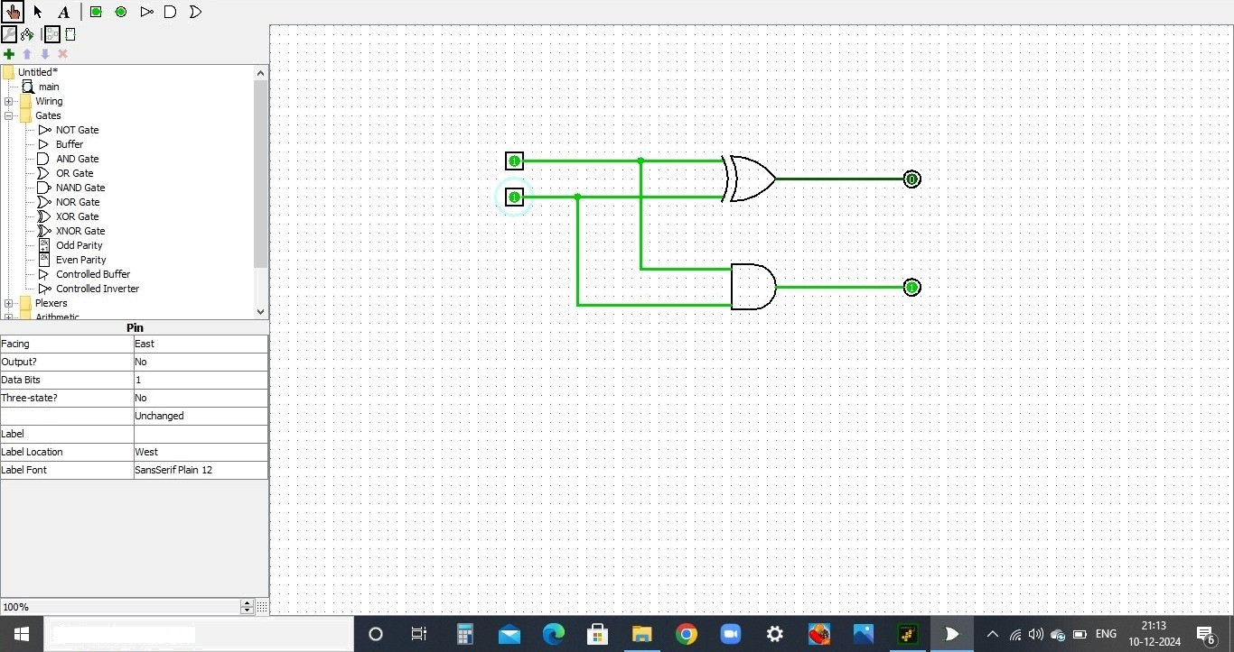
Logisim: main of Untitled
File Edit project Simulate Window Help
Pull Behavior
Type here to search

Slide 12
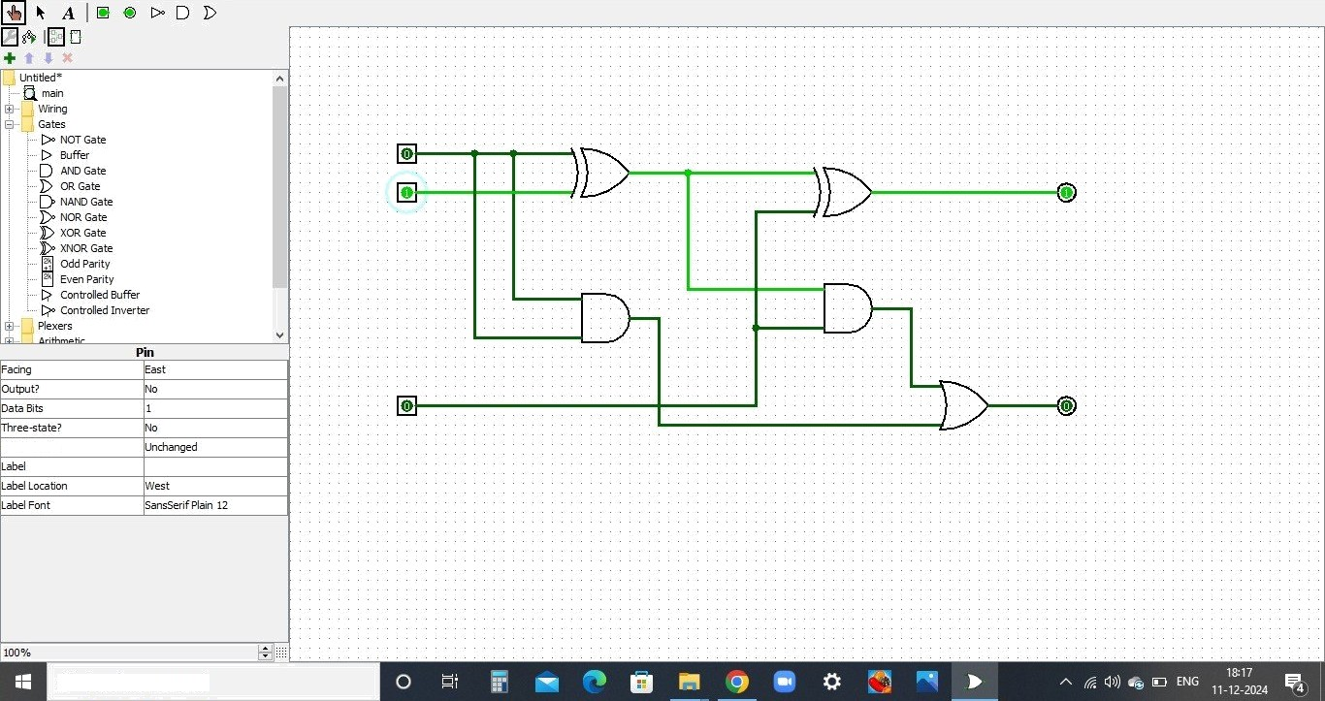
Logisim: main of Untitled
File Edit project Simulate Window Help
Pull Behavior
Type here to search

Slide 13
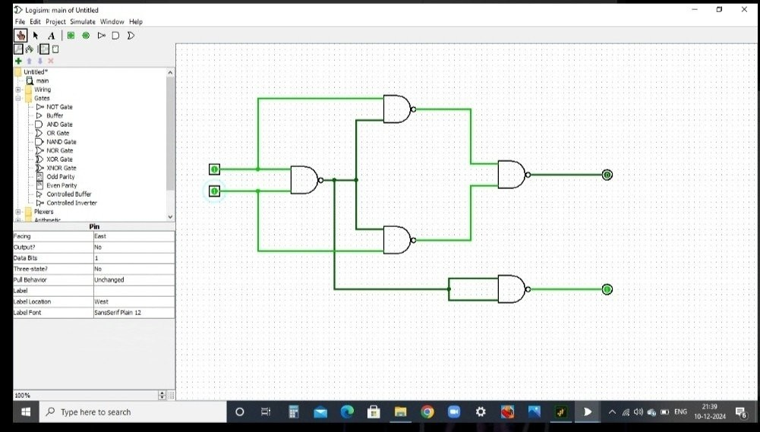

Slide 14
¢¥ltAim8085 - 8085 £4icroprooessor
'imuIator
Fil€' Reset Assembler Debu9
Hill
Registers
A
BC DF
/-II
W
Flag
Load me at
DaLa
SLack
KeyPad
38ernory
I/O PorCs
00
00
00
00
42
FF
18
05
18
00
00
1B
FF
S 0
1
2 MDV B,A
Start 2001)
Addi ess (Hex) 07D1
07D2
07D3
07D4
07D5
07D6
07D7
OK
8
Addl ess Datn 2001 4
2002 0
2003 0
2004 0
2005 0
2006 0
2007 0
AC 0
MVI E,#’i
LGGP: MOV D,C
MVI A,'JGH
LP: ADD E
p g p
JNZ LP
10
11
DCR B
JNZ LOOK
MOV A,E
STA S0i'3
p g
IP
O 0
Jfit-Rep
00
Decfiual - Hex Convertiorr
Decimal Hex
0 0
07D8 | 2008 | 0
07D9 | 2009 | 0
07DA | 2010 | 24
•@To Hex |  | %•To Dec | 16 | HLT | 07DB | 2011 | 0
 |  |  |  |  | 07DC | 2012 | 0
Line I4o 0
Assemhlei I.Message
Program assembled successfully
0
- e 00
/J Update Port Value
2001 — -I- 04
Update Nemory

Slide 15
¢¥ltAim8085 - 8085 £4icroprooessor
'imuIator
Fil€' Reset Assembler Debu9
Hill
Registers x
BC 22
DF 00
/-II IF
W 00
42
FF
Flag
Load me at
DaLa
SLack
KeyPad
38ernory
I/O PorCs
22
00
00
7A
00
17
FF
S 0
 | 1 | LXI H,9'5U |  | Start 8050
8 | 2 | MOV C, M
 | 3 | IMX H |  | Address (Flex) Addl ess |  | Dat
 | 4 | MOV B, M |  | 1F72 | 8050 | 6
AC 0 | 5 | DCR C |  | 1F73 | 8051 | 4
p g | 6 7 8 | LOCP: IMX MOV A, M CMP B | H | 1F74 1F75 | 8052 8053 | 2 12
OK
n
IP
Jfit-Rep
00
O 0 | 9 | JC SKIP | 1F76 | 8054 | 34
 | 10 | MOV B, A | 1F77 | 8055 | 0
Decfiual - Hex Convertiorr
11 SKIP: DCR C
1F78
8056
0
Decimal | Hex | 12 | JNZ | LOOP
 |  | 13 | LXI | H,8G58
0 | 0 | 14 | MOV | M, B
 |  | IS | HL'£
•@To Hex | %•To Dec
 | 1F79 | 8057 | 0
 | 1F7A | 805B | 34
 | 1F7B | 8059 | 0
 | 1F7C | 8060 | 0
 | 1F7D | 8061 | 0
Line tJo Assemhlei I.Message
0
- e 00
/J Update Port Value
0
Program assembled successfully
8050 — -I- 8
Update Nemory

Slide 16

¢¥ltAim8085 - 8085 £4icroprooessor
'imuIator
Fil€' Reset
Assembler
Debu9
Hill
Registers
A
BC DF
/-II
W
Flag
DaLa
SLack
KeyPad
38ernory
I/O PorCs
16
S 0
Load me at
10
00
80
00
42
FF
00
00
51
00
13
FF
?LOad the aCCU8HllatOF With the COOtOUt Of **
;Logical AND operation with accumulator and
;Jump to LOOP1 if the result of the AND oper
;Move immediate value 11 into the accumulate
; Jump tO zOOx2
A,22 ;Move immediate value 22 into the accumulato
Start 80B0
Address(Hex)
1F²
OK
8
ANI Gi
JZ LOOP1
MVI A,i:
LOOP2
LOOP1: MVI
LGGP2: STA 80:
HLT
Address Data 80a 4
AC 1
p g
1F73 | 8051 | 22
1F74 | 80B2 | 0
1F75 | 80B3 | 0
1F76 | 8054 | 0
1F77 | 8055 | 0
;Store the accumulator content at memory loc
;Halt the processor
IP
Jfit-Rep
00
0
Decfiual - Hex Convertiorr |  |  |  |  | 1F78 | 8056 | 0
Decimal Hex |  |  |  |  | 1F79 | 8057 | 0
0 |  |  | 0 |  | 1F7A | 805B | 0
 |  |  |  |  | 1F7B | 8059 | 0
 | •@To Hex |  |  | %•To Dec | 1F7C | 8060 | 0
 |  |  |  |  | 1F7D | 8061 | 0
Line tJo Assemhlei I.Message
0
- e 00
/J Update Port Value
0
Program assembled successfully
8050 — -I- 04

Slide 17

¢¥ltAim8085 - 8085 £4icroprooessor 'imuIator
Fil€' Reset
Assembler
Debu9
Hill
Registers
A
DaLa
SLack
KeyPad
38ernory
I/O PorCs
16
Load me at
BC | 10 | 00 | 1 | MVI A,*AH | ;Move immediate value 9AH into the aCCumulat | Strf | 80B0
DF | 00 | 00 Z 0 | 2 | ANI 8'3H | ;Logical AND operation with accumulator and
OK
JZ NEG
MVI A,2S
JMP STO
NEG: MVI A,i
STC: STA @5'3i
HLT
;Jump to NEG if the result of the AND operat
;Move immediate value 22 into the accumulate
Address(Hex)
Address Data
8050 9
/-II | 80 |  | 51
FT | 00 |  | 00
 | 42 |  | 12
AC 1
1
2
; Sum tO £i'EO
;Move immediate value 11 into the accumulato
;Store the accumulator content at memory loc
;Halt the processor
1F73 | 8051 | 22
1F74 | 80B2 | 0
1F75 | 80B3 | 0
1F76 | 8054 | 0
1F77 | 8055 | 0
1F78 | 8056 | 0
1F79 | 8057 | 0
1F7A | 805B | 0
1F7B | 8059 | 0
1F7C | 8060 | 0
1F7D | 8061 | 0
o
IP FF
Jfit-Rep 00
FF
0
Decfiual - Hex Convertiorr
Decimal Hex
0 0
•@To Hex %•To Dec
Line tJo Assemhlei I.Message
0
- e 00
/J Update Port Value
0
Program assembled successfully
8050 - e
09

Slide 18

¢¥ltAim8085 - 8085 £4icroprooessor
'imuIator
Fil€' Reset Assembler Debu9
Hill
Registers
A
BC DF
/-II
Flag
DaLa
SLack
KeyPad
38ernory
I/O PorCs
00
S 0
Load me at
00
00
IF
00
00
7A
1 | LXI
2 | MOV
3 | IMX
4 | MOV
5 | DCR
H,9'35'? C, M H
B, M
Start 8050
Address (Flex) 1F72
OK
8
Addl ess Datn 8050 6
AC 0
FT | 00 | 00 |  | C |  | 1F73 | 8051 | 4
IP | FF | FF | 8 | LOCP: IMX MOV A, M CMP B | H | 1F74 1F75 | 8052 8053 | 2 12
Jfit-Rep 00
Decfiual - Hex Convertiorr
0 |  | JNC SKIP |  | 1F76 | 8054 | 34
 | 10 | MOV B, A |  | 1F77 | 8055 | 0
 | 11 | SKIP: DCR | C | 1F78 | 8056 | 0
Decimal 0 | 0 |  | Hex | 12 13 14 1'5 | JNZ LXI MOV HLT | LOOK H,8G58 M, B | 1F79 1F7A 1F7B | 8057 805B 8059 | 0 2 0
•@To Hex |  | %•To Dec |  | 1F7C |  |  |  | 8060 | 0
 |  |  |  | 1F7D |  |  |  | 8061 | 0
Line tJo Assemhlei I.Message
0
- e 00
/J Update Port Value
0
Program assembled successfully
xnMemory
053 — -I-
12
Update Nemory

Slide 19
¢¥ltAim8085 - 8085 £4icroprooessor 'imuIator
Fil€' Reset
Assembler
Debu9
Hill
Registers
A
BC DF
Load me at
DaLa
SLack
KeyPad
38ernory
I/O PorCs
10
00
F8
00
00
2
3 STA 900i
; Load the number from memory location 8000H i
; Complement the number in the accumulator (o
; Store the result (one's complement) in memor
; Halt the program
Start 8000)
Addi ess (Hex)
OK
Z 0
Addl ess
Datn
/-II UPS' | 80 00 | 51 00 | AC | 4 1 | 1E40 1E41 | 8000 8001 | 7 248
K | 42 | 08 | p | 0 | 1E42 | 8002 | 0
5 HLT
:S’P FF
Jfit-Rep 00
FF |  | 1E43 | 8003 | 0
 | 0 | 1F44 | 8004 | 0
 |  | 1E45 | 8005 | 0
Decfiual - Hex Convertiorr
Decimal Hex
0 0
1E46
1E47
8006
8007
0
0
 |  | 1E48 | 8008 | 0
 |  | 1E49 | 8009 | 0
%•To Dec |  | 1E4A | 8010 | 0
 |  | 1E4B | 8011 | 0
•@To Hex
Line I4o 0
Assemhlei I.Message
Program assembled successfully
0
- e 00
/J Update Port Value
8000 — -I- 07
Update Nemory

Slide 20

¢¥ltAim8085 - 8085 £4icroprooessor
'imuIator
Fil€'
Reset
Assembler
Debu9
Hill
Registers A | F9 | Load me at | DaLa |  | SLack | KeyPad | 38ernory | I/O PorCs
BC 10 | 00 |  | ; Load the number from memory location 8000H i Start 8000 |  |  |  |  | OK
DF 00 | 00 Z 0 | 2 3 ADI 0iH | ; Complement the accumulator (one's complemen ; Add 1 to the accumulator (to get two's comp Address (Flex) |  | Addl ess | Datn
/-II 80 UPS' 00 | 51 AC 0 00 | 5 | ; Store the result (two's complement) in memor _{1E40} 1E41 |  | 8000 8001 | 7 249
K 42 | 0A p j | 6 HLT | ; Halt the program _{1E42} |  | 8002 | 0
:S’P FF | FF |  | 1E43 |  | 8003 | 0
Jfit-Rep | 00 ⁰ |  | 1F44 |  | 8004 | 0
 |  |  | 1E45 |  | 8005 | 0
Decfiual - Hex Convertiorr |  | 1E46 |  |  | 8006 | 0
Decimal Hex |  | 1E47 |  |  | 8007 | 0
0 | 0 |  | 1E48 | 8008 0
 |  |  | 1E49 | 8009 0
•@To Hex | %•To Dec |  | 1E4A | 8010 0
 |  | 192411091 Poojasree.B | 1E4B Line I4o | 8011 0 Assemhlei I.Message
0 - | e 00 |  | 0 | Program assembled successfully
/J Update Port Value
8000 — -I- 07

Slide 21
¢¥ltAim8085 - 8085 £4icroprooessor 'imuIator
Fil€' Reset Assembler Debu9
Hill
Registers |  |  | Flag
A BC | 09 | 09 00 |  | S | 0
DF | 00 | FB |  |  | 8
/-f£ | IF | 74
Load me at
DaLa
SLack
KeyPad
38ernory
I/O PorCs
LXI H, 805U
MOV C, M
DCR C
; Load HL with the address 8050H
; Load the number of elements (n) into regi
; Decrement C (n—1 passes required)
Start 8050
AdresHex)
1F72
lF 3 1F74
1F7ñ
176
1F77
OK
Addess Dat 8050 4
8051 9
80B2 8
8073 5
8094 3
80b 0
AC 0
p j
LOGP3: MOV D, C
LXI H, 8'J5i
LOOP2: MOV A, M
IMX H
CMP M
JNC LOOP1
B, M
MOV M, A
DCX H
MOV M, B
IMX H
LGGP1: DCR D
; Copy C to D for inner loop control
; Load HL with the starting address of the a
; Load current element into A
UPS' 00
K 42
IP FF
Jfit-Rep
00
lD FF
; Increment HL to point t, t t i, t
; Compare A with the next ei, ,nt
00
O 0
; Jump to LOOP1 if A 2 next element (no ¿
Decfiual - Hex Convertiorr Decimal Hex
0 0
; Save the next element in B
; Place the larger element at the current p
₁F78 | 80B6 | 0
1F79 | 80B7 | 0
1F7A | 805B | 0
1F7B | 8059 | 0
; Decrement HL to point t t p
; Place the smaller element at the next pos
; Increment HL to restore position
; Decrement D (inner loop counter)
•@To Hex |  | %•To Dec | 16 | JNZ | LOOK2 | ; | Repeat inner loop if D # 0 | 1F7C | 8060 | 0
 |  |  | 17 | DCR | C | ; | Decrement C (outer loop counter) | 1F7D | 8061 | 0
JNZ LOOP3
HU
; Repeat outer loop if C # 0
Line tJo 0
Assemhlei I.Message
Program assembled successfully
0
- e 00
/J Update Port Value
8055 — -I- 00
Update Nemory

Slide 22
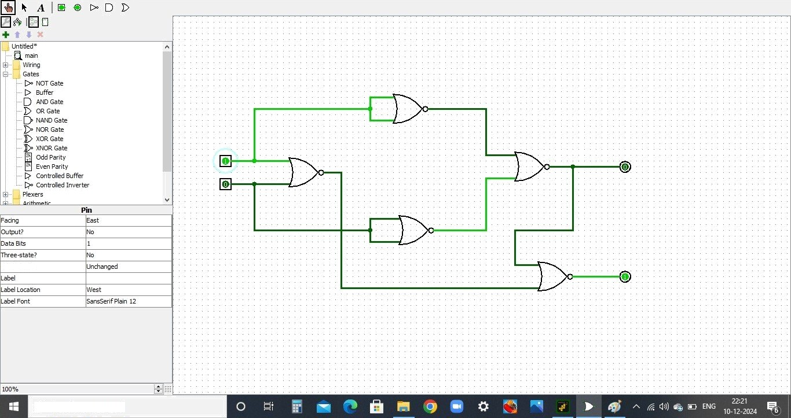
Logisim: main of Untitled
File Edit project Simulate Window Help
Pull Behavior
Type here to search

Slide 23
¢¥ltAim8085 - 8085 £4icroprooessor
'imuIator
Fil€' Reset Assembler Debu9
Hill
Registers x
BC 06
#£ 00
/-/l 00
UPS' 00
K 42
:S’P FF
Jfit-Rep
Flag
Load me at
DaLa
SLack
KeyPad
38ernory
I/O PorCs
06
00
00 1
00
00
OF
FF
S 0
2 MOV B,A
Start 8050
Arldi ess (Flex) 1F72
OK
0
Addl ess Datn 8050 3
AC 0
.SLA S ›3 E 0
MOV A,B
STA %05
HLT
1F73 | 8051 | 6
1F74 | 8052 | 0
1F75 | 8053 | 0
1F76 | 8054 | 0
1F77 | 8055 | 0
o
00
0
Decfiual - Hex Convertiorr |  |  |  |  | 1F78 | 8056 | 0
Decimal Hex |  |  |  |  | 1F79 | 8057 | 0
0 |  |  | 0 |  | 1F7A | 805B | 0
 |  |  |  |  | 1F7B | 8059 | 0
 | •@To Hex |  |  | %•To Dec | 1F7C | 8060 | 0
 |  |  |  |  | 1F7D | 8061 | 0
Line tJo Assefnhlei t4essage
0
- e 00
/J Update Port Value
0
Program assembled successfully
xn Memory
8052 —
-I- 0
Update Nemory

Slide 24
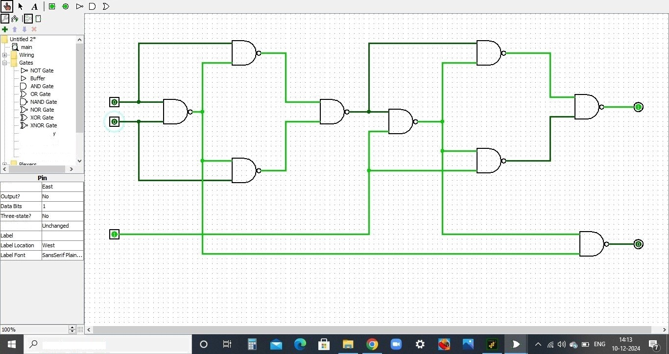
Logisim\ main of Untitled 2
File Edit p roject Simulate Window Help
, Odd Parit
y Even Parity
Q Conbolled Buffer Q• Conbolled Inverter
Facing
Pull Behavior
Type here to search

Slide 25
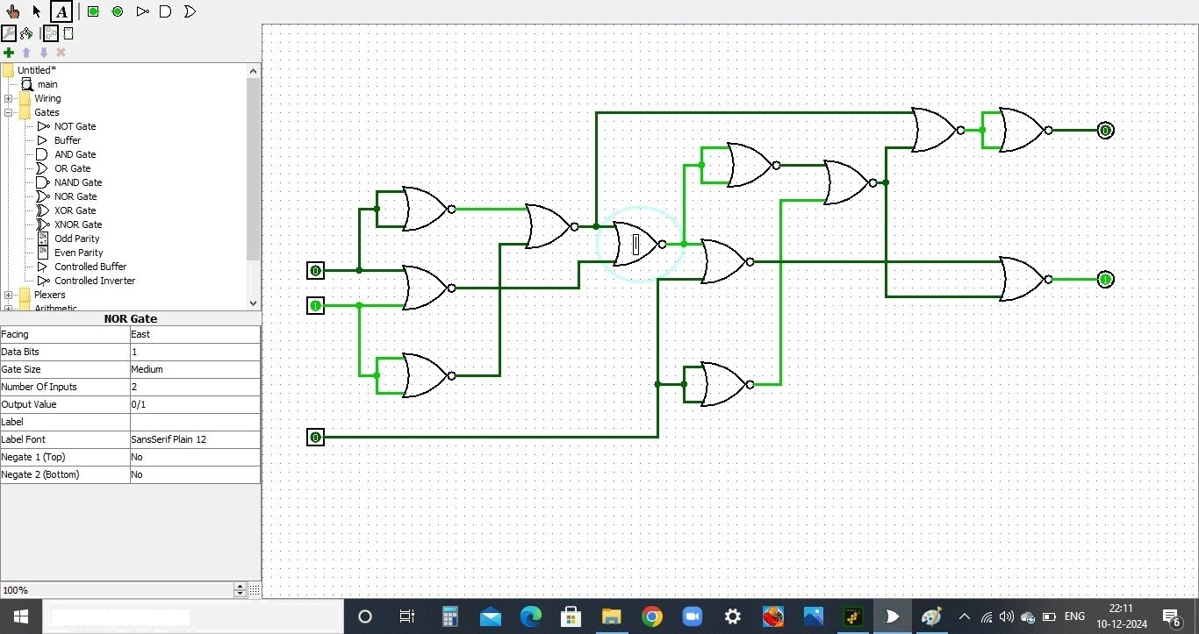
Logisim: main of Untitled
File Edit project Simulate Window Help
Type here to search

Slide 26
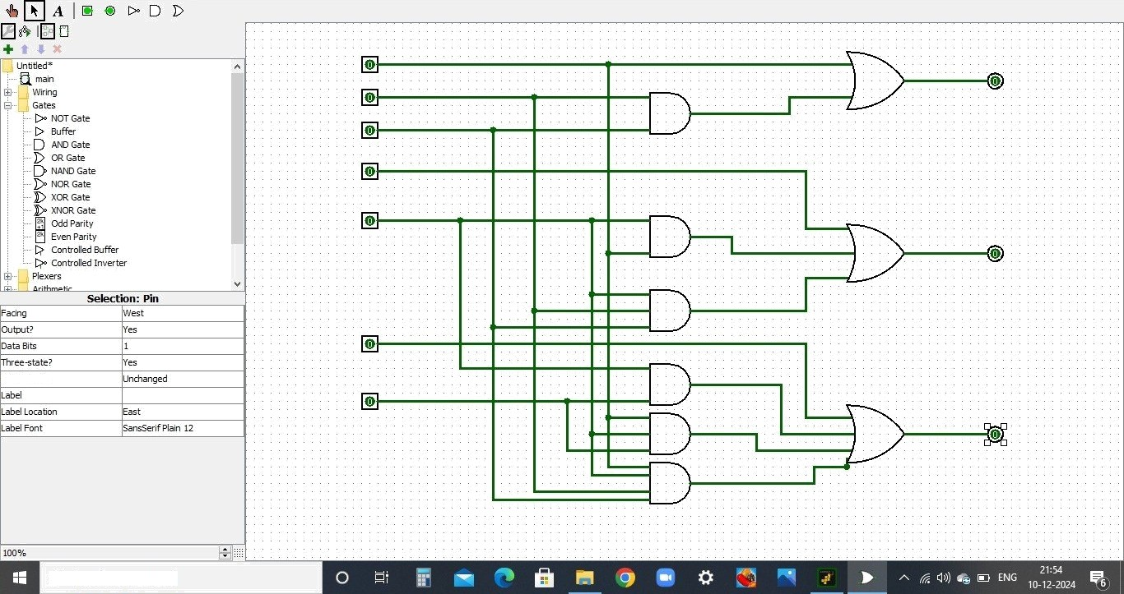
Logisim: main of Untitled
File Edit project Simulate Window Help
Pull Behavior
Type here to search

