Slide 1
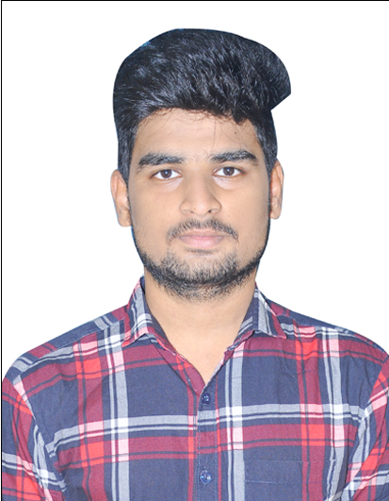

BALASAI CHILUVERU
Analyst
iTransfrom L&D Left Shift Batch
Bachelor of Technology,
Mechanical Engineering : 2018-2022
Certification:
AZ-900 Fundamental.
AZ-104 Microsoft Azure Administrator.
Mumbai
BALASAI.CHILUVERU@CAPGEMINI.COM
+91 6303360881
Skills
A4
C# | Basics, OOPS, Exception Handling ,Arrays, Collection and Generics.
.NET Framework | ADO.NET, ASP.NET with MVC 5 and WEB API, Entity Framework
Database | SQL
Tools | GIT, Swagger
UI Technology | HTML5 ,CSS & Angular
Add On Skills | Communication Skills, Team Management.
Full Stack Developer
Understanding of RDBMS concepts using SQL Server.
Practical understanding of C# and SQL concepts using Visual Studio and SQL Server
Hands on experience in developing applications using .NET Framework, ADO.NET Core
Understanding of HTML5 , CSS and Angular Cli.
Completed case study on CROP DEAL which is a Web based System where farmer can easily post crops for selling with the help of this Crop Deal application. where Dealer can visit farmer location and check the quality and quantity of the crops.
This project will be beneficial for Farmer's to sell their crop directly to the Dealer's with reasonable price and where Dealer can make payment directly into farmer bank account. for that users have needs to register in this System. Then user needs to Login. By Login user can decide which service he/she has needs.
Technologies used:
ANGULAR
ASP.NET CORE
Microsoft SQL Server
Video Link : Click
GitHub Link
https://github.com/sdsameer07

