Slide 1

CMR TECHNICAL CAMPUS Accredited by NBA, Approved by AICTE, affiliated to JNTUH Kandlakoya (V), Medchal Road, Hyderabad -501401
DEPARTMENT OF COMPUTER SCIENCE AND ENGINEERING
Generating Cloud Monitors From Models To Secure Cloud
Under the guidance
Dr. G. Madhukar
GROUP MEMBERS:
D.Mounika (18C21A0502)
S.Sai Kiran (187R5A0512)
M.Sai Kumar Goud (187R5A0502)

Slide 2
content
Abstract
Existing System
Disadvantages
Proposed System
Advantages
Hardware Requirements
Software Requirements
Project Architecture
Modules
UML Diagrams
Usecase Diagram
Class Diagram
Sequence Diagram
Activity Diagram
Data Flow Diagram
Sample code
Screen shot
Conclusion
Future enhancement

Slide 3
abstract
Authorization is an important security concern in cloud computing environments. It aims at regulating an access of the users to system resources. A large number of resources associated with REST APIs typical in cloud makes an implementation of security requirements challenging and error-prone. To alleviate this problem, in this paper we propose an implementation of security cloud monitor. We rely on model-driven approach to represent the functional and security requirements. Models are then used to generate cloud monitors. The cloud monitors contain contracts used to automatically verify the implementation. We use Django web framework to implement cloud monitor and OpenStack to validate our implementation. We present a cloud monitoring framework that supports a semi-automated approach to monitoring a private cloud implementation with respect to its conformance to the functional requirements and API access control policy. Our work uses UML (Unified Modeling Language) models with OCL (Object Constraint Language) to specify the behavioral interface with security constraints for the cloud implementation. The behavioral interface of the REST API provides an information regarding the methods that can be invoked on it and pre- and post-conditions of the methods. In the current practice, the pre- and post-conditions are usually given as the textual descriptions associated with the API methods

Slide 4
Existing system
In many companies, private clouds are considered to be an important element of data center transformations. Private clouds are dedicated cloud environments created for the internal use by a single organization. Therefore, designing and developing secure private cloud environments for such a large number of users constitutes a major engineering challenge. Usually, cloud computing services offer REST APIs (Representational State Transfer Application Programming Interface) to their consumers. The REST architectural style exposes each piece of information with a URI, which results in a large number of URIs that can access the system.

Slide 5
disadvantages
Data breach and loss of critical data are among the top cloud security threats.
The large number of URIs further complicates the task of the security experts, who should ensure that each URI, providing access to their system, is safeguarded to avoid data breaches or privilege escalation attacks.
Since the source code of the Open Source clouds is often developed in a collaborative manner, it is a subject of frequent updates. The updates might introduce or remove a variety of features and hence, violate the security properties of the previous releases.

Slide 6
Proposed system
We present a cloud monitoring framework that supports a semi-automated approach to monitoring a private cloud implementation with respect to its conformance to the functional requirements and API access control policy. Our work uses UML (Unified Modeling Language) models with OCL (Object Constraint Language) to specify the behavioral interface with security constraints for the cloud implementation. The behavioral interface of the REST API provides an information regarding the methods that can be invoked on it and pre- and post-conditions of the methods. In the current practice, the pre- and post-conditions are usually given as the textual descriptions associated with the API methods. In our work, we rely on the Design by Contract (DbC) framework, which allows us to define security and functional requirements as verifiable contracts.

Slide 7
advantages
Our methodology enables creating a (stateful) wrapper that emulates the usage scenarios and defines security-enriched behavioural contracts to monitor cloud.
The proposed approach also facilitates the requirements traceability by ensuring the propagation of the security specifications into the code. This also allows the security experts to observe the coverage of the security requirements during the testing phase.
The approach is implemented as a semi-automatic code generation tool in Django a Python web framework..

Slide 8
Hardware requirements
Processor : i3 7 th gen or higher
RAM : 4 GB min.
Free Space on Hard Disk : minimum 40 GB.

Slide 9
Software requirments
Operating system : Windows 7,8, XP
Language : Python, Django
Database : MySQL 5.0

Slide 10
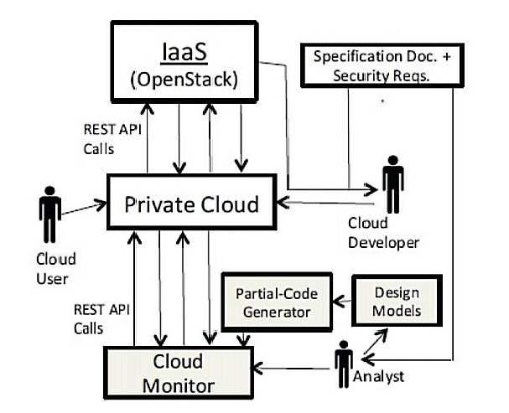
architecture

Slide 11
MODULES
User
Cloud
Admin

Slide 12
USER
It defines the access rights of the cloud users. A volume can be created, if the it has not exceeded its quota of the permitted volumes and a user Authorization is an important security concern in cloud computing environments. a POST request from the authorized user on the volumes resource would create a new volume. a DELETE request on the volume resource by an authorized user would delete the volume. if the user of the service is authorized to do so, and the volume is not attached to any instance. It aims at regulating an access of the users to system resources.

Slide 13
CLOUD
The cloud monitors contain contracts used to automatically verify the implementation. A cloud developer uses IaaS to develop a private cloud for her/his organization that would be used by different cloud users within the organization. In some cases, this private cloud may be implemented by a group of developers working collaboratively on different machines. We use Django web framework to implement cloud monitor and OpenStack to validate our implementation.

Slide 14
ADMIN
the cloud administrator using Keystone and users or usergroups are assigned the roles in these projects. It defines the access rights of the cloud users in the project. A volume can be created, if the project has not exceeded its quota of the permitted volumes and a user is authorized to create a volume in the project. Similarly, a volume can be deleted, if the user of the service is authorized to do so, and the volume is not attached to any instance, i.e., its status is not in-use.

Slide 15
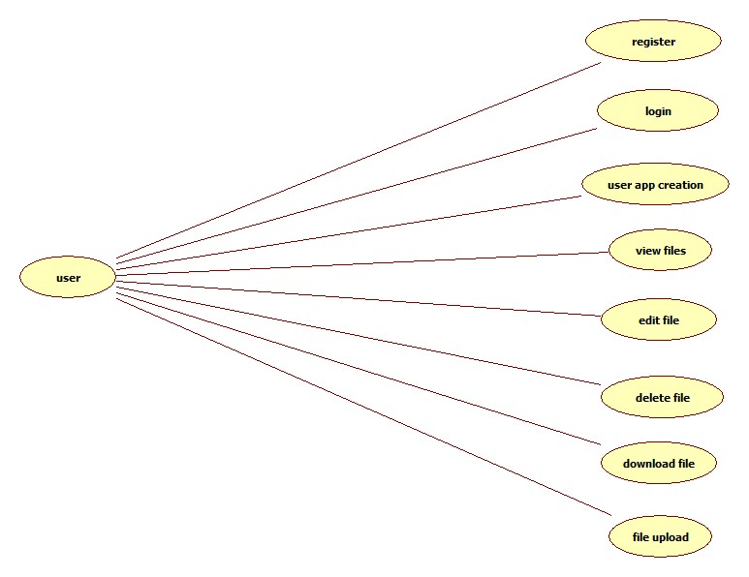
UML DIAGRAM(USER)

Slide 16
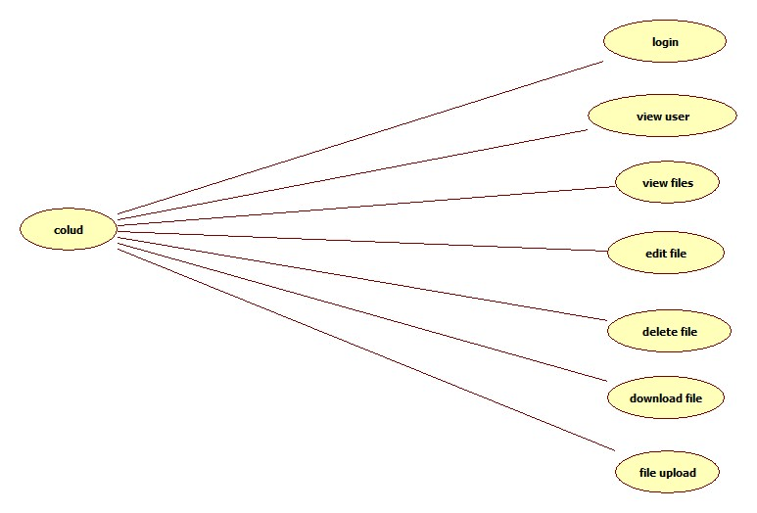
UML DIAGRAM(CLOUD)

Slide 17
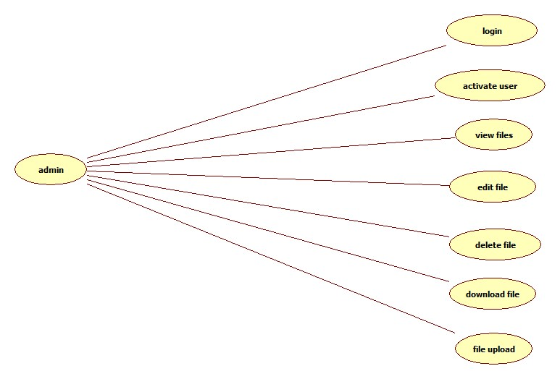
UML DIAGRAM(ADMIN)

Slide 18
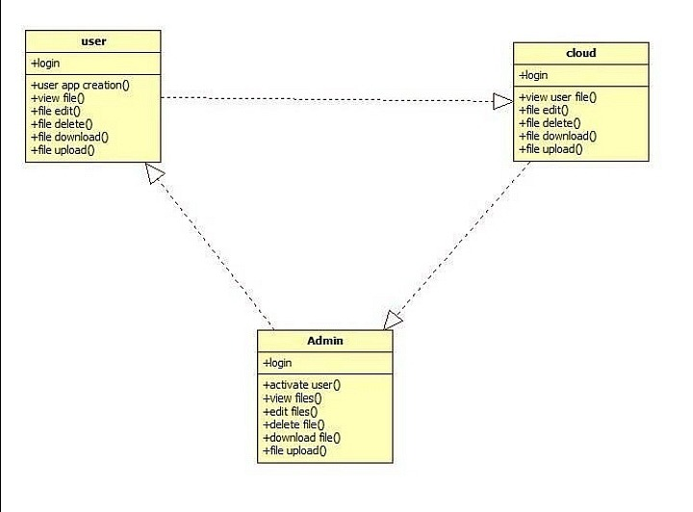
CLASS DIAGRAM

Slide 19
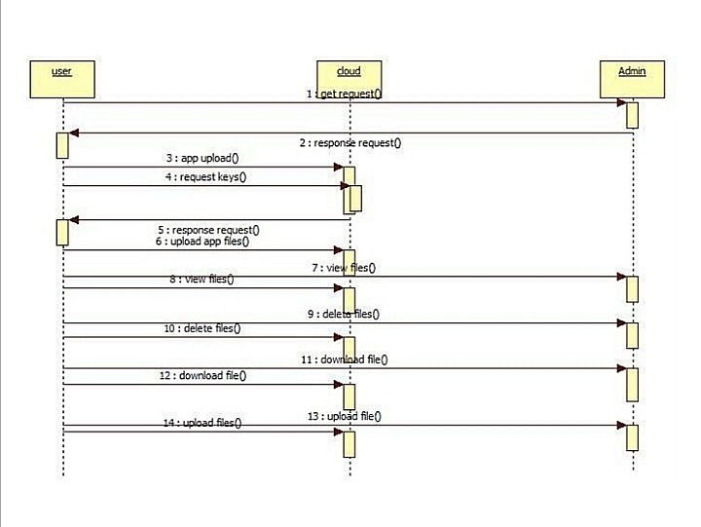
SEQUENCE DIAGRAM

Slide 20
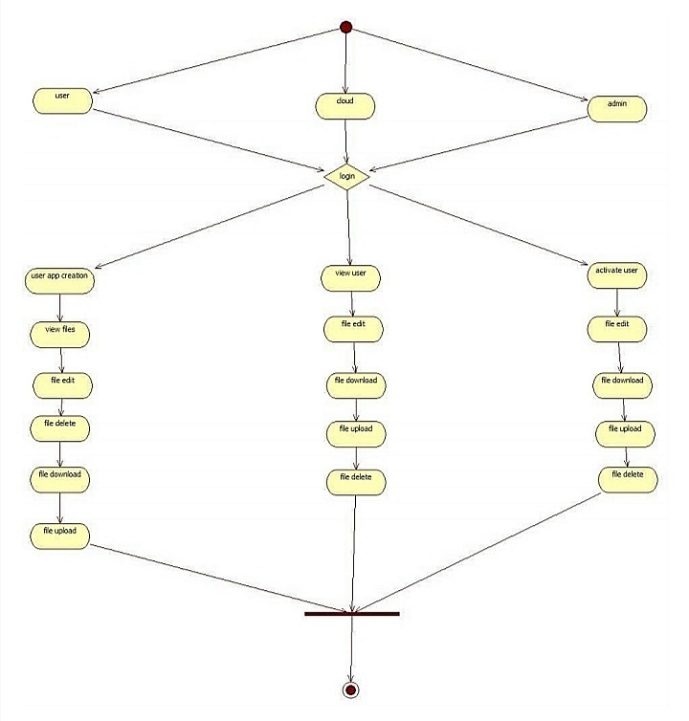
ACTIVITY DIAGRAM

Slide 21
SAMPLE CODE
from django.contrib import admin
from django.urls import path from django.conf import settings from django.conf.urls.static import static from users import views
from users.views import index,userlogin,adminlogin,cloudlogin,userregister,storeregistration,logout,userlogincheck,us ercreateapp,appcreaterequest,useruploadfile,snippet_detail
from admins.views import adminlogincheck,adminactivateusers,activatewaitedusers
from clouds.views import activateuserapp,cloudlogincheck,clouduserappactivations
from .views import resturl,downloadfile,deletefile,uploadfile
urlpatterns = [ path('admin/', admin.site.urls), path('',index,name='index'), path(r'accounts', views.AccountAPIView.as_view(), name='account-list'), path(r'contacts', views.ContactAPIView.as_view(), name='contact-list'), path(r'activities', views.ActivityAPIView.as_view(), name='activity-list'),
path(r'activitystatuses', views.ActivityStatusAPIView.as_view(), name='activity-statuslist'),
path(r'contactsources', views.ContactSourceAPIView.as_view(), name='contact-sourcelist'),
path(r'contactstatuses', views.ContactStatusAPIView.as_view(), name='contact-status-list'), path(r'logout',logout,name='logout'),

Slide 22
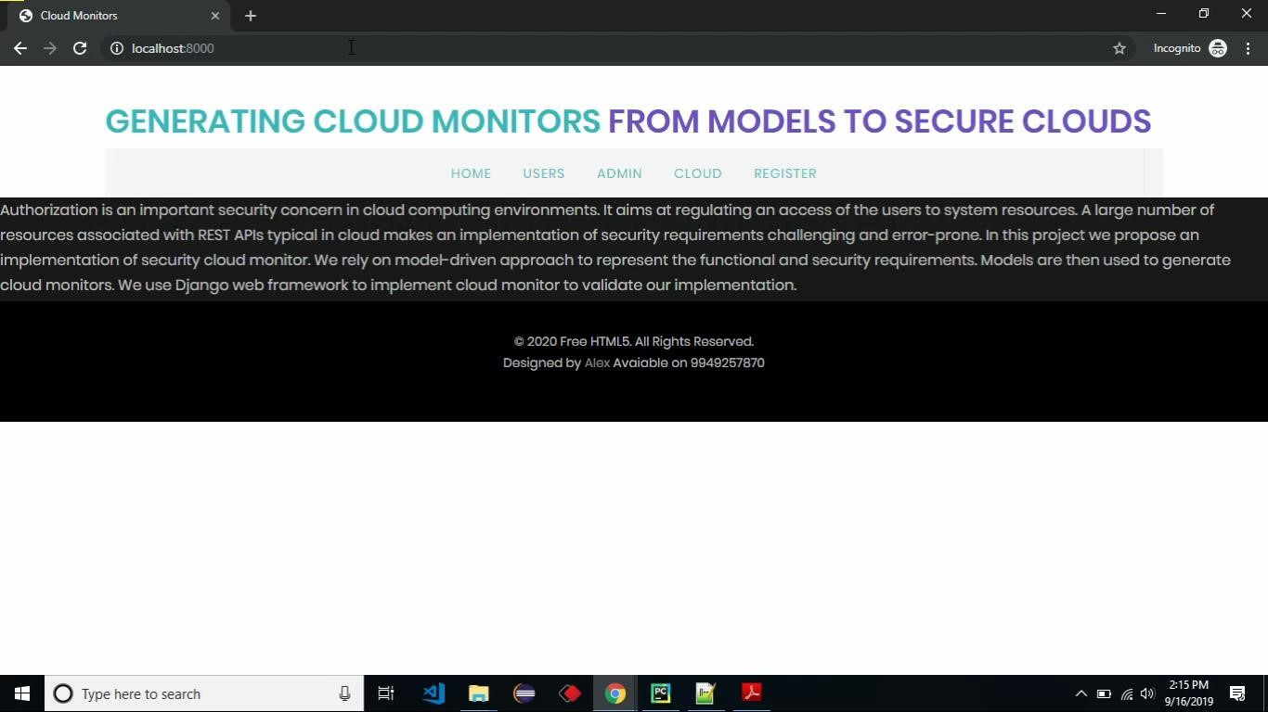
SCREEN SHOT

Slide 23
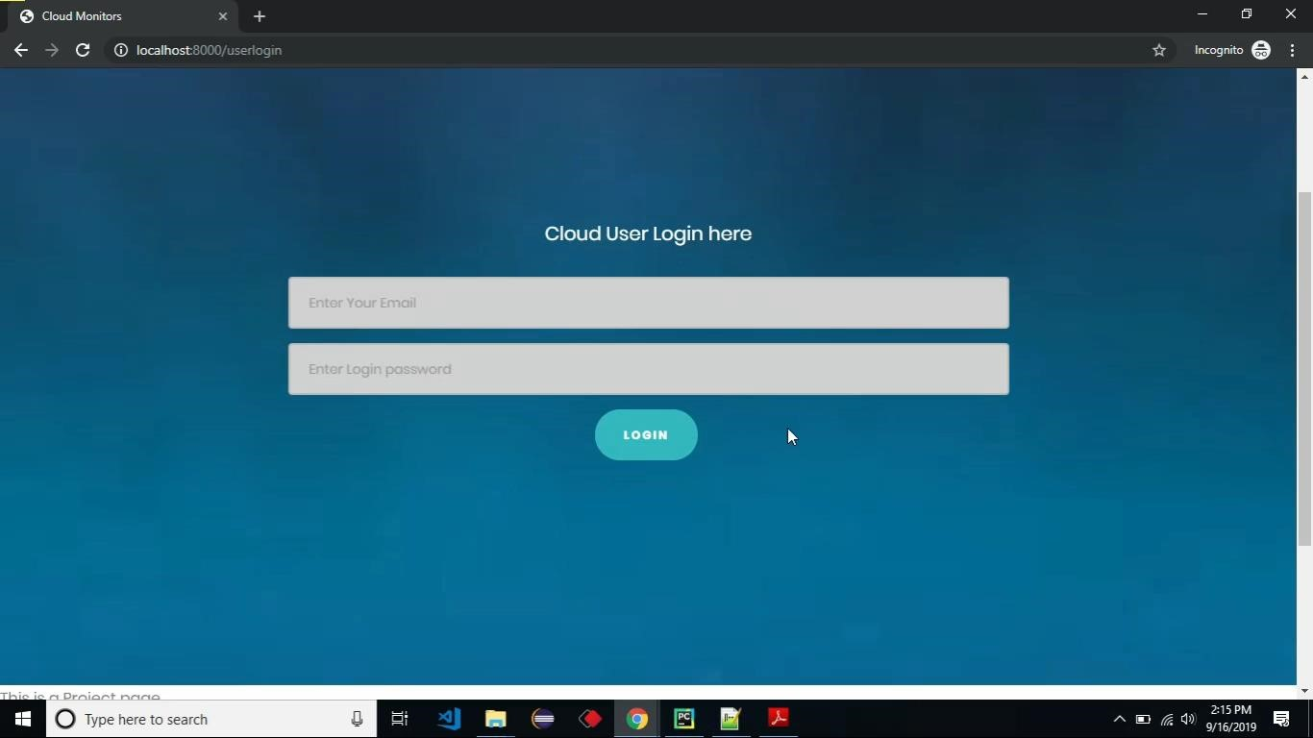
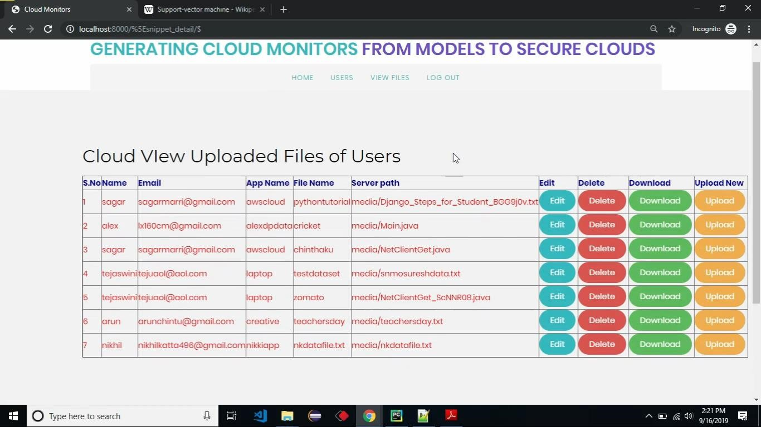

Slide 24
THANK YOU

