Slide 1
SUPER MARKET BILLING SYSTEM
PRESENTED BY: BATCH-03,GROUP-05
JEEVAN -2016CSE294
SHANMUKH-2016CSE273
DARSHAN-2016CSE253
RAVINDRANATH-2016CSE255
FACULTY:NAPA LAKSHMI MADAM
Dept of CSE

Slide 2
INTRODUCTION
Design and implement an super market billing system that simulates the functions of a real billing system.
The super market billing system will support product name,price and quantity.

Slide 3
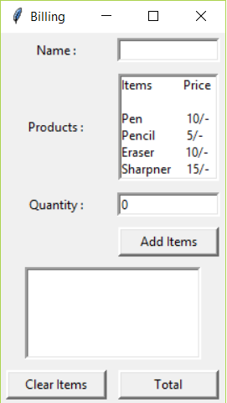

Slide 4
Literature Survey
https://pythonprogramming.net/introduction-to-python-programming/
Python for Data Analysis by Wes Mckinney
Python for Beginners Timothy C. Needham

Slide 5
Backend Description
Here we use a excel file in which we have created our database.we can also use a CSV file to create database.
The database contains detais of stock like product name, price,quantity,expiry date,serial no,etc.

Slide 6
Backend Description
serial no | product name | price(Rs) | quantity | expiry date
1111 | maha lacto | 1 | 200 | 10-05-2019
1112 | good day | 10 | 50 | 11-03-2019
1113 | dairy milk | 5 | 100 | 09-12-2019
1114 | parachute coconut oil | 120 | 25 | 01-01-2020
1115 | thumps up | 15 | 60 | 04-03-2019
1116 | nivea cream | 45 | 20 | 01-02-2021
1117 | surf excel easy wash | 116 | 15 | 01-06-2020
1118 | khadi shampoo | 145 | 5 | 01-11-2019
1119 | medimix soap | 49 | 30 | 12-10-2020
1120 | park avenue perfume | 210 | 4 | 01-01-2020

Slide 7
Modules Used
import matplotlib.pyplot(used for data visualization)
import pandas (to access the values from database)
import xlrd as xl(xlrd module is used to extract data from a spreadsheet)

Slide 8
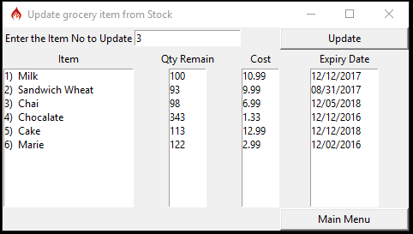
Results

