Slide 1
Analyzing the Drop in Electronics Sales in the Southern Region
Presented by: Sai
Date: 28-06-2025

Slide 2
Problem Statement
Electronics sales have dropped in the Southern Region.
Impacting overall revenue.
Need to find causes and solutions.

Slide 3
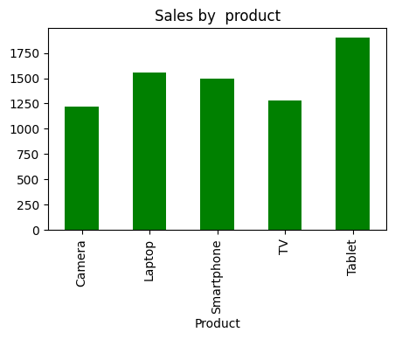
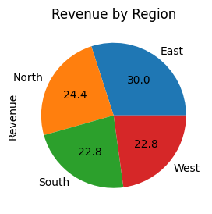
Sales Analysis & Revenue

Slide 4
Region wise sales analysis
Region | Q1 Sales (₹) | Q2 Sales (₹) | Change (%)
North | 1.2 Cr | 1.15 Cr | -4.2%
East | 1.05 Cr | 1.08 Cr | +2.9%
West | 1.3 Cr | 1.25 Cr | -3.8%
South | 1.1 Cr | 0.715 Cr | -35.0%

Slide 5
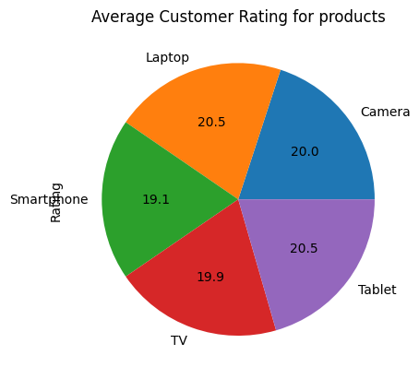
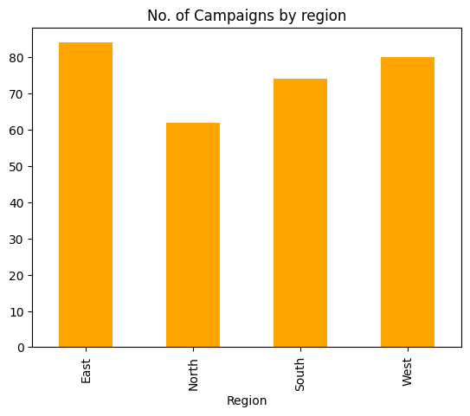
Customer Feedback and campaign Analysis

Slide 6
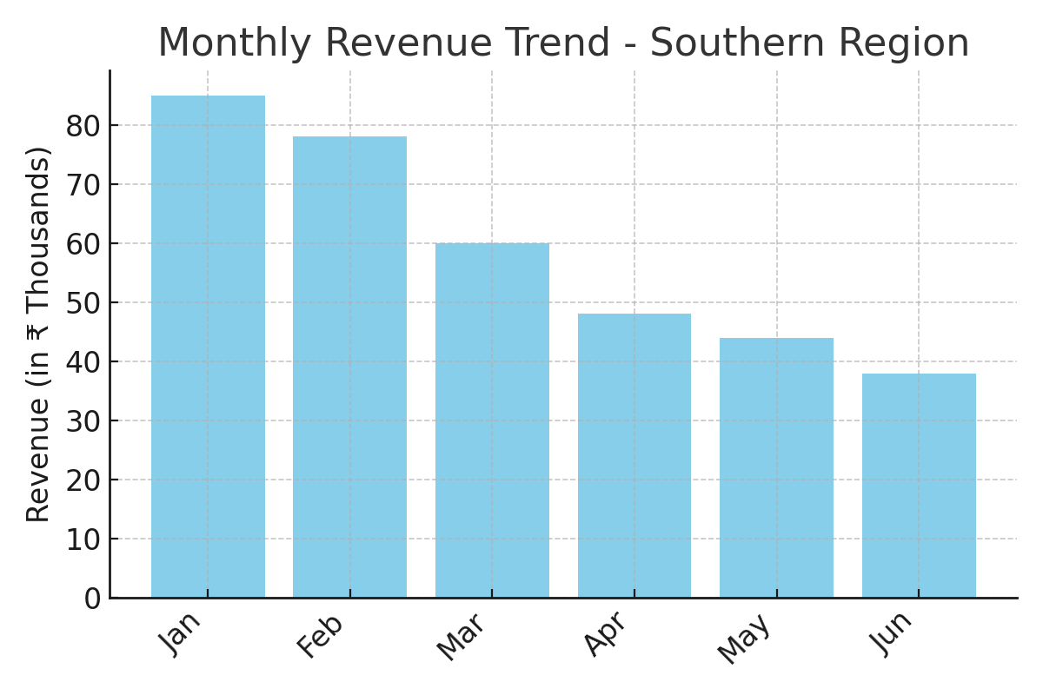
Drop in Revenue Over Months

Slide 7
Key Findings
35% drop in Q2 sales in Southern Region
Feedback highlights service-related issues
Only 10% of marketing focused on the South
Product returns spiked during sales decline

Slide 8
Recommendations
Launch targeted marketing campaigns in Southern Region
Offer discounts on underperforming products
Enhance customer service & post-sales support
Monitor feedback and respond proactively

Slide 9
Thank You / Q&A
Thank you for your attention!
We are happy to take your questions.

