Slide 1
JDBC(API)
Java database connectivity (JDBC) is a standard application programming interface (API) specification that is implemented by different database vendors to allow Java programs to access their database management systems.
Note : A Java program that uses the JDBC API loads the specified driver for a particular DBMS before it actually connects to a database.

Slide 2
JDBC(API)
Interestingly, JDBC is not an acronym and thus stands for nothing but popular as Java Database Connectivity. According to Sun (now merged in Oracle) JDBC is a trademark term and not an acronym. It was named to be redolent of ODBC.

Slide 3
JDBC Connectivity
Industry standard for database-independent connectivity between Java applications and wide range of relational databases (RDBMS)
Technology split into:
API(com.mysql.jdbc.Driver)
Driver(mysql-connector.jar)

Slide 4
JDBC Connectivity
JDBC API defines the Java™ interfaces and classes that programmers use to connect to databases and send queries.
A JDBC driver implements these interfaces and classes for a particular DBMS vendor.
A Java program that uses the JDBC API loads the specified driver for a particular DBMS before it actually connects to a database.
The JDBC DriverManager class then sends all JDBC API calls to the loaded driver.

Slide 5
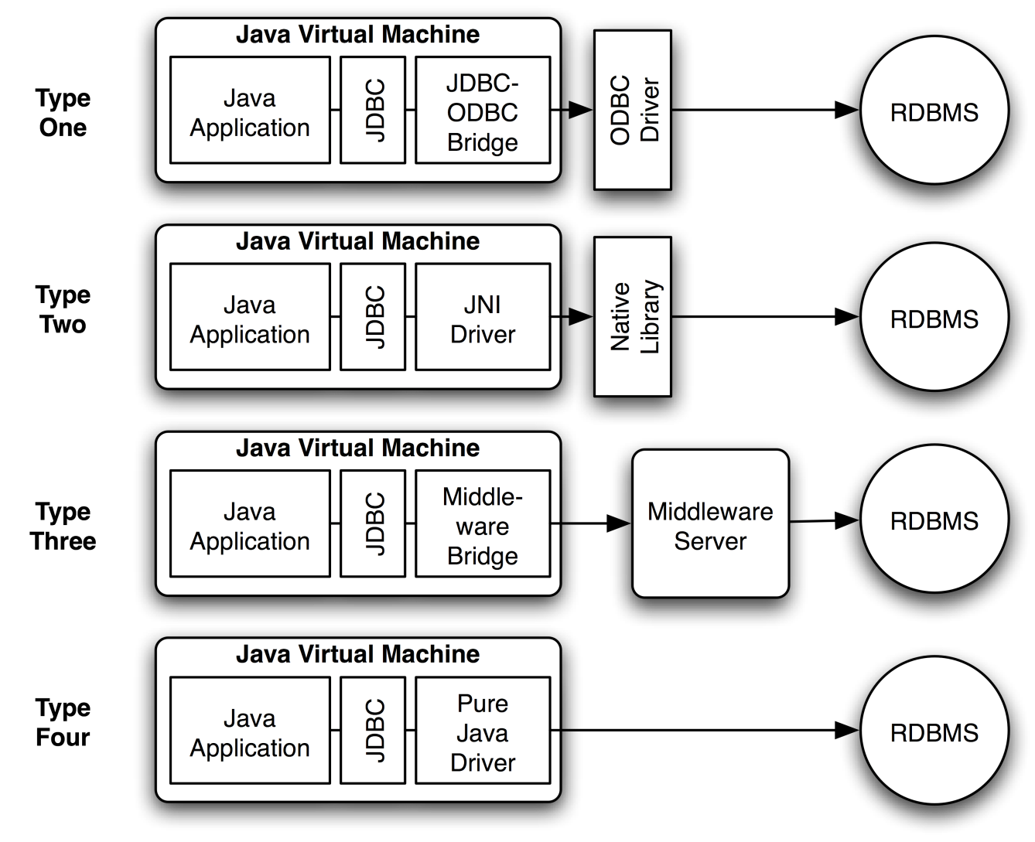
JDBC Types

Slide 6
MySQL Query
Connect to MySQL
Create Database
> CREATE DATABASE EXPDB;
Use Database
>USE EXPDB;
Create a table
>CREATE TABLE EXPTABLE ( ID INT NOT NULL AUTO_INCREMENT PRIMARY KEY, NAME VARCHAR (50));
Insert Records
>INSERT INTO EXPTABLE (NAME) VALUES ("Ragavan");
>INSERT INTO EXPTABLE (NAME) VALUES ("Vignesh");
List Records
>SELECT * FROM EXPTABLE;

Slide 7
JDBC Connection - Using JDBC
JDBC Connection - DataBase URL or String
JDBC Connection - Driver Class
JDBC Connection - Database User Name and Password

Slide 8
Java Program for JDBC Connection
Import API
Register JDBC Driver Class
Connect to Database through JDBC Driver
Execute SQL Statements through JDBC Connection
Close JDBC Connection

Slide 9
Step 1 : Import API
// Source Code
import java.sql.Connection;
import java.sql.DriverManager;
import java.sql.ResultSet;
import java.sql.SQLException;
import java.sql.Statement;

Slide 10
Step 2: Register JDBC Driver Class
// Syntax
Connection connection = DriverManager.getConnection(url);
URL : jdbc:sub-protocol://database-locator
//Sample Code
Connection con = DriverManager.getConnection("jdbc:mysql://server:3306/db", “username", “password");

Slide 11
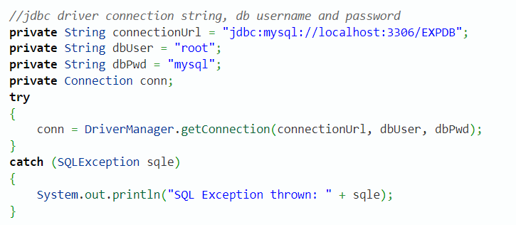
Step 2: Register JDBC Driver Class

Slide 12
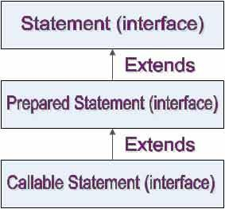
Step 3: Execute SQL Statements through JDBC Connection
A JDBC statement object is used to execute an SQL statement. JDBC API supports three types of JDBC statement object to work with the SQL statements.

Slide 13
Step 3: Execute SQL Statements through JDBC Connection
Statement Interface
Used for executing static SQL statement and returning the results it produces
Only one result per statement at any given time
PreparedStatement Interface
Precompiled SQL statement
Efficiently executed multiple times
Supports insertion + conversion + escaping of Java parameters into the statement

Slide 14
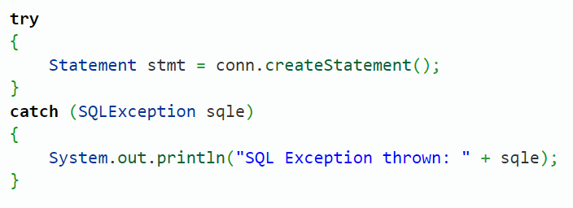
Step 3: Execute SQL Statements through JDBC Connection

Slide 15
Step 4 : Processing Results
A table of data representing database result in response to a executeQuery()
Maintains a cursor pointing to the current row of data
Call boolean next() advance the cursor
Can be made scrollable and/or updatable
Provides getter methods for reading the current row (by column name or index)
Type sensitive: getString, getInt, getDate
Index starts at 1; names are case insensitive

Slide 16
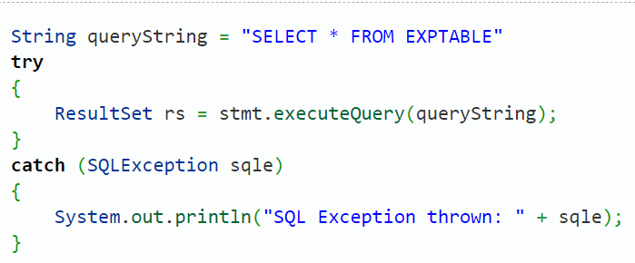
Step 4 : Processing Results

Slide 17
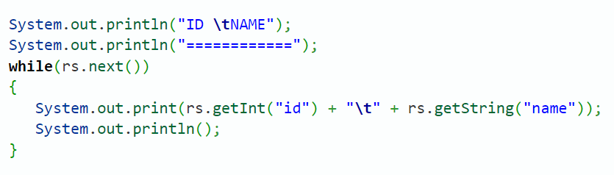
Step 4 : Processing Results

Slide 18
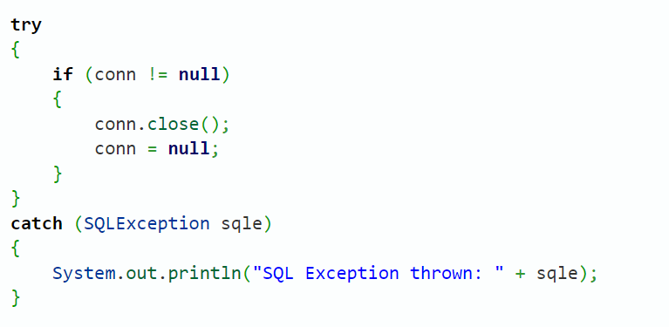
Step 5 : Close JDBC Connection

