Slide 1

Medical Insurance Fraud Detection using Big Data Analytics
AIT 614 002 Big Data Essentials
George Mason University
Team Members
Saihith Reddy Suram
Laxma Reddy Akkanapalli
Yesu Babu Jonnadula

Slide 2

Introduction
The proposed project aims to develop a unique data science model utilizing analysis and classification algorithms to predict fraud in the medical insurance market.
By integrating multiple big datasets and leveraging machine learning algorithms, this tool will assist government agencies in identifying fraudulent activities, thereby benefiting patients, pharmacies, and doctors.
Previous efforts in medical insurance fraud detection have primarily focused on retrospective analysis and rule-based approaches.
However, our solution distinguishes itself by employing real-time analysis and classification algorithms, enabling timely detection and intervention

Slide 3

Problem Statement
To develop a unique data science model utilizing real-time analysis and classification algorithms to predict fraud in the medical insurance market by integrating multiple big datasets and leveraging machine learning algorithms

Slide 4
Objectives:
develop a medical insurance fraud detection system.
01
Integrate multiple big datasets to enhance fraud detection capabilities.
02
Utilize machine learning algorithms for predictive analytics and anomaly detection.
03
Assist government agencies in identifying and preventing fraudulent activities in the medical insurance market
04

Slide 5
Summarized project timeline
Week 1: Initiation and Dataset Selection
Week 2:Data Pipelining and data integration
Week 3: Data cleaning and System Design
Week 4: System Development with model building and Experimentation
Week 5: Finalization, Documentation, and Presentation

Slide 6

Selected dataset
1. CMS Part D datasets: [https://www.cms.gov/Research-Statistics-Data-and-Systems/Statistics-Trends-and-Reports/Medicare-Provider-Charge-Data/Part-D-Prescriber.html](https://www.cms.gov/Research-Statistics-Data-and-Systems/Statistics-Trends-and-Reports/Medicare-Provider-Charge-Data/Part-D-Prescriber.html) 25.2 Million rows
2. LEIE Datasets:List of Excluded individuals and Entitites
[https://oig.hhs.gov/exclusions/exclusions_list.asp](https://oig.hhs.gov/exclusions/exclusions_list.asp) 79542 rows
3. CMS:https://www.cms.gov/priorities/key-initiatives/open-payments/data/dataset-downloads 13.2 MILLION ROWS

Slide 7
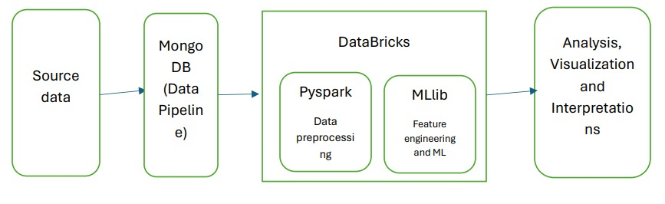
System Architecture

Slide 8

Data Pipelining and Data cleaning
By using Mongo DB we created some data pipes with these data sets.
In data bricks, we Imputed missing Data with zeros and some rows are removed nulls rows.
Removing duplicates
Data Sampling: The data set is imbalanced to balance it we performed over-sampling and under-sampling.

Slide 9

Insights
Using Tableau

Slide 10
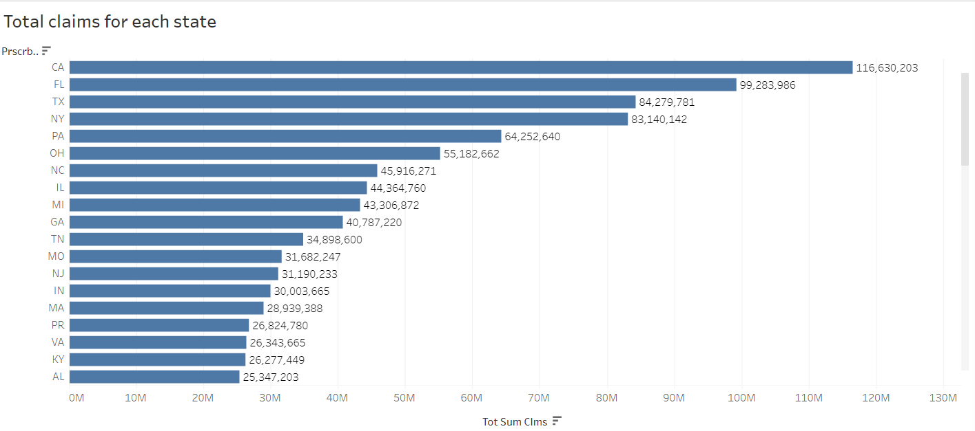

Slide 11
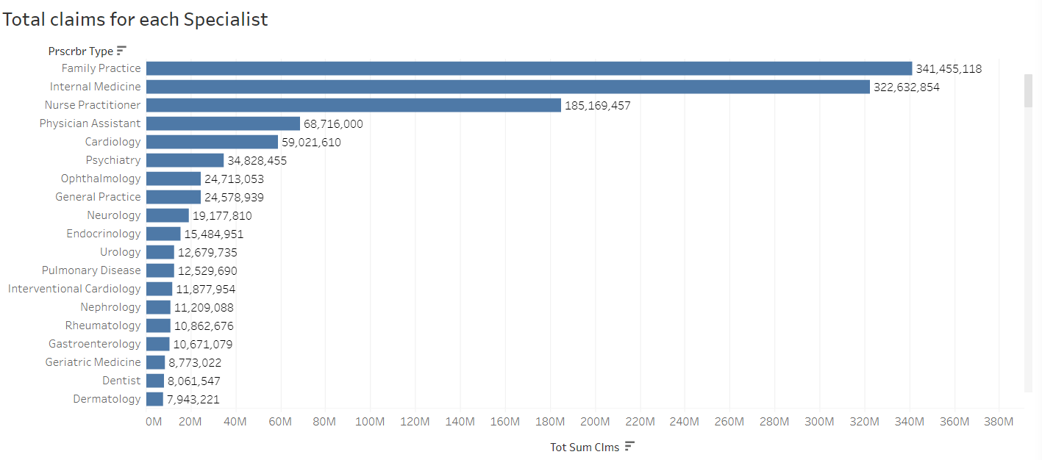

Slide 12
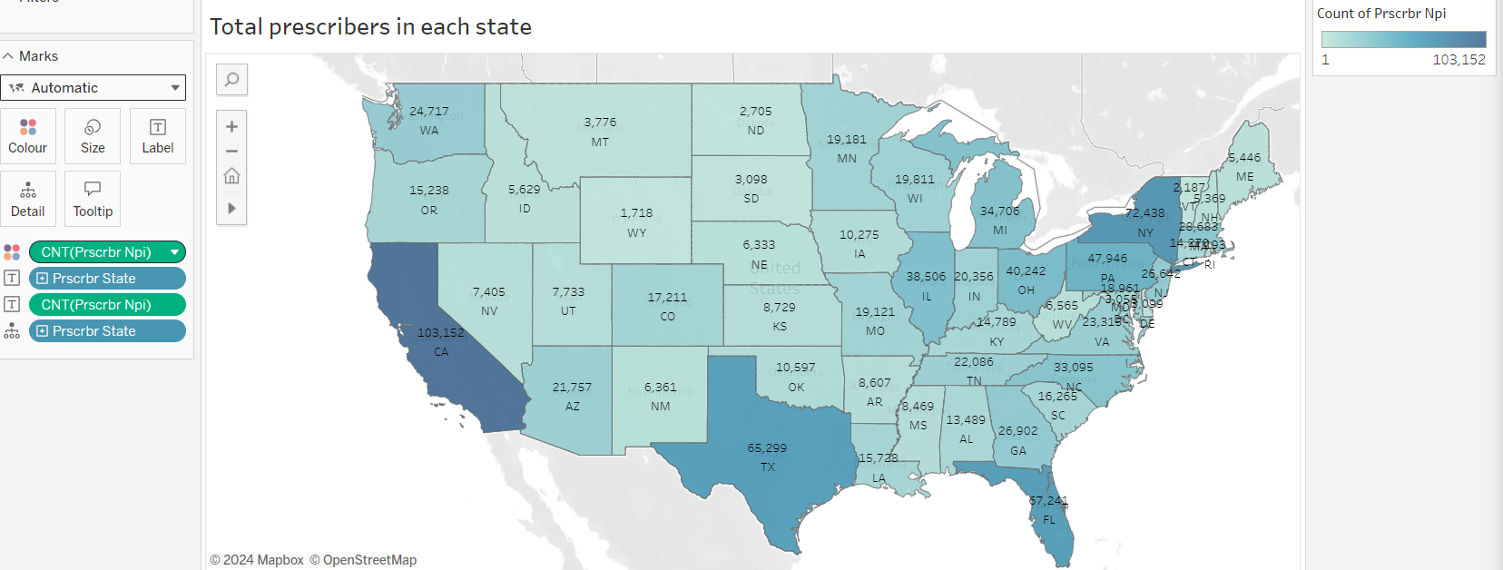

Slide 13
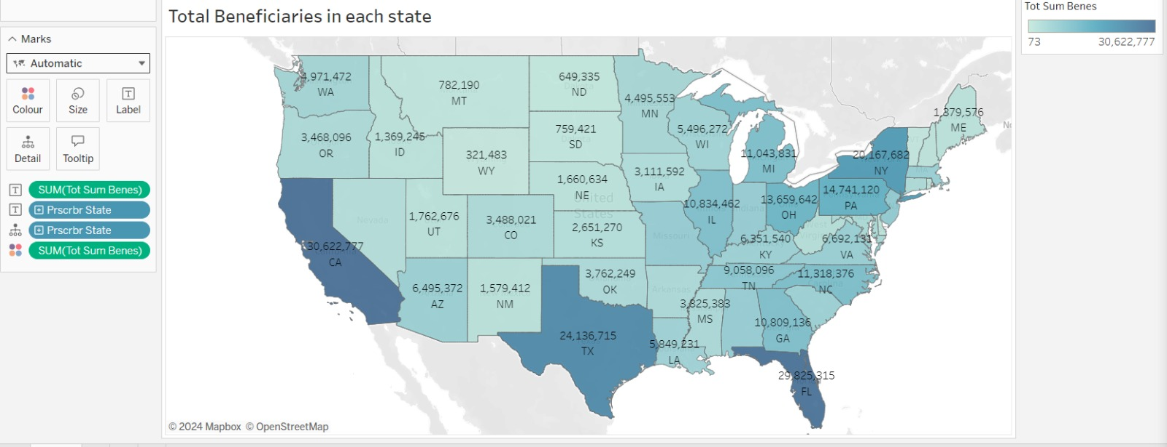

Slide 14
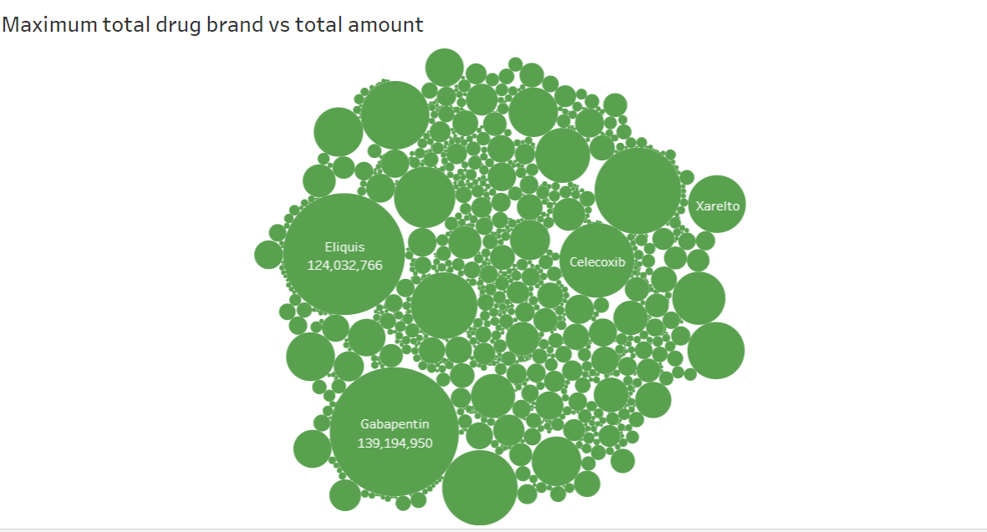

Slide 15
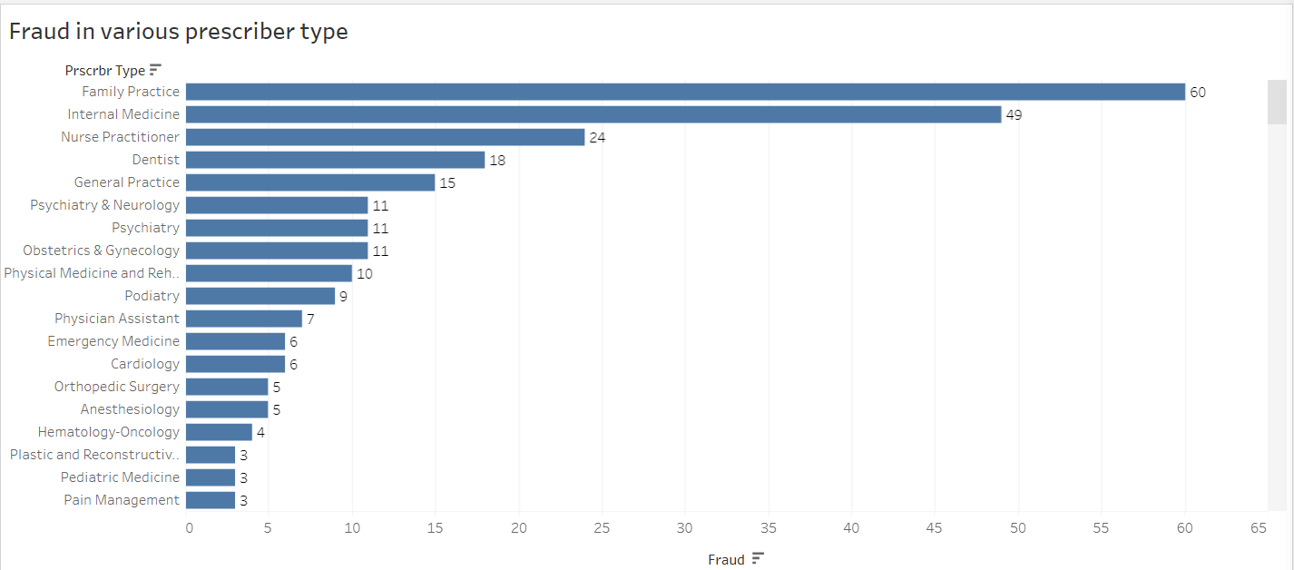

Slide 16
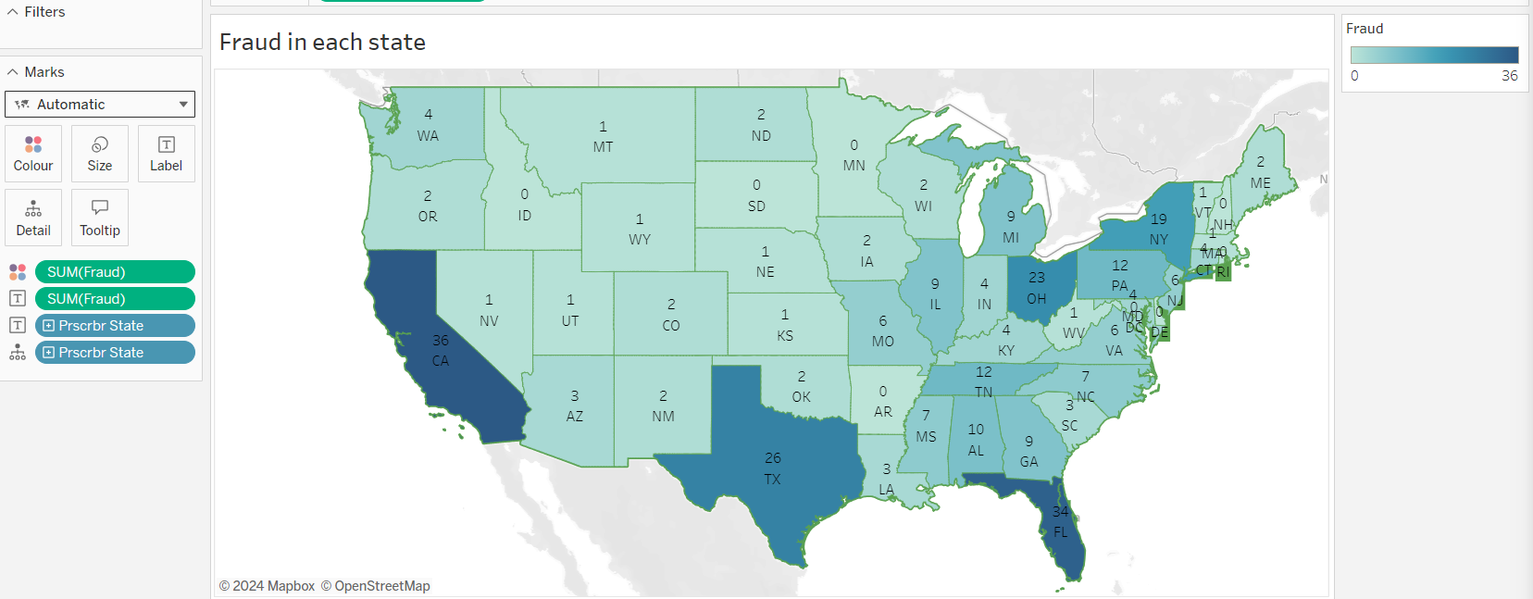

Slide 17
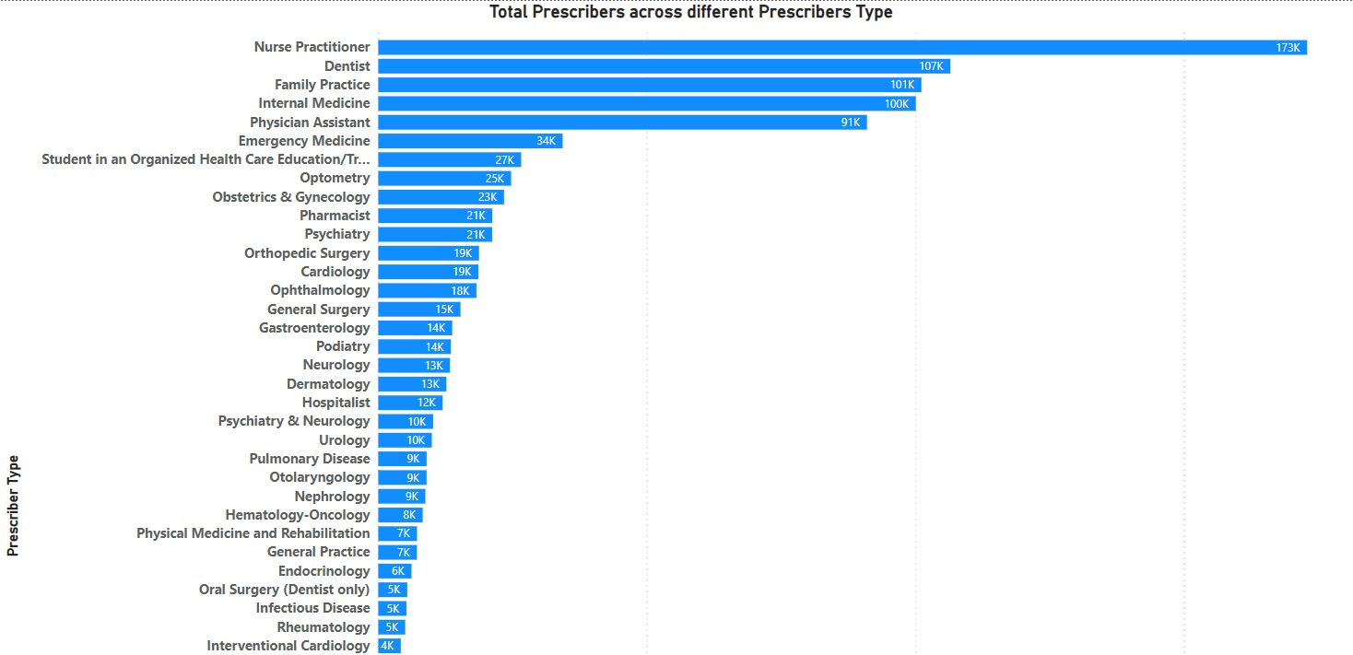

Slide 18
Experimental Results and Analysis

Slide 19
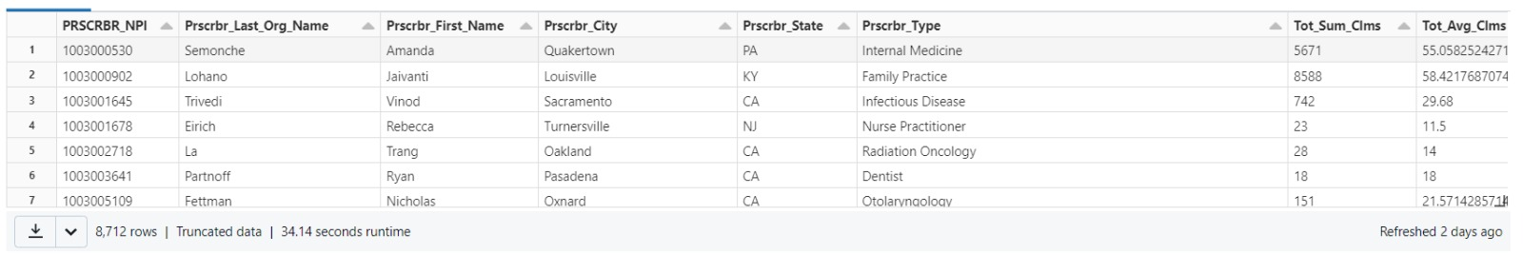
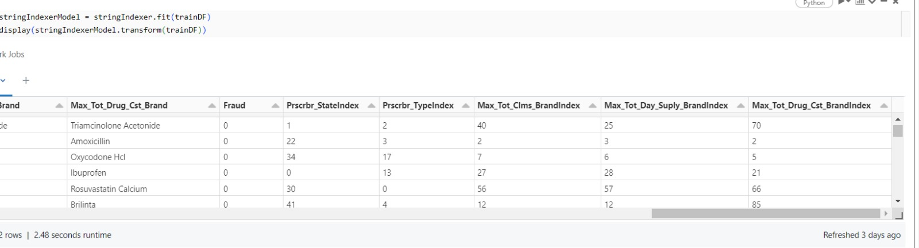
Feature Engineering
Categorical to numerical

Slide 20

Data Modelling
Models Implemented
1.Logistic Regression
2.Decision Tree
3. Random Forest
4. Naïve Bayes
5. Gradiant boosting

Slide 21
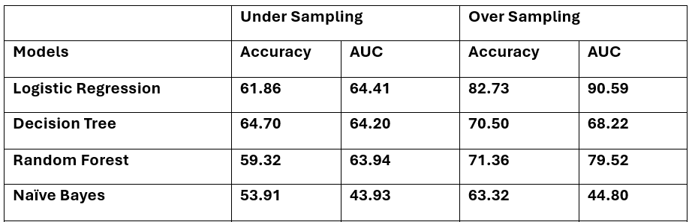
Model Evaluation

Slide 22
Random Forest

Slide 23

Conclusion
Here even though performing various models under 2 different conditions. But the basic and simple model logistic regression performed well with accuracy of 82.73% and area under the roc curve is 90.59% after over sampling before it this model also performed like others of accuracies of less than 75%.
Family practice,internal medicine and nurse practioners are committing more fraud among all the prescribers.
In conclusion, the development of an innovative data science model for medical insurance fraud detection represents a crucial step toward enhancing the integrity and sustainability of the healthcare industry.

Slide 24

Lessons Learned
Importance of leveraging AI algorithms to enhance fraud detection accuracy in the healthcare industry.
Recognizing the significance of analyzing diverse features such as service providers, prescription patterns in fraud detection models.
Understanding the potential of innovative data science approaches to mitigate financial losses and improve fraud detection outcomes in the medical insurance sector.

Slide 25

Future Scope
Integration of real-time data streams for dynamic fraud detection.
Implementation of advanced machine learning techniques, such as deep learning, for improved accuracy.
Collaboration with government agencies and industry stakeholders to deploy the model at scale.
Expansion into other sectors of the healthcare industry, such as pharmaceuticals and medical devices, to address broader fraud challenges.

Slide 26

Acknowledgement
Gratitude to Centers for Medicare and Medicaid Services (CMS) for data access.
Appreciation for the dedication and collaboration of our project team members and supervisors.
Thanks to healthcare professionals and support from family and friends for their invaluable contributions.

Slide 27

References
[1] https://data.cms.gov/
[2] Herland, M., Khoshgoftaar, T. M., & Bauder, R. A. (2018). Big Data fraud detection using multiple medicare data sources.Jounral of Big Data. 5(29).
https://journalofbigdata.springeropen.com/articles/10.1186/s40537-018-0138-3
[3] Nabrawi, E., & Alanazi, A. (2023). Fraud Detection in Healthcare Insurance Claims Using
Machine Learning. Risks, 11(9), 160. https://doi.org/10.3390/risks11090160

Slide 28

Thank You

