Slide 1
Abstract:-
DATAVERSE
This project is a web-based tool that simplifies the process of using datasets for machine learning and deep learning model development. Users can easily use a dataset file or insert a URL to load the data into the Python program. The same datasets are also available in the popular sklearn module, and the program is also accessible through the webpage. By integrating both options, developers can quickly experiment with and build various machine learning and deep learning models using a familiar and standardized dataset source. The webpage is also integrated with a chatbot, whose primary goal is to provide the data that users request, improving scalability and reducing limitations.

Slide 2
Project members
N. Sai Teja L23AM3268
B. Gopal L23am3267
B. Venkata Ram Y22AM3203
K. Jagadeesh Y22AM3223 signature of the mentor

Slide 3
Design aspects
Architecture: Use a client-server model with a web-based frontend and chatbot integration.
Goal: Develop a scalable, user-friendly web tool for easy dataset access and management. It supports file downloads, URL-based fetching, and sklearn datasets. An AI chatbot enhances accessibility and efficiency
Domain: This web-based project focuses on interactive data retrieval, preprocessing, and integration with analytical tools. It also serves as a Machine Learning and Data Science tool, enabling seamless dataset access for model development.

Slide 4
Requirements
Software Requirements
Frontend: Basic HTML, CSS, and JavaScript, bootstrap.
Version Control: Git for basic collaboration
Chatbot Framework: chatbase
Hardware Requirements
Processor: Any modern CPU (e.g., Intel i3 or equivalent).
RAM: 4GB or more.
Storage: 50GB free space on an SSD/HDD.

Slide 5
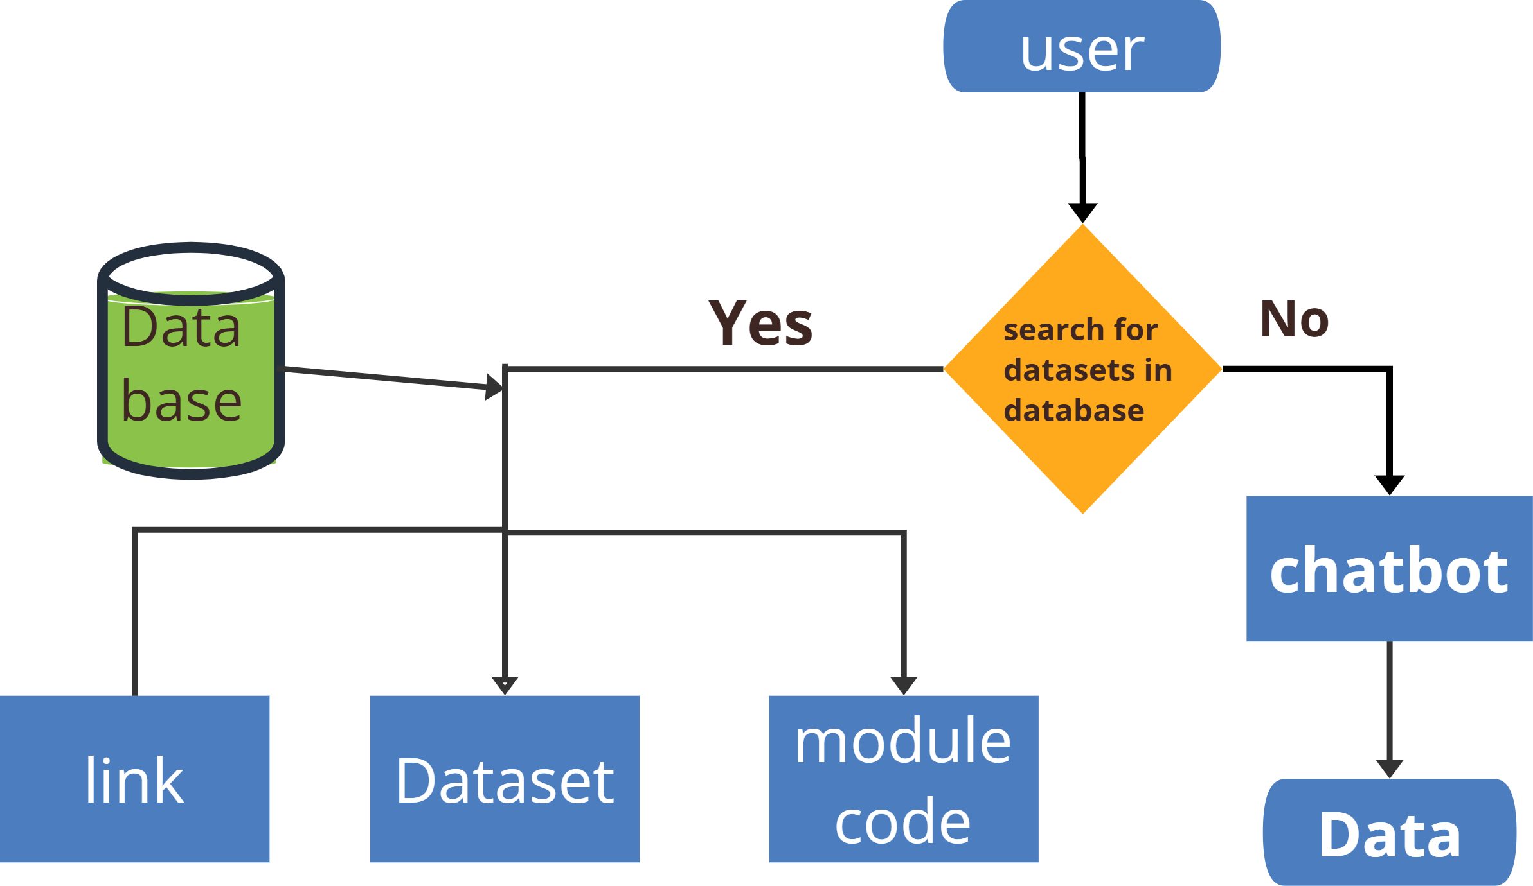
Architecture Design

Slide 6
Methods
System Architecture
Dataset Management & Retrieval
Web Interface Development
Chatbot Integration for Dataset Retrieval
Security & Performance Optimization
User Interaction & Experience Design

Slide 7
System Architecture
This project is designed as a purely frontend-based web application that allows users to easily access predefined datasets for machine learning and deep learning model development. Unlike traditional web applications, which rely on backend servers for data processing and storage, this project operates entirely on the client side.
Key Characteristics of the System Architecture:
Client-Side Execution: Since there is no backend, all processes, such as dataset selection and chatbot interaction, occur within the web browser.
Dataset Accessibility: The tool provides access to a list of predefined datasets that users can directly retrieve.
Chatbot Assistance: The chatbot is integrated into the system to help users navigate available datasets and retrieve relevant data.

Slide 8
Components of the System Architecture:
Web Interface:
The main interaction point for users.
Allows users to browse, search, and retrieve datasets.
Provides a structured and easy-to-use layout.
Preloaded Datasets:
A collection of datasets stored within the application.
These datasets are commonly used in machine learning projects.
Eliminates the need for external dataset uploads.
Chatbot Module:
Guides users by suggesting datasets based on their queries.
Uses a rule-based approach or keyword matching to understand user inputs.
This modular architecture ensures simplicity while maintaining fast and efficient dataset retrieval for users.

Slide 9
2. Dataset Management and Retrieval
1. Preloaded Datasets (Stored within the Application)
These datasets are embedded within the project’s code or linked from trusted sources.
Users can directly access them without requiring an internet connection.
Example datasets may include:
Iris Dataset (for classification problems)
Boston Housing Dataset (for regression problems)
Digits Dataset (for image recognition tasks)
Steps in Dataset Retrieval and Display:
User Requests a Dataset – Through the chatbot or the dataset selection menu.
Dataset Information is Displayed – Includes a brief description, format, and potential use cases.
Dataset is Provided as a Downloadable File or Copyable Link – Users can immediately start working with it.
This method of dataset handling ensures fast, reliable, and consistent access without requiring users to upload their own files.

Slide 10
3. Web Interface Development
The entire project is built using frontend technologies, ensuring that it runs smoothly in a web browser without requiring backend servers. The interface is designed to be simple, interactive, and easy to navigate.
Technologies Used:
HTML (HyperText Markup Language)
Defines the structure of the webpage.
Ensures that elements like buttons, dropdowns, and chatbot inputs are properly placed.
CSS (Cascading Style Sheets)
Enhances the visual appeal of the interface.
Implements responsive design to ensure compatibility with different screen sizes.
JavaScript (JS)
Enables dynamic behavior such as searching, filtering, and chatbot interactions.
Facilitates communication between different sections of the webpage.

Slide 11
Key Features of the Web Interface:
Dataset Selection & Search Functionality:
Users can browse datasets or use a search bar to find a specific dataset.
Dataset Previews & Descriptions:
Before selecting a dataset, users can view a description, format details, and application examples.
Minimalist and Responsive Design:
Ensures that the interface is clean and not cluttered with unnecessary features.
The frontend-based approach makes the project lightweight, accessible, and fast, requiring no complex setup.

Slide 12
4. Chatbot Integration for Dataset Retrieval
A chatbot is integrated into the project to help users find relevant datasets. Since there is no backend, the chatbot operates entirely on the client side, using predefined responses and keyword matching.
How the Chatbot Works:
User Input is Received
Users type dataset-related queries (e.g., “Show me datasets for regression”).
Keyword Matching & Response Generation
The chatbot scans the input for predefined keywords.
It then provides dataset recommendations based on the detected keywords.
Dataset Access & Display
The chatbot suggests datasets and provides links to download or copy them.

Slide 13
5. Security and Performance Optimization
Since this project is purely frontend-based, it avoids many security risks associated with backend processing. However, certain measures are still taken to ensure data integrity and performance efficiency.
Security Methods Implemented:
Preventing Malicious Inputs
The chatbot filters out inappropriate, irrelevant, or harmful queries.
Ensuring Read-Only Dataset Access
Users cannot modify or overwrite the datasets, maintaining their original state.
Preventing External Code Injection
Since JavaScript handles chatbot responses, safeguards are in place to prevent script injections.

Slide 14
Implementation
The implementation of this project focuses on a web-based tool for dataset retrieval without backend support. It is built using HTML, CSS, and JavaScript, allowing users to load datasets through a predefined list or via a chatbot interface.
The project is structured into three main components:
Frontend (HTML, CSS, JavaScript)
Dataset Retrieval Mechanism
Chatbot Integration

Slide 15
1. Frontend Implementation (HTML, CSS, JavaScript)
The frontend serves as the user interface where users can search for datasets and interact with the chatbot.
HTML Implementation
HTML is used to structure the webpage, providing a search box, dataset list, and chatbot panel.
Key Features:
Defines the layout and UI elements.
Includes input fields for dataset searching.
Provides chatbot interaction for dataset retrieval.

Slide 16
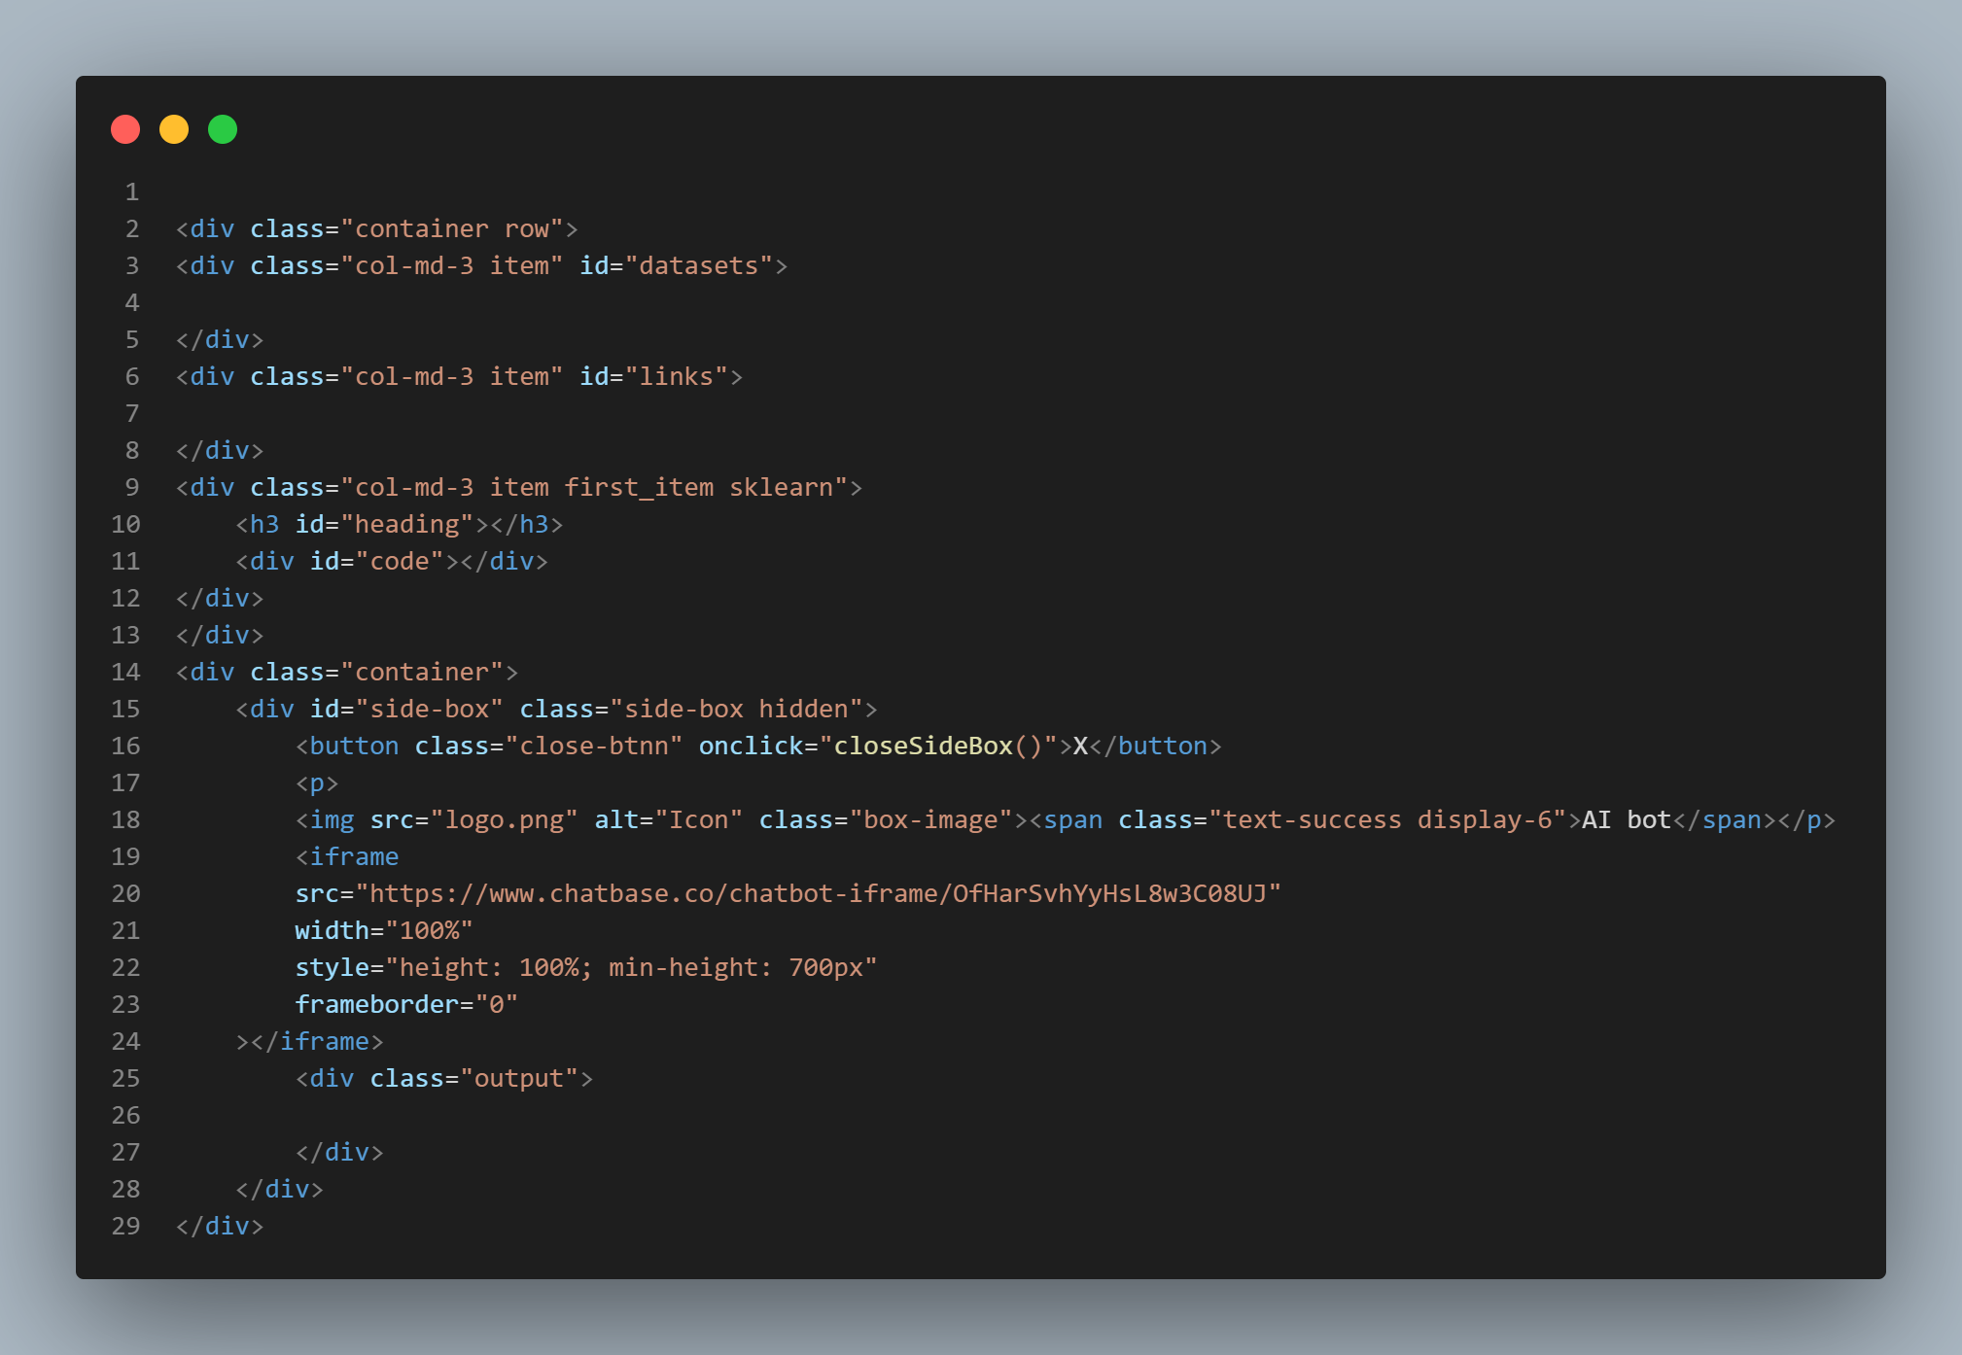

Slide 17
CSS Implementation
CSS enhances the design of the webpage, ensuring it is responsive and visually appealing.
Key Features:
Uses a grid-based layout for dataset display.
Implements light and dark modes for better readability.
Ensures the chatbot and dataset sections are well-styled.
We also use bootstrap which is a css framework for this project

Slide 18
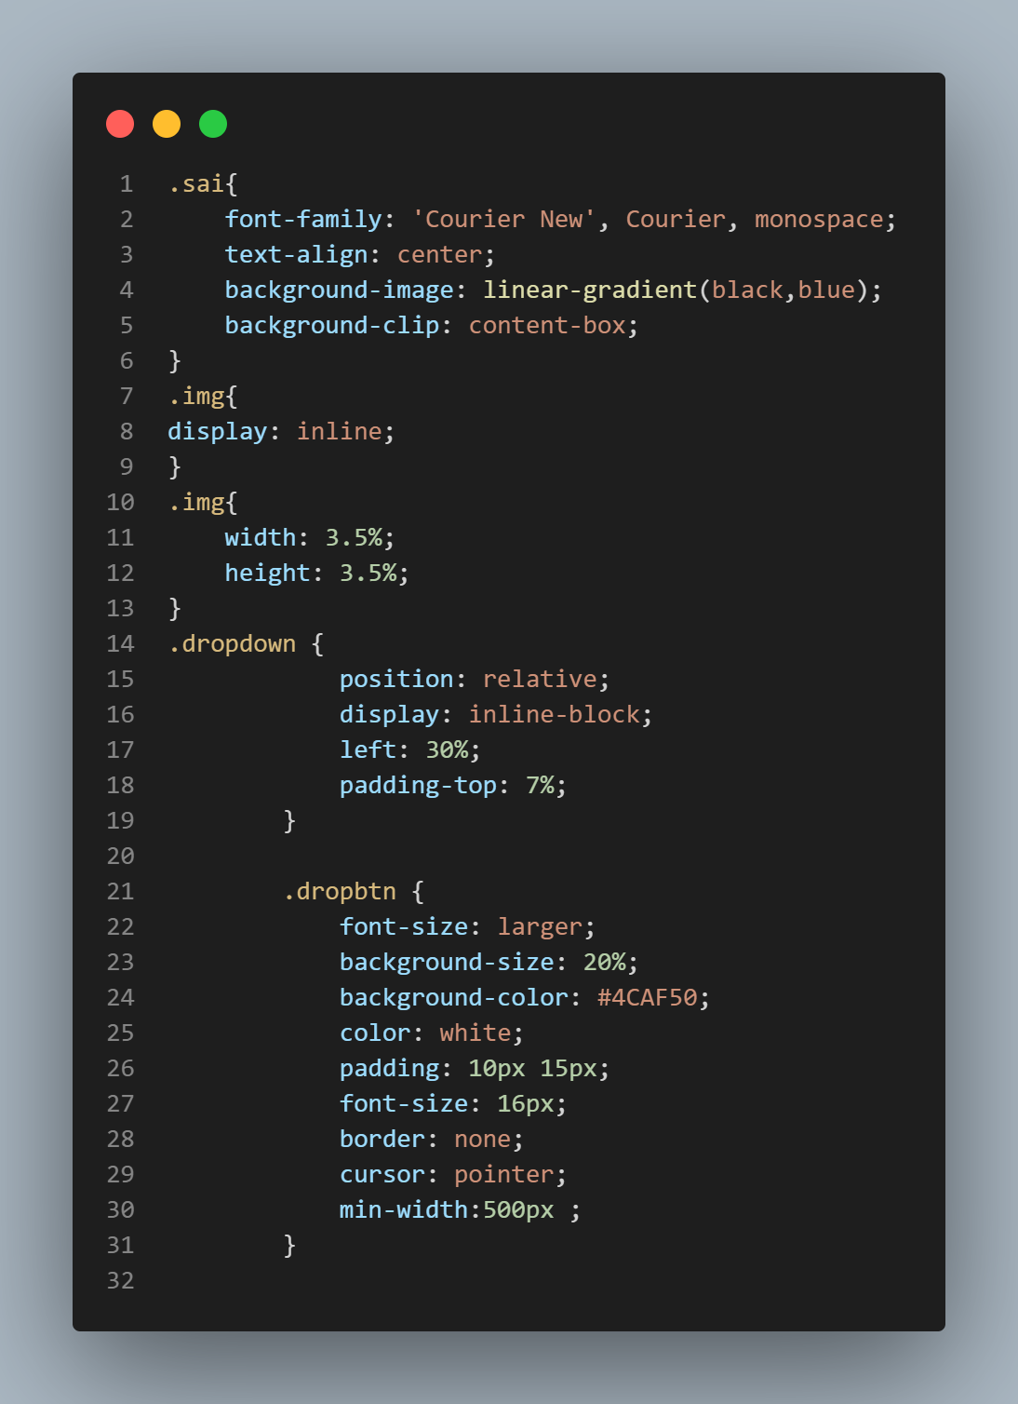

Slide 19
JavaScript Implementation
JavaScript enables the dynamic functionalities of the project, including dataset searching and chatbot responses.
Key Features:
Fetches datasets from a predefined list.
Implements search filtering to quickly find datasets.
Handles chatbot responses to user queries.

Slide 20
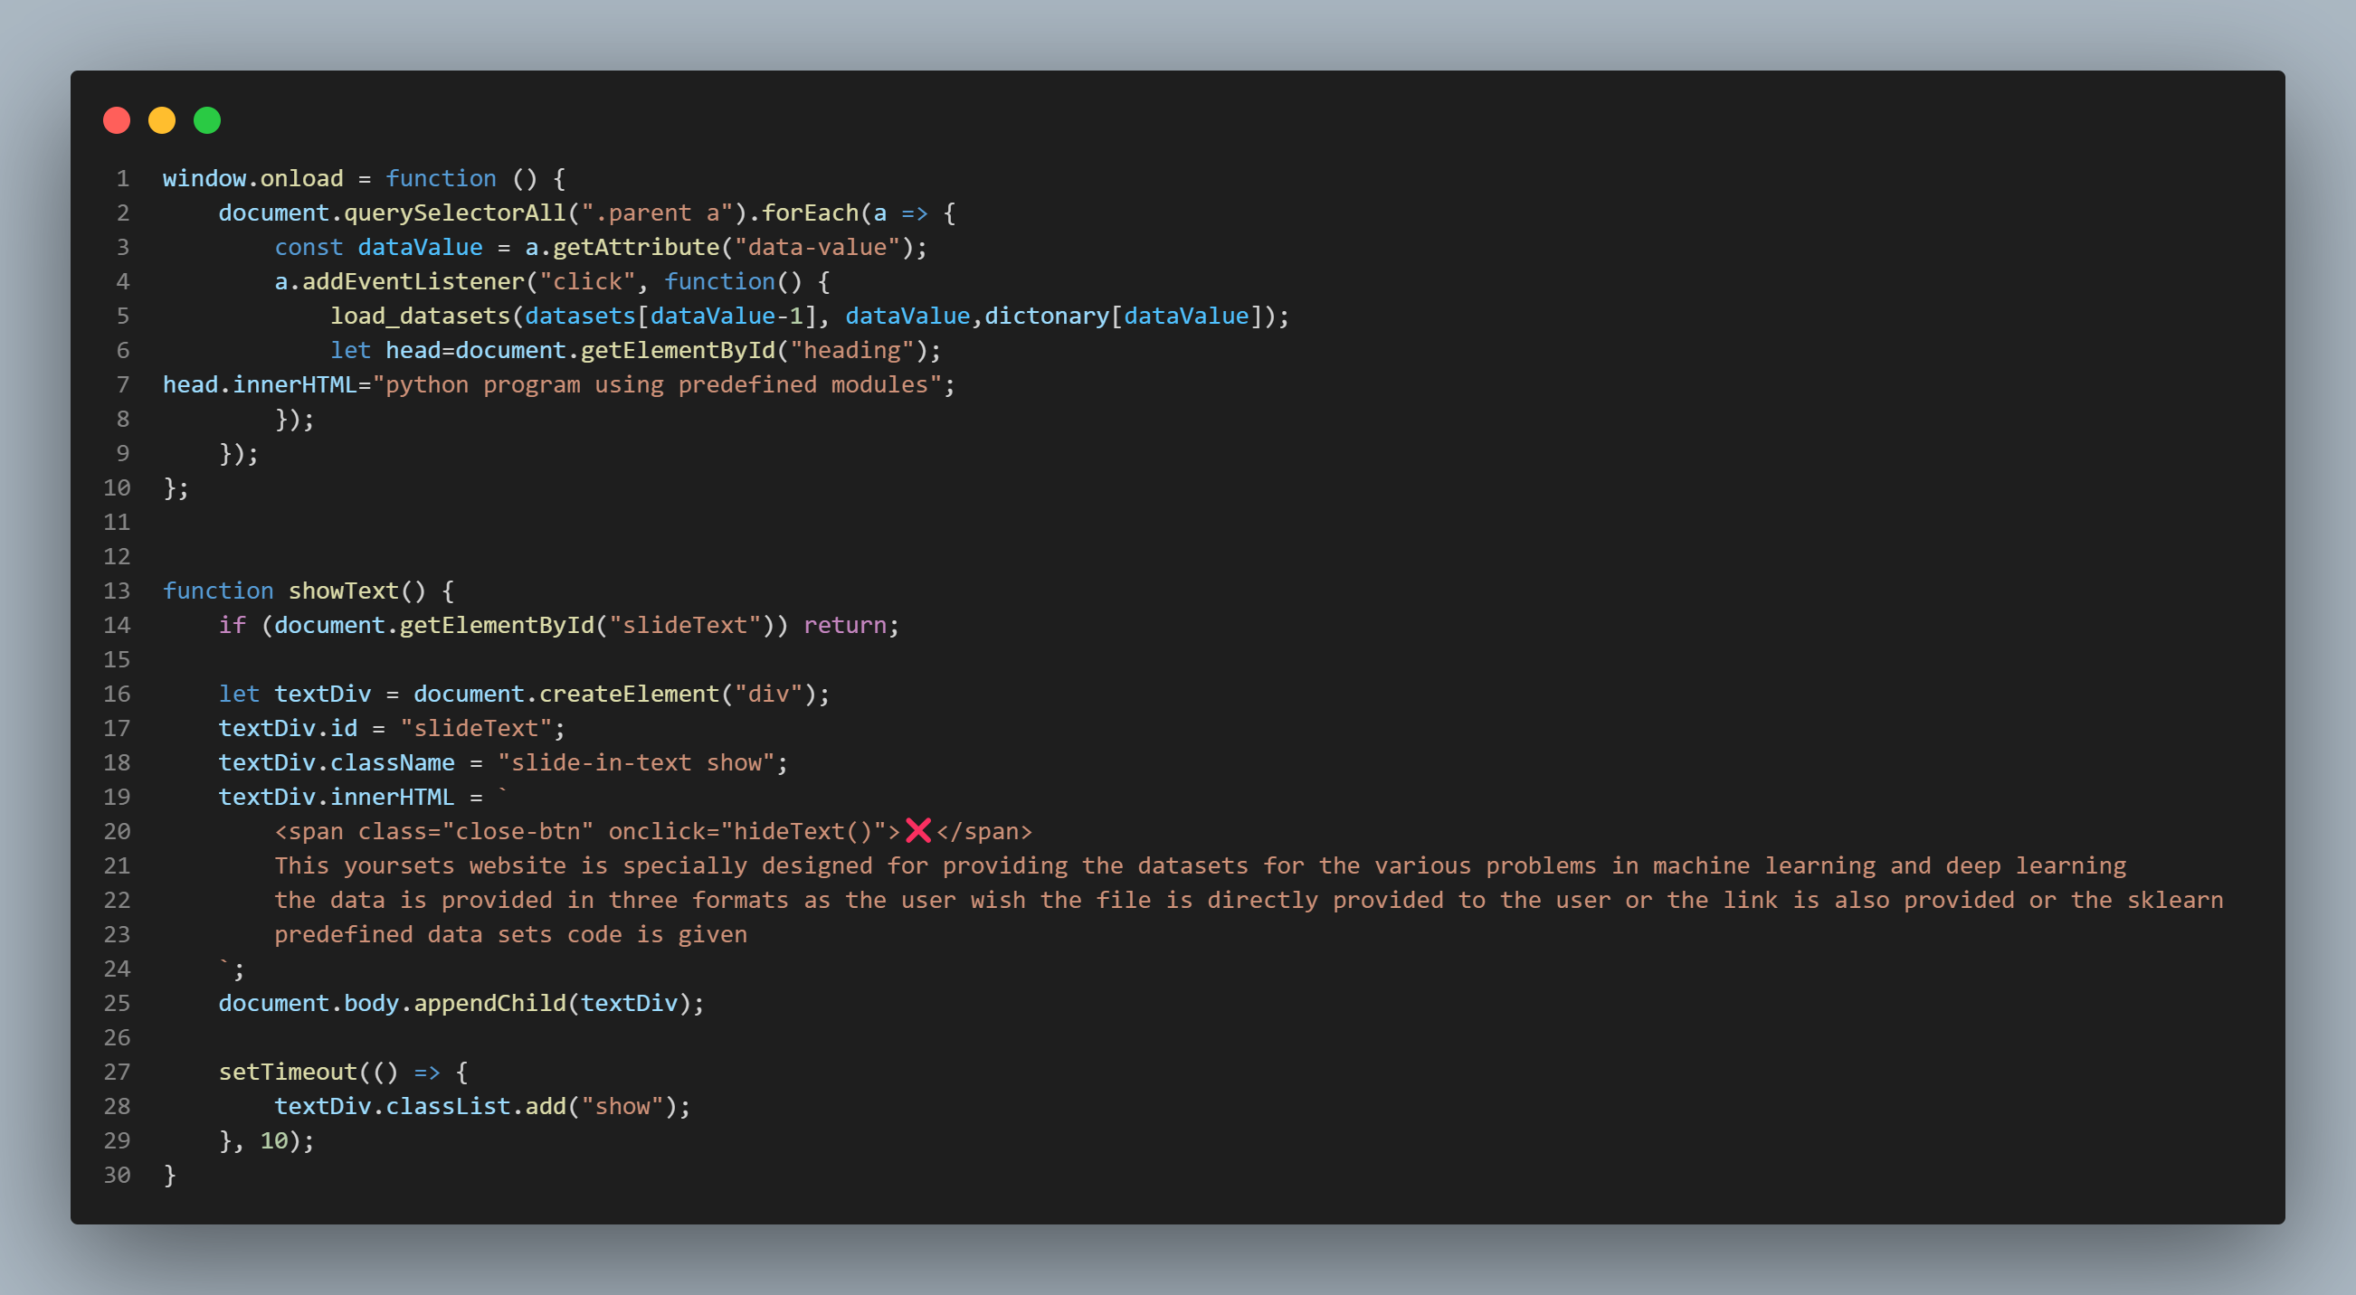

Slide 21
Dataset Retrieval Mechanism
The dataset retrieval process is entirely handled on the frontend. Users can:
Select datasets from a predefined list.
Ask the chatbot for a dataset recommendation.
The datasets are stored in a JavaScript object, and URLs are dynamically linked based on user input.

Slide 22
Chatbot Integration
The chatbot helps users find datasets by analyzing their queries. It works based on keyword matching, ensuring that users receive relevant dataset links.
Key Features:
Uses JavaScript functions to process user queries.
Provides dataset links based on keyword detection.
Displays an error message if the dataset is unavailable.

Slide 23
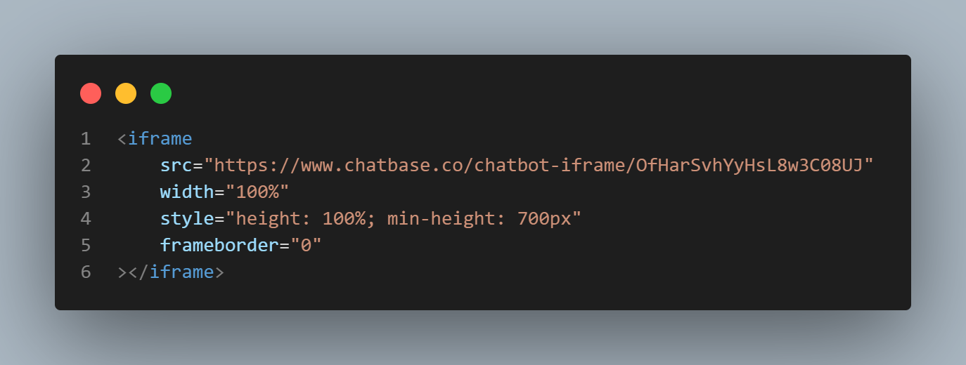

Slide 24
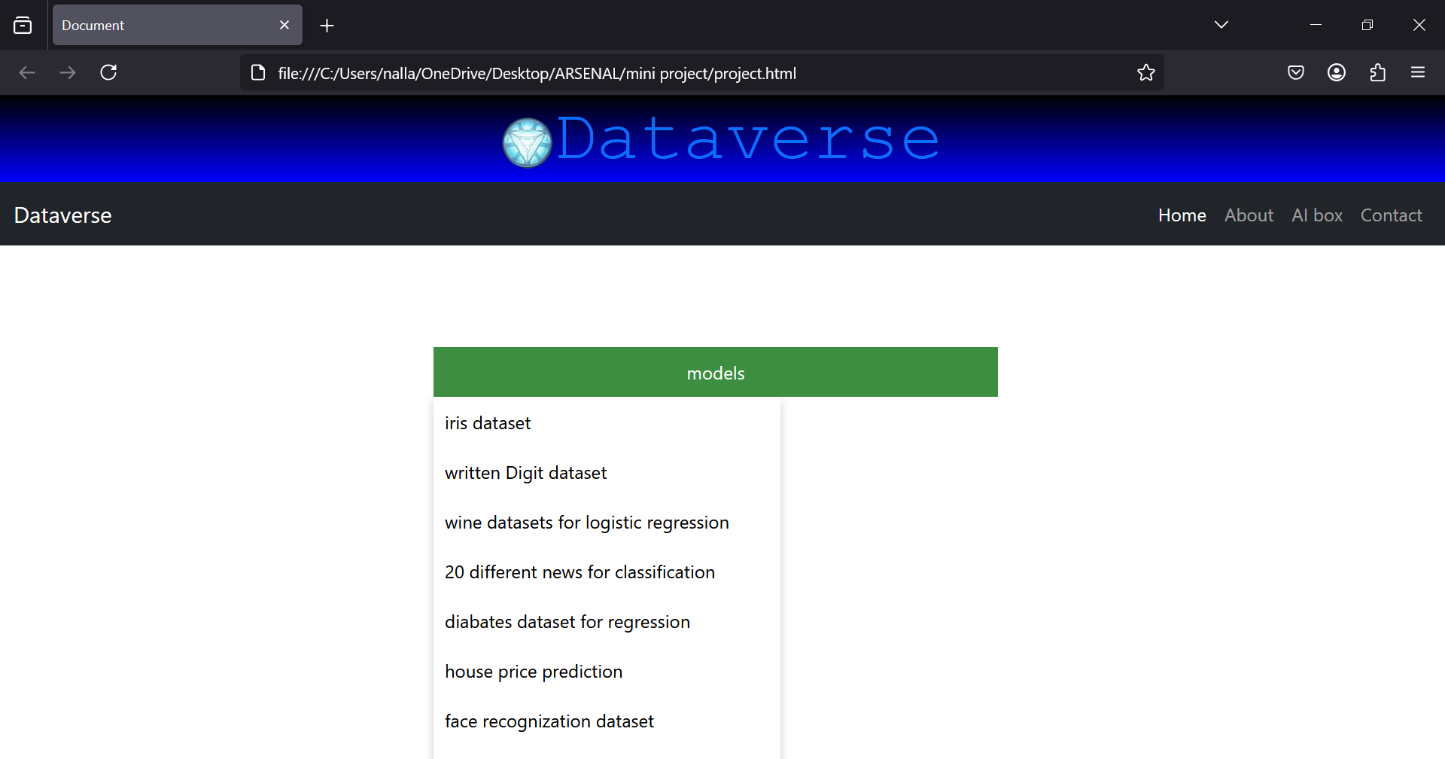
Execution of the project

Slide 25
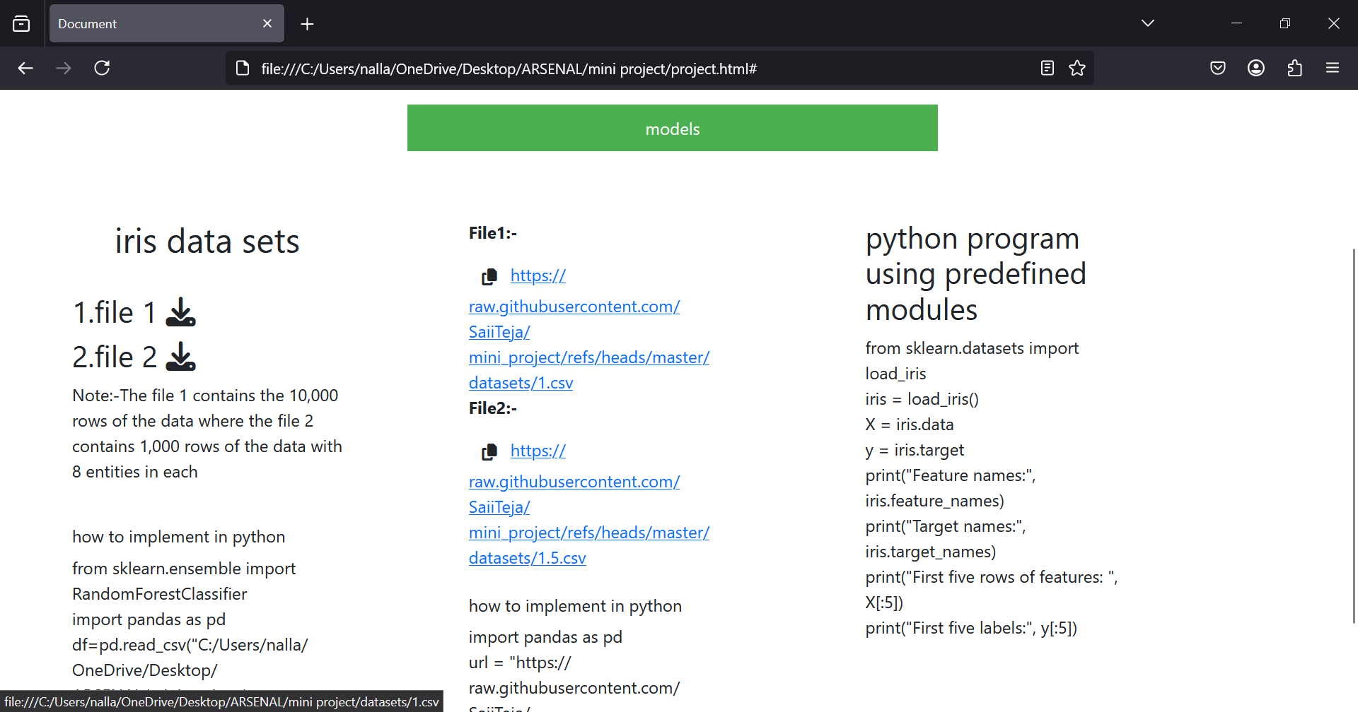
Model selection

Slide 26
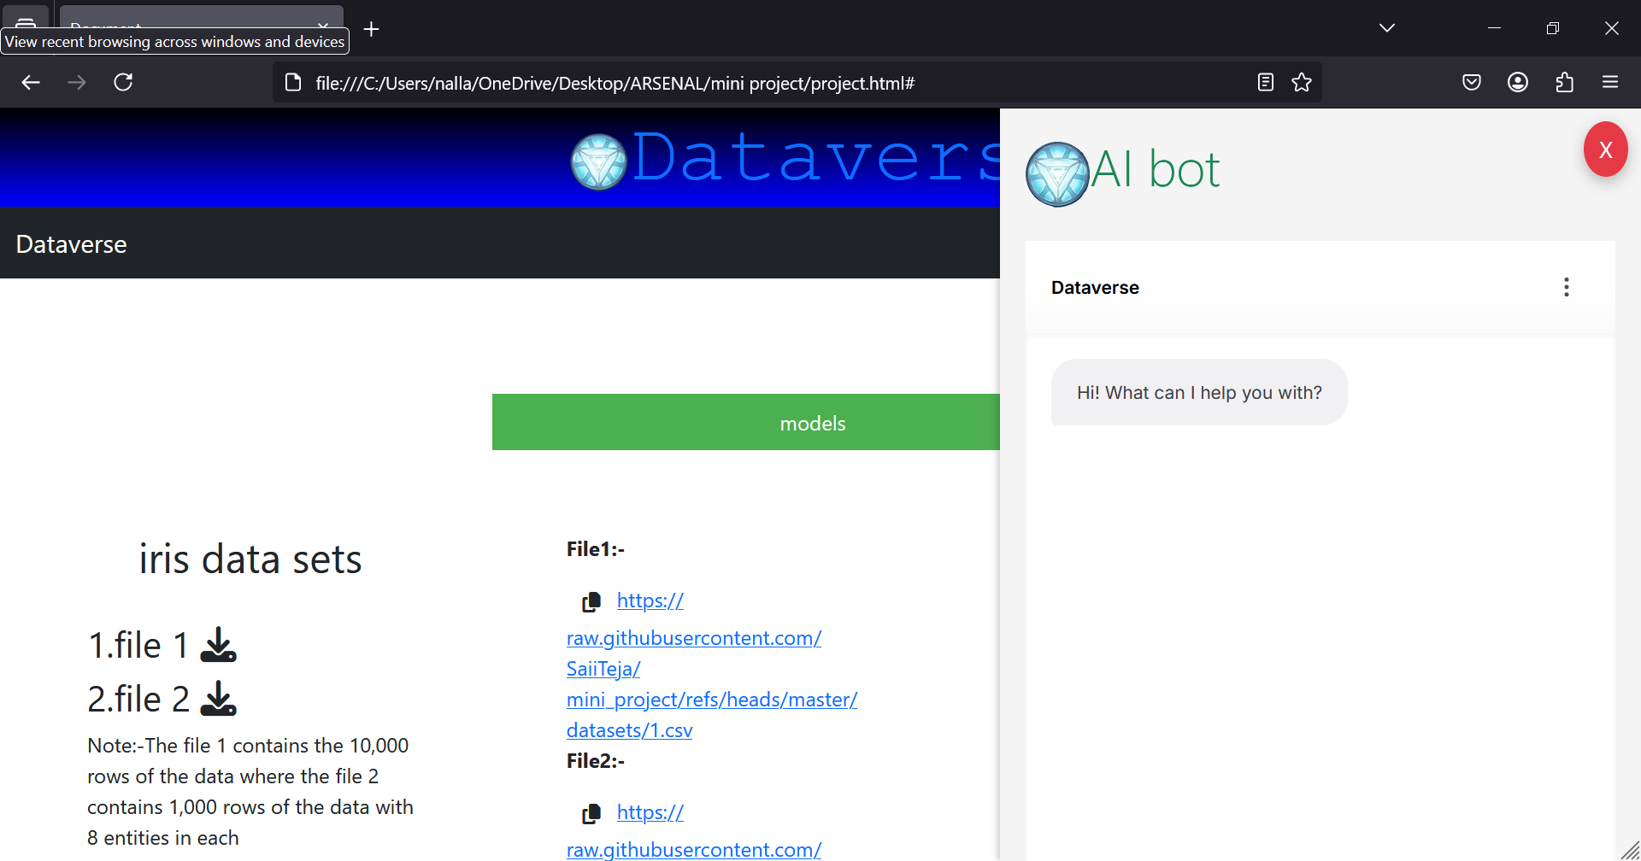
Chatbot integration

