Slide 1
Online Turf Booking System
DEPARTMENT OF COMPUTER SCIENCE AND ENGINEERING
SKILL ENHANCEMENT PROJECT
PROJECT STUDENT
M.PURNA SAITEJA
(43110541)

Slide 2
AGENDA
Abstract
Existing System
Proposed System
Advantages
Disadvantages
Hardware Requirements
Software Requirements
Modules
Module Description
Sample Output
Conclusion

Slide 3
Abstract
The Online Turf Booking System is a web-based application designed to automate and simplify booking sports turfs (e.g., football, cricket, tennis). It provides real-time slot availability, secure booking, and online payment options, reducing manual effort and booking conflicts. The system facilitates efficient turf management for owners and convenient turf reservation for users, enhancing user experience and operational efficiency.

Slide 4
Existing System
Currently, turf bookings are mostly manual, requiring users to call or visit the turf physically to check availability and book. This leads to communication delays, double bookings, manual record-keeping errors, and lack of transparency and secure payments. These processes limit accessibility and increase the administrative burden.

Slide 5
Proposed System
The proposed system offers an online platform with real-time slot availability checks, user registration, secure payment gateway integration, and digital booking confirmation with QR codes. Turf owners can manage turfs, slots, and bookings efficiently using an admin dashboard. Notifications and booking history improve user interaction and service quality. This streamlines operations and improves booking accuracy.

Slide 6
Advantages
Real-time slot availability preventing double bookings.
Convenient online booking and payment from anywhere.
Automated booking confirmations and reminders.
Efficient turf and booking management for owners.
Reduced manual errors and operational costs.
Increased accessibility and customer satisfaction.

Slide 7
Disadvantages
Requires stable internet connectivity.
Initial setup and maintenance cost.
Users unfamiliar with technology may face a learning curve.
Dependence on external payment gateways.

Slide 8
Hardware Requirements
Client devices: PCs, laptops, smartphones with internet access.
Server: Web server capable of hosting the application.
Networking equipment and internet connectivity for continuous access.

Slide 9
Software Requirements
Frontend: HTML/CSS/JSP (Java Server Pages)/Bootstrap for user interface.
Backend: Java / Java Servlets/ PHP (any RESTful API framework).
Database: MySQL for storing user, booking and turf data.
Payment Method: QR-based/manual payment integration.
Web server (Apache, Nginx, or cloud services).
Development environment: Eclipse IDE or Visual Studio Code.

Slide 10
Modules
Module | Description
User | Registration, browsing turfs, booking slots, payment processing, viewing booking history.
Admin | Manage turf listings, approve bookings, oversee users and transactions, manage offers and schedules.

Slide 11
Module Description
User Module: Enables users to create accounts, view available turfs and slots, book preferred slots, pay online, and track booking history.
Admin Module: Admin manages all system aspects like user management, turf registration, approval of bookings, payment management, and analytics.

Slide 12
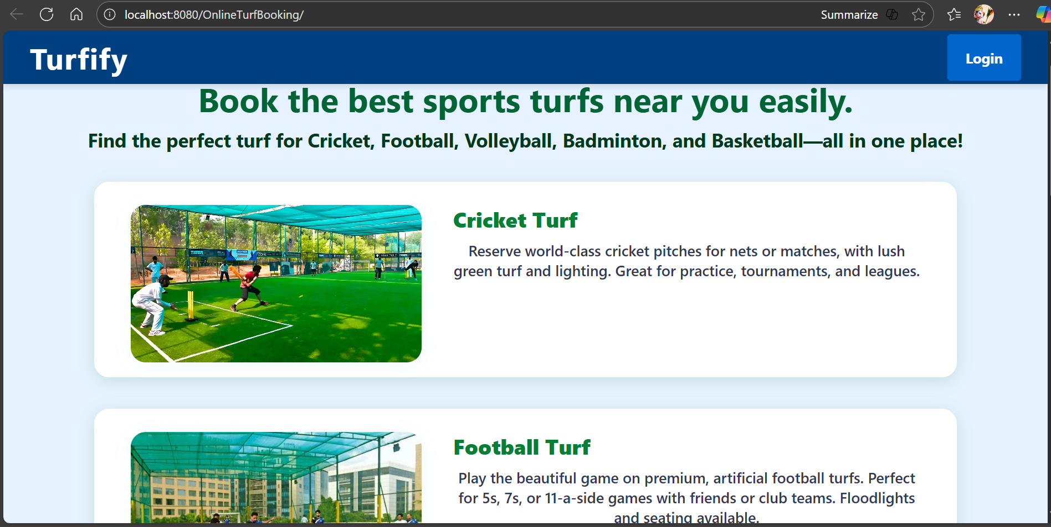
Sample Output

Slide 13
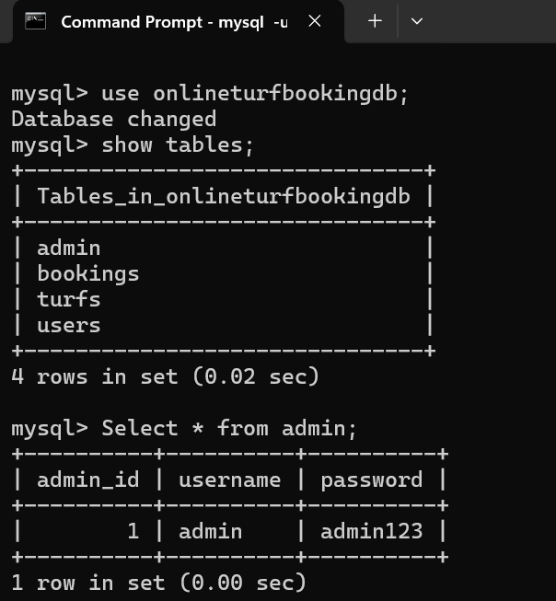
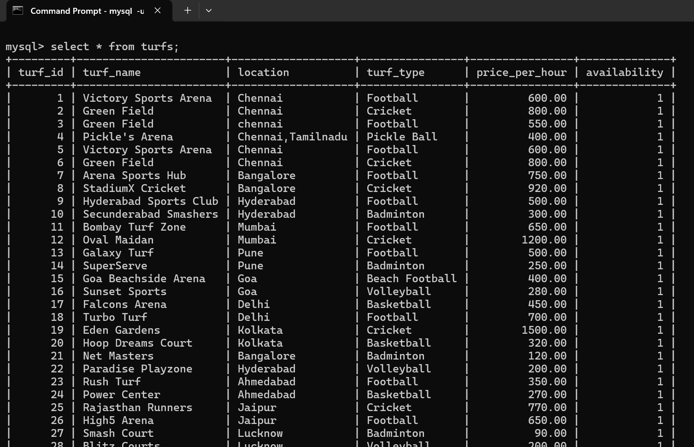
Sample Output

Slide 14
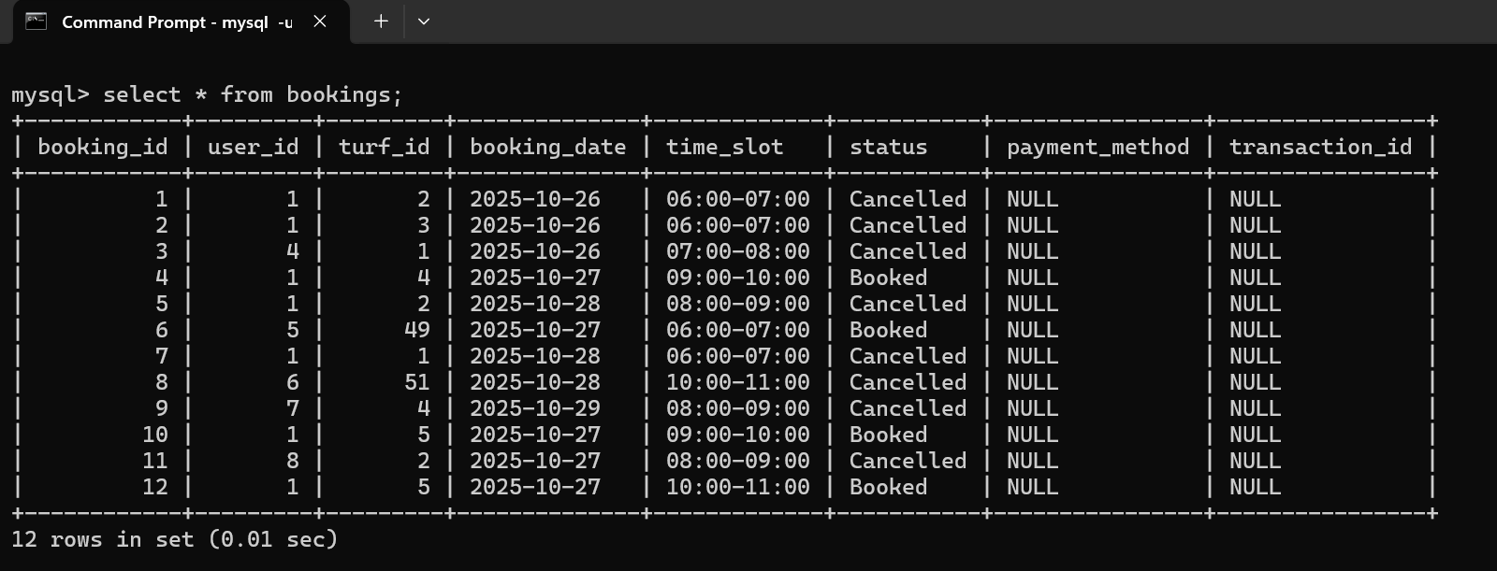
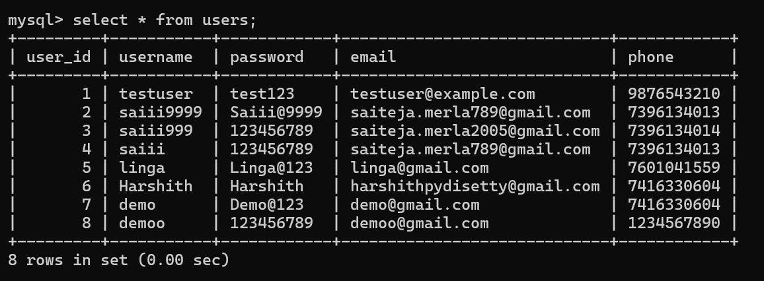
Sample Output

Slide 15
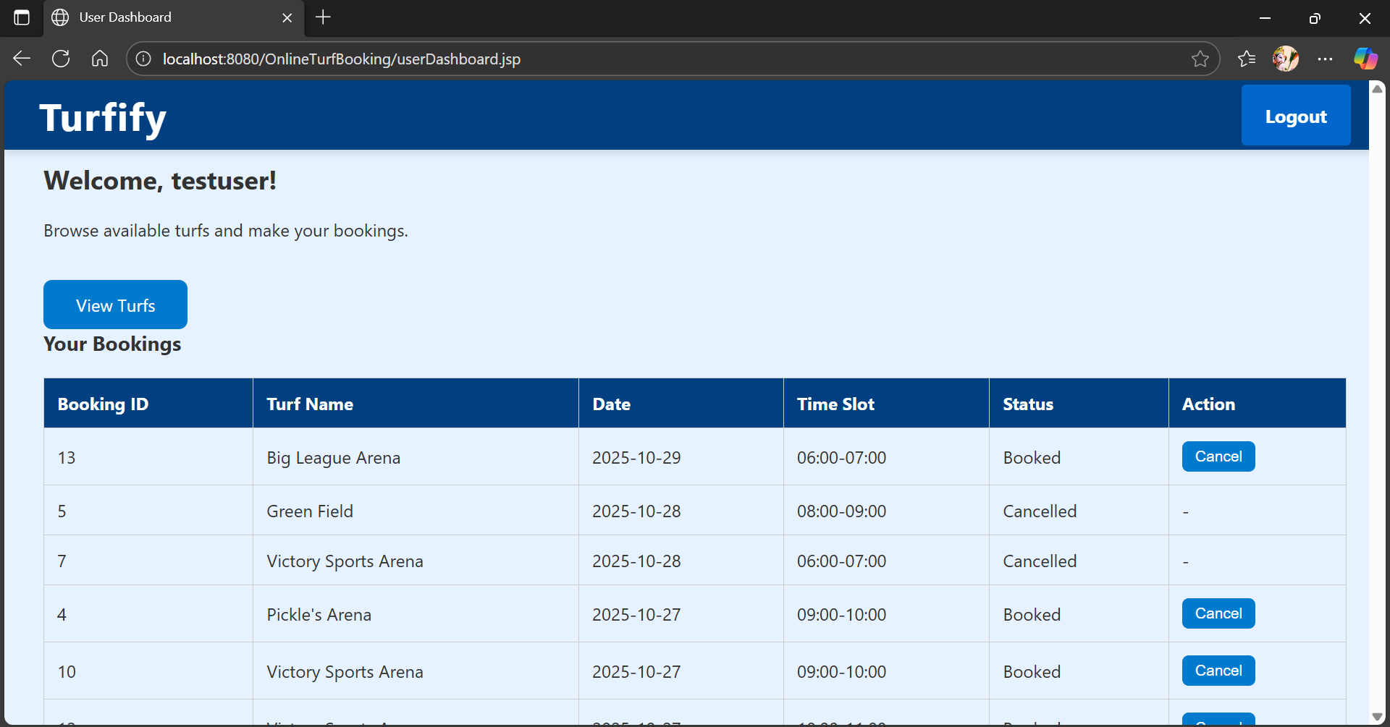
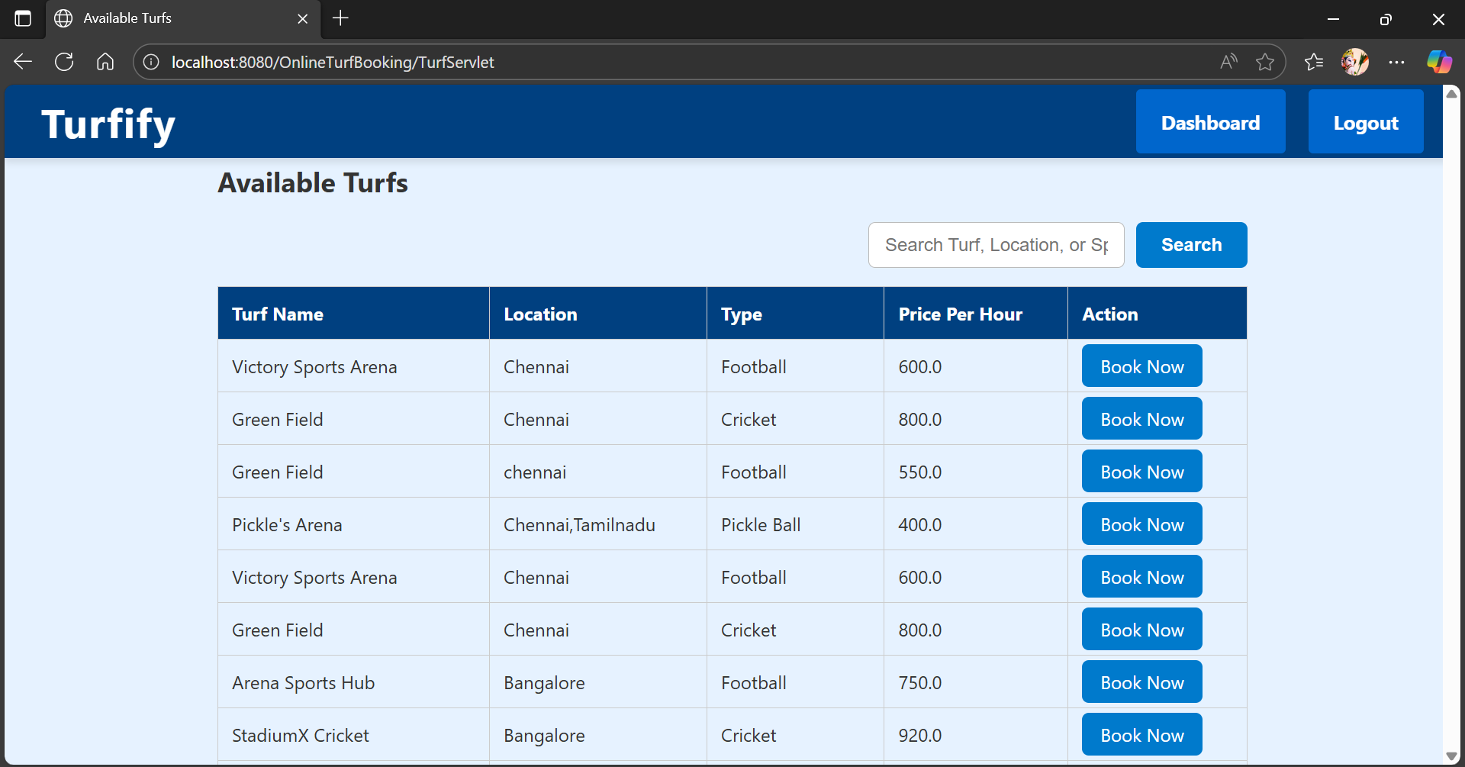
Sample Output

Slide 16
Conclusion
The Online Turf Booking System transforms manual turf reservation processes into a streamlined digital platform, increasing operational efficiency and providing enhanced convenience for users and turf owners. The system reduces booking conflicts, automates payment and confirmation processes, and supports scalable turf management, ultimately improving user satisfaction and business growth.

